Slide 1
GROWTH
as
CONDITION FOR CONTINUITY
and VALUE CREATION
Coelmo spa case
Marco Monsurrò
CEO at COELMO spa
25th of March, 2022
History

Slide 2
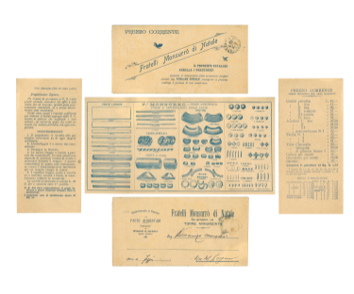
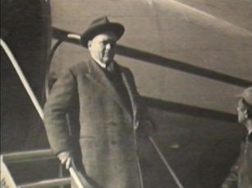
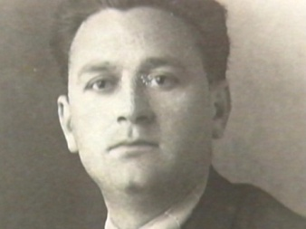
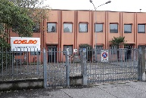
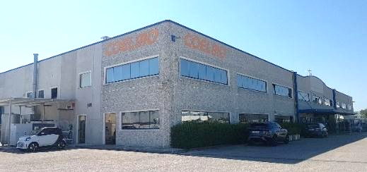
WHO IS COELMO?
- History
The Beginning (1946)
Coelmo’s history is the story of the Monsurrò family, which begins with Mario Monsurrò, born in 1906, the last child of a large family of pasta makers, but with an innate passion for electric engines, and with the establishment of Coelmo in 1946, led for over forty years by his sons, Domenico, Stefania and Franco, and from 1999 by his nephews Marco and Jacopo.
1946
1950
1976
2001
2006
2007
2011
2016
2017
2018
Mario Monsurrò Spa
is established in Naples, Italy.
Mario Monsurrò Spa introduces one of the first portable
Generating Sets.
Mario Monsurrò Spa becomes COELMO
(Monsurrò Electromechanical Constructions).
COELMO designs and develops a new range products: Marine
Generating Sets from 3 up to 40 kVA.
COELMO completes the first Acerra (Naples) plant.
COELMO open a branch in Dubai, UAE.
COELMO completes Acerra (Naples) second plant.
COELMO celebrates 70 years of history.
COELMO open a new Sales Office in Milano.
COELMO open in Acerra (Naples) the third plant.
Localization

Slide 3
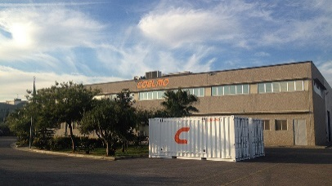
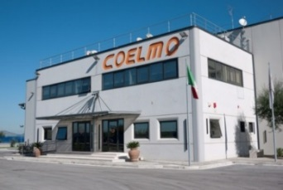
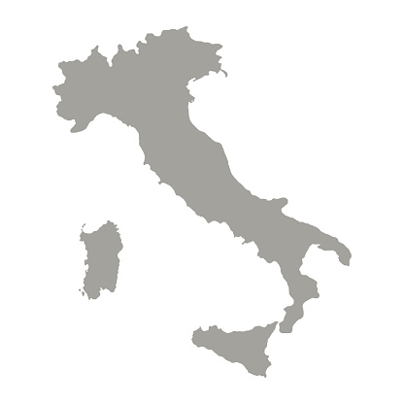
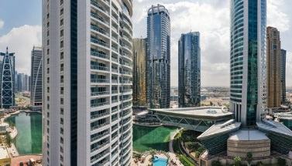
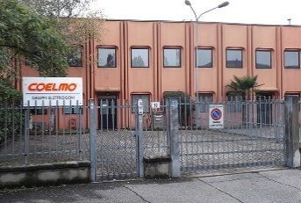
WHO IS COELMO?
ASSEMBLY PLANT CERTIFICATIONS
ISO9001 | ISO9004 | ISO14001 | SA8000 | ISO45001 | 1090-1
CERMET | AEO FULL | IT01 - 100% MADE IN ITALY
ELITE BORSA ITALIANA
- Localization
COELMO 1, Acerra (NA)
COELMO 2, Acerra (NA)
COELMO 3, Acerra (NA)
- Training and
Logistics Center
- Assembly
- 24h Control Room
- Headquarter
- Assembly Plant
DUBAI, UAE
Peschiera
BORROMEO, Milano
Acerra (NA)
- Dubai Branch
- Sales Office
Main Markets

Slide 4
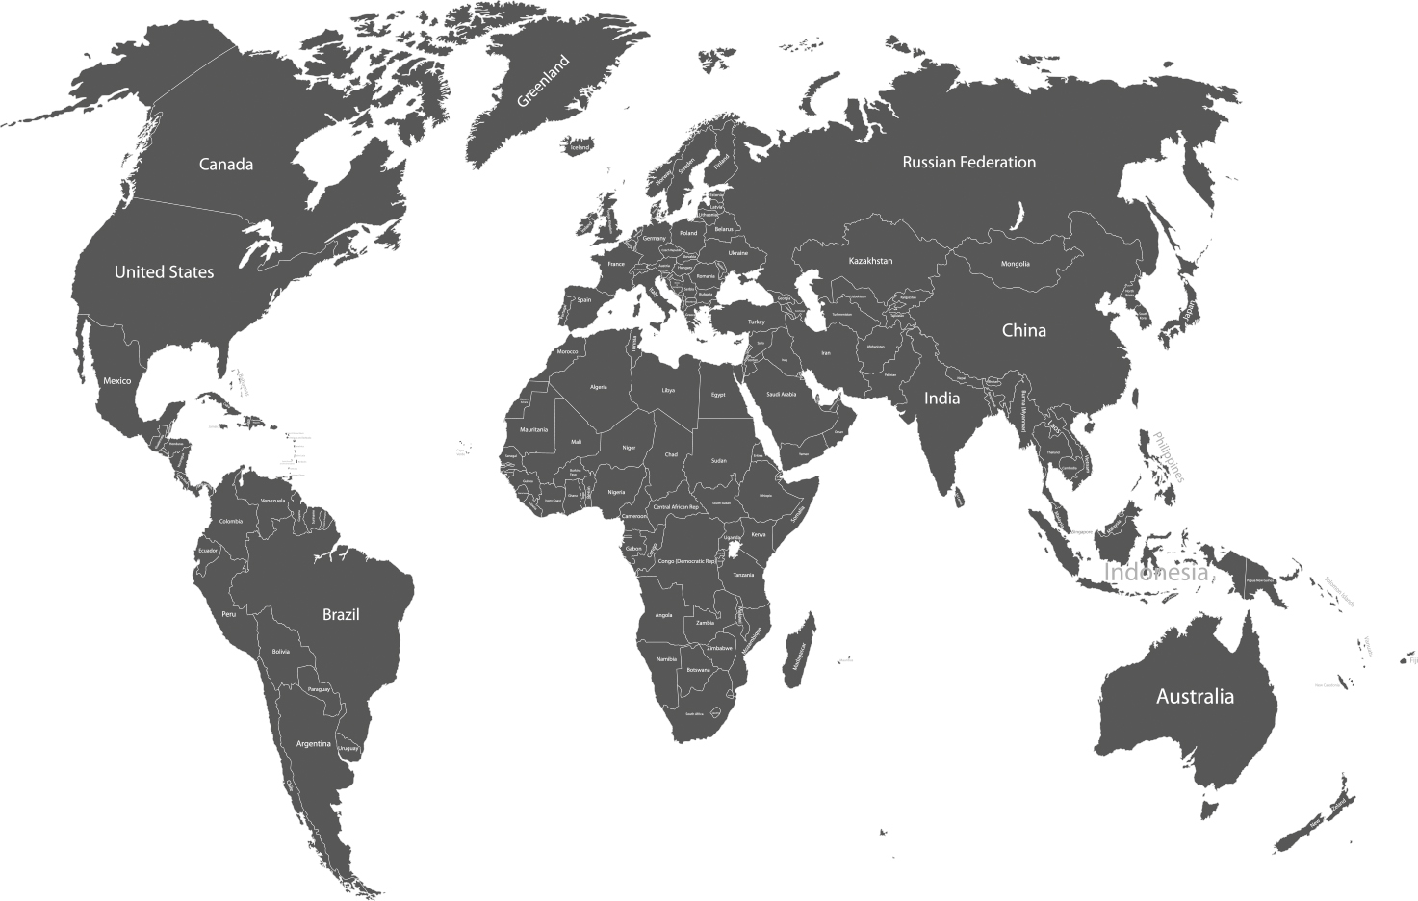
WHO IS COELMO?
Milano Sales Office
- Main Markets
Dubai Branch
COELMO exports to more than
36 countries in the world.
Business Units

Slide 5
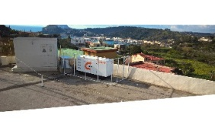
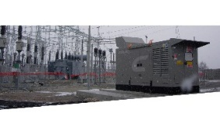
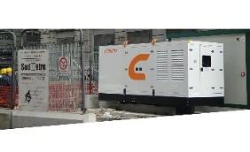
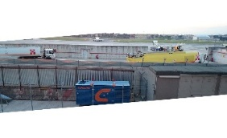
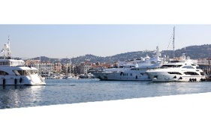
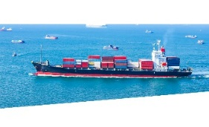
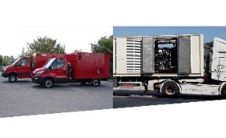
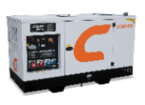
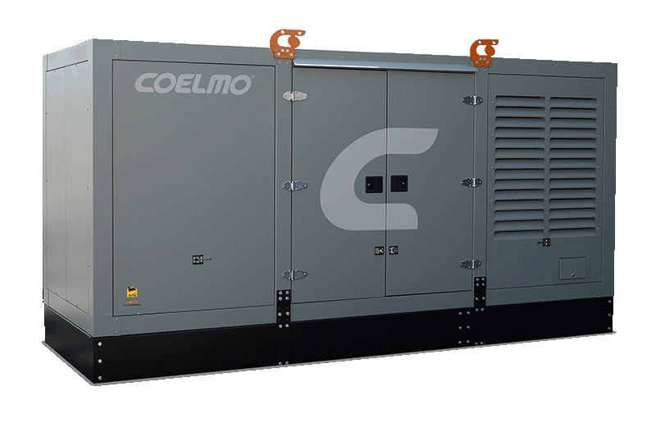
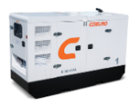
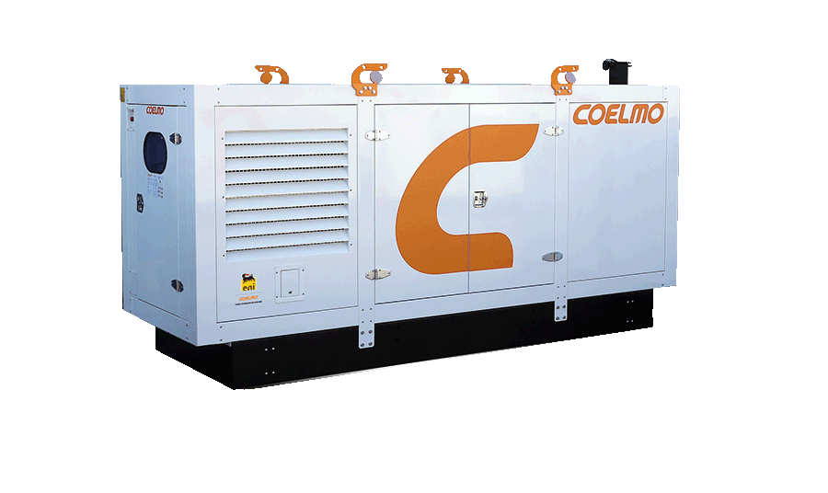
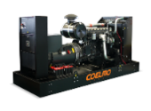
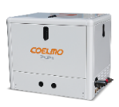
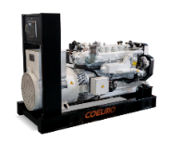
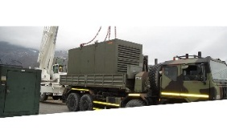
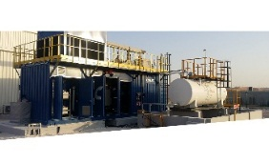
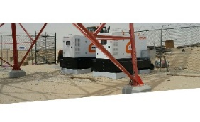
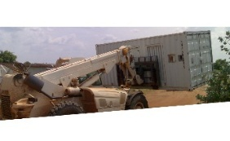
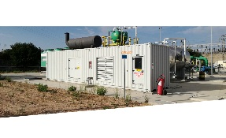
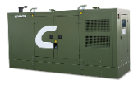
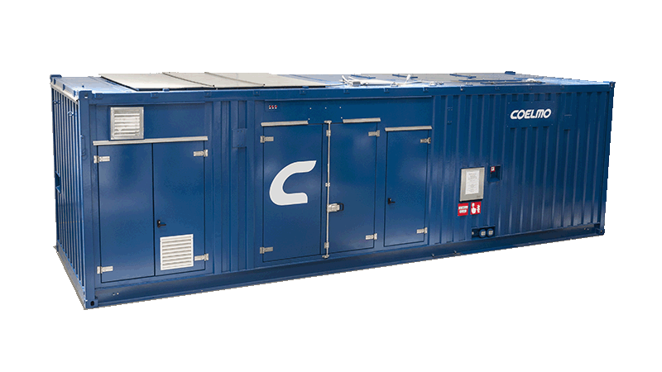
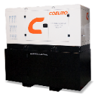
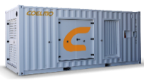
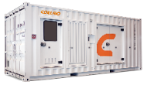
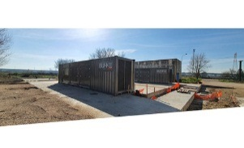
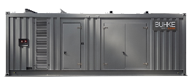
WHO IS COELMO?
- Industrial Business Units
- Marine Business Units
Residential and
Commercial
Industrial
Rental
Infrastructure
Vehicular
Leisure Boats
Commercial Vessels
Military
Oil & Gas
Telecom
Humanitarian Projects
Special Solutions
Cogeneration
Figures of growth

Slide 6
COELMO’S FIGURES OF GROWTH
SQM
Total Surface
of Offices and
Production Plants:
+ 350%
Number of
Employees:
+ 1000 %
Mio EUR
Number of
Produced Units:
+ 1200 %
Turnover:
+ 700%
Has growth been crucial

Slide 7
HAS GROWTH BEEN CRUCIAL FOR COELMO?
WHAT “SUSTAINABLE” GROWTH MEANS?
Often Growth has been seen as goal itself (expecially in sales), but growth as a meaning only if considered a condition for Continuity and Value Creation.
Sometimes, Growing does not means creating Value.
Growing is required as “critical dimension” is needed in some markets.
Coelmo’s goal has been the continuity for all stakeholders
Suppliers
Customers
Employees
Social Environment
Growth must be sustainable and governed.
Sustainable growth means that the entire organization (structure, supply chain (including financial mix), distributor network, people’s mindset) is ready for the next level of commitment.
It is very common, indeed, that some "parts" of company growth, while others stay behind (ie. Sales increase while production lines take time to be upgraded).
In medium terms, growth must be organic to the entire company organization and enviroment (suppliers, customers, employees).
cm
200
190
180
170
160
150
140
130
120
110
100
80
70
60
50
40
30
20
Growth is not a jump.
Growth must be organic.
How we manage growth

Slide 8
HOW WE MANAGED GROWTH
Sales
Production Strategy
Financial mix
Procedures
Production Infrastructure
Accountability
Organization
External Growth
- Sales
One of the first steps was to create an internal sales organization focused different sector of applications
Business Units are semi-indipendent interal structure that produces revenues and is responsible for costs.
Industrial Business Units
Std-Cst
Italy
Std-Cst
Foreign Countries
Rental
Telecom
Oil & Gas
Humanitarian Projects
Marine
Private
Label
Service
Sales Manager
Italian
Sales Office
Export
Sales Office
Marine Business Units
Leisure
Boats
Commercial
Vessels
Business Unit
Customers & Projects
Management
Regional Branches
Pre-Sales Engineering
Milano
Office
Dubai
Branch
Business Developer
1999
2022
Organization chart

Slide 9
HOW WE MANAGED GROWTH
Sales
Production Strategy
Financial mix
Procedures
Production Infrastructure
Accountability
Organization
External Growth
- Sales
The creation of a sales and after sales network has been the most time-consuming and challaging task ever
It is typical trial-and-error activity
Milano Sales Office
Dubai Branch
COELMO exports to more than
36 countries in the world.
1999
2022
Organization chart

Slide 10
HOW WE MANAGED GROWTH
Sales
Production Strategy
Financial mix
Procedures
Production Infrastructure
Accountability
Organization
External Growth
- Organization Chart
General Manager
Technical Office
Sales Office
Purchase Office
Secretary
Administration Office
Production and
Maintenance Office
Warehouse
1999
Organization chart

Slide 11
HOW WE MANAGED GROWTH
Sales
Production Strategy
Financial mix
Procedures
Production Infrastructure
Accountability
Organization
External Growth
- Organization Chart
CEO
Management System
Executive Assistant Human Resources
Customsm Procedures
Secretary
Workers’ Representative SA8000
Competent Doctor
CSS Health and Safety Committee
Safety Workers’ Representative
SPT Social Performance Team
IT and Communication Management
RSPP
Management Accounting
Finance
Marketing and Communication
Operations
After Sales Service
Business Units
Customer Administration
Procurement, Planning and Logistics
24h Control Room
Std-Cst
Italy
Oil & Gas
Supplier Front Office
Product and Process Engineering
Std-Cst
Foreign Countries
Humanitarian Projects
Administrative Assistant and Customs Procedures
Quality
Rental
Marine
Production
Telecom
Private Label
Factory Production Control – EN 1090
Service
Welding Coordinator
Vice Welding Coordinator
2022
Welders
Organization chart

Slide 12
HOW WE MANAGED GROWTH
Sales
Production Strategy
Financial mix
Procedures
Production Infrastructure
Accountability
Organization
External Growth
- Organization Chart
OPERATIONS
Procurement / Plannining and Logistics
Product and Process Engineering
Production
Quality
Procurement
Electrical Designers
Coelmo 1
Planning and Expediting
Mechanical Designers
Coelmo 2
Research and Developement
Coelmo 3
Warehouse and Logistics
Maintenance
Outbound Logistics
2022
Production Strategy

Slide 13
HOW WE MANAGED GROWTH
Sales
Production Strategy
Financial mix
Procedures
Production Infrastructure
Accountability
Organization
External Growth
- Production Strategy
1999
Coelmo is a System Integrator, with over active 210 suppliers. In the past, Coelmo had a make to order approach, placing orders to suppliers upon receipt of active orders.
Make to Order
Sales Order
BOM
Planning
Work Order
Today Coelmo has adopted two differed approaches (based on applications and markets):
Make to shelf
Strategical negotation with main suppliers
Annual forecast with suppliers
Needs of high logistic efficiency (expeditors)
2022
Make to Shelf
Reorder Level
Material Request
BOM
Work Order
Engineering to order
Frame agreements with suppliers
Investment in engineering HR and systems
Engineer to Order
Sales Order
Custom BOM
Planning
Work Order
Financial Mix

Slide 14
HOW WE MANAGED GROWTH
Sales
Production Strategy
Financial mix
Procedures
Production Infrastructure
Accountability
Organization
External Growth
- External Growth Strategy
Many attempts have been done in finding opportunities for external growths through mergers and acquisitions
The failure ratio is quite high due to difficulty of creating value through synergies
Today, two projects were successfull
BUHKE is a company specialized in the design, manufacturing and maintenance of cogeneration and trigeneration plants for various application sectors.
REVARGE is a company specialized in the design, manufacturing and maintenance of Charging Stations for Electrical Vehicles.
Financial Mix

Slide 15
HOW WE MANAGED GROWTH
Sales
Production Strategy
Financial mix
Procedures
Production Infrastructure
Accountability
Organization
External Growth
- Financial mix
1999
- Make to order
2022
- Make to order
- Engineering to order
Working Capital
Working Capital
Financial Mix
General LT loans
Advance invoices
Financial Mix
Bank advance payment
Loan capital (Bond)
General LT loans
Financial Structure
Equity 5%
Banks 95%
Financial Structure
Equity 52%
Banks 48%
Procedures

Slide 16
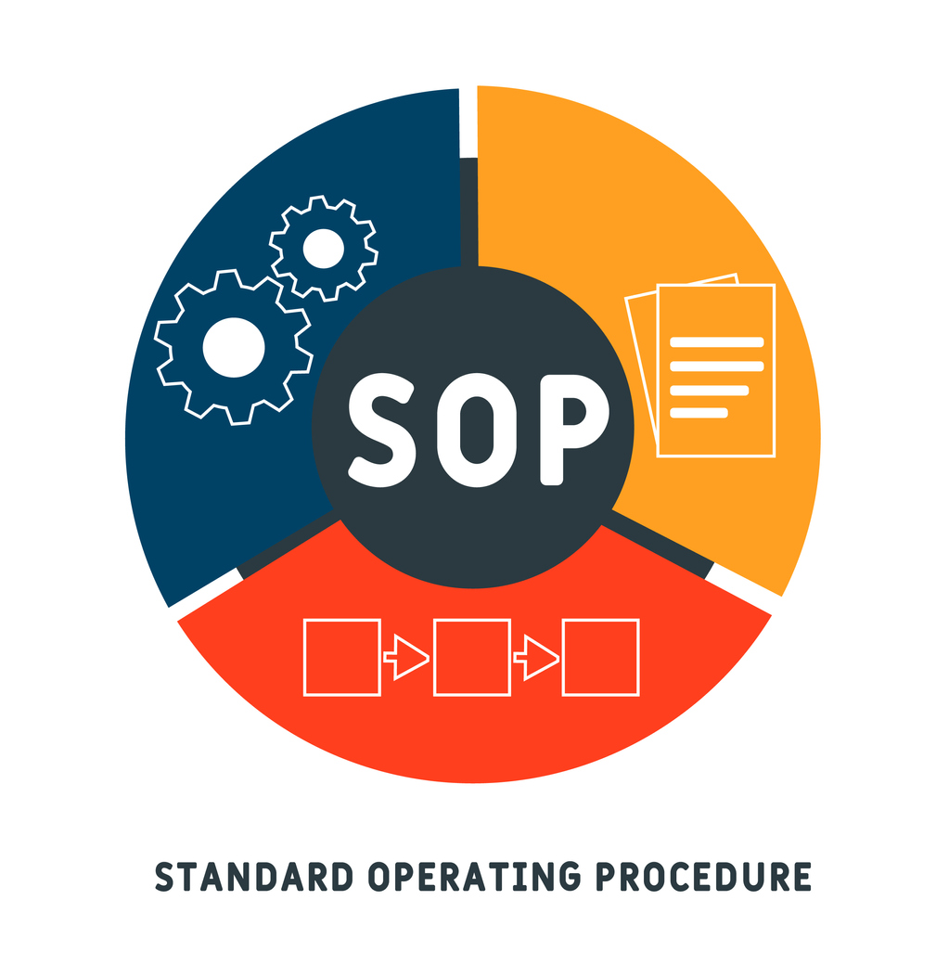
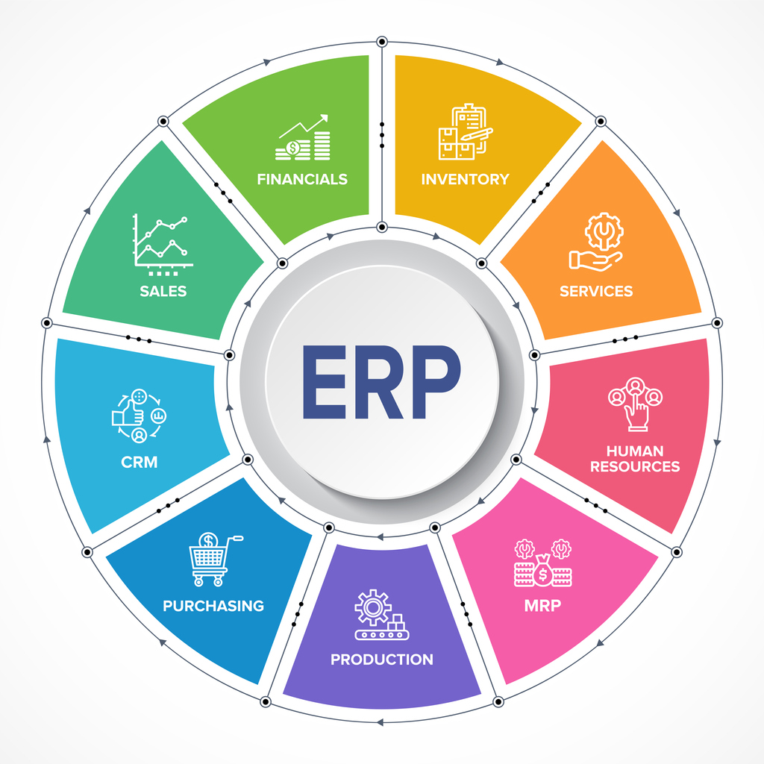
HOW WE MANAGED GROWTH
Sales
Production Strategy
Financial mix
Procedures
Production Infrastructure
Accountability
Organization
External Growth
- Procedures and ERP
A modern company cannot be based on the skills of single persons, but only on a shared system of procedures. The SOP (Standard Operating Procedures) are the guidelines for everyone in the company to understand how and where the value is produced.
- The ERP (Enterprise Resurce Planning) provides visibility, analytics and efficency across every aspect of business. The ERP system facilitates the flow of real-time information across departments so that decisions are data-driven decisions.
The old Management Software was designed according the functional tasks (sales, administration, warehouse, etc.)
The software operator was not able to understand the whole process and the status of it.
The modern ERP is designed according the SOPs
Any ERP operator has the whole understanding of procedures and the status of it
The ERP is designed to be proactive in generating alerts and dashboards and sollicitate actions by the operators.
1999
2022
Production Infrastructure 1999

Slide 17
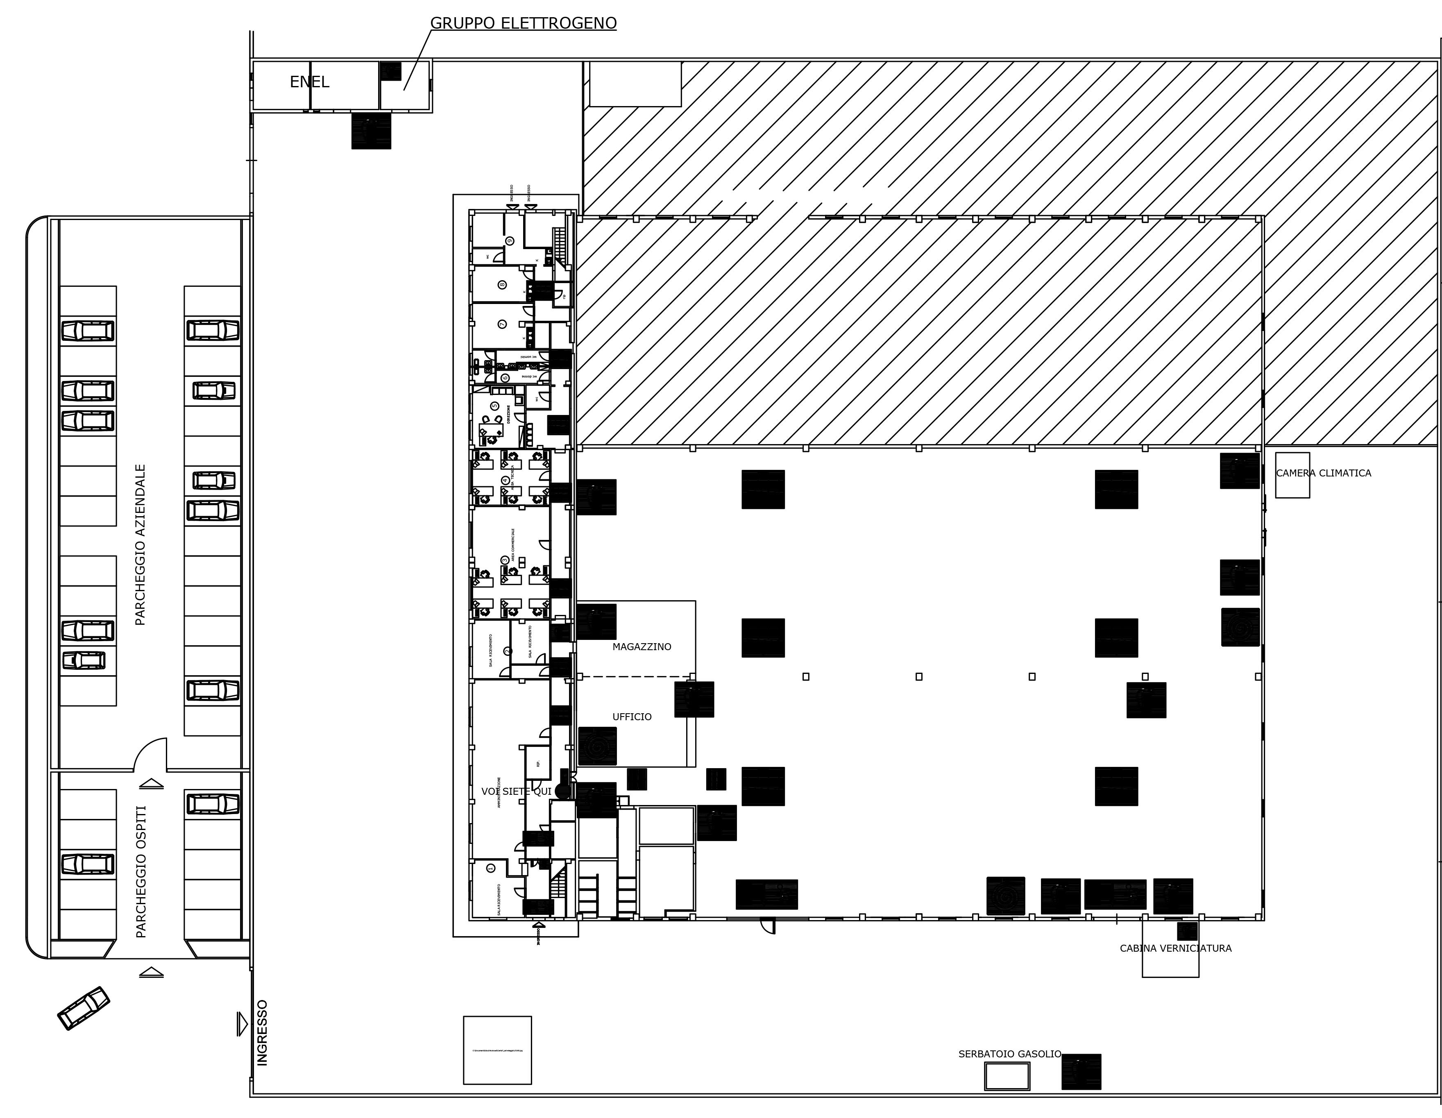
HOW WE MANAGED GROWTH
Sales
Production Strategy
Financial mix
Procedures
Production Infrastructure
Accountability
Organization
External Growth
- Production Infrastructure
COELMO
-Nr. 1 production line
-Nr. 1 overheadcrane
Total Area: 9.600 sqm
1999
Production Infrastructure 2022

Slide 18
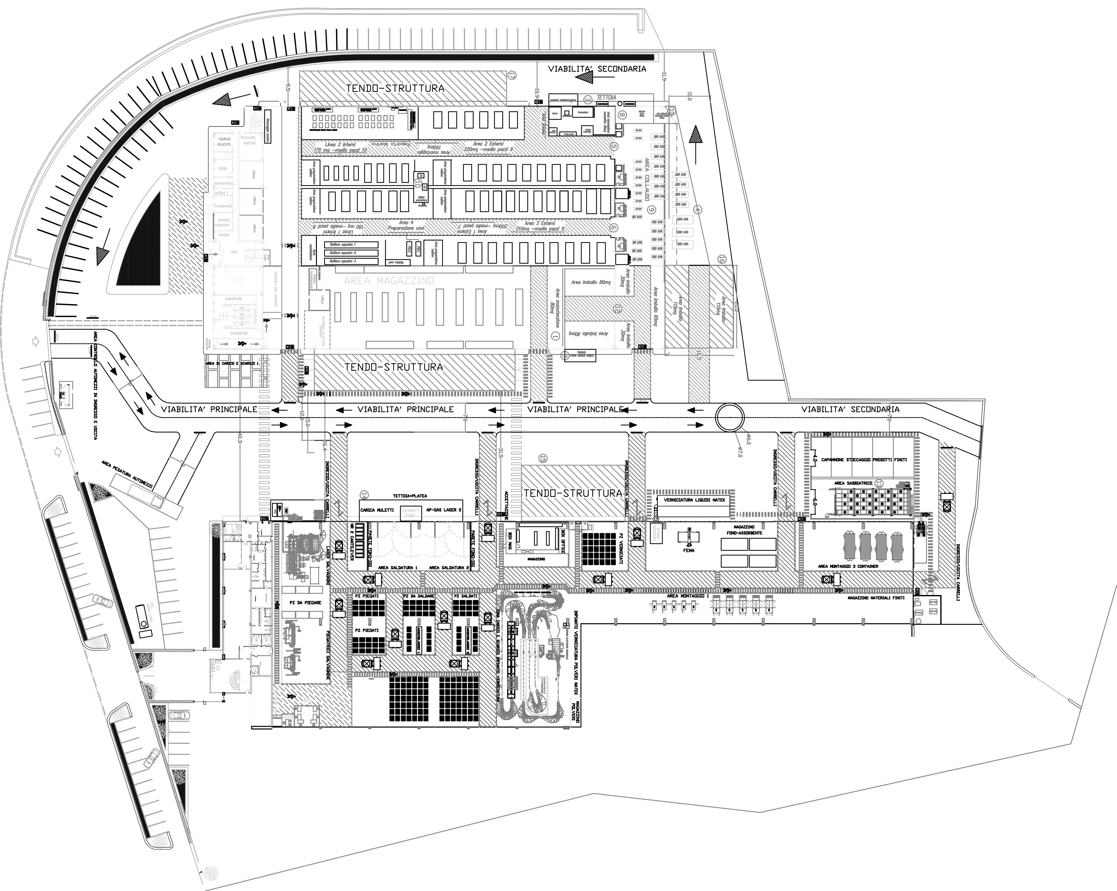
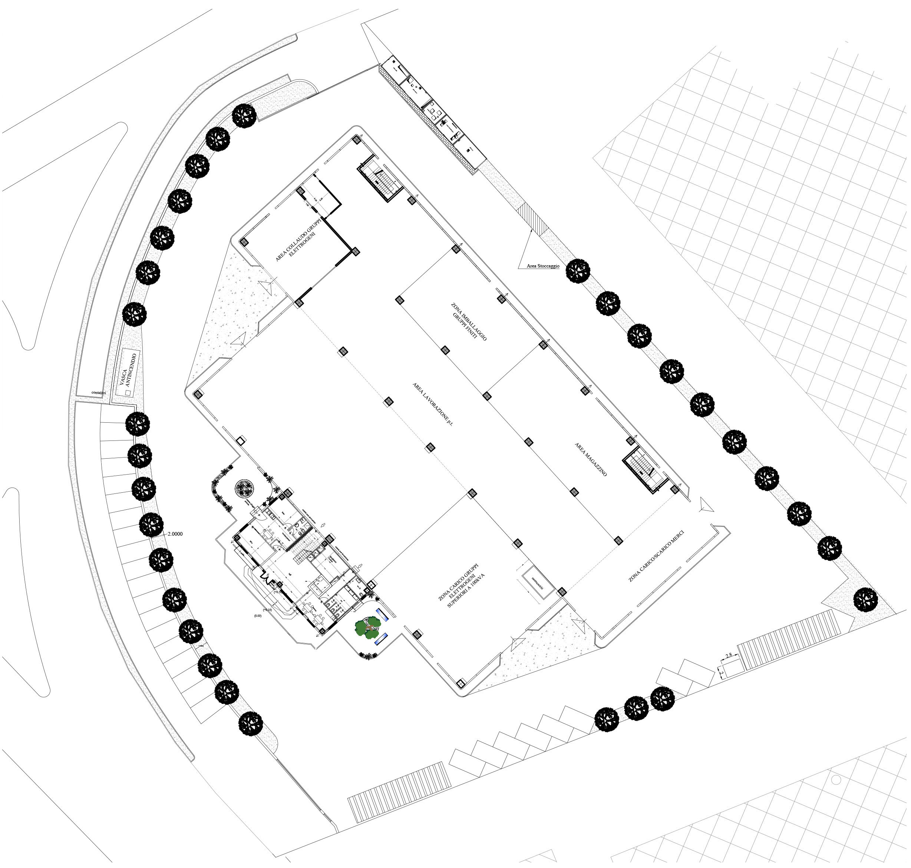
HOW WE MANAGED GROWTH
Sales
Production Strategy
Financial mix
Procedures
Production Infrastructure
Accountability
Organization
External Growth
COELMO 1
- Nr. 3 production lines
- Nr. 1 overheadcrane: 12,5 tonscapacity
- Nr. 2 overheadcrane: 6,3 tonscapacity
(max 12,6 tons)
- Nr. 1 overheadcrane: 12,5 tonscapacity
COELMO 2
- Nr. 1 production line
- Nr. 1 overheadcrane:
12,5 tons
COELMO 3
- Nr. 1 production line
- Nr. 2 overhead cranes: 6,3 tons (max12,6 tons)
- Laser System, Cantilever Sheet Metal Rack, Press Brakes, Welding Machines, Powder Coating Plant, Liquid Painting Plant, Low Pressure Plant.
- Production Infrastructure
Industry 4.0
1
2
3
Total Area: 36.000 sqm
2022
Accountability

Slide 19
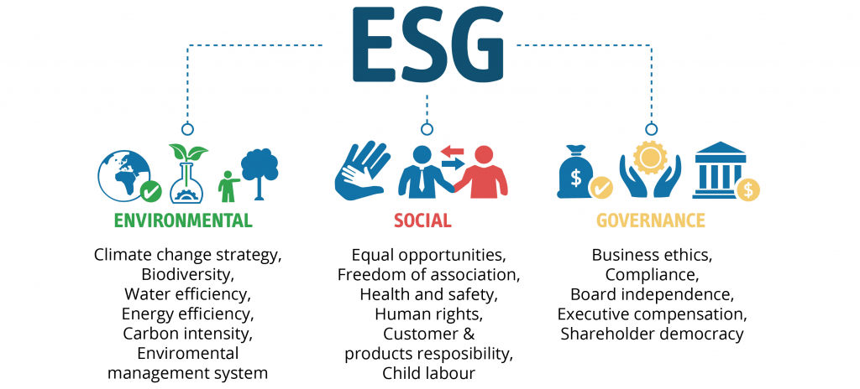
HOW WE MANAGED GROWTH
Sales
Production Strategy
Financial mix
Procedures
Production Infrastructure
Accountability
Organization
External Growth
Accountability
Growing means responsibly taking care of people and environment.
Along with Fiscal Balance Sheet, Coelmo publishes an Annual Sustainability Report
Coelmo has started the ESG rating procedures based on standard 88088:20 (based on 2023 Sustainable Development UN Agenda)
Certificates and Ratings
ISO14001
ISO9004
ISO9001
AEO FULL
1090-1
SA8000
IT01 - 100% MADE IN ITALY
ISO45001
ELITE BORSA ITALIANA
3 STARS LEGAL RATING
Thank you

Slide 20
QUESTIONS AND ANSWERS?
Thank you

