Slide 1
Lesson 16
Monetary policy
A general framework

Slide 2
What do central banks do?
They issue banknotes
They set the price of liquidity
They extend liquidity to banks via open-market operations
–outright purchases of securities (Fed) or repurchase agreements (‘repos’) (ECB)
–in so doing, they (normally) set the price of liquidity
–and they control the quantity of base money
They impose compulsory reserves on commercial banks
On a temporary basis, they act as lenders of last resort to banks
They can, but according to present theory they should not finance governments

Slide 3
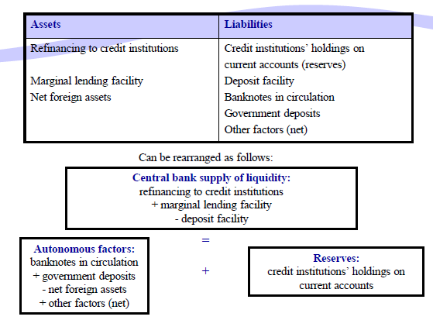
Standardized central bank balance sheet

Slide 4
Money creation
Monetary instruments are sorted by liquidity into aggregates ‘M0’ to ‘M3’
Only M0 is controlled by the central bank
Liquidity creation is endogenous;
It is prone to cycles and depends very much on confidence

Slide 5
Monetary policy objectives
Depending on their mandates, central banks may pursue one or several of these objectives:
•Price stability
•Full employment
•Financial stability
•Exchange-rate stability

Slide 7
Quantitative measures
These are the traditional measures of monetary control:
Open Market Operations
Reserve Ratio
Policy Rates

Slide 8
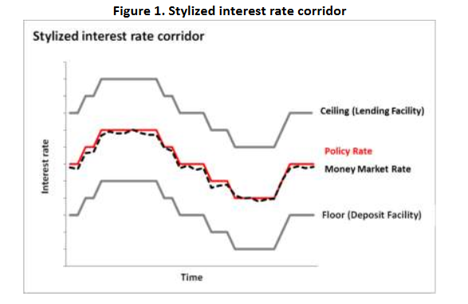
The interest rate corridor

Slide 9
An interest rate corridor (IRC) is a system for guiding short-term market interest rates towards the central bank (CB) target/policy rate. It consists of a rate at which the CB lends to banks (typically an overnight lending rate) and a rate at which it takes deposits from them (deposit rate).
In a standard corridor, the lending rate will be above the CB target/policy rate (thereby forming an upper bound for short-term market rates), and the deposit rate will be below the CB rate, thereby forming the lower bound
The IRC system is intended to help ensure that money market interest rates move within a reasonably close range around the CB’s policy rate. The close relationship between the policy rate and market interest rates provides the fundamental basis for monetary policy transmission.
Through the IRC system, the CB is able to generate a more effective policy signal as market rates closely track the policy target rate.
While there is no consensus on the width of the corridor, international central banking practice suggests the use of a narrow and symmetrical corridor.
The choice of corridor width is determined largely by the importance assigned by the central bank to the amount of interest rate volatility, the central bank’s preferences on the extent of counterparties’ reliance on CB liquidity facilities, and degree of interbank market activity

Slide 10
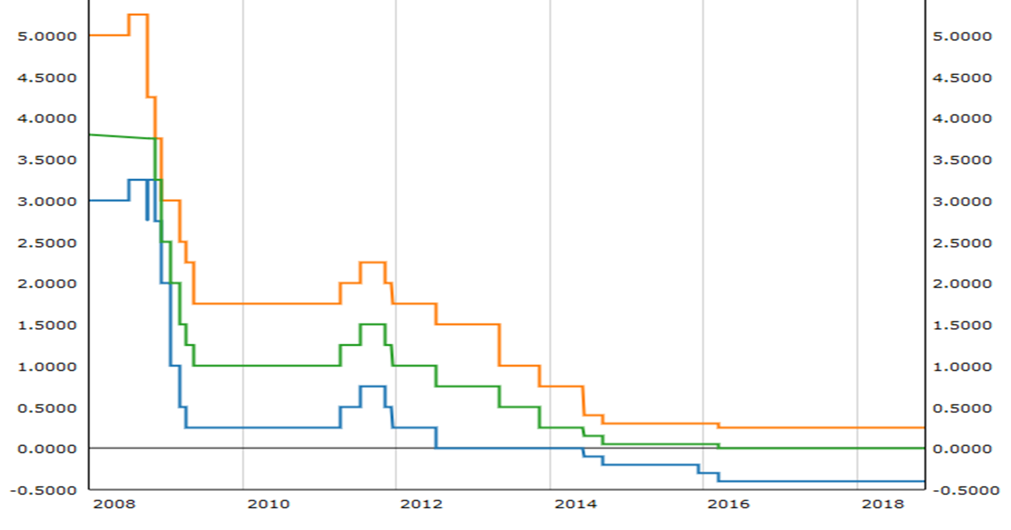
ECB rates (2007-2018)

Slide 11
Selective Credit Controls
Since the objectives of credit control are not served by the quantitative methods, the economists rely on selective control methods to fulfill the purpose. The credit objectives may include rationing the credit, directing the flow of credit from least important sectors to the most important sectors, controlling a speculating tendency based on the availability of bank credit. Thus, these objectives are very well served by the selective control methods. It includes the following monetary measures:
Credit Rationing
Change in Lending Margins
Moral Suasion

