Slide 1
Lesson 5
The policy model of the New Consensus Macroeconomics

Slide 2
The profound revision of Keynesian paradigm
At the beginning of the 1970s in the U.S., Europe and Japan, a new phenomenon occurred: so-called stagflation or the contemporaneous presence of high and rising inflation and high rates of unemployment.
It led to profound rethinking of the hitherto dominant policy framework. The Bretton Woods agreements were abandoned in the conviction that restoration of monetary autonomy would serve the internal objective of price stability and that the flexible exchange rate would absorb the shocks on aggregate equilibrium income

Slide 3
The main features at the core of the new paradigm
the long-run neutrality of money
the dichotomy between the monetary variables and the real variables
private firms and individuals decide on the basis of expectations about the future level of prices.
households and firms have the ability to intertemporally optimise their decisions.

Slide 4
The shift of the policy debate
From the objective of full employment and external equilibrium towards the minimisation through optimal monetary policy strategies of short-run output fluctuation around the long-run unemployment level.
Additional assumptions of the model are:
a) intertemporal optimisation of a utility function that reflects optimal consumption smoothing;
b) the transversal condition, meaning that all debts are ultimately paid in full: economic agents are creditworthy;
c) all debt instruments are perfectly acceptable in exchange;
d) nobody is liquidity-constrained.

Slide 5
The reply the new Keynesian Macroeconomics
The aim was to justify through a similar analytical apparatus the presence of persistent levels of short–run macroeconomic disequilibria
microfoundations in order to justify the presence of nominal rigidities and market failures;
prices are sticky due to the inherent existence among agents of imperfect information and bounded rationality.
the presence of liquidity constraints and wealth effects allow for short-run output fluctuations.
The policy prescription emerging from this framework is to set a monetary policy rule for money interest rates – the so-called Taylor (1993) rule – in order to minimise output and price fluctuations. The shift from an equation for equilibrium in the money market to a rule for interest rates was supposed to work as a nominal anchor to help agents to set relative prices efficiently.

Slide 6
The birth of a new synthesis
The New Classical Economics and the New Keynesian economics merged in the 1990s in a new paradigm known as the New Neoclassical Synthesis or as called elsewhere New Consensus Macroeconomics: it represented a bridge between classical (monetarists, new classical and RBC) and (new) Keynesian economics within the context of the Great Moderation – a period of low volatility in business cycle fluctuations believed at that time to be permanent. Here the basic feature of this macroeconomic model is presented as it is the building block of the policy model on which the common currency area is based

Slide 7
The model of the New Macroeconomic consensus

Slide 8
Features of the model
The model is conceived to be a general equilibrium model, always having equilibrium solutions. Conditions of disequilibrium may occur in the presence of incorrect evaluations of the future course of the economy. However, they can be promptly corrected by following monetary and fiscal policy rules.
existence of an output gap, defined as the difference between the current output and the potential output, which does not vary in the presence of short-run policy interventions
The second feature is the introduction of expected inflation as a means for households and firms to make decisions about the future. Through the intertemporal optimisation process they smooth consumption and investment over time and minimise the effects of policy intervention. What the central bank has to do is to set a monetary policy rule, to stabilise inflation expectations and minimise output fluctuations. This is the Taylor (1993) rule according to which central banks have to set the money interest rate to stabilise inflation expectations.

Slide 9
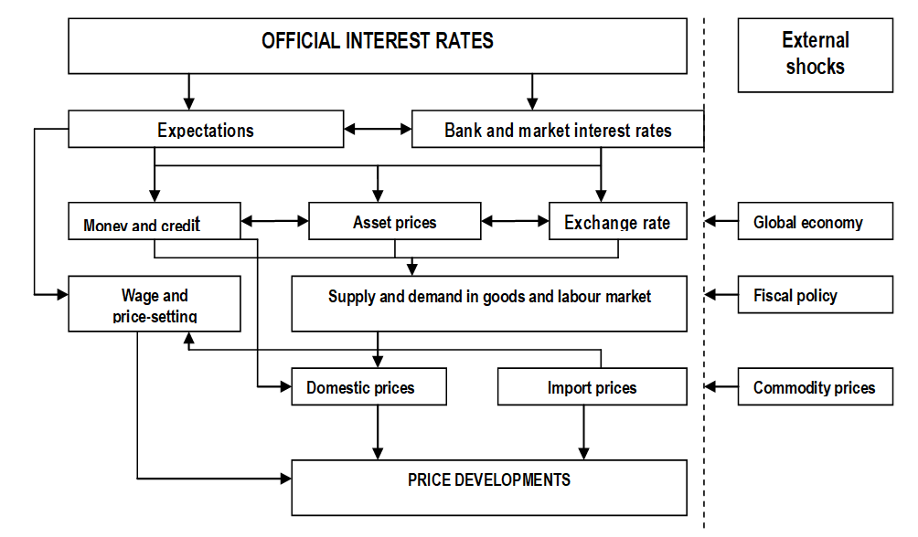

Slide 10
3. The third feature is the absence in the model of an equation defining the liquidity preference as being dependent on interest rates.
This reduces the possibility of managing money in circulation in the presence of deflation and declining macroeconomic conditions. In the model presented above negative current and expected inflation imply a monetary policy rule able to set negative money interest rates, and therefore able to push additional liquidity into the market. However, in a Keynesian world these are conditions for a liquidity trap and infinite demand for money
4. As a fourth element it has to be said that the model pays insufficient attention to the exchange rate.
However, a strong real exchange rate contributes to ‘imbalances’ in the economy through its impact on the domestic composition of output: exports in manufacturing decline, while imports of services increase so that the current account worsens. While under flexible exchange rates external shocks could be quickly absorbed by changes in the nominal value of the currency, under fixed exchange rates – or irrevocably fixed exchange rates as in the case of a common currency – the process of external adjustment has to be achieved by relative prices. This process takes much more time and sometimes does not work at all.
5. Finally, in each equation there is the presence of an external stochastic shock which never affects the economy in a systematic way.

