Slide 1
MASTER MEIM 2021-2022
INNOVATION MANAGEMENT
Master 2021-2022
DEFINING INNOVATION
A cura del prof. Marco Ferretti
Prof. Di Economia e Management all’Università degli Studi di Napoli Parthenope

Slide 2
Agenda
What is innovation?
Diffusion of innovations
The technology cycle
Types of Innovation
Innovation in the economic thought
The technology push approach
The demand pull approach
The circular process «technologies-needs»
The sources of innovation
Innovation Development
Profiting from technological innovation
The acquisition of the technological knowledge
Mapping the winds of creative destruction
The disruptive innovation
Organizing and leading project teams
Functional team structure
Lightweight Team Structure
Heavyweight Team Structure
Autonomous Team Structure
References

Slide 3
What is innovation?
A PAUSE FOR DEFINITIONS
Always true?
INNOVATION
INVENTION
Transformation of the invention into a new product or production process and its commercial exploitation. Innovation includes the planning (design), physical realization (manufacturing) and commercialization (marketing) of the invention (Freeman 1982).
New ideas, new scientific development or technological innovation not yet technically and materially realized.
Often born randomly, not induced by economic and competitive motivations.
CREATIVITY

Slide 4
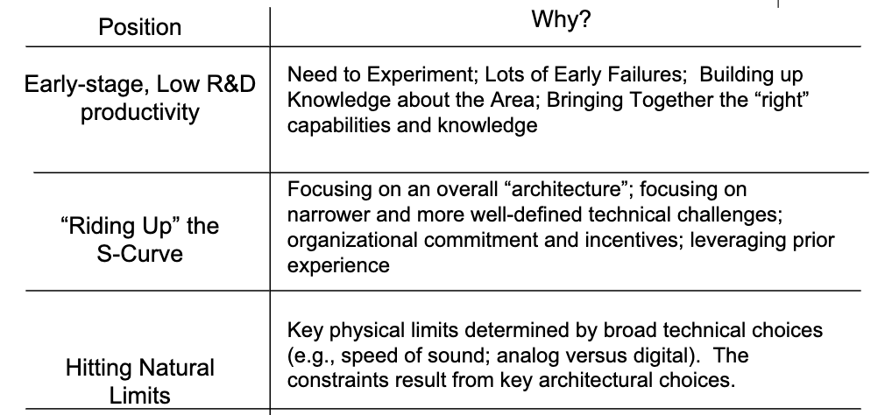
Diffusion of innovations
WHERE AM I STRATEGICALLY?
WHAT PERFORMANCE MEASURE SHOULD I PLOT?
Process of adoption of an innovation by user companies or final consumers. It refers, in particular, to the economic relevance that the innovation acquires over time in the economic system of reference
THE FOSTER’S S CURVE
Physical limit???
TECHNOLOGY PERFORMANCE/ TECHNOLOGICAL MATURITY
EFFORT EXPENDED/ TIME

Slide 5
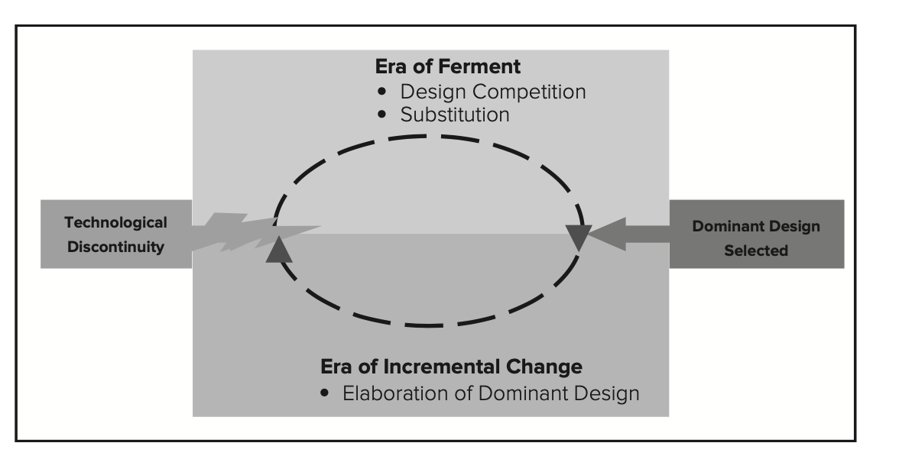
The technology cycle
Utterback and Abernathy, and later Anderson and Tushman found that each technological discontinuity inaugurated a period of turbulence and uncertainty (which they termed the era of ferment).
The technology cycle
The S-curve model suggests that technological change is cyclical: Each new S-curve ushers in an initial period of turbulence, followed by rapid improvement, then diminishing returns, and ultimately is displaced by a new technological discontinuity. The emergence of a new technological discontinuity can overturn the existing competitive structure of an industry, creating new leaders and new losers. Schumpeter called this process creative destruction, and argued that it was the key driver of progress in a capitalist society.
Source: Underson & Tushman (1990)

Slide 6
Types of Innovation
THE MAIN DEFINITIONS
Product innovation
Market
Process innovation
Competence-Enhancing Innovation
Competence-Destroying Innovation
Technology

Slide 7
Innovation in the economic thought
Adam Smith in «The Wealth of Nations» (1776) considers the relationship between technological change, division of labor, and structural change in the economy. The incorporation of technological progress into capital promotes the division and specialization of labor, which in turn is reflected in productivity.
Ricardo in «Principles of Political Economy» (1817) analyzes the effects of technological change on employment.
Marx emphasizes the key role of technology in modern economies and stresses that innovation is a social process rather than an individual one. The impetus for innovation comes from capitalist competitive pressure and the size of markets.
Usher (1921) views innovation as a process. Innovations are the result of a phenomenon of "cumulative synthesis" that from the perception of a problem leads to the initial introduction of an innovation and then to its progressive modification and improvement.

Slide 8
Innovation in the economic thought
Innovation is the product of the deliberate and exclusive willingness of the entrepreneur/innovator
(«The Theory of Economic Development», 1912)
Innovation as «Creative Destruction»
Technology push approach
INNOVATION LEADS THE ENTIRE ECONOMY TOWARDS ECONOMIC DEVELOPMENT
The innovation process does not derive from the sporadic action of the entrepreneur, but it becomes a component of the management activity, object of systematic and organic planning.
(«Capitalism, socialism and democracy», 1942)
Innovation is endogenous
SCHUMPETER

Slide 9
The technology push approach
Innovation in the economic thought
New scientific and technological knowledge
New commercial application opportunities
THE SCHUMPETERIAN THOUGHT
Returns generated by the introduction of new technologies
Entrepreneurial activity stimulus
Investments in new technologies
The supremacy of technological progress is the main driver of the innovation phenomenon.
Development of new production models
Innovation-related profits
New market structure

Slide 10
The demand pull approach
Innovation in the economic thought
Unmet demand
Latent needs
Innovation-related profits
SCHMOOKLER (1966)
Significant potential market
R&D investments
Market demand influences and promotes the innovative process.
Exogenous scientific and technological knowledge has a weak impact on the innovative process.
Evaluation of the degree of appropriability of revenues
Investments in new plants
New solutions
New market structure
Start of production

Slide 11
The circular process «technologies-needs»
Innovation in the economic thought
ROSENBERG (1976)
Explicit and Latent needs
Control of R&D-related returns
Market demand and the opportunities associated with scientific knowledge coexist and support each other.
The way in which technology develops is strongly influenced by the trend and direction of market demand. It is likewise true that technology opens up new avenues to satisfy explicit and latent needs.
Incentive
R&D investments
Increase in R&D resources
Innovations
Satisfaction of latent explicit needs
Increase in profits

Slide 12
The sources of innovation
CS&T
Prestige
Competitiveness
Political- institutional context
Resources
Infrastructure
THE PROCESS OF CREATING NEW TECHNOLOGICAL KNOWLEDGE
Lobby
Incentives
Science/ Technology Parks
Pressures/ Lobbies
CS&T
Internally developed knowledge
Context/ Network
Products/ Services
Customers
Resources
Infrastructure
CS&T
Needs
ABSORPTIVE CAPACITY!
Firm
Solutions
Suppliers
Solutions
Products/ Services
Informations
Research centers
Universities
Needs
Externally developed knowledge
CS&T
Needs

Slide 13
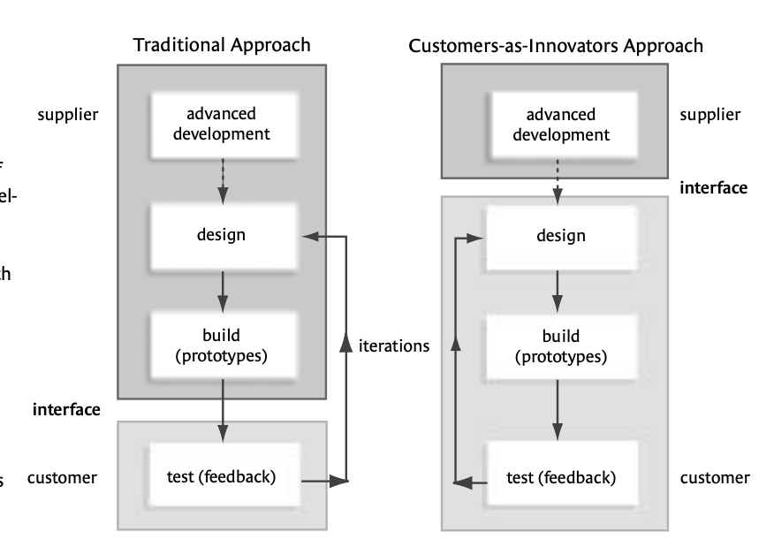
The sources of innovation
«The innovator is defined as the individual or firm that first develops an innovation to a useful state, as proven by documented, useful output.»
A New Approach to Developing Custom Products
VON HIPPEL
The sources of innovation vary greatly and differ significantly between categories of innovation
WHO IS THE LEAD USER?
The Functional source of Innovation
If we can understand the cause(s) of such variation, we may be able to predict and manage the innovation process much better
Source: Thomke, von Hippel (2002)

Slide 14
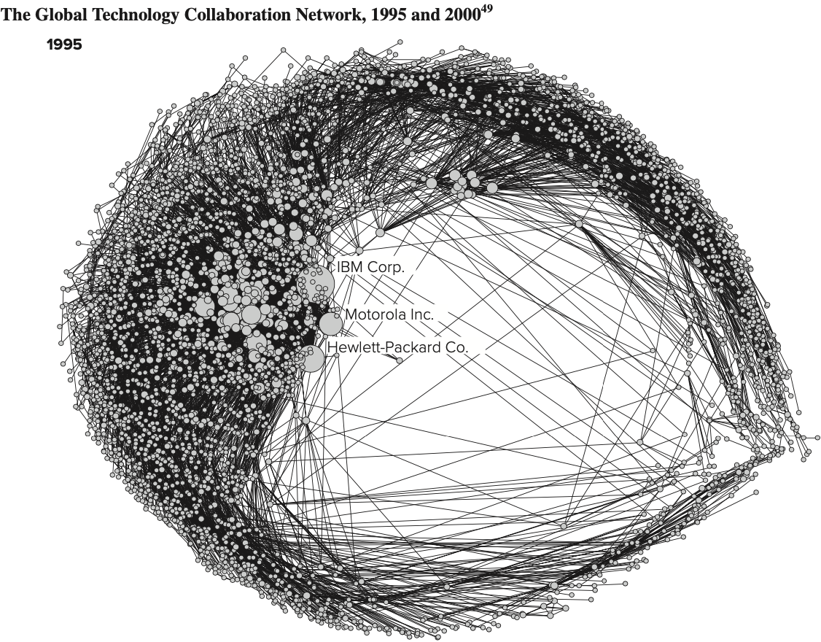
Innovation Development
The alternatives are:
Internal development: time, costs, risks, freedom, benefits
Acquisitions: high costs and integration challenges, rapidity
Agreements and Joint Ventures.: sharing cost and risk reduction, integration difficulty
External R&D contracts: integration challenges, timing, appropriateness
Licenses: rapidity, constraints
Private label: rapidity, temporary solution
INTERNAL VS EXTERNAL DEVELOPMENT
Decisions about how to develop innovation reflect, on the one hand, the need to protect the results of research from competitors and, on the other, the need to find outside resources, technologies and skills not present within the firm. All this must ensure the profitability and the achievement of strategic objectives.
Innovation in collaborative networks
Source: Schilling, 2017

Slide 15
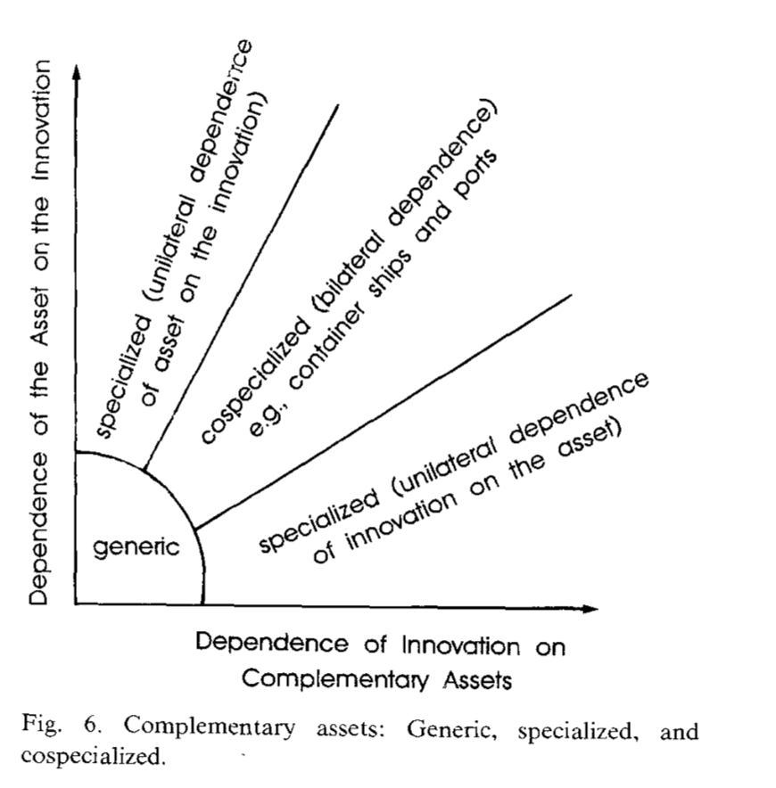
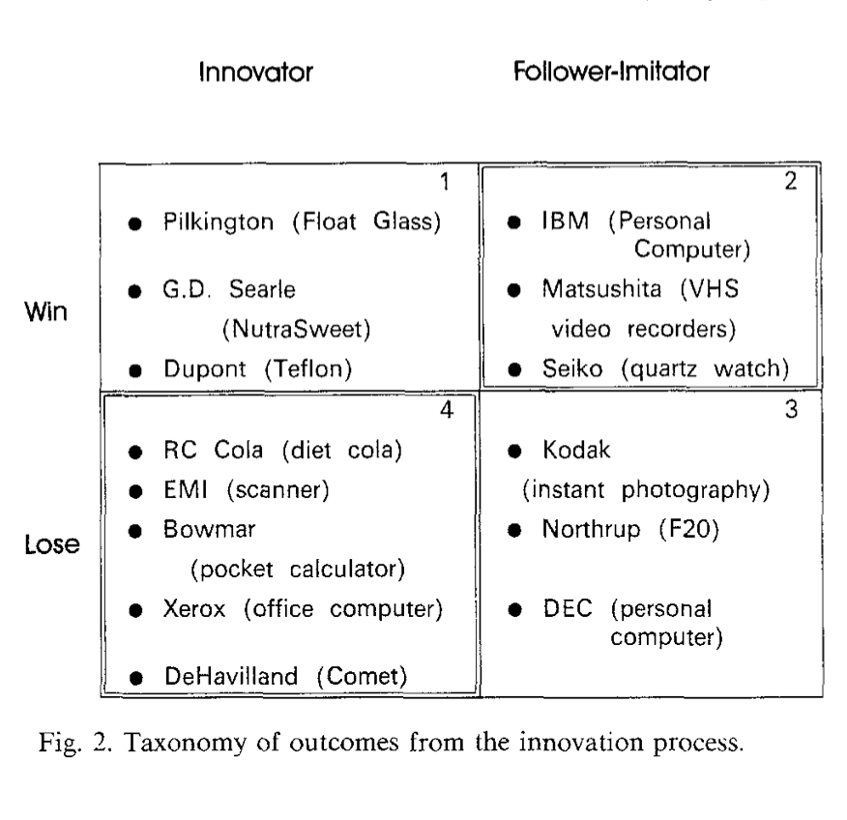
Profiting from technological innovation:
WHO WINS FROM INNOVATION?
The firm which is first to market, follower firms, or firms that have related capabilities that the innovator needs?
TEECE, 1986
Three fundamental building blocks must be put in place:
the appropriability regime
complementary assets, and
the dominant design paradigm.

Slide 16
The acquisition of the technological knowledge
The familiarity matrix
BEYOND THE «INTERNAL-EXTERNAL» DICHOTOMY
Distinction between complementary assets according to their mutual dependence
Source: Roberts & Berry (1985)
Source:Teece (1986)

Slide 17
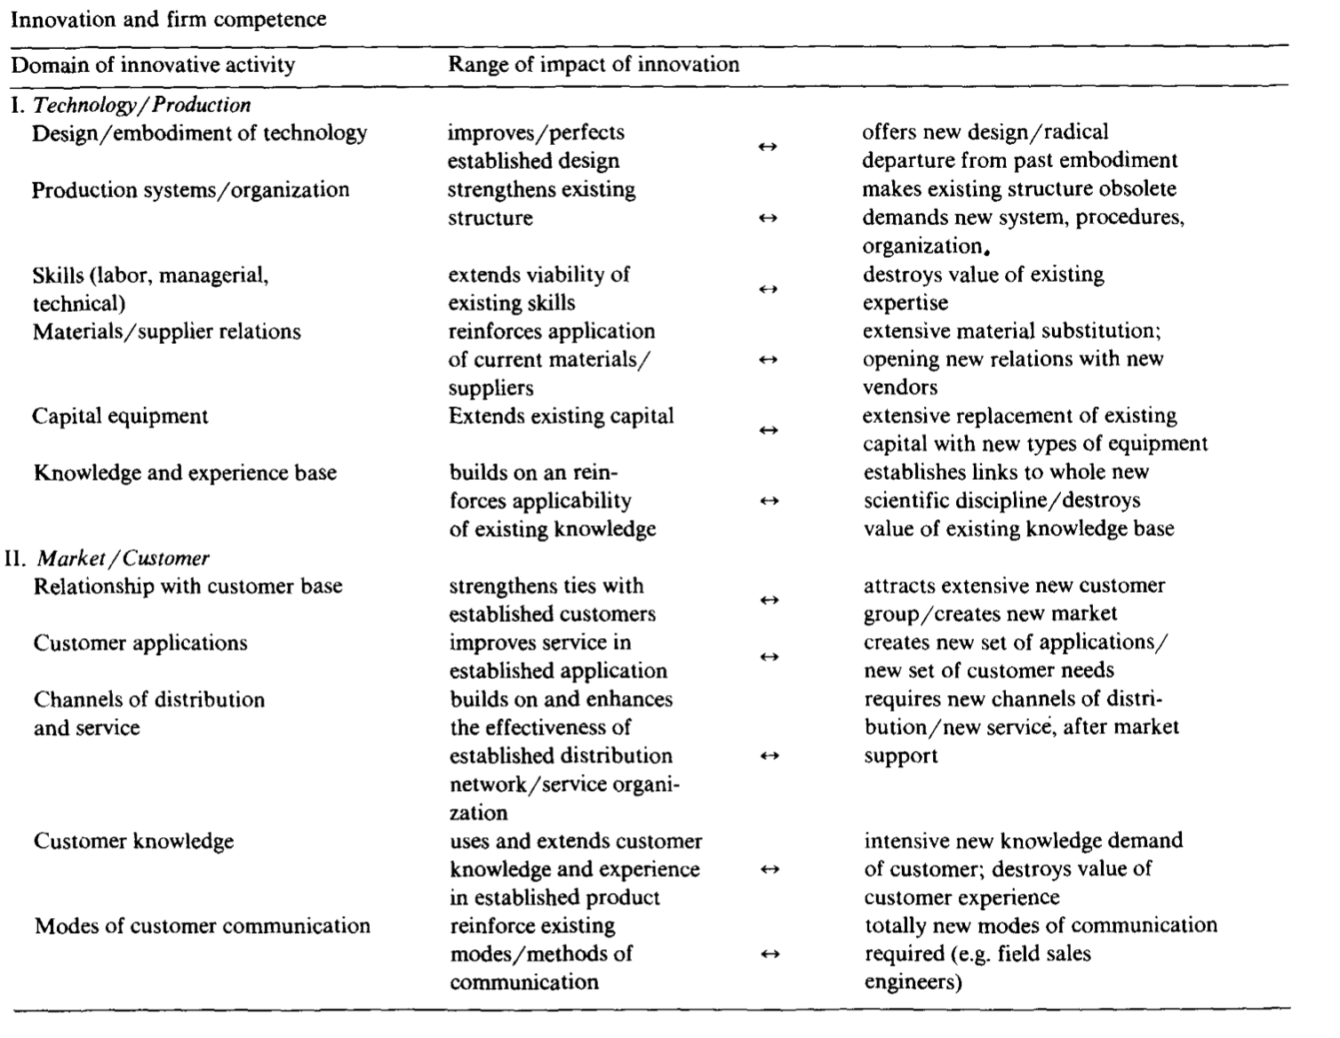
Mapping the winds of creative destruction
THE COMPETITVE IMPILCATIONS OF INNOVATION
The Transilience map
The significance of innovation for competition depends on what we shall call its "transilience" that is, its capacity to influence the firm's existing resources, skills and knowledge .
Source: Abernathy & Clark (1985)

Slide 18
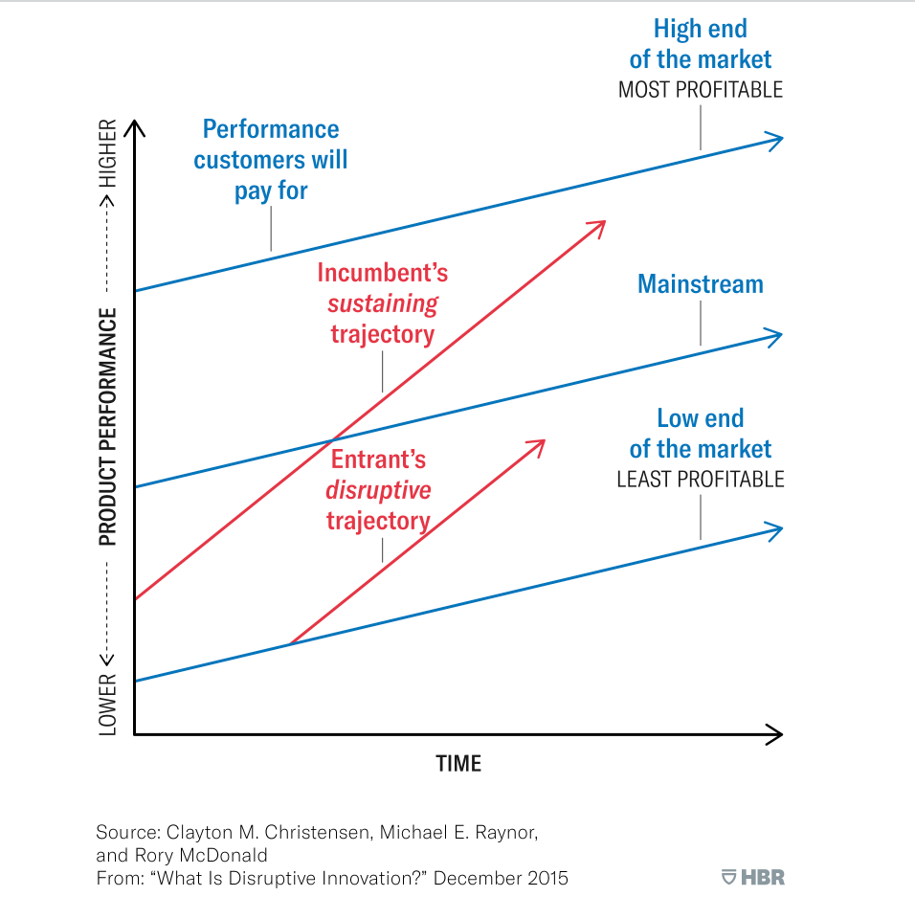
The disruptive innovation
Why do the market leaders fail?
Why does it occur after the interoduction of particular technological innovations?
CHRISTENSEN, 1995
Disruptive innovation is the process in which a smaller company, usually with fewer resources, is able to challenge an established business (often called an “incumbent”) by entering at the bottom of the market and continuing to move up-market.
THE INNOVATOR’S DILEMMA
Identify the emergence of competitive dynamics through which technological innovations lead to the destruction of firm value.
Balance short- and long-term investments in innovation to prevent such " disruption."

Slide 19
Organizing and leading project teams
Types of development teams
TYPES OF DEVELOPMENT TEAMS
Effective product and process development requires both that all of the organizational groups involved develop and bring to bear the appropriate specilazied capabilities, and that the efforts of all of these groups be appropriately integrated.
As organizations experimented teams, they discovered that success with a cross-functional team required much more than simply naming the team and setting up a regular schedule of team meetings
Source: Wheelwright & Clark (1992)

Slide 20
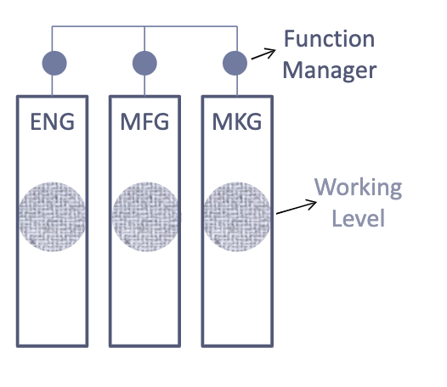
Functional team structure
team
Team members grouped by discipline
leaders
Subfunction managers
Senior functional managers
characteristics
Coordination of ideas
Cross-functional issues discussed in occasional meetings
Responsibility passed from one function to another
• managers w/responsibility & authority
•learning effects
•separated, subdivided activities
•individual performance hard to evaluate

Slide 21
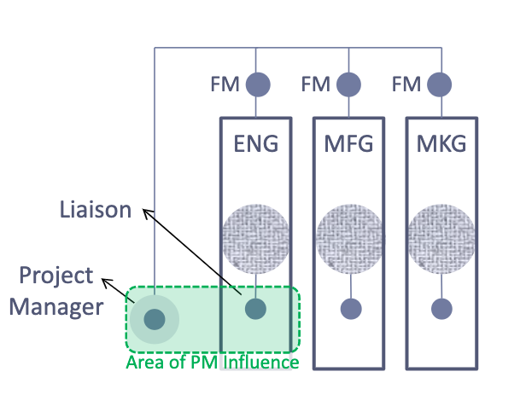
Lightweight Team Structure
team
Members remain in function
Designated representatives (L)
leaders
Lightweight project manager
Junior /mid-level
Littele influence, inexperienced
characteristics
Project as broadening experience
Key resource or cadre decisions by senior mgmt
PM: schedules, time plans etc.
•
• PM overlooks coordination/integration
•seImproved communication
•only few differences to functional teams
• Low acceptance of lightweight PM

Slide 22
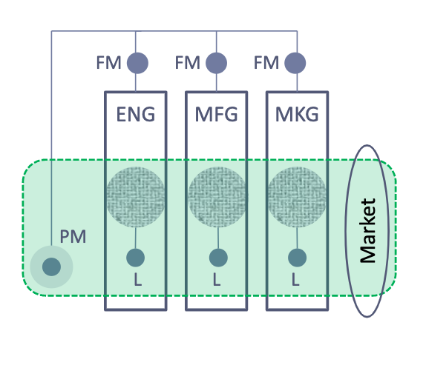
Heavyweight Team Structure
team
Cross-functional but physically co-located
Core team and other members
leaders
Primary influence/supervision
Usually senior managers
Highly engaged «champions»
Influence mainly thru core team
characteristics
PM has direct responsibility and authority
Cross-functional focus and consideration of market needs.

Slide 23
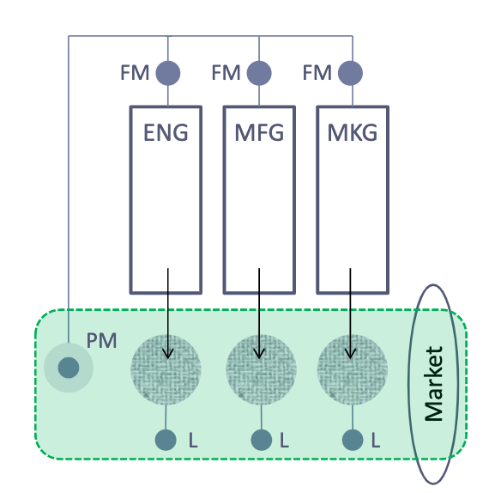
Autonomous Team Structure
team
Cross-functional team members
Separeted from original functions
leaders
Heavyweight PM with full contrtol and evaluation authority
characteristics
«Clean sheets», no formar rules
Fully responsible for outcome.
• concentration on project success
•birthplace of unique ideas/breakthrus
•rethink instead of utilize existing assets
•high risks, hard to change at half-way

Slide 24
References
Abernathy, W. J., & Clark, K. B. (1985). Innovation: Mapping the winds of creative destruction. Research policy, 14(1), 3-22.
Ferretti, M. (2007). Lo sviluppo delle conoscenze tecnologiche nell'impresa. G. Giappichelli.
Hippel, E. V. (2007). The sources of innovation. In Das Summa Summarum des Management (pp. 111-120). Gabler.
Joseph, A. (1934). Schumpeter. The Theory of Economic Development. An Inquiry into Profits, Capital, Credit, Interest, and the Business Cycle.
Schilling, M. A., & Izzo, F. (2017). Gestione dell'innovazione. McGraw-Hill Education.
Schumpeter, J. A. (2010). Capitalism, socialism and democracy. routledge.
Teece, D. J. (1986). Profiting from technological innovation: Implications for integration, collaboration, licensing and public policy. Research policy, 15(6), 285-305.
Thomke, S., & Von Hippel, E. (2002). Innovators. Harvard business review, 80(4), 74-81.
Wheelwright, S. C., & Clark, K. B. (1992). Revolutionizing product development: quantum leaps in speed, efficiency, and quality. Simon and Schuster.
What Is Disruptive Innovation? @https://hbr.org/2015/12/what-is-disruptive-innovation

Slide 25
MASTER MEIM 2021-2022
Thank you for the attention
«If you're not failing every now and again, it's a sign you're not doing anything very innovative.»
Woody Allen

