Slide 1
MASTER MEIM 2022
Soft skills 03/18/2022
A cura del dott. Luca Fusco
Psicologo clinico e dell’orientamento
Assegnista di ricerca dell’Università degli studi di Napoli Parthenope

Slide 2
Program of the day:
Team working, task strategies
Communication skills training

Slide 3
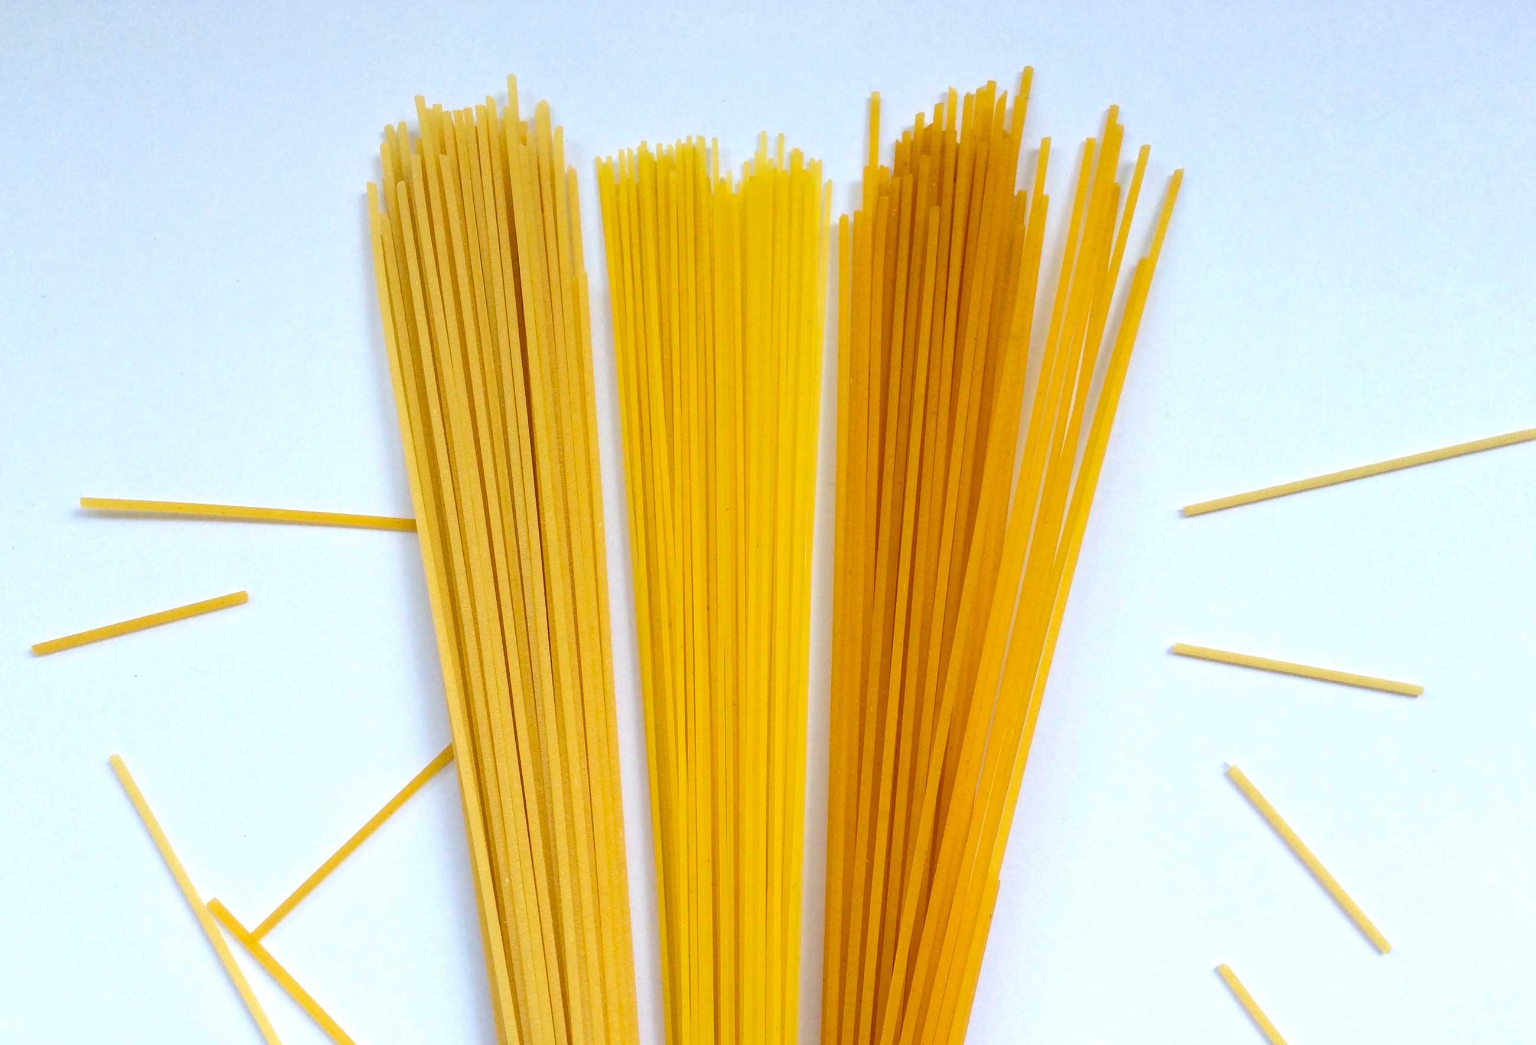
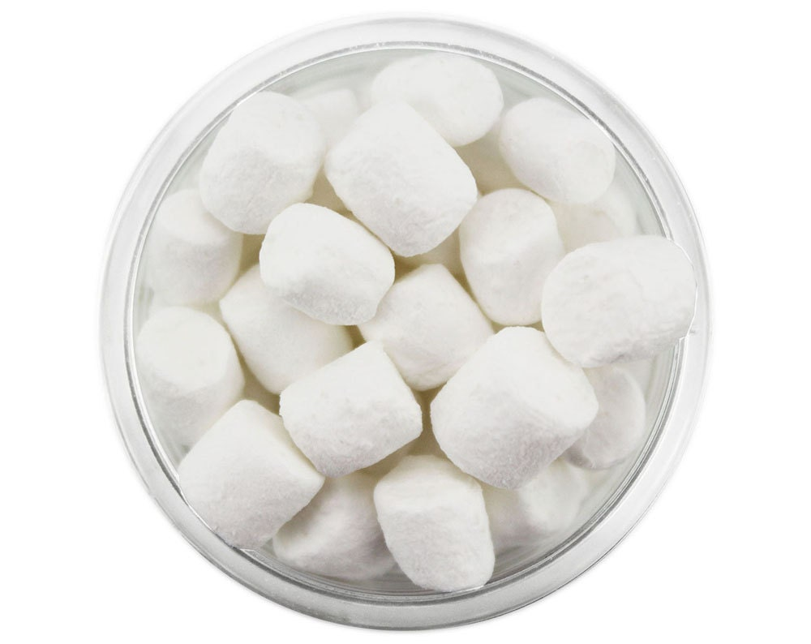
Team working activity
THE MARSHMELLOW CHALLENGE

Slide 4
The goal of the game is to build the tallest structure using:
20 spaghetti
1 marshmellow
Tape
String

Slide 5
Rules:
The entire marshmellow must be on top of the structure
You can use as much as you want of the other stuff (you can break and cut spaghetti, tape, string)
The challenge lasts 18 minutes (after that moment nobody can touch the structure)

Slide 6
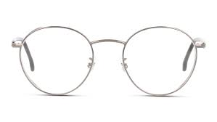
Activity: How do people see you?

Slide 7
Communication:
«the ability of living (and non-living) systems to exchange information. It can involve individual entities or groups. It’s an act (a behavior) of meaning sharing through the use of signs, symbols and conventional messages.»

Slide 8
Communication channels:
Verbal
Non-verbal
Para-verbal

Slide 9
What does it mean to improve your communication?

Slide 10
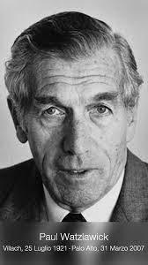
Communication:
5 axiomes (Paul Watlzawick)
Axiome number 1:
«One cannot not communicate»

Slide 11
Communication:
5 axiomes (Paul Watlzawick)
Axiome number 2:
«Every communication has a content and relationship aspect»

Slide 12
Communication:
5 axiomes (Paul Watlzawick)
Axiome number 3:
«Communication is punctuated»

Slide 13
Communication:
5 axiomes (Paul Watlzawick)
Axiome number 4:
«Communication involves digital and analogic (verbal and non- verbal) modalities»

Slide 14
Communication:
5 axiomes (Paul Watlzawick)
Axiome number 5:
«Communication can be symmetrical or complementary»

Slide 15
Meta-communication?

Slide 16
Communication is…
SIGN VS SYMBOL
SIGNIFIED VS SIGNIFIER

Slide 17
Activity: Read each other

Slide 18
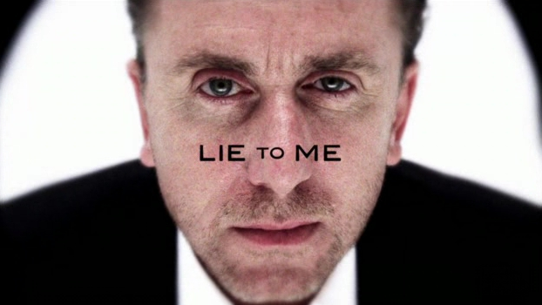
LIES?

Slide 19
The science of lie detection
Non-verbal details are not reliable
People’s ability to detect lies is mediocre
People overestimate their ability to detect lies
People use double-standards to judge lies

Slide 20
What are the best indicators for lies/truths?
Details of the discourse
Verbal and vocal immediacy
Nervosism
Vocal tention
Logical structure

Slide 21
Activity: For or against?

Slide 22
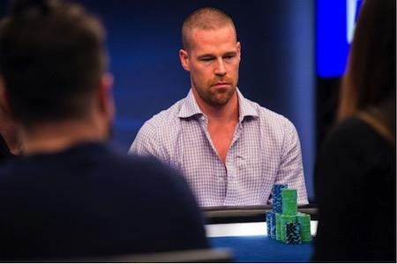
Activity: The bluff game

Slide 23
Rules:
Choose «split»,«steal» or «you’re a stealer»
Scores:
Split vs split → 1 point each
Steal vs split → 2 points steal
Steal vs you’re a stealer → 2 points you’re a stealer
Split vs you’re a stealer → 2 points to split
Steal vs steal → 0 points each

Slide 24
Persuasion based on:
Commitment, coherence
Reciprocity
Social approval
Authority
Sympathy
Scarcity

