Slide 1
How to compute Derivatives
derivatives appear very often in Computer Science, under several forms

Slide 2
How to compute Derivatives
we have 3 approaches
1 ) Numerical Differentiation
2 ) Symbolic Differentiation
3 ) Automatic Differentiation

Slide 3
Symbolic Differentiation
compute the symbolic expression of the derivative of a function
it needs manipulation in computer algebra systems such as Mathematica, Maxima, Maple, Matlab’s Symbolic Toolbox, Python’s sympy
input:
the symbolic expression of the function
output:
the symbolic expression of the derivative

Slide 4
>> syms x
>> diff(sin(x))
ans =
cos(x)
>> diff(sin(x),2)
ans =
-sin(x)
>> diff(x*sin(2*x))
ans =
sin(2*x) + 2*x*cos(2*x)

Slide 5
>> syms y
>> diff(x*y^2+cos(x*y),x)
ans =
y^2 - y*sin(x*y)
>> diff(x*y^2+cos(x*y),y)
ans =
2*x*y - x*sin(x*y)
>> diff(x*y^2+cos(x*y),x,2)
ans =
-y^2*cos(x*y)

Slide 6
>> f(x,y) = x*y^2+cos(x*y);
>> gradient(f,[x,y])
ans(x, y) =
y^2 - y*sin(x*y)
2*x*y - x*sin(x*y)
>> laplacian(f,[x,y])
ans(x, y) =
2*x - x^2*cos(x*y) - y^2*cos(x*y)
>> diff(f,x,2)+diff(f,y,2)
ans(x, y) =
2*x - x^2*cos(x*y) - y^2*cos(x*y)

Slide 7
Automatic Differentiation (AD)
compute the exact value of derivatives of a function at a given point (called differentiation point)
its basic idea is to apply repeatedly the chain rule from Calculus
input:
the point where the derivative has to be evaluated
the symbolic expression of the function OR a program that evaluates the function at any point

Slide 8
Automatic Differentiation (AD)
compute the exact value of derivatives of a function at a given point (called differentiation point)
the idea is to apply repeatedly the chain rule from Calculus to either the basic functions that compose the function to be differentiated or the lines of the program that implements such function
output:
the exact value of the derivative at the differentiation point

Slide 9
Automatic Differentiation (AD)
AD does not compute either the symbolic expression of the derivatives or generate a program that implements such an expression
AD, like finite difference, computes the value of the derivatives at a given point
unlike finite difference, AD provides the exact value of the derivatives
if we want to evaluate the derivative (gradient,..) of the same function at several distinct points we need to run several times the AD code

Slide 10
Automatic Differentiation (AD)
AD is used in many Machine Learning optimization problems, e.g. deep neural networks, which are parametrized by (millions/billions of) weights that are computed by Stochastic Gradient descent or its variants (GD with momentum, ADAM,..) to find the minimum of the loss function defined in terms of a trained set
AD may also be used in Newton’s minimization method and Levenberg-Marquardt method

Slide 11
Automatic Differentiation (AD)
AD may operate in two ways:
Forward mode
Reverse mode (also called Backpropagation)
Forward mode evaluates a derivative of a function at a given point by performing elementary derivative operations concurrently with the operations of evaluating the function itself at a given point
AD relies on the computational graph that represents the function to be differentiated

Slide 12
Automatic Differentiation (AD)
AD may operate in two ways:
Forward mode
Reverse mode (also called Backpropagation)
Reverse mode uses an extension of the forward mode computational graph to enable the computation of derivatives (gradient) by a reverse traversal of the computational graph
AD relies on the computational graph that represents the function to be differentiated

Slide 13
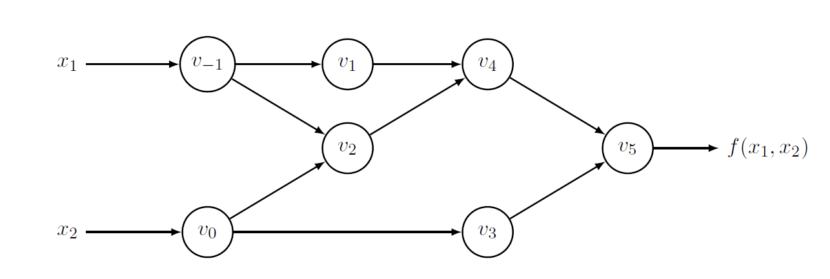
Automatic Differentiation (AD)
Forward mode
evaluation (differentiation) point: (2,5)
computational graph of f

Slide 14
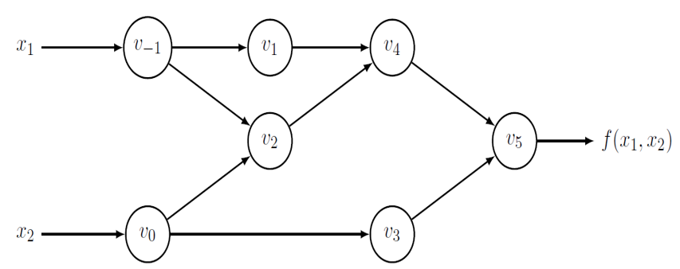
Automatic Differentiation (AD)
Forward mode
evaluation (differentiation) point: (2,5)
log
2
+
*
-
sin
5
a forward traversal of the computational graph (i.e. from left to right) allows us to compute f (2,5)

Slide 15
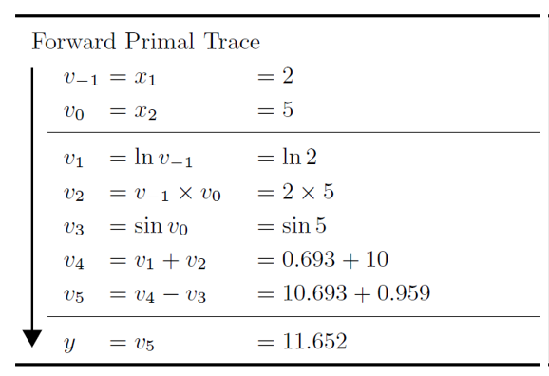
Automatic Differentiation (AD)
Forward mode

Slide 16
Automatic Differentiation (AD)
Forward mode
using the computational graph enriched with the derivatives of the variables ( ) we compute the value of the gradient, by first computing the value of the partial derivative respect to x₁ and then the value of the partial derivative respect to x₂

Slide 17
Automatic Differentiation (AD)
Forward mode
derivatives are computed by recursively applying the chain rule
the chain rule is the formula that expresses the derivative of the composition of two differentiable functions in terms of the derivatives of each function

Slide 18
recap chain rule
remind the chain rule in one-dimension: given
then

Slide 19
recap chain rule
remind the chain rule in two-dimension: given
then

Slide 20
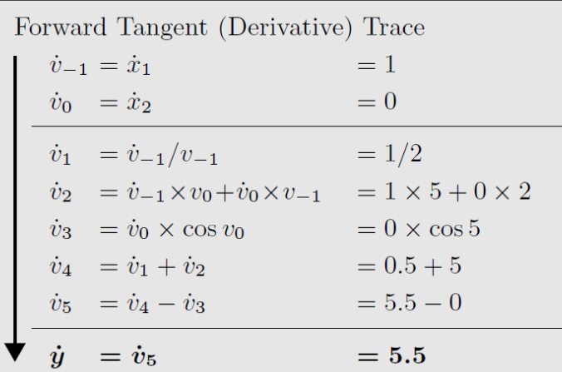
Automatic Differentiation (AD)
Forward mode

Slide 21
Automatic Differentiation (AD)
Forward mode
the choice
implies that we are computing
the choice
implies that we are computing

Slide 22
Automatic Differentiation (AD)
Forward mode

Slide 23
Automatic Differentiation (AD)
Forward mode
we need 2 (forward) traversals of the tangent computational graph to compute the gradient of f,
one for each component of the gradient
with n variables, we need n (forward) traversals to compute the gradient of f

Slide 24
Automatic Differentiation (AD)
Reverse mode
the Reverse mode corresponds to a generalized backpropagation algorithm, in that it propagates derivatives backward from the output y toward the input variables x₁ and x₂.
Reverse mode must be used after the forward traversal of the computational graph

Slide 25
Automatic Differentiation (AD)
Reverse mode
Reverse mode requires to complement each intermediate variable with the so called
adjoint variable
the adjoint variable represents the sensitivity of a considered output with respect to changes in

Slide 26
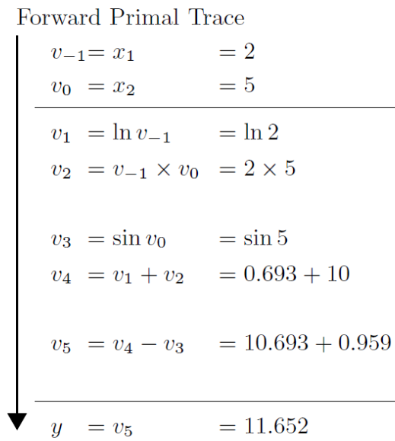
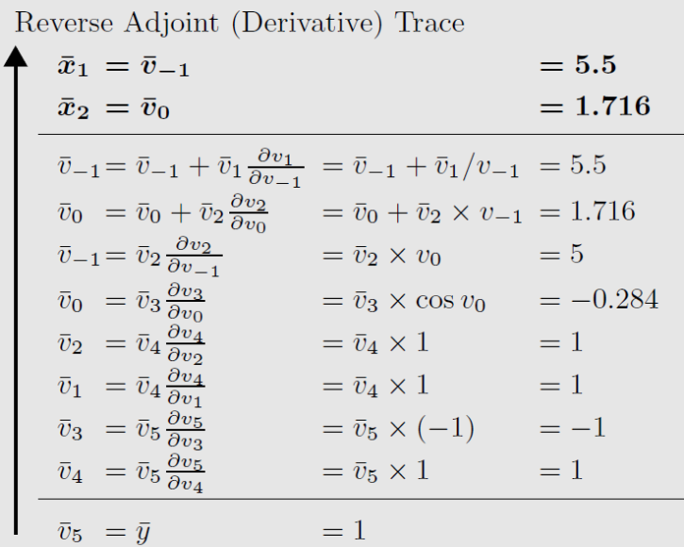
Automatic Differentiation (AD)
Reverse mode

Slide 27
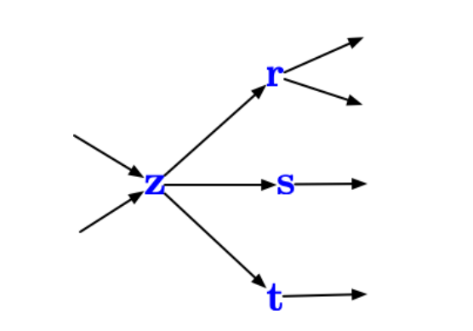
Automatic Differentiation (AD)
Reverse mode
the general rule for is

Slide 28
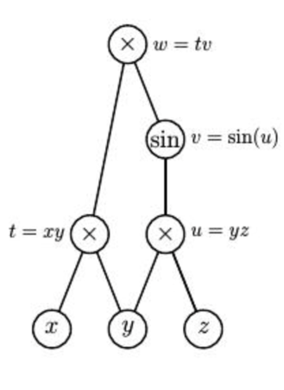
Automatic Differentiation (AD)
one more example
computational graph of f

Slide 29
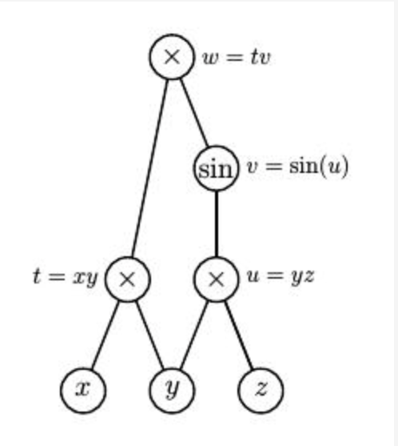
Automatic Differentiation (AD)
one more example
computational graph of f

Slide 30
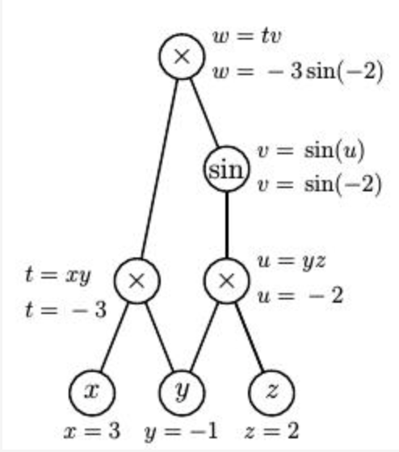
Automatic Differentiation (AD)
Forward mode
Forward pass on
the computational graph
(evaluating f at the
differentiation point (3,-1,2)

Slide 31
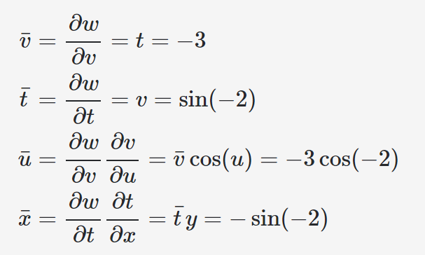
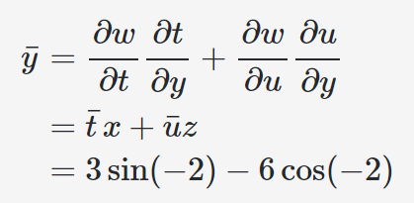
Reverse mode
Backward pass on
the computational graph

Slide 32
Automatic Differentiation (AD)
Reverse mode
note that the Reverse mode needs just
one forward pass and one reverse pass to compute the gradient (all partial derivatives) at a given point,
regardless of the
number of independent variables
Reverse mode is more efficient than Forward mode in computing gradient of functions of several variables

Slide 33
Automatic Differentiation (AD) in Matlab
>> x0=2; y0=5;
>> xdl = dlarray([x0,y0]);
>>[fval,AD_grad]=dlfeval(@simplefg1,xdl)
fval =
1×1 dlarray
11.6521
AD_grad =
1×2 dlarray
5.5000 1.7163
function [f,grad] = simplefg1(x)
f = log(x(1))+x(1)*x(2)-sin(x(2));
grad = dlgradient(f,x);
end

Slide 34
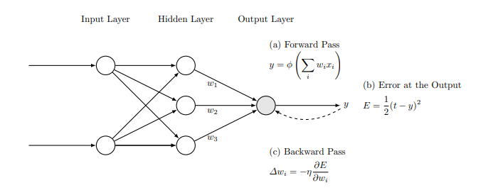
AD in Machine Learning
training of a (deep) neural network
find weights w_{i}
the computational graph is the neural network
activation function (i.e. ReLU)
Loss function
training sample x₁,x₂,t
Gradient Descent, learning rate η update w_{i}

Slide 35
AD in Machine Learning
training of a neural network
Neural network with two linear layers
$$V_{1}^{(1)}$$
x₁
$$v_{}^{(2)}$$
Loss L
x₂
$$V_{2}^{(1)}$$
forward mode
$V_{1}^{(1)}$=$W_{11}^{(1)}x_{1}+W_{12}^{(1)}x_{2}$+ $b_{1}^{(1)}$
$V_{2}^{(1)}$=$W_{21}^{(1)}x_{1}+W_{22}^{(1)}x_{2}$+ $b_{2}^{(1)}$
$v_{}^{(2)}$=$w_{1}^{(2)}V_{1}^{(1)}+w_{2}^{(2)}V_{2}^{(1)}$+ $b_{}^{(2)}$

Slide 36
AD in Machine Learning
training of a neural network
Neural network with two linear layers
$$V_{1}^{(1)}$$
x₁
$$v_{}^{(2)}$$
Loss L
x₂
$$V_{2}^{(1)}$$
forward mode
$V_{}^{(1)}$=$W_{}^{(1)}x+$ $b_{}^{(1)}$
$v_{}^{(2)}$=$w_{}^{\left(2\right)T}V_{}^{(1)}+$ $b_{}^{(2)}$
matrix-vector notation

Slide 37
AD in Machine Learning
training of a neural network
Neural network with two linear layers
$$V_{1}^{(1)}$$
x₁
$$v_{}^{(2)}$$
Loss L
x₂
$$V_{2}^{(1)}$$
$L$= $\frac{1}{\left|T\right|} \sum_{\left|T\right|}{{\left(v^{(2)}−T_{true}\right)}^{2}}$
Training set T

Slide 38
AD in Machine Learning
training of a neural network
Neural network with two linear layers
$$V_{1}^{(1)}$$
x₁
$$v_{}^{(2)}$$
Loss L
x₂
$$V_{2}^{(1)}$$
backward mode
$L$= $\frac{1}{\left|T\right|} \sum_{\left|T\right|}{{\left(v^{(2)}−T_{true}\right)}^{2}}$
this is the gradient of the Loss respect to each individual prediction of the network
$\frac{∂L}{∂v^{(2)}}$= $\frac{2}{\left|T\right|}$ $\left(v^{(2)}−T_{true}\right)$

Slide 39
AD in Machine Learning
training of a neural network
Neural network with two linear layers
$$V_{1}^{(1)}$$
x₁
$$v_{}^{(2)}$$
Loss L
x₂
$$V_{2}^{(1)}$$
backward mode
${\overline{v}}^{(2)}=\frac{∂L}{∂v^{(2)}}$= $\frac{2}{\left|T\right|}$ $\left(v^{(2)}−T_{true}\right)$
${\overline{w}}^{(2)}=\left({\overline{w}}_{1}^{(2)},{\overline{w}}_{2}^{(2)}\right)=\frac{∂L}{∂w^{(2)}}$=$\frac{∂L}{∂v^{(2)}}$ $\frac{∂v^{(2)}}{∂w^{(2)}}$= ${\overline{v}}^{(2)}$ $\frac{∂v^{(2)}}{∂w^{(2)}}$

Slide 40
AD in Machine Learning
training of a neural network
Neural network with two linear layers
$$V_{1}^{(1)}$$
x₁
$$v_{}^{(2)}$$
Loss L
x₂
$$V_{2}^{(1)}$$
backward mode
${\overline{w}}^{(2)}=\left({\overline{w}}_{1}^{(2)},{\overline{w}}_{2}^{(2)}\right)=\frac{∂L}{∂w^{(2)}}$=$\frac{∂L}{∂v^{(2)}}$ $\frac{∂v^{(2)}}{∂w^{(2)}}$= ${\overline{v}}^{(2)}$ $\frac{∂v^{(2)}}{∂w^{(2)}}$
$${\overline{w}}^{(2)}=\left({\overline{w}}_{1}^{(2)},{\overline{w}}_{2}^{(2)}\right)={\overline{v}}^{(2)}V^{(1)}$$
$v_{}^{(2)}$=$w_{}^{\left(2\right)T}V_{}^{(1)}+$ $b_{}^{(2)}$

Slide 41
AD in Machine Learning
training of a neural network
Neural network with two linear layers
$$V_{1}^{(1)}$$
x₁
$$v_{}^{(2)}$$
Loss L
x₂
$$V_{2}^{(1)}$$
backward mode
${\overline{b}}^{(2)}=\frac{∂L}{∂b^{(2)}}$=$\frac{∂L}{∂v^{(2)}}$ $\frac{∂v^{(2)}}{∂b^{(2)}}$= ${\overline{v}}^{(2)}$ $\frac{∂v^{(2)}}{∂b^{(2)}}={\overline{v}}^{(2)}$
$v_{}^{(2)}$=$w_{}^{\left(2\right)T}V_{}^{(1)}+$ $b_{}^{(2)}$

Slide 42
AD in Machine Learning
training of a neural network
Neural network with two linear layers
$$V_{1}^{(1)}$$
x₁
$$v_{}^{(2)}$$
Loss L
x₂
$$V_{2}^{(1)}$$
backward mode
${\overline{V}}^{(1)}=\frac{∂L}{∂V^{(1)}}$= ${\overline{v}}^{(2)}w^{(2)}$
$V_{}^{(1)}$=$W_{}^{(1)}x+$ $b_{}^{(1)}$
${\overline{W}}^{(1)}=\left(\begin{matrix}{\overline{W}}_{11}^{(1)} & {\overline{W}}_{12}^{(1)} \\ {\overline{W}}_{21}^{(1)} & {\overline{W}}_{22}^{(1)}\end{matrix}\right)=\frac{∂L}{∂W^{(1)}}$=$\frac{∂L}{∂V^{(1)}}$ $\frac{∂V^{(1)}}{∂W^{(1)}}$= ${\overline{v}}^{(2)}w^{(2)}x$

Slide 43
AD in Machine Learning
training of a neural network
Neural network with two linear layers
$$V_{1}^{(1)}$$
x₁
$$v_{}^{(2)}$$
Loss L
x₂
$$V_{2}^{(1)}$$
backward mode
${\overline{V}}^{(1)}=\frac{∂L}{∂V^{(1)}}$= ${\overline{v}}^{(2)}w^{(2)}$
$V_{}^{(1)}$=$W_{}^{(1)}x+$ $b_{}^{(1)}$
${\overline{b}}^{(1)}=\left({\overline{b}}_{1}^{(1)},{\overline{b}}_{2}^{(1)}\right)=\frac{∂L}{∂b^{(1)}}$=$\frac{∂L}{∂V^{(1)}}$ $\frac{∂V^{(1)}}{∂b^{(1)}}$= ${\overline{v}}^{(2)}w^{(2)}$

Slide 44
AD in Machine Learning
training of a neural network
Neural network with two linear layers
$$V_{1}^{(1)}$$
x₁
$$v_{}^{(2)}$$
Loss L
x₂
$$V_{2}^{(1)}$$
Parameters Upgrade in backward mode
(GD)
$$w_{new}^{(2)}=w_{old}^{(2)}−α{\overline{w}}^{(2)}$$
$$b_{new}^{(2)}=b_{old}^{(2)}−α{\overline{b}}^{(2)}$$
$$W_{new}^{(1)}=W_{old}^{(1)}−α{\overline{W}}^{(1)}$$
$$b_{new}^{(1)}=b_{old}^{(1)}−α{\overline{b}}^{(1)}$$

