Slide 1
DIGITAL ECONOMY AND DIGITAL SOVEREIGNTY: A DIGITAL EUROPE
https://commission.europa.eu/strategy-and-policy/priorities-2019-2024/europe-fit-digital-age_en
https://commission.europa.eu/strategy-and-policy/priorities-2019-2024/europe-fit-digital-age/shaping-europes-digital-future_en

Slide 2
There is no official definition of the digital economy. However, the European Commission refers to the fact that digitalisation affects all businesses, albeit to varying degrees. It encompasses businesses that sell goods and services via the internet, and digital platforms that connect spare capacity and demand. It notes that there is no single defining feature of new ways of doing business in the digital space and the different aspects are often combined in a single business.

Slide 3
Eurofound defines digitalisation, in research published in May 2018, as follows:
When applied to social systems or organisations, digitalisation refers in a broad way to the transformation brought about by the widespread adoption of digital technologies (robotics, machine learning, sensors, virtual reality and so on). When applied to specific pieces of information, digitisation refers to the process of converting them into a digital form that can be processed by a computer (or vice versa): it can be seen as a driver of digitalisation and encompasses actions performed through technologies, such as sensors, 3D printing or augmented reality and virtual reality.

Slide 4
The digital economy is also related to the concept of ‘Industry 4.0’, widely regarded as the fourth and next phase in the digitalisation of the manufacturing sector. Industry 4.0 is the term given to production processes with fully integrated automated facilities which communicate with one another.
Luciano Floridi: As the boundaries between life online and offline break down, and we become seamlessly connected to each other and surrounded by smart, responsive objects, we are all becoming integrated into an "infosphere".

Slide 5
Digital economy concerns the human beings.
Goal of of Commission: putting human beings at the center of the 4° industrial revolution.
4° industrial revolution: Industry 4.0—also called the Fourth Industrial Revolution or 4IR—is the next phase in the digitization of the manufacturing sector, driven by disruptive trends including the rise of data and connectivity, analytics, human-machine interaction, and improvements in robotics.

Slide 6
Digital transformations in the EU: The Digital Economy and Society Index (DESI)
DESI summarises indicators on Europe’s digital performance and tracks the progress of EU countries
During the COVID-19 pandemic, Member States have been advancing in their digitalisation efforts but still struggle to close the gaps in digital skills, the digital transformation of SMEs, and the roll-out of advanced 5G networks.

Slide 7
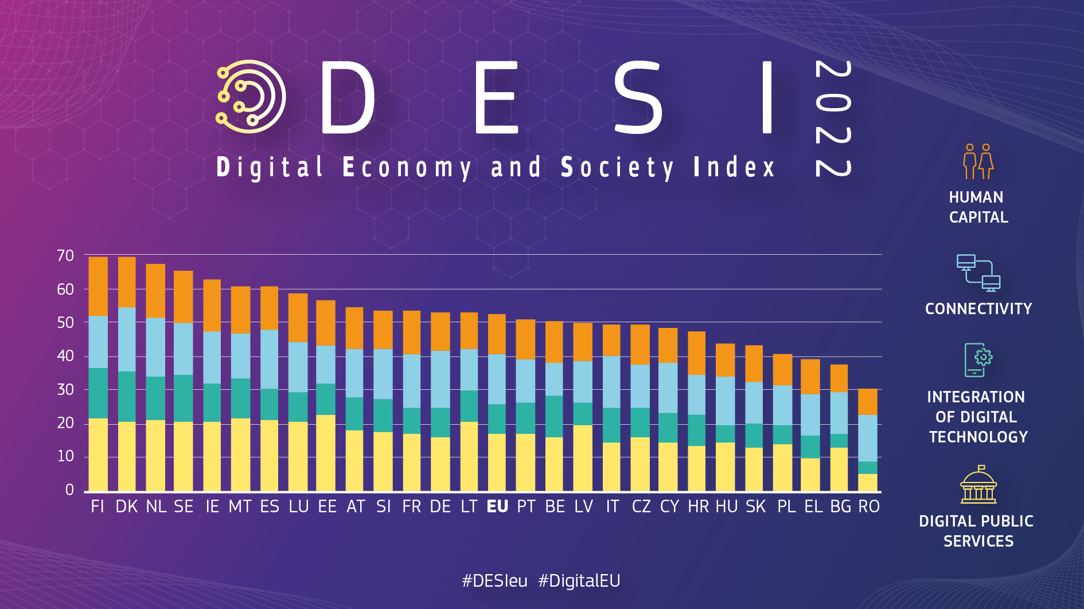

Slide 8
Human capital: The Commission monitors ‘internet user skills’ and ‘advanced skills and development’ across the EU to ensure people are equipped for the digital decade.
Connectivity: The Commission continues to monitor connectivity throughout the EU, measuring both supply and demand of fixed and mobile broadband.
As new technologies emerge, the Commission monitors their integration in businesses and eCommerce, it is based on the state of the data economy among European Union enterprises by mapping the uses and exchanges of data, the sources of data stored and where, the frequency with which data is analysed and, how it contributes to business value.
Digital public services: Egovernment services delivered to the Union citizens

Slide 9
EU DIGITAL ECONOMY: builing a european digital internal market
Concept of internal market: The internal market refers to the single market within the EU's territory.
The aim is to have an area without internal frontiers or regulatory obstacles in which the free movement of goods, persons, services and capital is ensured in accordance with the articles of the Treaties.
1. Free movement of goods (Articles 26 and 28-37 of the Treaty on the Functioning of the European Union (TFEU))
With the creation of the internal market, customs duties and quantitative restrictions were eliminated.
The free movement of goods relies on the principles of mutual recognition of national technical rules, the removal of physical and technical barriers, and standardisation.

Slide 10
2. Free movement of capital (Articles 63 to 66 TFEU)
Restrictions on capital movements and payments, between EU countries as well as between EU countries and with non-EU countries have been prohibited since 2004, as a result of the Maastricht Treaty. However, there are some exceptions that are primarily linked to taxation and public policy considerations.
The free movement of capital contributes to economic growth by enabling capital to be invested efficiently and promotes the use of the euro as an international currency.
3. Freedom of establishment and to provide services (Articles 26, 49 to 62 TFEU)
The freedom of establishment and the freedom to provide services guarantee mobility of businesses and professionals within the EU. The self-employed and professionals or legal persons within the meaning of Article 54 TFEU who are legally operating in one EU country may:
carry out an economic activity in a stable and continuous way in another EU country (freedom of establishment: Article 49 TFEU); and offer and provide their services in other EU countries on a temporary basis while remaining in their country of origin (freedom to provide services: Article 56 TFEU).

Slide 11
4. Free movement of workers (Articles 26 and 45-48 TFEU)
This covers aspects such as the rights of movement and residence for workers, the rights of entry and residence for family members, and it entails the abolition of any discrimination based on nationality as regards employment, remuneration and other conditions of work and employment. Restrictions may apply for the public service.
The European Labour Authority serves as a dedicated agency for the free movement of workers, including posted workers.

Slide 12
Free movement of capitals, services, persons, goods….and DATA
5. Free movement of data :
The EU wants to ensure a free flow of data in Europe, allowing companies and public administrations to store and process non-personal data wherever they choose.
Which data ? NON-PERSONAL data → BIG DATA.
Our economy depends more and more on data: data can create significantly added value to existing services and facilitate entirely new business models. To fully unleash the benefits of the data economy the Commission needs to ensure the free-flow of non-personal data.

Slide 13
The Regulation on a framework for the free flow of non-personal data in the EU (REGULATION 2018/1807) aims at removing obstacles to the free movement of non-personal data between different EU countries and IT systems in Europe.
The Regulation ensures:
Free movement of non-personal data across borders: every organisation should be able to store and process data anywhere in the EU.
The availability of data for regulatory control: public authorities will retain access to data, even when it is located in another EU country or when it is stored or processed in the cloud.

Slide 14
Easier switching between cloud service providers for professional users. The Commission has started facilitating self-regulation in this area, encouraging providers to develop codes of conduct regarding the conditions under which users can move data between cloud service providers and back into their own IT environments.
Full consistency and synergies with the cybersecurity package, and clarification that any security requirements that already apply to businesses storing and processing data will continue to do so when they store or process data across borders in the EU or in the cloud.
NB: The General Data Protection Regulation (GDPR) already provides for the free movement of personal data within the EU. This Regulation will therefore ensure a comprehensive and coherent approach to the free movement of all data in the EU.

Slide 15
BENEFIT OF THE DIGITAL SINGLE MARKET
«CASSICAL» BENEFITS:
Having no regulatory obstacles to free movement means:
EU businesses benefit from:
a large market of over 400 million consumers;
access to many suppliers of goods and services within the single market;
lower costs because of economies of scale and harmonised rules, standards and requirements across the territory.
EU citizens benefit from:
the creation of additional jobs;
lower prices and a wider selection of products and services;
quality and safety, assured by harmonised rules and standards;
the benefits of more innovation, research and development;
the opportunity to live, work, study and do business throughout the EU;
selling goods and moving money without restrictions.

Slide 16
NEW / ADDITIONAL BENEFITS
The EU Digital Single Market: Making the European Union’s single market fit for the digital age requires tearing down unnecessary regulatory barriers and moving from individual national markets to one single EU-wide rulebook.
These steps could contribute €415 billion per year to economic growth, boosting jobs, competition, investment and innovation in the EU.

