Slide 1
Hardware-assisted Security: a Survey
Corso di Sicurezza dei Sistemi
Luigi Romano and Giovanni Mazzeo

Slide 2
Roadmap
Concepts of Hardware-assisted security
Historical Overview
Current Solutions and their Limitations
Physically Unclonable Function (PUF)
Hardware-enabled Trusted Computing
Trusted Platform Module
Trusted Execution Environment
Cryptographic Optimization

Slide 3
Concepts of Hardware-assisted security
Hardware-assisted security does NOT mean hardware security
Hardware security aims at protecting physical device rather than software that is installed on the hardware of a computer system
The term hardware security also refers to the protection of physical systems from harm
Conversely, in hardware-assisted security, features of hardware are used to support software security, such as:
Support for trustworthy computing in which specific hardware in the computing device is considered trusted and applications can be made secure thanks to mechanisms built on top of this hardware.
Support for optimization (e.g., performance) of security functions

Slide 4
Historical Overiew
Over the years, industries proposed a number of hardware-assisted technological solutions to be used in different fields, such as smart card, mobile and computer security

Slide 5
Current Solutions
Physical Unclonable Functions (PUF)
Hardware-enabled Trusted Computing
Trusted Platform Module (or Cryptoprocessor)
Trusted Execution Environment
ARM TrustZone
Intel Software Guard eXtension (SGX)
AMD Memory Encryption Technology
Intel Threat Detection Technology (TDT)
Cryptographic Optimization
Intel AES-NI
External to
CPU
Internal to
CPU

Slide 6
Physically Unclonable Functions (PUF)

Slide 7
Fundamentals of PUF
History → PUF were initially proposed by MIT, even though Philips claimed the property of the idea
Background Concepts → In cryptography, the quality of random numbers directly determines the security strength of the system
That is, the random number generator influences how difficult breaking the system is
Solution → PUF leverages the physical property of hardware devices to extract randomness
At a high level, the PUF device receives challenges from a stimulator (that could be a signal generator) to provide a final response that is a unique hardware fingerprint.
Challenge (C)
Unique
Hardware Fingerprint
Device
PUF
Response (R)

Slide 8
Properties of PUF
Properties of PUF are the following.
Inherently unclonable – a PUF cannot be copied since two device chips of the same type “always” provide different responses
PUF exploits variability in CMOS circuits by taking advantage of imperfections in manufacturing processes that lead to intrinsic and random variations in the physical and electrical characteristics of integrated circuits, such as the metal resistivity and the actual channel lengths of transistors
Infeasible to predict – it is impossible to predict the next response when challenges are sent to the PUF
Tamper-evident – if an attacker wants to perform a physical attack to the PUF, then the resulting fingerprint - and so the keys - will change

Slide 9
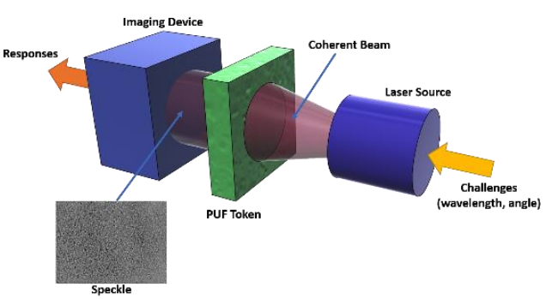
Examples of PUF – 1/2
The physical systems used by the PUF to obtain randomness gave birth to different categories of PUF. For example
Optical PUF – physical mechanism relies on the random interference pattern (speckle) created when a coherent light (laser beam) that propagates through an inhomogeneous material.
Delay (or Arbiter) PUF – exploits the random variations in delays of wires and gates on silicon. Given an input challenge, a condition is set up in the circuit, and two transitions that propagate along different paths are compared to see which comes first. An arbiter, typically implemented as a latch, produces a 1 or a 0, depending on which transition comes first.

Slide 10
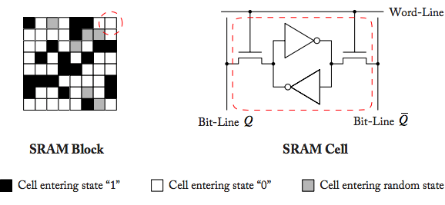
Examples of PUF – 2/2
SRAM PUF – uses static random-access memory (SRAM) to obtain randomness. The challenge to an SRAM PUF is a memory address, while the corresponding PUF response is the content of the uninitialized memory cells at this address.
When an SRAM cell is powered without applying a data signal, the state the cell enters depends on the threshold voltage differences of its transistors. SRAM cells with large threshold voltage differences always enter either the “0” or the “1” state on each power-up.

Slide 11
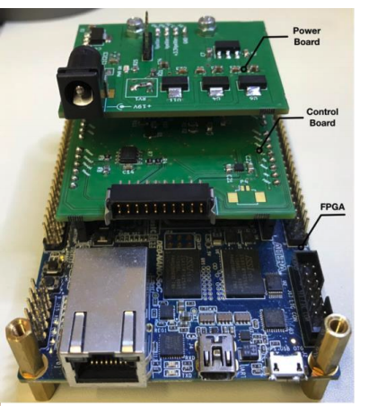
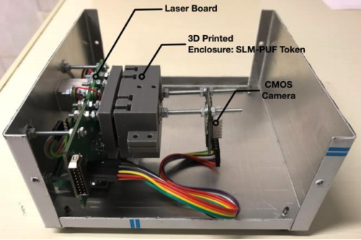
Acquisition Infrastructure of Optical PUF – 1/2
An example of optical PUF acquisition infrastructure is reported here in the following

Slide 12
Acquisition Infrastructure of Optical PUF – 2/2
Power Board: Electronic board containing all the appropriate voltage sources for powering the peripheral electronic circuits
Control Board: Electronic board containing all the appropriate circuitry for controlling and monitoring the PUF opto-electronic components. This includes the laser current source, thermistor current source, signal conditioning circuits for power and temperature monitoring of the laser diode
Laser Board: Electronic board that hosts the laser diode and the peltier module for the diode’s temperature stabilization. The board includes the routing for the control and monitoring of the laser and peltier module.
PUF enclosure: 3D printed enclosure for the PUF token, the SLM and the camera. This module is mounted to the laser board and constitutes the photonic heart of the PUF module.

Slide 13
Use Cases of PUF
Is the PUF actually used or it is only a hardware-assisted security solution belonging to the research world?
Some implementations of PUF, such as Optical PUF, are still only research prototypes
Others have started the process of being used in industrial solutions
For example, the company Maxim Integrated released ChipDNA to be used in the context of the Internet of Things (IoT)
The ChipDNA product uses a SRAM PUF for providing secure keys to IoT devices
https://www.maximintegrated.com/en/design/partners-and-technology/design-technology/chipdna-puf-technology.html

Slide 14
Limitations and Weaknesses of PUF
The first limitation of PUF systems lays in the difficulty of implementing the acquisition infrastructure. It is often costly both in terms of effort and money
Reliability of the PUF with respect to the long term application in devices related to aging, environmental conditions as temperature and others
Attacks to PUF exist and must be taken into account
Modeling Attacks using machine learning
Side-channel Attacks
Invasive Attacks

Slide 15
Hardware-enabled Trusted Computing

Slide 16
The Concept of Trust
What do we mean for Trust?
Trusted systems are those upon whose correct (or predictable) operation we rely.
The idea of trust is somewhat orthogonal to that of security:
Trusted components may be used to build secure systems
Trust on its own does not entail security: merely, predictable behaviour
If a piece of software has been tainted by the introduction of a virus, normal good behaviour can easily turn bad
“An entity can be trusted if it always behaves in the expected manner for the intended purpose”

Slide 17
Trusted Computing
The activities in the context of trust for building secure systems are the result of an industrial consortium born in 1999:
The Trusted Computing Group (TCG)
An initiative started by AMD, HP, IBM, Intel, Microsoft, CISCO, and Wave Systems Corp
The TCG developed and promoted technologies of Trusted Computing, which have been widely adopted and standardized
With Trusted Computing, the computer will consistently behave in expected ways, and that behaviour will be enforced by computer hardware and software
This is achieved by loading the hardware with unique encryption keys inaccessible to the rest of the system

Slide 18
Services of Trusted Computing
Trusted Computing provides confidence in a product, especially if the product’s behaviour isn’t fully-secure or might become insecure
Establish whether an individual product is the intended product, and whether it is doing what it is designed to do, even if that behaviour isn’t secure or becomes insecure because of modification.
Provide controlled access to keys and secrets that depends on the product’s current behaviour
Trusted Computing allows a compromised product to be restored by installing and replacing software

Slide 19
Requirements for Trusted Computing
A mechanism is required to verify (measure) what software is running
Monitoring the boot process
Needs an anchor to start the measurement from a root-of-trust
Nobody should be able to modify or forge these measurements
Some shielded/secure location for the measurements is required
Once measured:
Why should someone else believe this claim?
A mechanism to securely report (attest) the measurement to a 3rd party is needed
A mechanism must be defined to isolate the execution

Slide 20
Key Concepts: Trusted Computing Base
The Trusted Computing Base (TCB) of a computer system is the set of all hardware, firmware, and/or software components that are critical to its security
Bugs or vulnerabilities occurring inside the TCB might jeopardize the security properties of the entire system.
Trusted Computing Base
Trusted Computing Environment
Applications

Slide 21
Key Concepts: Chain of Trust
Trusted computing is based on the concept of chain-of-trust:
A chain-of-trust is established by validating each component of hardware and software from the end entity up to the root-of-trust
It is a concept that comes from PKIs where digital certificates are verified using a chain of trust. In that case, the trust anchor for the digital certificate is the root certification authority (CA)
In TC, the trust anchor usually lays in a piece of HW
It could also be in SW components but then security will be lower

Slide 22
Features of Trusted Computing
Some generally agreed upon features of Trusted Computing are:
Trusted Boot, allows the system to boot into a defined and trusted configuration.
Sealed Storage, allows software to keep cryptographically secure secrets.
Curtained Memory, will provide strong memory isolation; memory that cannot be read by other processes including operating systems and debuggers.
Attestation, allows a trusted device to present reliable evidence to remote parties about the software it is running.
Integrity Measurement, the ability to compute hashes of executable code, configuration data, and other system state information.
Secure I/O thwarts attacks like key-stroke loggers and screen scrapers

Slide 23
Trusted Platform Module (TPM)
History → TPM was conceived by the TCG and standardized in 2009
A TPM is a chip external to CPU, designed to provide hardware-based security-related functions
It is a secure crypto-processor that is designed to:
Carry out cryptographic operations, such as, key or random number generation
Ensure platform integrity by taking and storing security measurements
Perform attestation of software
Store artifacts used for authentication or integrity purposes, such as passwords, certificates, or encryption keys
A TPM acts as trust anchor for the chain-of-trust established during the measurement of software

Slide 24
Trusted Platform Module (TPM)
App 1
App 2
App 3
App 4
SW
OS
HW
Peripherals
CPU
Memory
I/O

Slide 25
Trusted Platform Module (TPM)
App 1
App 2
App 3
App 4
SW
OS
HW
Peripherals
CPU
Memory
I/O
TPM

Slide 26
Trusted Platform Module (TPM)
App 1
App 2
App 3
App 4
SW
OS
HW
Peripherals
CPU
Memory
I/O
TPM
Trusted Boot and Attestation

Slide 27
Trusted Platform Module (TPM)
App 1
App 2
App 3
App 4
SW
OS
HW
Peripherals
CPU
Memory
I/O
TPM
Trusted Boot and Attestation

Slide 28
Implemented TC Features
 | TPM
Trusted Boot | ✓
Sealed Storage | ✓
Curtained Memory
Attestation | ✓
Integrity Measurement | ✓
Secure I/O

Slide 29
Main Components of TPM

Slide 30
The TPM Roots of Trust
The TPM is intended to provide three Roots of Trust
Root of trust for measurement (RTM) a trusted implementation of a hash algorithm, responsible for the first measurement on the platform whether at boot time, or in order to put the platform into a special, trusted state;
Root of trust for storage (RTS) a trusted implementation of a shielded location for one or more secret keys, the storage root key (SRK);
Root of trust for reporting (RTR) a trusted implementation of shielded location to hold a secret key representing a unique platform identity, the Endorsement Key (EK)
Both SRK and EK are 2048-bit RSA public and private key pairs, which are created randomly on the chip at manufacture time. These keys cannot be migrated or removed

Slide 31
Trusted Boot with TPM

Slide 32
Secure Boot vs Trusted Boot
Secure boot:
Boot process is halted when untrusted software is loaded
Only execute code that is signed by the device manufacturer or a certified software vendor
Examples: game consoles, smart phones, TV settop box
Trusted boot:
TPM is passive and only records the boot process
Platform can still load arbitrary software, like with a traditional open platform (e.g., PC)
Enforcement of “good” configurations has to be done separately

Slide 33
Attestation with TPM
Remote attestation: challenge-response protocol

Slide 34
Use Cases of TPM
TPMs have been around for a long time
It was standardized and widely adopted in different industrial contexts, for both embedded and general-purpose systems
For example:

Slide 35
Limitations and Weaknesses of TPM
The TPM is a good solution but…
It is external to the CPU, thus subjected to hardware attacks such as bus sniffing attacks
A TPM can protect against code injection attacks. In that case, in fact, the hash of the binary would change.
It is not able able to protect, instead, against runtime attacks (e.g., code-reuse attacks) where the attacker changes the code available in memory at runtime

Slide 36
Trusted Platform Module (TPM)
Runtime Attacks
App 1
App 2
App 3
App 4
SW
OS
HW
Peripherals
CPU
Memory
I/O
TPM
Hardware Attacks

Slide 37
Trusted Platform Module (TPM)
Runtime Attacks
App 1
App 2
App 3
App 4
SW
OS
HW
Peripherals
CPU
Memory
I/O
TPM
Hardware Attacks

Slide 38
Hardware-assisted Trusted Execution Environment
The concept of TEE can be seen as an extension (an advancement) of the TPM
A TEE is an area on the chipset that works like a TPM, but is not physically isolated from the rest of the chip
A TEE is usually embedded within the CPU, thus ensures higher protection against hardware attacks
A TEE offers a wider set of Trusted Computing features
Notably, it provides an isolated execution area for sensitive code with curtained memory, thus ensures protection against runtime attacks
Most important silicon industry produce their own solution of TEE

Slide 39
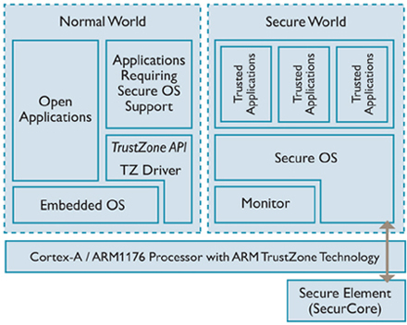
ARM TrustZone
TrustZone is an extension of many ARM’s CPUs
It is based on two different modes of operation (Secure World and Normal World) that allows a process to access protected areas of memory and protected peripherals
So at runtime the CPU can switch its context to a secure world where the execution is protected
The secure Monitor is code that runs in Secure Monitor mode and processes switches to and from the Secure world.
The overall security of the software relies on the security of this code along with the Secure boot code.

Slide 40
ARM TrustZone
App 1
App 2
App 3
App 4
SW
OS
HW
Peripherals
CPU
Memory
I/O

Slide 41
ARM TrustZone
App 1
App 2
Secure World
Trustlet 1
Trustlet 2
SW
OS
OS
HW
Peripherals
CPU
Memory
I/O
TEE

Slide 42
ARM TrustZone
App 1
App 2
Secure World
Trustlet 1
Trustlet 2
SW
OS
OS
HW
Peripherals
CPU
Memory
I/O
TEE

Slide 43
Implemented TC Features
 | TPM | TrustZone
Trusted Boot | ✓ | ✓
Sealed Storage | ✓ | ✓
Curtained Memory |  | ✓
Attestation | ✓ | ✓
Integrity Measurement | ✓ | ✓
Secure I/O |  | ✓

Slide 44
Use Cases of TrustZone
The majority of embedded systems like mobile devices (e.g. smartphone, cars’ ECU) follow the ARM design architecture for their Systems-on-Chip ICs
TrustZone is used in such contexts, or more in general in the Internet of Things (IoT) world. For example:
The trusted application executing in the secure world could be Apple Pay
Or, the Android’s Full-Disk Encryption (FDE) could use keys stored in TrustZone
Or, TrustZone could be used for Digital Rights Management (DRM) licenses. In the case of Netflix, e.g., all video decryption, decoding and rendering occur in the TEE

Slide 45
Limitations and Weaknesses of TrustZone
Ok, TrustZone seems more secure than TPM. But…
App 1
App 2
Secure World
Trustlet 1
Trustlet 2
SW
OS
OS
HW
Peripherals
CPU
Memory
I/O
TEE

Slide 46
Limitations and Weaknesses of TrustZone
Ok, TrustZone seems more secure than TPM. But…
Once an attacker violates a single trusted application,
App 1
App 2
Secure World
Trustlet 1
Trustlet 2
SW
OS
OS
HW
Peripherals
CPU
Memory
I/O
TEE

Slide 47
Limitations and Weaknesses of TrustZone
Ok, TrustZone seems more secure than TPM. But…
Once an attacker violates a single trusted application,
App 1
App 2
Secure World
Trustlet 1
Trustlet 2
SW
OS
OS
HW
Peripherals
CPU
Memory
I/O
TEE

Slide 48
Limitations and Weaknesses of TrustZone
Ok, TrustZone seems more secure than TPM. But…
Once an attacker violates a single trusted application, then everything is compromised!
App 1
App 2
Secure World
Trustlet 1
Trustlet 2
SW
OS
OS
HW
Peripherals
CPU
Memory
I/O
TEE

Slide 49
Limitations and Weaknesses of TrustZone
Ok, TrustZone seems more secure than TPM. But…
Once an attacker violates a single trusted application, then everything is compromised!
App 1
App 2
Secure World
Reflections on trusting TrustZone [BlackHat, 2014]
Attacking your trusted Core
[BlackHat, 2015]
Breaking Android Full Disk Encryption [ProjectZero, 2016]
Trustlet 1
Trustlet 2
SW
OS
OS
HW
Peripherals
CPU
Memory
I/O
TEE

Slide 50
Limitations and Weaknesses of TrustZone
Ok, TrustZone seems more secure than TPM. But…
Once an attacker violates a single trusted application, then everything is compromised!
On the positive side, TrustZone is able to provide Secure I/O
App 1
App 2
Secure World
Reflections on trusting TrustZone [BlackHat, 2014]
Attacking your trusted Core
[BlackHat, 2015]
Breaking Android Full Disk Encryption [ProjectZero, 2016]
Trustlet 1
Trustlet 2
SW
OS
OS
HW
Peripherals
CPU
Memory
I/O
TEE

Slide 51
Intel SGX
Intel SGX is an extension to Intel’s CPU ISA that allows user-level code to allocate private regions of memory, called Secure Enclaves, in applications’ address space
Secure enclaves are address regions protected (with encryption and hashing) from anything outside the enclave, included privileged software.
In SGX, the OS is considered untrusted!
With SGX, the process memory never leaves the CPU package unencrypted
The boundary between trusted and untrusted worlds is defined through the enclave interface which is monitored by the CPU
Code outside/inside the enclave access the trusted/untrusted world through ECALLS/OCALLS

Slide 52
Intel SGX
App 1
App 2
App 3
App 4
SW
OS
HW
Peripherals
CPU
Memory
I/O

Slide 53
Intel SGX
App 1
App 2
App 3
App 4
SW
Enclave1
Enclave2
Enclave3
Enclave4
OS
HW
Peripherals
CPU
Memory
I/O
TEE

Slide 54
Intel SGX
App 1
App 2
App 3
App 4
SW
Enclave1
Enclave2
Enclave3
Enclave4
OS
Peripherals
CPU
Memory
I/O
HW
TEE

Slide 55
Implemented TC Features
 | TPM | TrustZone | SGX
Trusted Boot | ✓ | ✓ | ✓
Sealed Storage | ✓ | ✓ | ✓
Curtained Memory |  | ✓ | ✓
Attestation | ✓ | ✓ | ✓
Integrity Measurement | ✓ | ✓ | ✓
Secure I/O |  | ✓

Slide 56
Use Cases of SGX
Contrary to TrustZone, SGX can be used in General-purpose computers
The threat model of SGX perfectly fits for contexts of Cloud Security where the provider (the company offering the hosting solution) is usually considered untrusted
In this regard, in the last two years, SGX-based solution started gaining ground
For example, Microsoft proposed Azure Confidential Computing, which uses SGX to protect cloud processing
Or even IBM has started to deploy cloud machines where the SGX hardware is available and usable

Slide 57
Limitations and Weaknesses of SGX
The threat model of SGX states that the system is vulnerable to side-channel attacks lower than L2 cache.
L3 cache, instead, are not possible since this is external to the CPU core
In spite of this, once the Spectre/Meltdown attacks reached the front-page news, people started doubting about SGX
App 1
App 2
App 3
App 4
SW
Enclave1
Enclave2
Enclave3
Enclave4
OS
HW
Peripherals
CPU
Memory
I/O
TEE

Slide 58
Limitations and Weaknesses of SGX
The threat model of SGX states that the system is vulnerable to side-channel attacks lower than L2 cache.
L3 cache, instead, are not possible since this is external to the CPU core
In spite of this, once the Spectre/Meltdown attacks reached the front-page news, people started doubting about SGX
App 1
App 2
App 3
App 4
SW
Enclave1
Enclave2
Enclave3
Enclave4
OS
HW
Peripherals
CPU
Memory
I/O
TEE

Slide 59
Limitations and Weaknesses of SGX
The threat model of SGX states that the system is vulnerable to side-channel attacks lower than L2 cache.
L3 cache, instead, are not possible since this is external to the CPU core
In spite of this, once the Spectre/Meltdown attacks reached the front-page news, people started doubting about SGX
App 1
App 2
App 3
App 4
SW
Enclave1
Enclave2
Enclave3
Enclave4
OS
HW
Peripherals
CPU
Memory
I/O
TEE

Slide 60
AMD Memory Encryption Technology
AMD introduces SME, TSME, and SEV:
Secure Memory Encryption (SME) and Transparent Secure Memory Encryption (TSME) protect against the physical access attacks.
Secure Encrypted Virtualization (SEV) protects against system software class of attacks.
SME and TSME encrypt the system memory providing the confidentiality for illegally physical access attempts.
SEV encrypts VM’s memory image with an unique key to the VM providing confidentiality for VM’s memory image and protects against system software class of attacks.

Slide 61
Implemented TC Features
 | TPM | TrustZone | SGX | SEV
Trusted Boot | ✓ | ✓ | ✓ | ✓
Sealed Storage | ✓ | ✓ | ✓
Curtained Memory |  | ✓ | ✓ | ✓
Attestation | ✓ | ✓ | ✓ | ✓
Integrity Measurement | ✓ | ✓ | ✓ | ✓
Secure I/O |  | ✓

