Slide 1
Innovation & Entrepreneurship Session 3
Son Thi Kim LE
University of Littoral Côte d’Opale
France

Slide 2
Course sessions
1. Identify entrepreneurial ideas and opportunities
2. Building a business model and plan
3. Innovation and entrepreneurship
4. Innovation diffusion and Open innovation/Innovation network
5. Protecting intellectual property
6. Innovation management in resource-constrained environment

Slide 3
3. Innovation and entrepreneurship
From invention to innovation
Types of innovation
Innovation and entrepreneurship

Slide 4
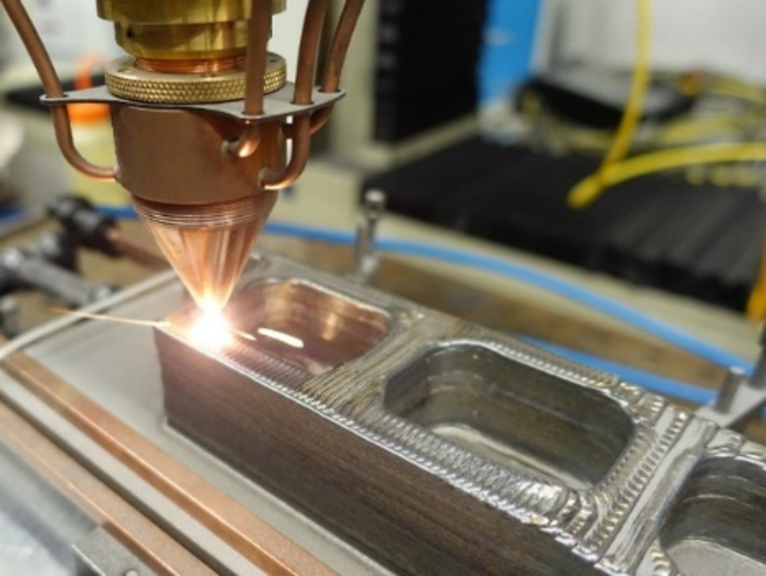
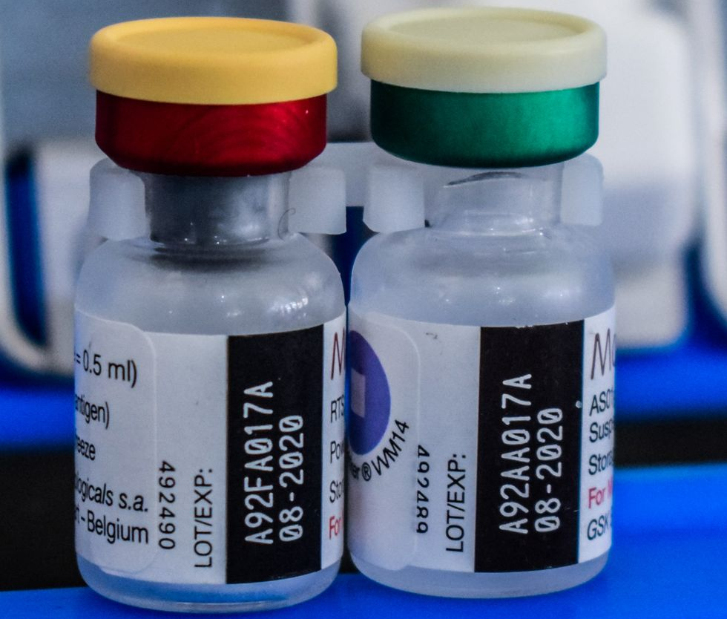
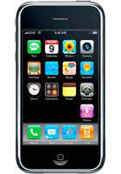
From invention to innovation
The Greatest Inventions from 2000s
1999: Bluetooth Version 1.0 (a future free of needless wires)
2000: PlayStation 2
2001: Wikipedia
2003: The Human Genome Project
2004: Facebook
2005: Google Maps
2007: iPhone
2009: Bitcoin
2010: Siri
2017: Tesla Model 3
2018: Metal 3D Printing
2020: Covid-19 Vaccine
2021: Malaria Vaccine
2022: James Webb Space Telescope

Slide 5
From invention to innovation
Schumpeter (1911) - Theory of Economic Development
Invention is the first occurrence of an idea for a new product or process (first to the world)
Innovation is the first attempt to carry it out in practice within a specific context.
=> Invention and innovation could be closely linked, although in most cases they are separated in time, place and organization.

Slide 6
From invention to innovation
An innovation is more than a new idea or an invention. Innovation means ​“to use a new ​idea or​ method”.
To innovate is to introduce something new to the market, to manipulate existing inventions and turn them into a product or process that is of use in the real world.
An innovation only occurs with the first commercial exploitation involving the new product, process, system or device => commercializing the invention

Slide 7
From invention to innovation
Invention versus Innovation
Invention | Innovation
The occurrence of an idea for a product or process that has never been made before | The implementation of the idea for product or process for the very first time
Invention is coming up with a fresh idea and how it works in theory | Innovation is all about practical implementation of the new idea.
Invention requires scientific skills | Innovation requires a broad set of marketing, technical and strategic skills.
Invention occurs when a new idea strikes a scientist. | Innovation arises when a need realized for a new product or improvisation in the existing product.
Invention is limited to R&D department of the organization | Innovation is spread all over the organization.

Slide 8
b. Types of innovation
Radical innovation is an innovation that has a significant impact on a market and on the economic activity of firms in that market; concerns creation of totally new products or processes and is major technological breakthrough.
Disruptive innovation: is often used to describe any situation that shake up the industry, and former successful incumbents stumble
Incremental innovation concerns an existing product, service, process, organization or method whose performance has been significantly enhanced or upgraded.

Slide 9
b. Types of innovation
Example of Radical innovation
Washing Machine, Personal Computers, Cloud Technology
Examples of Disruptive innovation
Netflix, UBER
Example of Incremental innovation:
1/ Product and service improvements: minor improvements to existing products by learning from customer feedback and leveraging technological advancements
2/ Process improvements: automation reduces costs, saves time, and eliminates human errors (i.e. Toyota Kaizen Methods)
3/ Waste reduction: incremental innovation is the key to solving this global issue.

Slide 10
b. Types of innovation
Classifying innovation by object
Product innovation
Process innovation
Marketing innovation
Organizational innovation

Slide 11
b. Types of innovation
Product innovation: a new or improved good or service that differs significantly from the firm’s previous goods or services and that has been introduced on the market”.
New products/services: solve an existing problem in a new and exciting way or solve a completely new problem.
Improved products/services: Add more functionality to the product or make the functionality work better, or significant improvements to one or more characteristics or performance specifications, such as quality, technical specifications, user friendliness or usability.

Slide 12
b. Types of innovation
Process innovation: a new or significantly improved way of doing things in a business that typically increases production levels and decreases costs.
Changes in the equipment and technology used in manufacturing (including the software used in product design and development)
Improvement in the tools, techniques, and software solutions used to help in supply chain and delivery system
Changes in the tools used to sell and maintain goods and products
Methods used for accounting and customer service.
Example of Process innovation: An assembly line of Henry Ford, Tesla’ s Gigafactory, AliExpress, Amazon book store, eBay.

Slide 13
b. Types of innovation
Marketing innovation: A new marketing method involving significant changes in product packaging, product placement, product promotion or pricing.
Ways of acquiring new customers have evolved, of advertising can be innovative. With the creation of social media, for example, lots of brands innovated by advertising on those platforms instead of newspapers and television.
Organizational innovation: A new organizational method in business practices, workplace organization or external relations.
Organizational concern structural changes and practices that improve productivity, services, products, and processes.

Slide 14
c. Innovation and entrepreneurship
Entrepreneur and innovation
An entrepreneur is someone who is willing and able to transform an invention into an innovation.
Innovation and Entrepreneurship: “Innovation is the specific tool of entrepreneurs … Entrepreneurs need to search purposefully for the sources of innovation, the changes and their symptoms that indicate opportunities for successful innovation. And they need to know and to apply the principles of successful innovation” (Drucker, 1985, p. 19).
The role of entrepreneur in innovation: ready to take risks that result from the diffusion of new products or services, the opening of new markets, the implementation of new organizations or the successful exploitation of a new source of raw material.

Slide 15
c. Innovation and entrepreneurship
Entrepreneurship = Creativity + Innovation
Creativity is the ability to develop new ideas and to discover new ways of looking at problems and opportunities.
Innovation is the ability to apply creative solutions to those problems and opportunities in order to enhance people’s lives or to enrich society.
Entrepreneurship is the result of a process that apply both creativity and innovation to capitalize on marketplace opportunities.
Entrepreneurs are those who marry their creative ideas with the purposeful action and structure of a business.

Slide 16
c. Innovation and entrepreneurship
The potential resources of entrepreneurs
Source: Boutillier & Uzunidis, 2011
Resources | Main features
Knowledge | Tacit knowledge acquired within the family framework Scientific and technical knowledge acquired during education process at school Knowledge acquired through relationships with others (family, professional activities, etc.)
Financial resources | Own savings Affective contributions: parents; relatives, etc. Bank credit Institutional financial aid (ex: direct aid of government) Financial contribution from other entrepreneurs
Social relations | Informal relationships (family, friends, neighbourhood, colleagues, etc) Formal relationships (Governments, bank, different enterprises, research center, etc.)

Slide 17
Thank you for your attention
Don’t hesitate to contact me
if you have any question or you need further information
Son Thi Kim Le
ISI/Lab RII and ISCID-CO (ULCO)
Sontk.le@univ-littoral.fr

