Slide 1
MASTER MEIM 2021-2022
DIGITAL TECH
High Performance Computing
Lesson 1
Prof. Giulio Giunta
Prof. of Scientific Computing, Università degli Studi di Napoli Parthenope

Slide 2
Organization of the 60 hours of the HPC module of the Digital Tech course
 | Ore 9:00-11:00 | Ore 11:00-13:00 | Ore 14:00-16:00 | Ore 16:00-18:00
04-7 | GIUNTA-1 | GIUNTA-2 | MARCELLINO-1 | MARCELLINO-2
05-7 | GIUNTA-3 | GIUNTA-4 | MARCELLINO-3 | MARCELLINO-4
07-7 | MARCELLINO-5 | MARCELLINO-6 | GALLETTI-1 | GALLETTI-2
08-7 | MARINO-1 | MARINO-2 | GALLETTI-3 | GALLETTI-4
12-7 | MONTELLA-1 | MONTELLA-2 | MARINO-3 | MARINO-4
14-7 | MARATEA-1 | MARATEA-2 | MONTELLA-3 | MONTELLA-4
15-7 | MONTELLA-5 | MONTELLA-6
20-7 | CONCLUSION-1 | CONCLUSION-2 | TEST-1 | TEST-2

Slide 3
Organization of the 60 hours of the HPC module of the Digital Tech course
DIGITAL TECH
CLOUD COMPUTING
HIGH PERFORMANCE COMPUTING
provide information and insights on the two enabling technologies of the current development of IT in society and companies

Slide 4
Organization of the 60 hours of the HPC module of the Digital Tech course
GIUNTA-1 Introducing the HPC module – Computational thinking
GIUNTA-2 Algorithms and complexity – Can we always design an algorithm to solve any problem
GIUNTA-3 Today’s Supercomputers- Impact of HPC on society
GIUNTA-4 Current HPC projects - Exascale computing infrastructure: a perspective
MARCELLINO-1 Moore’s law – The need for distributed and novel
architectures
MARCELLINO-2 A survey of HPC architectures
MARCELLINO-3 Thinking parallel - Parallel and distributed software
design: applications
MARCELLINO-4 Parallel and distributed software performance –
Performance measures
MARCELLINO-5 HPC tools and libraries
MARCELLINO-6 Classroom exercise (using Python and Jupyter
notebooks)
 | Ore 9:00-11:00 | Ore 11:00-13:00 | Ore 14:00-16:00 | Ore 16:00-18:00
04-7 | GIUNTA-1 | GIUNTA-2 | MARCELLINO-1 | MARCELLINO-2
05-7 | GIUNTA-3 | GIUNTA-4 | MARCELLINO-3 | MARCELLINO-4
07-7 | MARCELLINO-5 | MARCELLINO-6 | GALLETTI-1 | GALLETTI-2
08-7 | MARINO-1 | MARINO-2 | GALLETTI-3 | GALLETTI-4
12-7 | MONTELLA-1 | MONTELLA-2 | MARINO-3 | MARINO-4
14-7 | MARATEA-1 | MARATEA-2 | MONTELLA-3 | MONTELLA-4
15-7 | MONTELLA-5 | MONTELLA-6
20-7 | CONCLUSION-1 | CONCLUSION-2 | TEST-1 | TEST-2

Slide 5
Organization of the 60 hours of the HPC module of the Digital Tech course
 | Ore 9:00-11:00 | Ore 11:00-13:00 | Ore 14:00-16:00 | Ore 16:00-18:00
04-7 | GIUNTA-1 | GIUNTA-2 | MARCELLINO-1 | MARCELLINO-2
05-7 | GIUNTA-3 | GIUNTA-4 | MARCELLINO-3 | MARCELLINO-4
07-7 | MARCELLINO-5 | MARCELLINO-6 | GALLETTI-1 | GALLETTI-2
08-7 | MARINO-1 | MARINO-2 | GALLETTI-3 | GALLETTI-4
12-7 | MONTELLA-1 | MONTELLA-2 | MARINO-3 | MARINO-4
14-7 | MARATEA-1 | MARATEA-2 | MONTELLA-3 | MONTELLA-4
15-7 | MONTELLA-5 | MONTELLA-6
20-7 | CONCLUSION-1 | CONCLUSION-2 | TEST-1 | TEST-2
MONTELLA-1 Case study: HPC on the cloud - AWS
MONTELLA-2 Case study: HPC on the cloud - AWS
MONTELLA-3 Case study: HPC for environmental forecasting
MONTELLA-4 Case study: HPC for environmental forecasting
MONTELLA-5 Case study: developing a weather forecasting app
MONTELLA-6 Case study: developing a weather forecasting app
MARATEA-1 HPC, Cloud and big data
MARATEA-2 HPC, Cloud and big data

Slide 6
Organization of the 60 hours of the HPC module of the Digital Tech course
GALLETTI-1 Basic scientific computing tools
GALLETTI-2 Basic scientific computing tools
GALLETTI-3 Basics of stochastic modeling
GALLETTI-4 Basics of stochastic modeling
MARINO-1 Case study: HPC for Portfolio Management
MARINO-2 Case study: HPC for Fraud Detection
MARINO-3 Case study: HPC for Risk Management
MARINO-4 Case study: HPC for Trading
CONCLUSION-1 Concluding remarks and discussion
CONCLUSION-2 Concluding remarks and discussion
TEST-1 Final test Digital Tech
TEST-2 Final test Digital Tech
 | Ore 9:00-11:00 | Ore 11:00-13:00 | Ore 14:00-16:00 | Ore 16:00-18:00
04-7 | GIUNTA-1 | GIUNTA-2 | MARCELLINO-1 | MARCELLINO-2
05-7 | GIUNTA-3 | GIUNTA-4 | MARCELLINO-3 | MARCELLINO-4
07-7 | MARCELLINO-5 | MARCELLINO-6 | GALLETTI-1 | GALLETTI-2
08-7 | MARINO-1 | MARINO-2 | GALLETTI-3 | GALLETTI-4
12-7 | MONTELLA-1 | MONTELLA-2 | MARINO-3 | MARINO-4
14-7 | MARATEA-1 | MARATEA-2 | MONTELLA-3 | MONTELLA-4
15-7 | MONTELLA-5 | MONTELLA-6
20-7 | CONCLUSION-1 | CONCLUSION-2 | TEST-1 | TEST-2

Slide 7
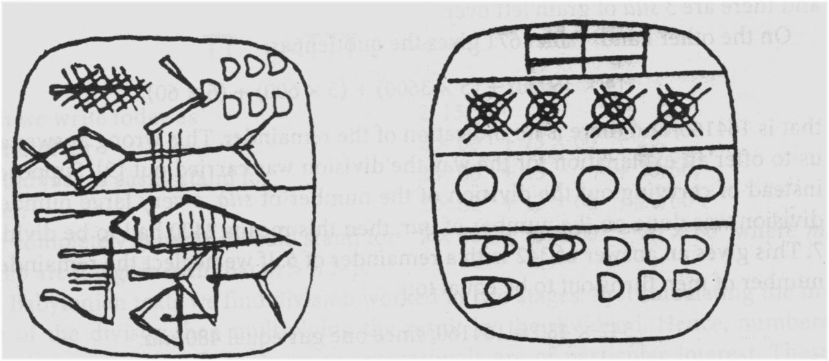
Algorithms are old stuff
algorithm for dividing the grain of a barn among several individuals:
input: capacity of granary C, predetermined part per person P
output: number N of people who can receive the portion of wheat: N = C/P
Sumerian tablet, Euphrates valley, 2500 B.C.

Slide 8
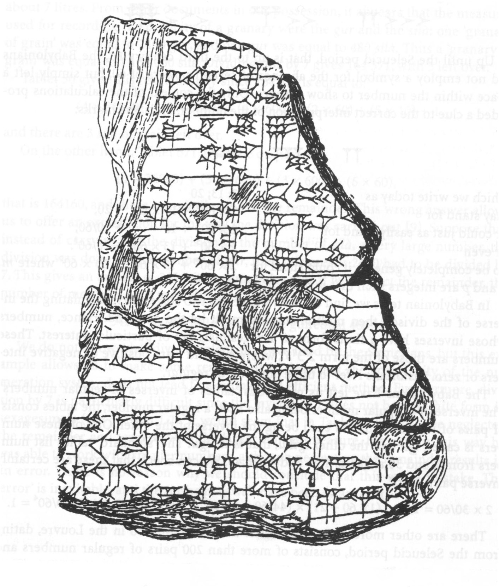
Algorithms are old stuff
algorithm for dividing the grain of a barn among several individuals:
dividend / divisor
Step 1) calculating the inverse of the divisor
Step 2) multiplication by the dividend
Babylonian tablet, 1800 B.C.

Slide 9
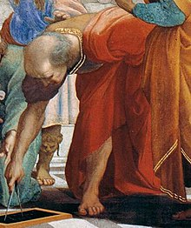
Algorithms are old stuff
A more complex algorithm: Euclid’s algorithm for the greatest common divisor
def gcd(m,n):
if m < n:
(m,n) = (n,m)
r = m
while r != 0:
r = m % n
(m, n) = (n, r)
return n
Euclid, detail of the fresco The School of Athens, Raphael 1510

Slide 10
Algorithms are old stuff
A more complex algorithm: Euclid’s algorithm for the greatest common divisor
def gcd(m,n):
if m < n:
(m,n) = (n,m)
r = m % n
if r == 0:
return n
else:
return (gcd(n, r))
Euclid, detail of the fresco The School of Athens, Raphael 1510
recursive version of Euclid’s algorithm

Slide 11
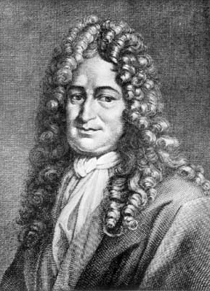
Executing Algorithms
«It is not worthy of excellent men to waste hours as slaves in the manual activity of calculating, which could certainly be entrusted to a machine»
Gottfried von Leibniz
(Leipzig 1646 -1716)

Slide 12
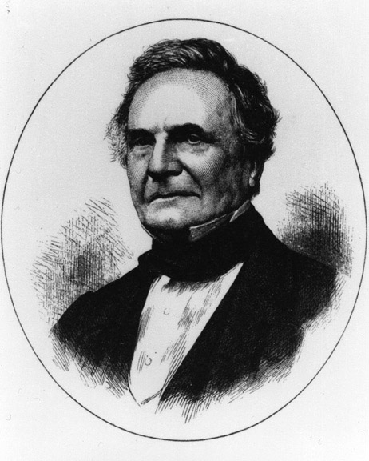
Executing Algorithms
Charles Babbage (London 1791-1871)
Difference Engine
Analytical Engine

Slide 13
Executing Algorithms
a politician asks Babbage :
Pray, Mr. Babbage, if you put into the machine wrong figures, will the right answers come out
Babbage's answer :
I am not able to rightly apprehend
the kind of confusion of ideas that could provoke such a question !
Charles Babbage (London 1791-1871)
Charles Babbage Institute
Center for History of Information Technology
http://www.cbi.umn.edu/
Virginia Tech, USA
History of computing and virtual museum
http://ei.cs.vt.edu/~history

Slide 14
Executing Algorithms
It is not necessary to have an infinite number of different machines available to perform different tasks. It is enough to have only one. The problems of producing various machines for different tasks turn into desk work, which consists of programming the universal machine to do those tasks. (A. Turing, 1940)
The machine must calculate, then it must contain an arithmetic central, which constitutes the first specific module.
The logical control of the machine, that is, the appropriate sequential frequency of its operations can be carried out by a central control module.
The machine must perform long sequences of operations, then it must have a considerable memory, which constitutes the third specific module.
The machine must also maintain an input - output contact with the outside.
The machine must have components to transfer information between the various modules.(J. Von Neumann, I Draft, 1945)
John von Neumann
(Budapest 1903 - Washington 1957)
Alan Turing
(London 1912 –
Manchester 1954

Slide 15
Executing Algorithms
ENIAC, the first electronic calculator 1944-48
the term Computer indicated the operators

Slide 16
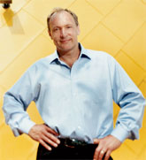
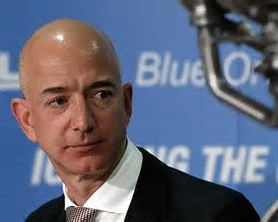
Executing Algorithms and more
Steve Jobs e Steve Wozniack
1977 – the pc is born (Apple)
Tim Berners-Lee
1980 – the web is born
Larry Page e Sergey Brin
1998 – Google is born
Jeff Bezos
2003 – Amazon is born
Mark Zuckerberg
2004 – Facebook is born

Slide 17
lines of technological development
miniaturization
connectivity
more computing power
greater storage capacity
easy access to computing power and big data availability

Slide 18
Some basic terminology
G (iga) =10⁹ T (era) =10¹²
P (eta) =10¹⁵ E (xa) =10¹⁸
Z (etta) = 10²¹ Y (otta) =10²⁴
Tbyte (Terabyte) =10¹² byte
Pflops (Petaflops) =10¹⁵ floating-point operations per second
Eops (Exaops) =10¹⁸ operations per second

Slide 19
How big are big numbers ?
how big is number 10²⁰ ?
www.wolframalpha.com
number of people who have ever lived on Earth
1.085x10¹¹ (people)
[as estimate for the year 2017 by the Population Reference Bureau, which assumes homo sapiens appeared about 50,000 B.C.]

Slide 20
How big are big numbers ?
how big is number 10²⁰ ?
hypothesis: average life of 60 years convert 60 years to seconds
1.892 x10⁹ (seconds)
hypotesis: about half of life spent talking, with a rapidity of 5 characters per second. Then, all humans who have lived on Earth have uttered altogether
about 5x10²⁰ characters; that is 500 Exabytes allow you to memorize all the words spoken by mankind

Slide 21
How good is an algorithm ?
efficiency of an algorithm
time and memory of a computer are computing resources
the performance evaluation of a program is the quantification of the use of the computing resources necessary for its execution

Slide 22
How good is an algorithm ?
the total number of operations and data of an algorithm is proportional to the time and memory required for the execution of the program that implements the algorithm on a specific computer
computational complexity of an algorithm
determine the amount of resources for the execution of an algorithm

Slide 23
How good is an algorithm ?
computational complexity of an algorithm
impact
impact
programming language
computer architecture
performance of the program (software)
that implements the algorithm

Slide 24
How good is an algorithm ?
the total number of operations to be executed by an algorithm depends on the number of input data
number of input data
=
computational dimension of the (instance of the) problem
when the computational dimension of a problem grows,
how do the number of operations (execution time) and the number of data (memory) of the algorithm change ?

Slide 25
How good is an algorithm ?
Computational Complexity Theory investigates issues related to the amount of resources required for the execution of algorithms and the inherent difficulty of providing efficient algorithms to solve specific problems
time complexity of an algorithm
space complexity of an algorithm
inherent difficulty of a problem
to classify
algorithms and problems in complexity classes

Slide 26
How good is an algorithm ?
time complexity of an algorithm
identify the computational dimension of the problem
identify the dominant operation (or dominant operations) of the algorithm
the time complexity function T(n)
of an algorithm is a function that expresses the number of dominant operations depending on the computational dimension n of the problem

Slide 27
How good is an algorithm ?
space complexity of an algorithm
identify the computational dimension of the problem
the space complexity function S (n) of an algorithm is the function that expresses the total size of the data structures used to store input, local and output data, depending on the computational dimension n of the problem

Slide 28
How good is an algorithm ?
time and space complexity of an algorithm
may also depend on
input data values
worst case
time complexity and space complexity

Slide 29
Time complexity of algorithms
for i in range (n):
q dominant operations
time complexity T(n) = qn
that is
T(n) is proportional to n
LINEAR
time complexity
for i in range(n):
q dominant operations
for j in range (n):
q dominant operations
time complexity T(n) = 2qn
that is
T(n) is proportional to 2n
(proportional to n)

Slide 30
Time complexity of algorithms
time complexity
T(n) = q n²
that is
T(n) is proportional to n²
for i in range (n):
for j in range (n): q dominant operations
QUADRATIC
time complexity
time complexity
T(n) = q(1+2+3+…+n)
= qn(n+1)/2
that is
T(n) is proportional to n²
for i in range (n):
for j in range (i,n):
q dominant operations

Slide 31
Time complexity of algorithms
for i in range (n):
for j in range (n):
for k in range (n):
q dominant operations
time complexity T(n) = q n³
that is
T(n) is proportional to n³
CUBIC
time complexity

Slide 32
Time complexity of algorithms
i = 0
while 2**i < n:
i = i+1
q dominant operations
time complexity T(n) = qlog₂n
that is
T(n) is proportional to log₂n
LOGARITHMIC
time complexity

Slide 33
Time complexity of algorithms
how many times can you divide an array of size n in half?
n=8
LOGARITHMIC
time complexity
n power of 2: log₂(n) times
in general: smallest integer greater than log₂(n) times

Slide 34
Time complexity of algorithms
algorithms that carry out log₂(n) steps and at each step execute n dominant operations
n =8
time complexity T(n) = n log₂n
that is
T(n) is proportional to n log₂n
LIN-LOG
time complexity
n power of 2: n log₂(n) operations

Slide 35
Time complexity of algorithms
information on the time complexity of an algorithm can be obtained experimentally, by executing a program that implements the algorithm
run the program to solve the problem of dimensione n, and then 2n,4n,8n,16n
and finally analyze the execution times
execution
time
(sec)
increasing factor of time
execution
(current / previous)
n

Slide 36
Time complexity of algorithms
execution
time
(sec)
increasing factor of time
execution
(current / previous)
n
1000
0.0201
2000
0.0408
2.004
4000
0.0793
1.967
8000
0.1611
2.031
16000
0.3182
1.975

Slide 37
Time complexity of algorithms
increasing factor almost constant and approximately equal to 2
if you double the dimension
the execution time doubles
time complexity T(n) of the algorithm is proportional to n

Slide 38
Time complexity of algorithms
if the time complexity T(n) of the algorithm is proportional to n
then:
and it must hold that:

Slide 39
Time complexity of algorithms
if the time complexity T(n) of the algorithm is proportional to n²
then:
and it must hold that:

Slide 40
Time complexity of algorithms
if the time complexity T(n) of the algorithm is proportional to n³
then:
and it must hold that:

Slide 41
Time complexity of algorithms
increasing factor of time
execution, doubling the
computational dimension
presumable form of time complexity
time complexity proportional to a POWER of n
2
proportional to n
4
proportional to n²
POLYNOMIAL complexity
8
proportional to n³
16
proportional to n⁴

Slide 42
Asymptotic time complexity of algorithms
Let f (n) and g(n) be two non negative and non decreasing functions, then
f is of the order of g
if there are two positive constants c and N₀ such that:

Slide 43
Asymptotic time complexity of algorithms
the curve f (n) stays below (or coincides) the curve cg(n), starting from N₀
cg(n)
f(n)
N₀
n

Slide 44
Asymptotic time complexity of algorithms
Exercise: if
that is, f(n) is a polynomial of degree p then:
Exercise: if
f(n) = 2n² + 3n + 5
then:

Slide 45
Asymptotic time complexity of algorithms
Exercise: give a function f (n) such that
f (n) = O(1)
Exercise: yes or no:
n = O(n²)

Slide 46
Complexity classes
T(n) =
constant
T(n) =
logarithmic
T(n) =
linear
T(n) =
lin-log
T(n) =
quadratic
T(n) =
polynomial of degree k
T(n) =
exponential
T(n) =
factorial

Slide 47
Can we always design an algorithm to solve any problem?
complexity 1 sec 1 minute 1 hour
10⁸ 6⋅10⁹ 3.6⋅10¹¹
≈4⋅10⁶ ≈2⋅10⁸ ≈1⋅10¹⁰
10⁴ 77459 6⋅10⁵
26 32 38
11 12 14
dimensions of problems that can be solved,
with a 100 Mops/sec computer
in WolframAlpha: solve 10^(-8)*x^2=60

Slide 48
Can we always design an algorithm to solve any problem?
complexity 1 sec 1 minute 1 hour
10¹² 6⋅10¹³ 3.6⋅10¹⁵
2.5 ⋅10¹⁰ ≈1.4 ⋅10¹² ≈ 7.5⋅10¹³
10⁶ ≈7.7⋅10⁶ 6⋅10⁷
35 45 51
14 16 17
dimensions of problems that can be solved,
with a 1000000 Mops/sec computer
in WolframAlpha: solve 10^(-12)*2^x=60

Slide 49
Can we always design an algorithm to solve any problem?
algorithms that can be used for effective problem solving
polynomial time complexity algorithms
exponential/factorial time complexity algorithms
cannot be used
in any practical problem solving

Slide 50
Can we always design an algorithm to solve any problem?
exponential/factorial time complexity algorithms cannot be used in any practical problem solving
algorithm of factorial time complexity,
computer which executes 1 operazione in 10⁻¹² sec,
problem of computational dimensione 100
in WolframAlpha:
10^(-12)*factorial(100)/(86400*365)
total execution time : 10¹³⁸ years

Slide 51
Are there problems solved only by exponential/factorial time complexity algorithms ?
TSP, travelling salesman problem
city
road
given a set of cities and travel costs, from any city to any other city, determine the cheapest route that allows you to visit each city exactly once and then return to the city of departure

Slide 52
Are there problems solved only by exponential/factorial time complexity algorithms ?
TSP, travelling salesman problem
city
road
The only known algorithm that solves this problem is a brute force algorithm that computes all possible routes and determine the cheapest one
The number of possible routes is equal to the number of the permutations of n cities

Slide 53
Algorithms ARE technology
problem of computational dimension n=10⁷
algorithm of
quadratic complexity
algorithm of
lin-log complexity
computer power
10000 Mops/sec
100 Mops/sec
(10⁷)² operations
10⁷ ⋅ log₂ 10⁷
execution time
10¹⁰ operations/sec
10⁸ operationis/sec
=10⁴ sec
= 2 sec

Slide 54
MASTER MEIM 2021-2022
High Performance Computing
……. to be continued

