Slide 1
Innovation & Entrepreneurship Session 6
Son Thi Kim LE
University of Littoral Côte d’Opale
France

Slide 2
Course sessions
1. Identify entrepreneurial ideas and opportunities
2. Building a business model and plan
3. Innovation and entrepreneurship
4. Innovation diffusion and Open innovation/Innovation network
5. Protecting intellectual property
6. Innovation management in resource-constrained environment

Slide 3
6. Innovation management in resource-constrained environment
Resource-constrained environment – BOP markets
Innovation at the BOP
Bricolage

Slide 4
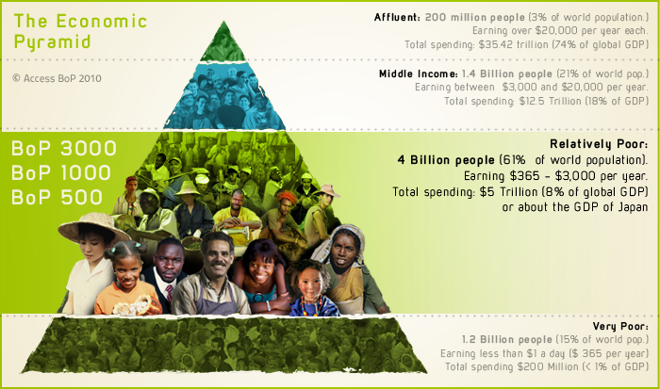
a. Resource-constrained environment – BOP markets
Resource-constrained environment – BOP markets

Slide 5
a. Resource-constrained environment – BOP markets
Bottom of the pyramid (BOP) context
A majority of this BOP population resides in emerging markets
Need products at a very low price, or price is decreased drastically compared to similar offers in a developed market
Need re-design products which can be well adapted with the living condition at BOP context

Slide 6
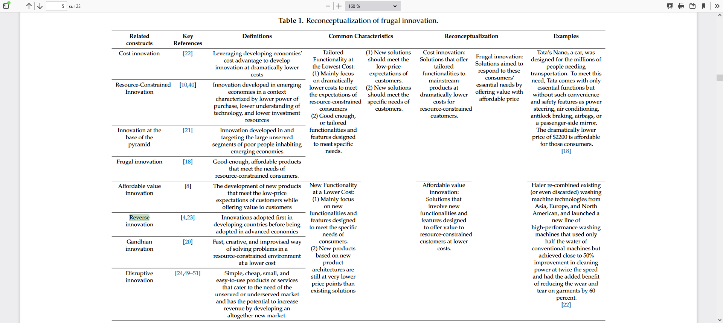
b. Innovation at the BOP

Slide 7
b. Innovation at the BOP
Resource-constrained innovation
a. Cost innovation
b. Good-enough innovation
c. Frugal innovation
d. Reverse innovation

Slide 8
b. Innovation at the BOP
Cost innovations: solutions that offer similar functionalities to Western products at lower costs for resource-constrained customers through 1) process innovations largely grounded in cost advantages enabled by low labor costs, local sourcing, standardized components, and cost-effective raw material sourcing.
Good-enough innovations: solutions that include functionalities and features designed to meet a range of resource constraints beyond capital constraints.
Same point: Both cost innovations and good-enough innovations achieve low price points by taking advantage of local cost advantages combined with better local sourcing conditions.
Different point: in addition to cost innovations, good-enough innovations are adapted or re-engineered to fit the specific use requirements of the low-income market.

Slide 9
b. Innovation at the BOP
Frugal innovations:
“Frugal innovation is a design innovation process in which the needs and the circumstances of citizens in the developing world are put first in order to develop appropriate, adaptable, affordable, and accessible services and products for emerging markets”.
Frugal innovation is “not just a matter of exploiting cheap labour (although cheap labour helps), it is a matter of redesigning products and processes to cut out unnecessary costs”.
=> Frugal innovation is implemented to improve the standard of living for the poor.
=> However, frugal innovation presents an opportunity in developed economies

Slide 10
b. Innovation at the BOP
Frugal innovation radically redesigns products and services to make them much cheaper for the emerging middle class – and then re-exports them to the West.
Reverse innovation: developing and selling new products in emerging markets as a first step and then modifying these products for sale in developed countries
Comparing with cost, good-enough, and frugal innovation, reverse innovation refers to a market rather than a product concept.
Reverse innovations are cost, good-enough, or frugal innovations that find a market among customers outside of the emerging markets at which they were originally targeted

Slide 11
c. Bricolage
Bricolage: ‘Necessity is the mother of invention’
The concept of bricolage - Lévi-Strauss (1967): ‘Bricolage is often described as making do with ‘whatever is at hand’ (Lévi-Strauss, 1967: 17).
The underlying logic is that resource-scarce conditions might encourage—or even urge—people to explore and ‘make do’ with existing resources in novel ways.
Entrepreneurial bricolage: “as making do by applying combinations of the resources at hand to new problems and opportunities” (Baker & Nelson, 2005, p.333)
Entrepreneurial bricolage consists of three key elements:
(a) using resources at hand,
(b) recombining the resources for new purposes and
(c) making do to provide appropriate solutions.

Slide 12
Thank you for your attention
Don’t hesitate to contact me
if you have any question or you need further information
Son Thi Kim Le
ISI/Lab RII and ISCID-CO (ULCO)
Sontk.le@univ-littoral.fr

