Slide 1
MASTER MEIM 2021-2022
DIGITAL TECH
High Performance Computing
Lesson 2
Prof. Giulio Giunta
Prof. of Scientific Computing, Università degli Studi di Napoli Parthenope

Slide 2
Do we really need very powerful computers ?
Supercomputing has the potential to be the underlying layer to support solutions for many of the world’s most pressing contemporary challenges:
global privacy and identity issues, stalemates in medical research, sustainable supply-chain logistics, genomics, weather forecast, energy-smart power grid, carbon capture, astrophysics, market economics, blockchain, and cryptography to name a few.

Slide 3
Do we really need very powerful computers ?
With the proliferation of data, we need to extract insights from big data and escalating customer demands for near-real-time service
The need for systems that can handle AI technologies such as deep learning is making high-performance computing a must-have for the enterprise market
Since the number of connected devices is growing at a rapid pace, we expect that by 2025 there will be more than 10 billion devices and sensors interconnected via the internet.
All these devices will generate around 4.4 Yottabyte/year of data

Slide 4
Do we really need very powerful computers ?
High Performance Computing (HPC) Market by Component (Solutions (Servers, Storage, Networking Devices, and Software) and Services), Deployment Type, Organization Size, Server Prices Band, Application Area, and Region - Global Forecast to 2025
https://www.marketsandmarkets.com/Market-Reports/Quantum-High-Performance-Computing-Market-631.html

Slide 5
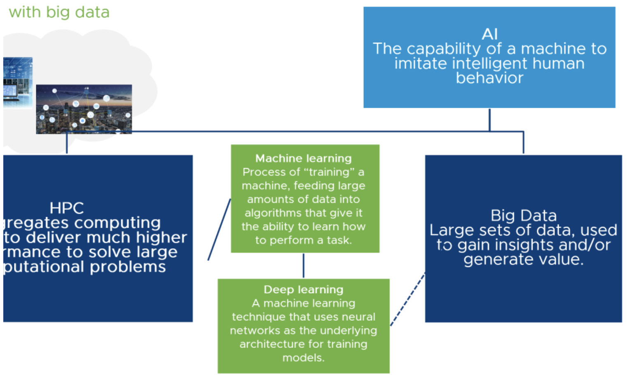
Do we really need very powerful computers ?

Slide 6
Do we really need very powerful computers ?
To have an idea of the range of applications of HPC, let’s give a look to the scientific journal
The International Journal of High Performance Computing Applications
Articles in the current (May 2022) issue:
Data-driven global weather predictions at high resolutions
Development of a hardware-accelerated simulation kernel for ultra-high vacuum with Nvidia RTX GPUs
A GPU-accelerated adaptive FSAI preconditioner for massively parallel simulations
A massively parallel time-domain coupled electrodynamics–micromagnetics solver
Large-scale ab initio simulation of light–matter interaction at the atomic scale in Fugaku
Large-scale ab initio simulation of light–matter interaction at the atomic scale in Fugaku
SAM++: Porting the E3SM-MMF cloud resolving model using a C++ portability library
Parallel encryption of input and output data for HPC applications
Resiliency in numerical algorithm design for extreme scale simulations

Slide 7
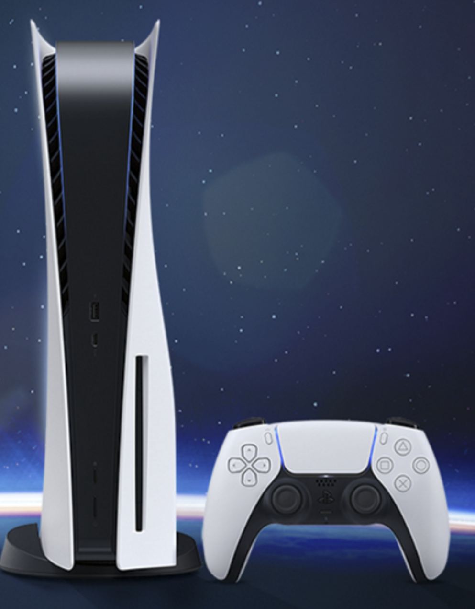
How powerful is a powerful computer ?
AMD 8 core, GPU 10.3 Teraflops, 5 watt, network connection, cost: 399 Euro
Cray 1, 1977
133 Mops, no graphics,
60Kw, 56kb/s
PS5 Sony, 2022

Slide 8
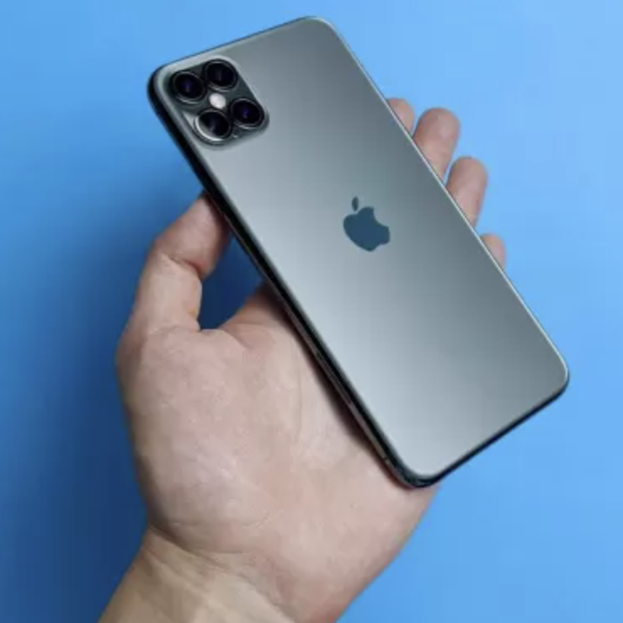
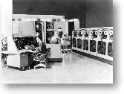
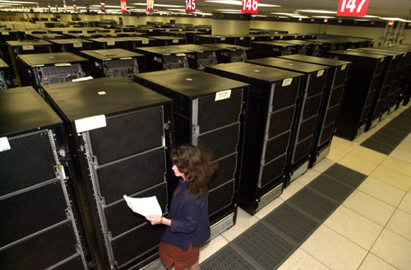
How powerful is a powerful computer ?
supercomputers ?
supercomputer
2022
Univac 1106, 1977
0.15 Mops, 2Mbyte

Slide 9
How powerful is a powerful computer ?
Computers have been increasing steadily in performance since the 1940s
The Colossus vacuum tube computer was the first electronic computer in the world
Built in Britain during the Second World War, Colossus ran at 500,000 FLOPS
CDC 6600 in 1964 was the first supercomputer with 3 MegaFLOPS
Cray-2 in 1985 was the first supercomputer to reach over 1 GigaFLOPS
ASCI Red in 1996 was the first massively parallel computer reaching over a TeraFLOPS
Roadrunner in 2008 first supercomputer to reach 1 PetaFLOPS

Slide 10
How powerful is a powerful computer ?
today’s treshold
Petaflops scale ( 10¹⁵ )
Exaflops scale ( 10¹⁸ )
pre-Exascale era

Slide 11
How powerful is a powerful computer ?
in June 2022, he supercomputer FRONTIER has broken the Exaflpos treshold ( 10¹⁸ ) in solving a standard basic computational problem
we are entering the Exascale era

Slide 12
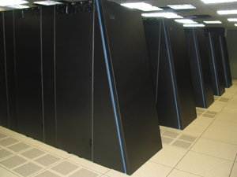
What is the computer more powerful in the world today ?
http://www.top500.org
the 500 fastest computers at solving a predetermined set of standard problems (benchmark)
LINPACK Benchmark
High-Performance Conjugate Gradient (HPCG) Benchmark

Slide 13
What is the computer more powerful in the world today ?
June 2022
FRONTIER, HPE CRAY Power: 1,102 Exaflops
DOE/SC/Oak Ridge National Laboratory USA
first EXAFLOPS computer
https://www.olcf.ornl.gov/frontier/
8.730.112 core HPC and AI Optimized 3rd Gen AMD EPYC CPU 4 Purpose Built AMD Instinct 250X GPUs, 10 PB Ram

Slide 14
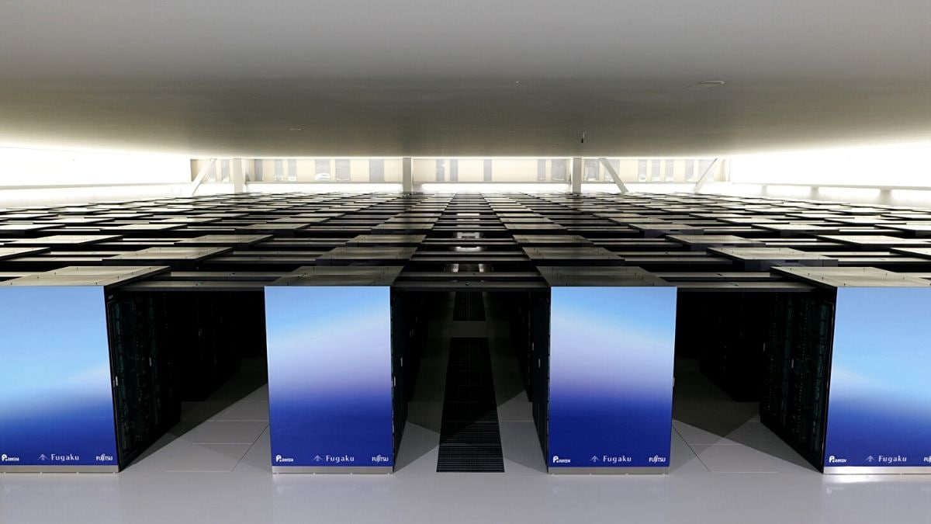
What is the computer more powerful in the world today ?
June 2022
second in the ranking
Fugaku, FUJITSU
power: 442 Petaflops
Riken Center for Computational Science, Kobe, Japan
https://www.r-ccs.riken.jp/en/ fugaku/project
7.630.848 core ARM, 160.000 nodes A64FX 48C, 160 PB Ram

Slide 15
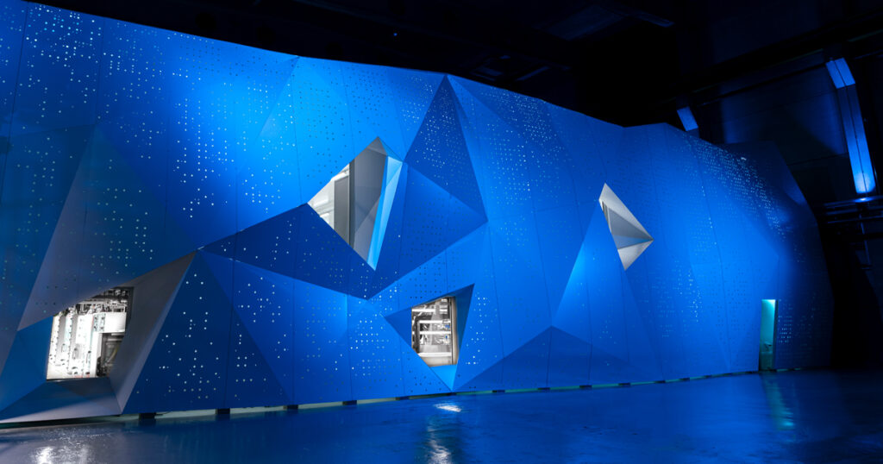
What is the computer more powerful in the world today ?
June 2022
third in the ranking
LUMI, HPE Cray
power: 151 Petaflops
EuroHPC/CSC
Kajaani, Finland
https://www.lumi-supercomputer.eu/
1.110.144 core AMD Optimized 3rd Generation EPYC 64C 2GHz, AMD Instinct MI250X, Slingshot-11, 8 PB Ram

Slide 16
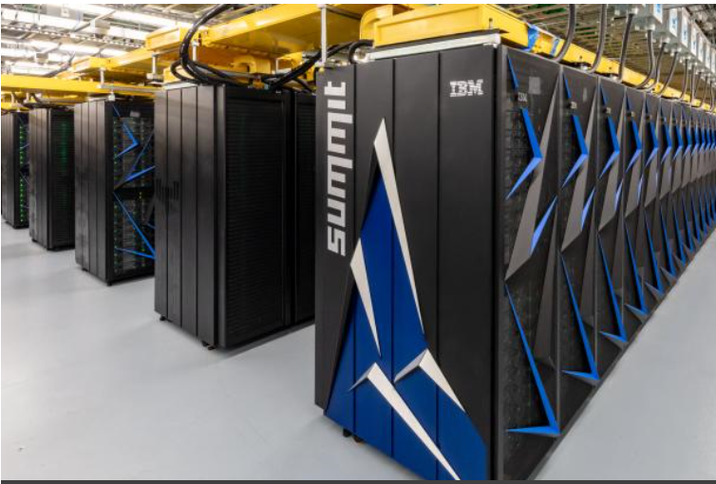
What is the computer more powerful in the world today ?
June 2022
fourth in the ranking
Summit, IBM
power: 148 Petaflops
Oak Ridge National Laboratory,
USA
https://www.olcf.ornl.gov/olcf-resources/compute-systems/summit/
2.414.592 core Power9, 4600 nodes Nvidia Volta, 10 PB Ram

Slide 17
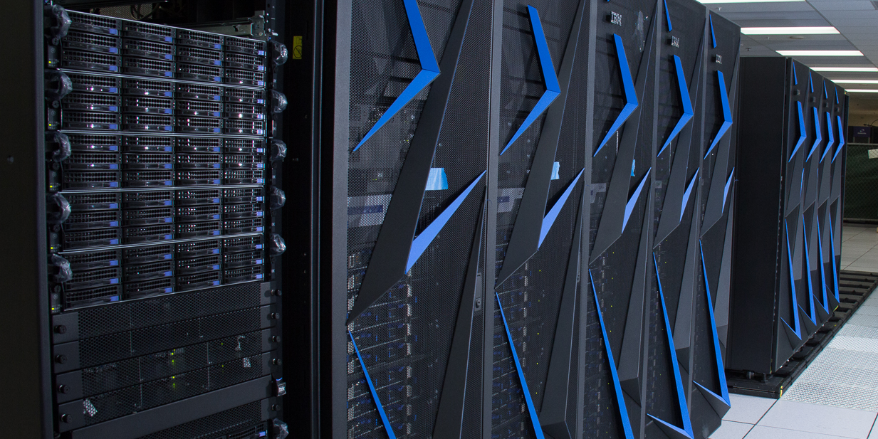
What is the computer more powerful in the world today ?
June 2022
fifth in the ranking
SIERRA , IBM
power: 94 Petaflops
Lawrence Livermore National Laboratory, USA
https://hpc.llnl.gov/hardware/platforms/sierra
1.572.000 core, 710 TB Ram

Slide 18
What is the computer more powerful in the world today ?
June 2022
sixth in the ranking
Sunway TaihuLight, NRCPC
power: 93 Petaflops
National Supercomputing Center, Wuxi, Cina
http://www.nsccwx.cn/
10.649.600 core, 1.3 PB Ram

Slide 19
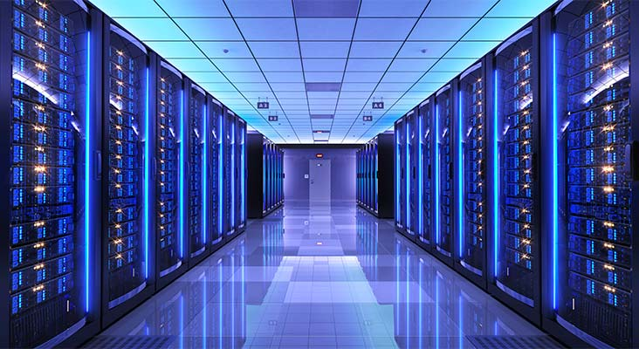
What is the computer more powerful in the world today ?
June 2022
12° place
HPC5 , IBM
power: 35 Petaflops
ENI SpA, Pavia, Italia
https://www.eni.com/it_IT/attivita/green-data-center-hpc5
669.760 core, nodes Power Edge Xeon + Nvidia Tesla V100, Infiniband

Slide 20
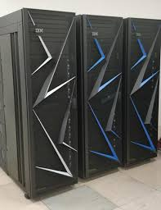
What is the computer more powerful in the world today ?
June 2022
21° place
Marconi-100 , IBM
power: 21 Petaflops
CINECA, Bologna, Italia
https://www.hpc.cineca.it/hardware/marconi100
347.766 core, nodes IBM Power9

Slide 21
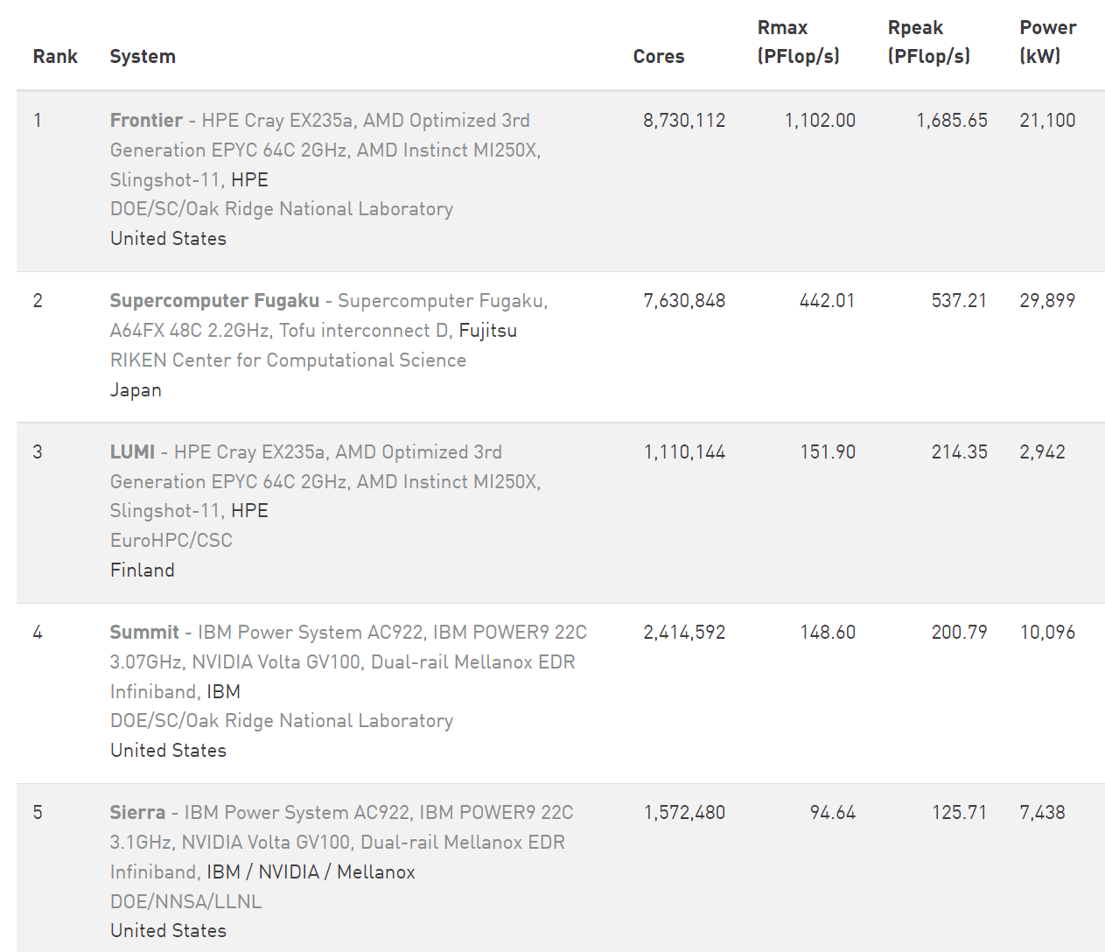
TOP500
June 2022

Slide 22
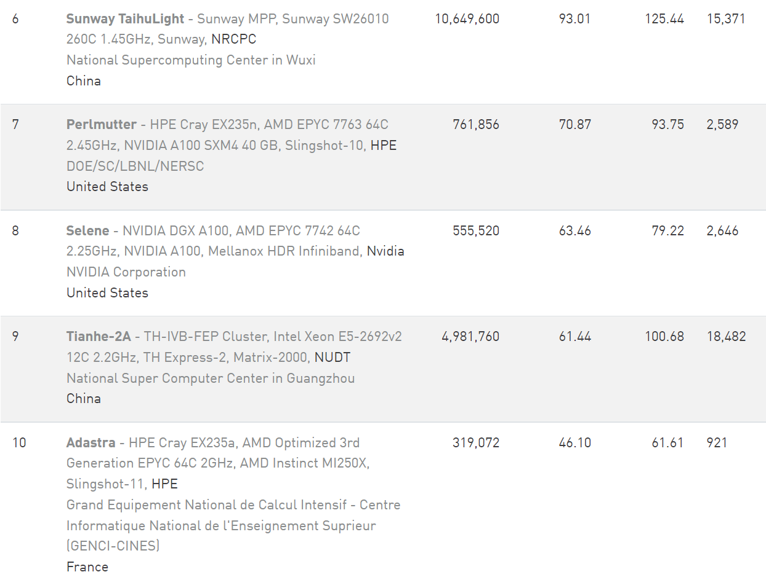
TOP500
June 2022

Slide 23
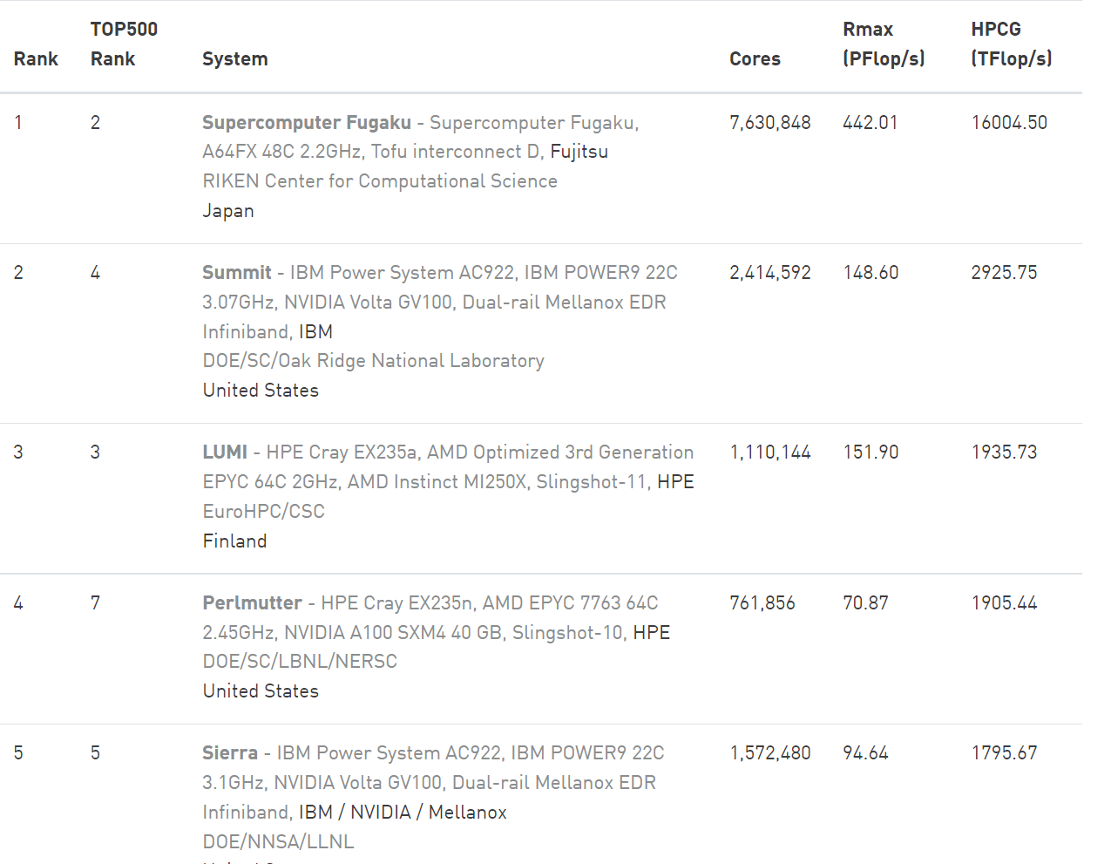
TOP500
June 2022
HPCG Benchmark

Slide 24
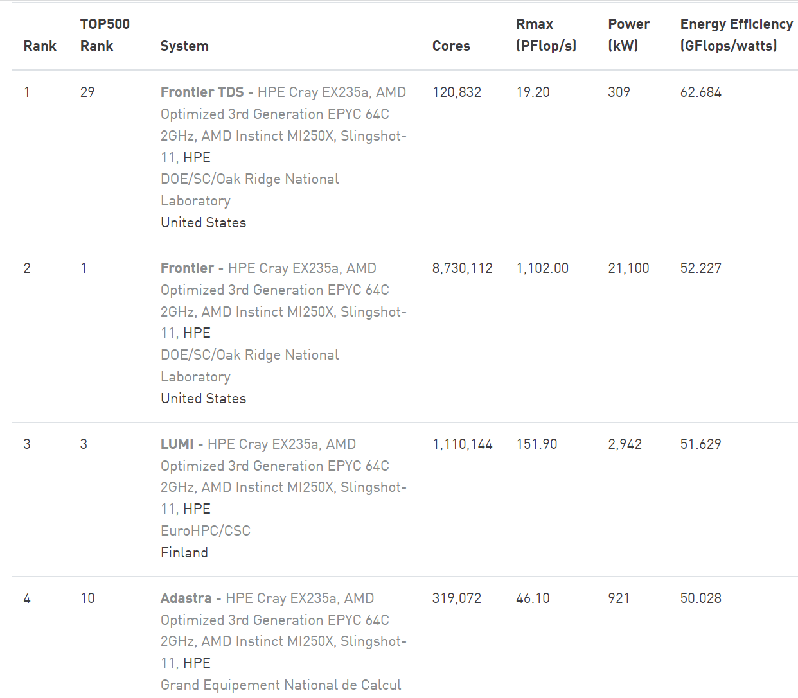
TOP500
June 2022
GREEN 500

Slide 25
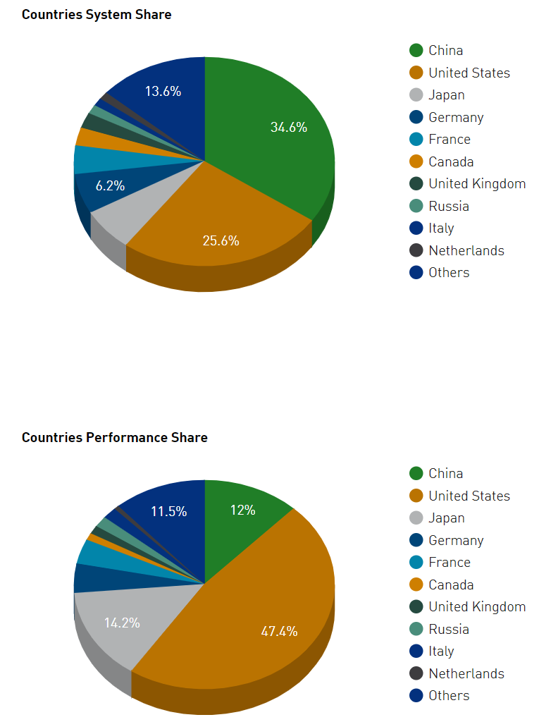
TOP500
distribution by countries of supercomputing power
June 2022

Slide 26
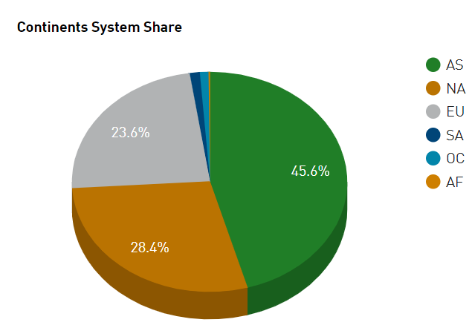
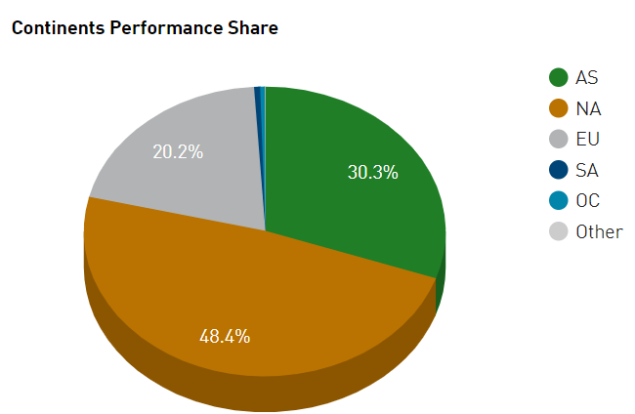
TOP500
distribution by continents of supercomputing power
June 2022

Slide 27
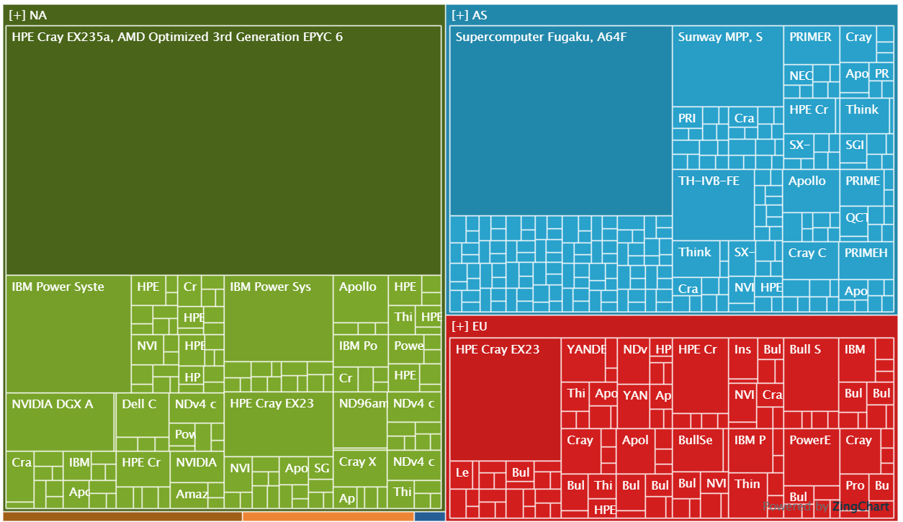
TOP500
June 2022
Treemap of Continents
https://www.top500.org/statistics/treemaps/

Slide 28
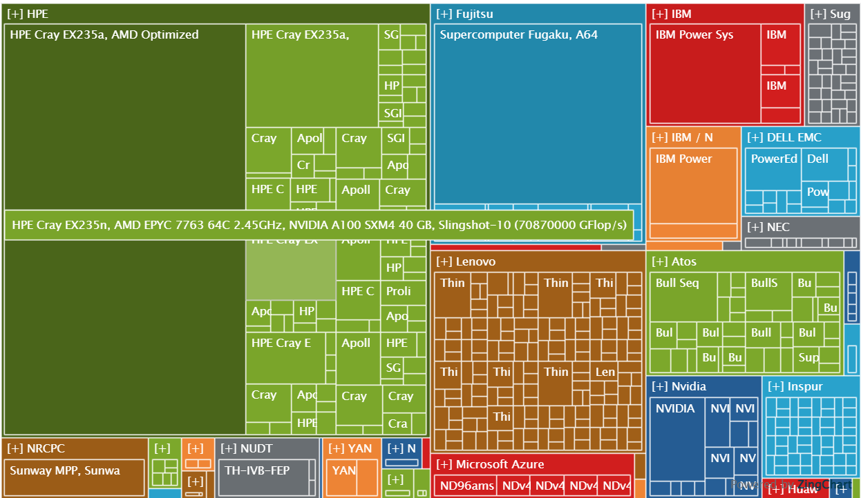
TOP500
June 2022
Treemap of Vendors
https://www.top500.org/statistics/treemaps/

Slide 29
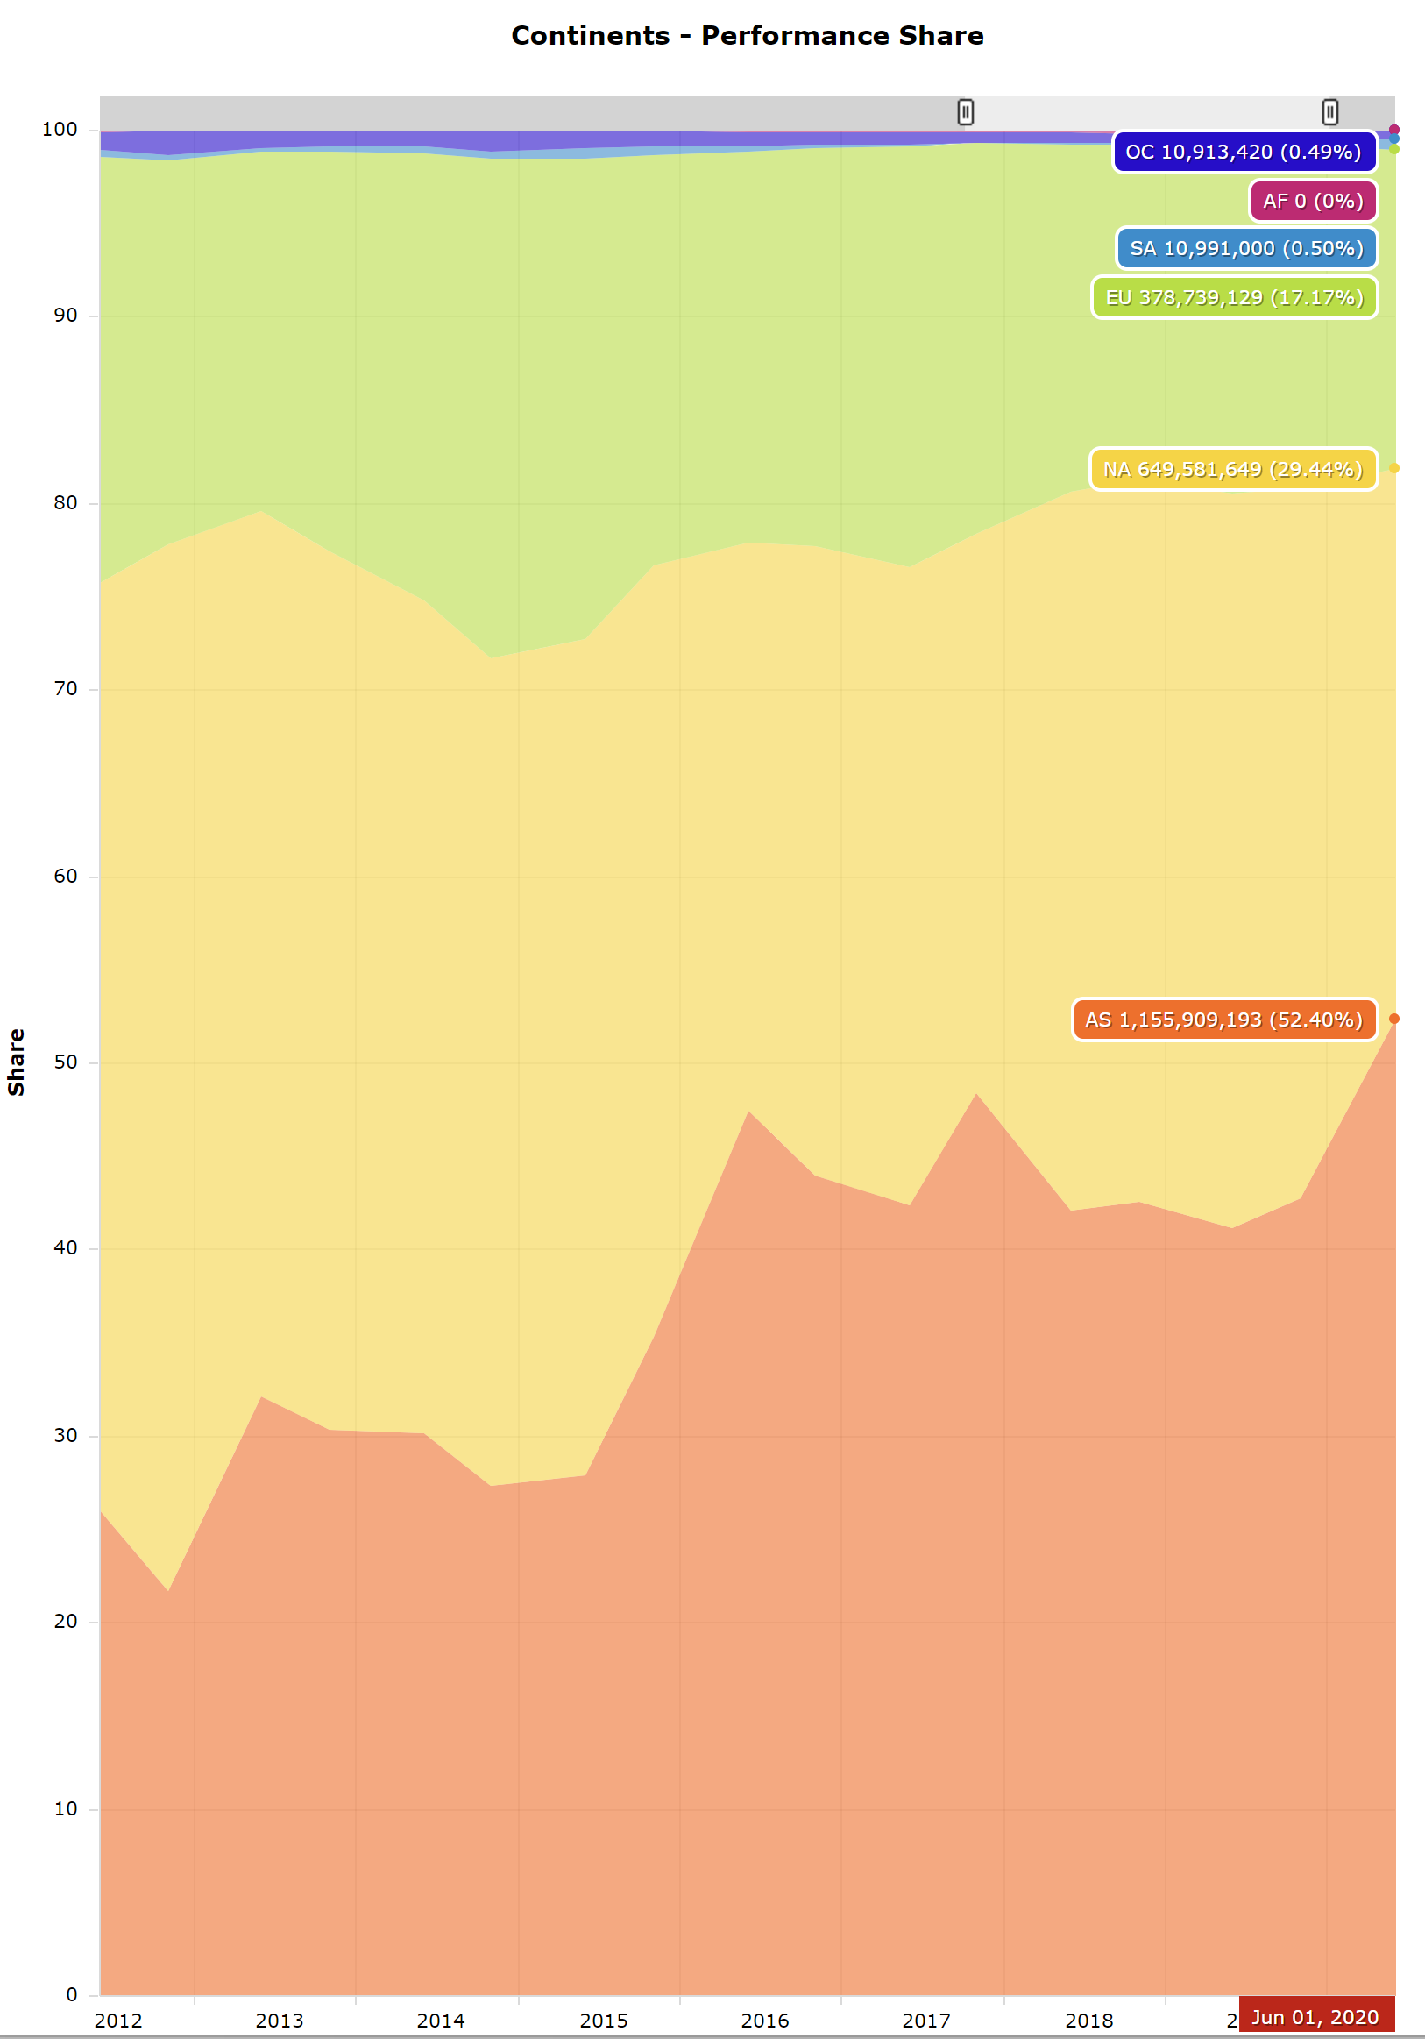
TOP500
November 2021
Overtime Continents
number of systems share
https://www.top500.org/statistics/overtime/

Slide 30
Rate of growth
what computing powers will be reached in the next 3 years ?
5 Exaflops (10¹⁸)
50 - 150 Exabyte HD

Slide 31
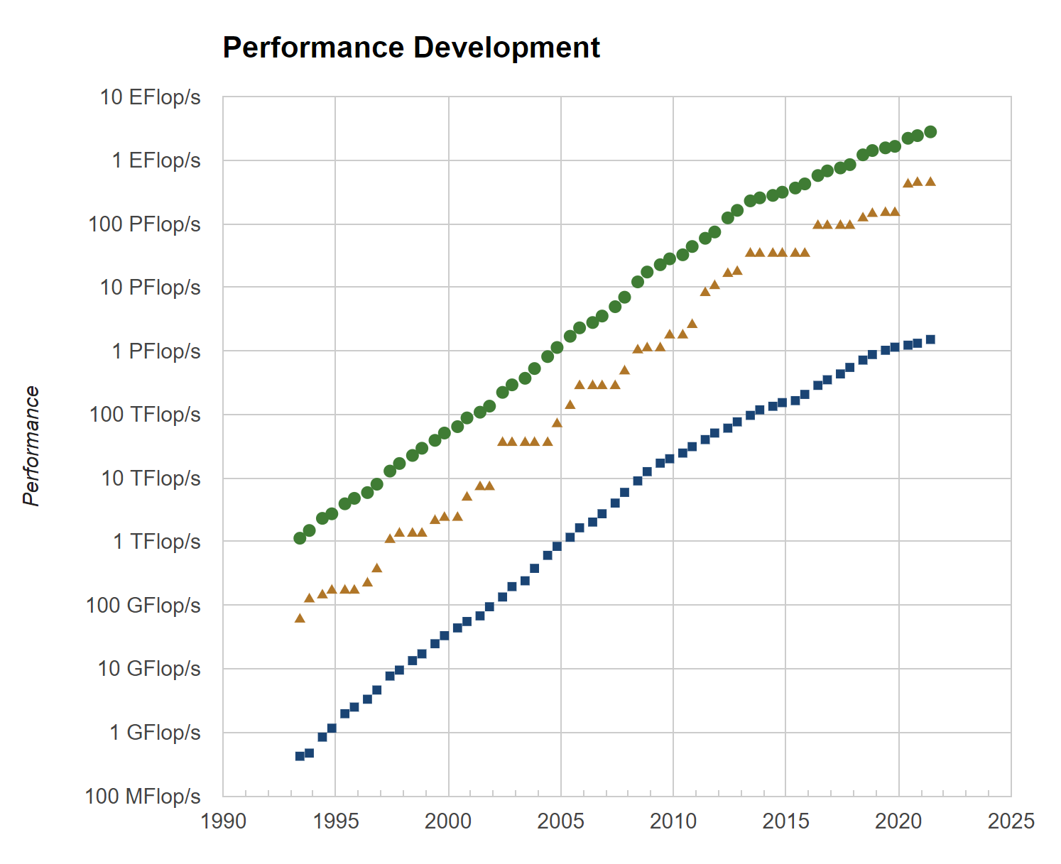
Rate of growth

Slide 32
Exascale computing
Exascale computing refers to computing systems capable of calculating at least 10¹⁸ floating point operations per second (1 EXAFLOPS)
Fugaku is the first supercomputer in history to hit this milestone (HPL-AI benchmark)
In April 2020, the distributed computing network Folding@home attained one EXAFLOPS on a real world problem (genomic analysis)

Slide 33
Exascale computing
The supercomputer Summit was the first supercomputer to reach one EXAFLOPS speed during a genomic analysis in 2021, achieving 1.88 EXAFLOPS in 2021
Summit is expected to reach 3.3 EXAFLOPS using mixed-precision calculations
The supercomputer Frontier was the first supercomputer to achieve 1.1 EXAFLOPS on a standard LINPACK benchmark (solution of a linear system of equations) in June 2022, with 64 bit arithmetic

Slide 34
Exascale computing
Exascale computing is a significant achievement in IT.
Primarily it will allow improved scientific applications and better prediction such as in weather forecasting, climate modeling and personalised medicine.
Exascale also reaches the estimated processing power of the human brain at the neural level, a target of the Human Brain Project
Wikipedia
Human Brain Project (Wikipedia)
https://www.humanbrainproject.eu/en/

Slide 35
A quick look at floating-point numbers
a floating-point number (or float) is a 64-bit representation of a real number, in which the 1-bit sign of the number, the first 52 nonzero bits of its binary representation and its 11-bit base-2 exponent are stored
any number in the interval [-10³⁰⁸, 10³⁰⁸] can be represented with a relative error less or equal than 10⁻¹⁶
there are near 2⁶⁴ ≈ 10¹⁹ floating-point numbers in the interval [-10³⁰⁸, 10³⁰⁸]

Slide 36
A quick look at floating-point numbers
mixed-precision arithmetic is for operating on inaccurate numbers with a small width and expanding them to a larger, more accurate representation.
For example, two half-precision such as fp16 (16-bit 1-5-10) or bfloat16 (16-bit 1-8-7) floats may be multiplied together to result in a more accurate single-precision (32-bit) float or double-precision (64-bit) float.
Some platforms, including Nvidia and AMD GPUs, provide mixed-precision for this purpose, using a coarse float when possible, but expanding them to higher precision when necessary.
Iterative algorithms (that compute a sequence of improved approximations of the solution of a problem) are perfect for mixed-precision, since a coarse guess can be made and refined over many iterations until the smallest possible error in that precision is reached. Then the precision can be increased, which allows for smaller increments to be used for the approximation.
Some supercomputers, e.g. Summit, utilize mixed-precision arithmetic to be more efficient with regards to memory and processing time, as well as power consumption

Slide 37
Distributed supercomputers
Folding@home (FAH or F@h) is a distributed computing project aimed to help scientists develop new therapeutics for a variety of diseases by the means of simulating protein dynamics.
This includes the process of protein folding and the movements of proteins and is reliant on simulations run on volunteers' personal computers.
Folding@home is currently based at Washington University in St. Louis
https://foldingathome.org/

Slide 38
Distributed supercomputers
Folding@home is one of the world’s fastest computing systems. With heightened interest in the project as a result of the COVID-19 pandemic, the system achieved a speed of approximately 1.22 Exaflops by late March 2020 and reached 2.43 Exaflops by April 12, 2020 making it the world's first Exaflops computing system
https://foldingathome.org/

Slide 39
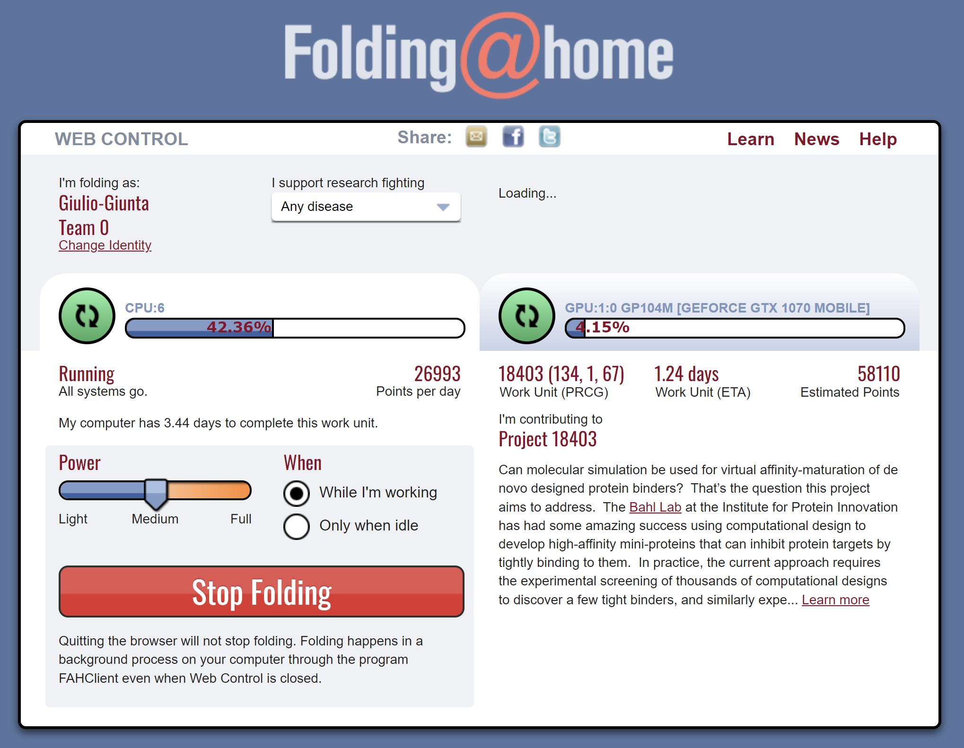
Distributed supercomputers
https://foldingathome.org/

Slide 40
…and beyond
and then ZETTAscale (10²¹ FLOPS)
List of hypothetical technologies - Wikipedia
Zettascale computers will be able to accurately forecast the global weather for the period of approximately 2 weeks. Climate change models will become more accurate than ever before, further reducing uncertainty about temperature increases and future impacts
Zettascale computing will also be able to reduce the time required for astrophysical simulations of such phenomena as black holes, neutron star mergers, and supernovae. For example, the calculating of a 3D model of shock wave instability from a collapsing supernova core, which takes 1 million hours on Petaflops computers and 1000 hours on Exaflops machines, can be done in just one hour on Zettaflops systems
Zettascale (10²¹ Flops) or Yottascale (10²⁴ Flops) systems might be able to accurately model the whole human brain

Slide 41
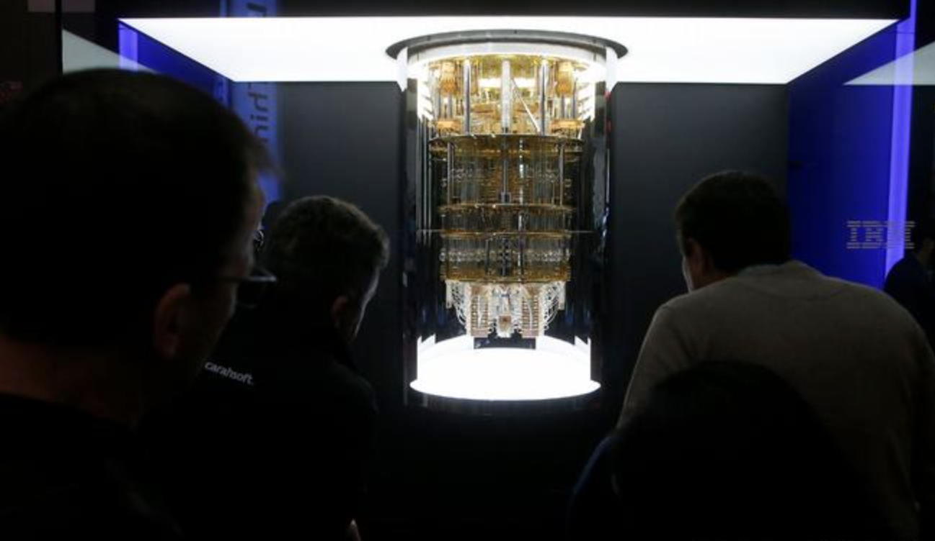
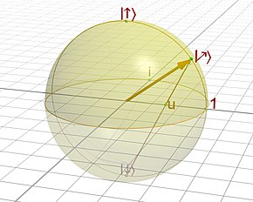
Quantum computers
IBM Quantum System One, 20 Q-bits
the first commercial Quantum Computer
https://en.wikipedia.org/wiki/Quantum_computing/
https://www.dw.com/en/ibm-unveils-first-quantum-computer-in-germany/a-57909494

Slide 42
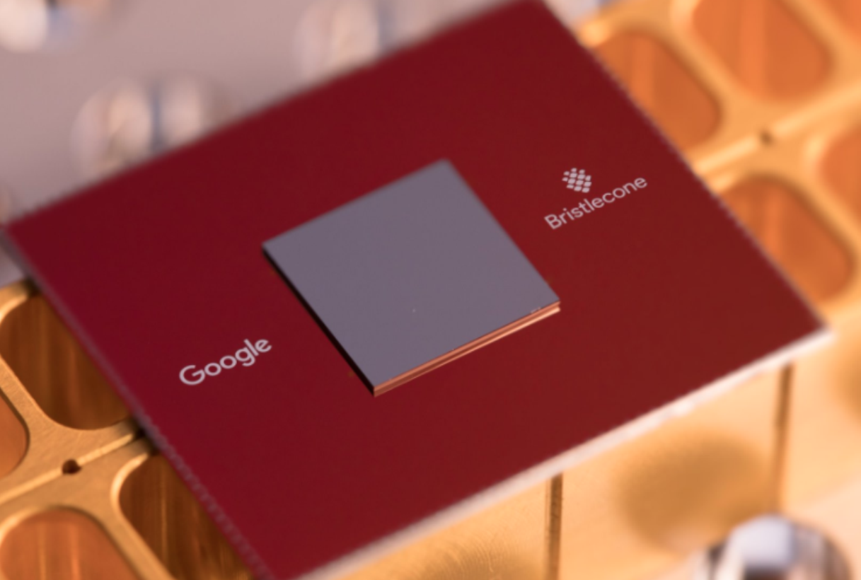
Quantum computers
https://www.technologyreview.com/s/613507/the-new-benchmark-quantum-computers-must-beat-to-achieve-quantum-supremacy
Google Bristlecone, 72 Q-bits
https://ai.googleblog.com/2018/03/a-preview-of-bristlecone-googles-new.html
https://www.technologyreview.com/s/610274/google-thinks-its-close-to-quantum-supremacy-heres-what-that-really-means/

Slide 43
Quantum computers
from McKinsey:
https://www.mckinsey.com/business-functions/mckinsey-digital/our-insights/a-game-plan-for-quantum-computing
https://www.mckinsey.com/business-functions/mckinsey-digital/our-insights/quantum-computing-use-cases-are-getting-real-what-you-need-to-know
https://www.mckinsey.com/business-functions/mckinsey-digital/our-insights/tech-forward/quantum-computing-is-coming-how-can-your-company-prepare

Slide 44
Supercomputers and strategic policies
2015, US President B. Obama:
executive order authorizing the creation of new supercomputing research initiative called the National Strategic Computing Initiative, or NSCI.
https://obamawhitehouse.archives.gov/the-press-office/2015/07/29/executive -order-creating-national-strategic-computing-initiative
https://obamawhitehouse.archives.gov/blog/2015/07/29/advancing-us-leadership-high-performance-computing
https://www.wired.com/2015/07/obama-supercomputing/

Slide 45
Strategic projects
THE NATIONAL STRATEGIC COMPUTING INITIATIVE (NSCI) - USA
https://www.nitrd.gov/nsci/
https://www.nitrd.gov/pubs/National-Strategic-Computing-Initiative-Update-2019.pdf
Report - NATIONAL STRATEGIC COMPUTING INITIATIVE UPDATE: PIONEERING THE FUTURE OF COMPUTING (nitrd.gov)

Slide 46
Strategic projects
The NETWORKING AND INFORMATION TECHNOLOGY RESEARCH AND DEVELOPMENT OROGRAM (NITRD)
NITRD is the US primary source of federally funded research and development in advanced Information Technologies in computing, networking, and software
https://www.nitrd.gov

Slide 47
Strategic projects
AI – Artificial Intelligence
CHuman – Computing-Enabled Human Interaction, Communication, and Augmentation
CNPS – Computing-Enabled Networked Physical Systems
CSP – Cyber Security and Privacy
EdW – Education and Workforce
ENIT – Electronics for Networking and Information Technology
EHCS – Enabling-R&D for High-Capability Computing Systems
HCIA – High-Capability Computing Infrastructure and Applications
IRAS – Intelligent Robotics and Autonomous Systems
LSDMA – Large-Scale Data Management and Analysis
LSN – Large-Scale Networking
SPSQ – Software Productivity, Sustainability, and Quality
https://www.nitrd.gov/coordination-areas/

Slide 48
Strategic projects
THE CONVERGENCE OF HIGH PERFORMANCE COMPUTING, BIG DATA, AND MACHINE LEARNING.
https://www.nitrd.gov/pubs/Convergence-HPC-BD-ML-JointWSreport-2019.pdf

Slide 49
Strategic projects
THE EXASCALE COMPUTING PROJECT- USA
The Compelling Case for Exascale Computing (U.S. Department of Energy (DOE): Office of Science (SC), National Nuclear Security Administration (NNSA))
Scientific applications and software for Quality of Life, Strong Economy, National Security
https://www.exascaleproject.org/

Slide 50
Strategic projects
INTERNATIONAL EXASCALE SOFTWARE PROJECT
“The International Exascale Software Roadmap," Dongarra, J., Beckman, P. et al., Volume 25, Number 1, 2011, International Journal of High Performance Computer Applications
An international research community that organized a series of bi-annual meetings from 2009 to 2012 to develop ideas for hardware/software design to move to exascale science and to produce an overview of the state of different national and international projects to develop exascale computing
https://www.exascale.org/iesp/Main_Page

Slide 51
Strategic projects
THE EUROPEAN HIGH PERFORMANCE COMPUTING JOINT UNDERTAKING (EuroHPC JU) - EU
joint initiative between the EU, European countries and private partners to develop a World Class Supercomputing Ecosystem in Europe
https://eurohpc-ju.europa.eu/
https://en.wikipedia.org/wiki/Supercomputing_in_Europe

Slide 52
Strategic projects
PRACE – PARTNERSHIP FOR ADVANCED COMPUTING IN EUROPE
The mission of PRACE is to enable high-impact scientific discovery and engineering research and development across all disciplines to enhance European competitiveness for the benefit of society. It has 25 member countries whose representative organisations create a pan-European supercomputing infrastructure, providing access to computing and data management resources and services to researchers from academia and industry for large-scale scientific and engineering applications.
https://prace-ri.eu/about/introduction/
https://prace-ri.eu/wp-content/uploads/PRACE_Annual_Report_2020.pdf

Slide 53
An interesting report
Exascale Computing Market Analysis, Innovation Trends and Current Business Trends by 2026
The research report assesses ongoing market trends, as well as the factors that are poised to enhance the market growth during the analysis timeframe. It encompasses major market restraints which may hamper the market growth.
The report also comprises of the key manufacturers which formulate the competitive terrain of the Exascale Computing market and also highlights the major market segmentations
https://www.business-newsupdate.com/exascale-computing-market-328354

Slide 54
a META project
AI RSC - Artificial Intelligence Research Super Cluster
“Meta (Facebook) is announcing that they have designed and built the AI Research SuperCluster (RSC) — which will be among the fastest AI supercomputers running today and will be the fastest AI supercomputer in the world when it’s fully built out in mid-2022. Meta’s researchers have already started using RSC to train large models in natural language processing (NLP) and computer vision for research, with the aim of one day training models with trillions of parameters”.
https://www.youtube.com/watch?v=fZnykn1tDSE
https://ai.facebook.com/blog/ai-rsc/

Slide 55
MASTER MEIM 2021-2022
Thanks for your attention
…… Digital Tech HPC continues

