Slide 1
Innovation & Entrepreneurship Session 1
Son Thi Kim LE
University of Littoral Côte d’Opale
France

Slide 2
Course instructor
Researcher at Research centre on Innovation and Industrial Strategies ISI /Lab.RII, University of Littoral Côte d’Opale, France.
Lecturer at International Business School ISCID-CO
E-mail: Sontk.le@univ-littoral.fr

Slide 3
Course sessions
1. Identify entrepreneurial ideas and opportunities
2. Building a business model and plan
3. Innovation and entrepreneurship
4. Innovation diffusion and Open innovation/Innovation network
5. Protecting intellectual property
6. Innovation management in resource-constrained environment

Slide 4
1. Identify entrepreneurial opportunities
What is Entrepreneurship and Who is Entrepreneur
What are business opportunities?
Identifying opportunities
Researching and verifying entrepreneurial opportunities
Competitive analysis

Slide 5
a. What is Entrepreneurship and Who is Entrepreneur?
(According to Stanford Online)
Entrepreneurship refers to an individual or a small group of partners who strike out on an original path to create a new business
An entrepreneur: actively seeks a particular business venture and assumes the greatest amount of risk associated with the project as well as stands to benefit most if the project is a success.

Slide 6
b. What are business opportunities?
According to Joseph Schumpeter:
Entrepreneurs create value “by exploiting a new invention or, more generally, an untried technological possibility for producing a new commodity or producing an old one in a new way, by opening up a new source of supply of materials or a new outlet for products, by reorganizing an industry”.
Entrepreneurial Opportunity: when identifiable consumer demand meets the feasibility of satisfying the requested product or service.

Slide 7
b. What are business opportunities?
Drivers of Opportunities:
New funding options: Increased access to capital through several new sources, venture capital investment
Technological advancements continue to provide new opportunities
Increasing globalization promotes entrepreneurship by allowing imports and exports to flourish.
Economic factors could include a strong economy that drives other business activities.

Slide 8
c. Identifying opportunities
1. Develop a new market for an existing product.
2. Find a new supply of resources that would enable the entrepreneur to produce the product for less money.
3. Use existing technology to produce an old product in a new way.
4. Use an existing technology to produce a new product.
5. Use new technology to produce a new product.

Slide 9
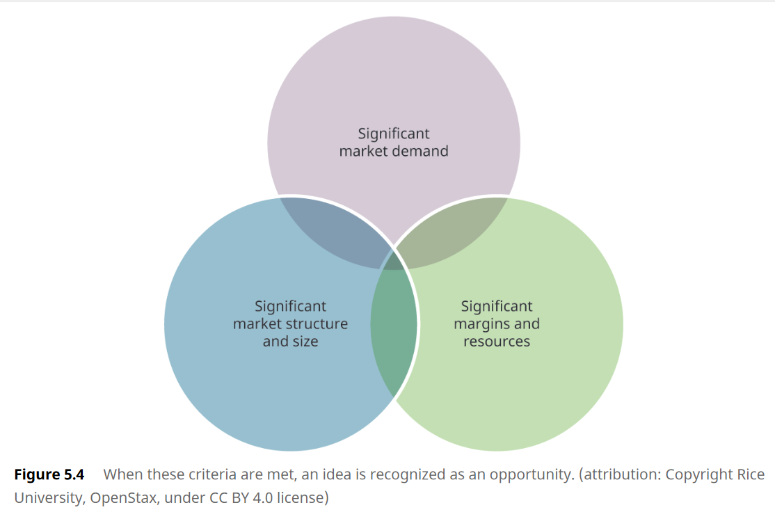
d. Researching and Verifying the Entrepreneurial Opportunity
An idea can move to a recognized opportunity when the following criteria are met.

Slide 10
e. Competitive analysis
A competitive analysis:
how competitors market their business,
ways to enter the market by entry through product or service gaps in areas that your competitors do not serve or do not serve well.
=> develop a competitive advantage that will help create a sustainable revenue stream.
Two main tools of analysis of competitors:
a competitive analysis grid: identify competitors, their key characteristics, competitive strengths, weaknesses, key success factors.
the “three circles” approach: identify competitors’ strengths and competitive advantages with any overlaps among competitors => identify values or features not offered by competitors.

Slide 11
e. Competitive analysis
SWOT analysis (strengths, weaknesses, opportunities, and threats)
SWOT focuses on analyzing your venture’s potential and builds on the knowledge gained from the competitive analysis grid and the three circles.

Slide 12
e. Competitive analysis
Three Circles Tool
Three circles tool: gap in value or offered services helps to identify your unique selling proposition and thereby your competitive advantage.
The unique selling proposition
important to the marketing plan
used as a slogan.
align with the value communicated by the product or company brand

Slide 13
Thank you for your attention
Don’t hesitate to contact me
if you have any question or you need further information
Son Thi Kim Le
ISI/Lab RII and ISCID-CO (ULCO)
Sontk.le@univ-littoral.fr

