Slide 1
Supply Chains
The Operations Management View

Slide 2
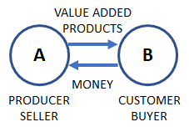
What is a “supply chain”?
The basic cell of economic activities is the exchange relationship between a supplier and a customer.

Slide 3
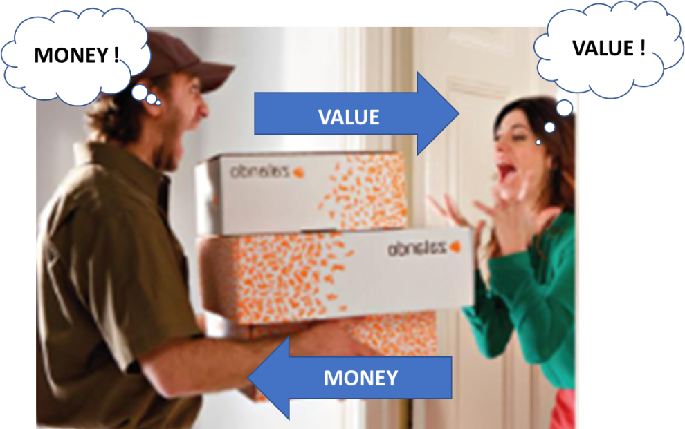

Slide 4
Exchanges happen in a market
A MARKET
The place of exchanges is the market.
A market could exist in any place in the center of a city (as it always has been), in the real World or on the World Wide Web.
Wherever it is possible to exchange goods, money and information.
That is to say that today the market is everywhere.
A
B
MANY
COMPETING
SUPPLIERS
MANY
POTENTIAL
CUSTOMERS

Slide 5
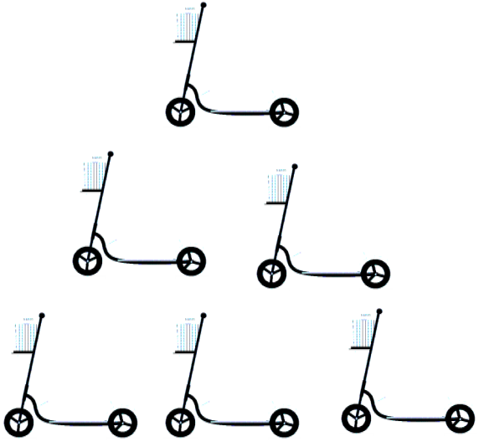
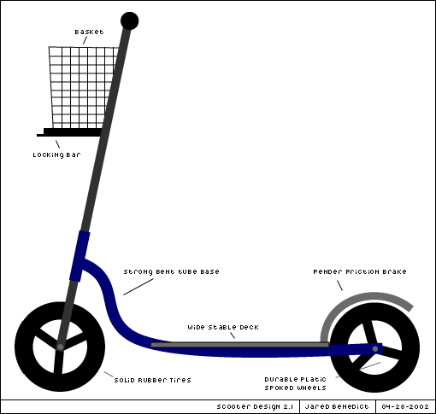
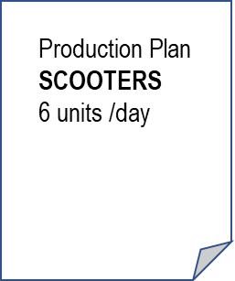
PRODUCTION PROCESSES
(OPERATIONS)
OUTCOMES =
+ VALUE
INPUTS
OUTPUTS
BUYING
PROCESSESS
LOGISTIC
PROCESSESS
MANUFAC-TURING
PROCESSES
ASSEMBLY
PROCESSESS
LOGISTIC
PROCESSESS
DELIVERING
PROCESSESS
Planning of procurements
Buying materials & components
Paying the suppliers
Warehouse management
Intarnal transportations
folding of the frames
painting the frames
Assemble together the frame, the wheels, the basket, the packaging (envelop + box)
Intarnal transportations
Warehouse management
Shipments
invoicing,
outgoing logistics
To be purchased:
For each planned scooter:
1.5 m of steel tubes
12 screws and bolts
2 wheels
2 pins for the wheels
1 basket
2 knobs
100 grams of paint
To be delivered each day:
6 packaged scooters
Production Processes

Slide 6
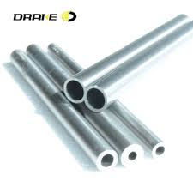
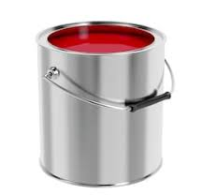
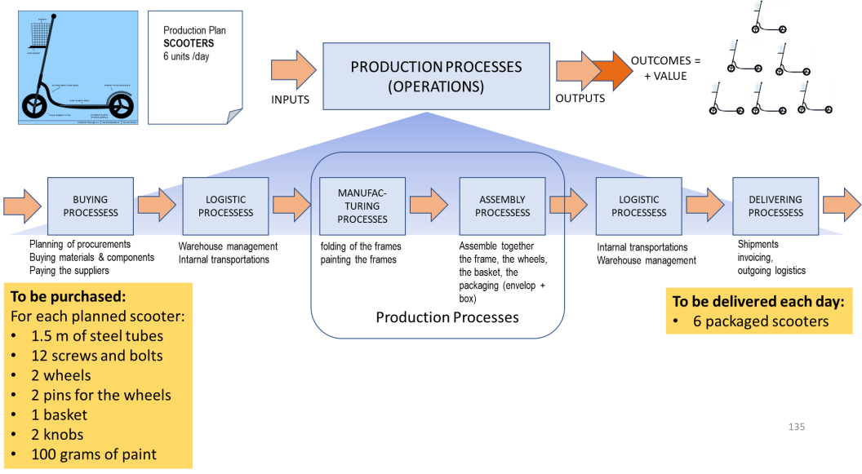
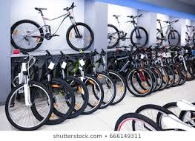
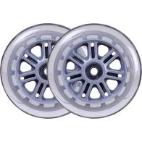
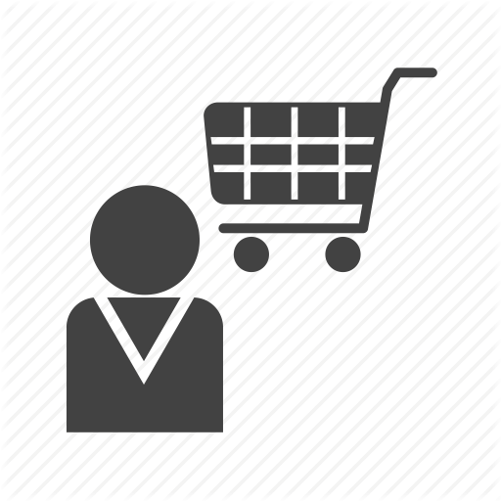
COMPONENTS & MATERIALS
SUPPLYNG PROCESSES
PRODUCTION PROCESSES
(OPERATIONS)
RETAIL PROCESSES
(DISTRIBUTION & SALES)
COMPONENTS, SUBSYSTEMS
AND MATERIALS
SUPPLIER
PRODUCT
INTEGRATOR
SELLER
CUSTOMER

Slide 7
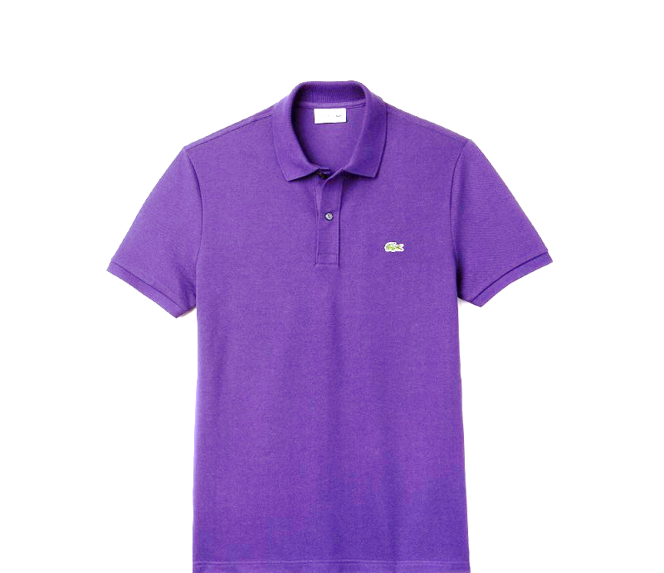
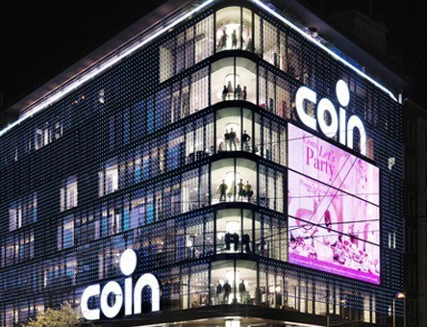
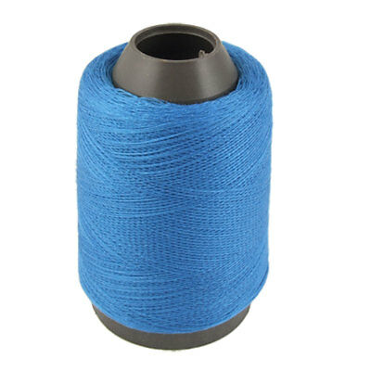
COMPONENTS, SUBSYSTEMS
AND MATERIALS
SUPPLIER
PRODUCT
INTEGRATOR
SELLER
CUSTOMER

Slide 8
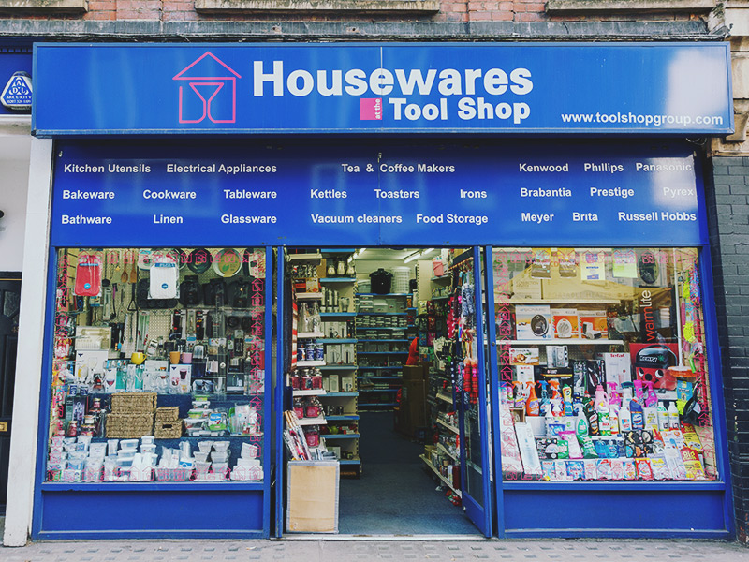
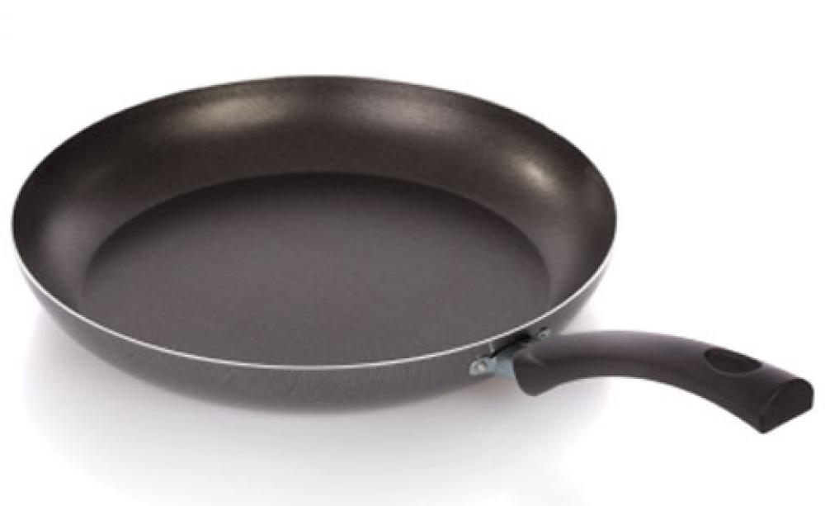
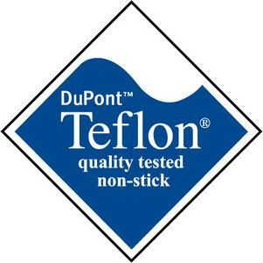
COMPONENTS, SUBSYSTEMS
AND MATERIALS
SUPPLIER
PRODUCT
INTEGRATOR
SELLER
CUSTOMER

Slide 9
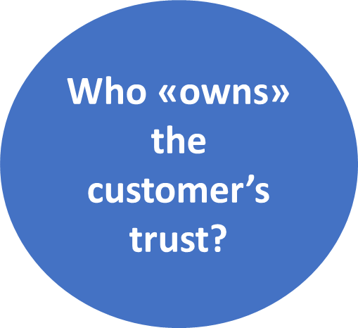
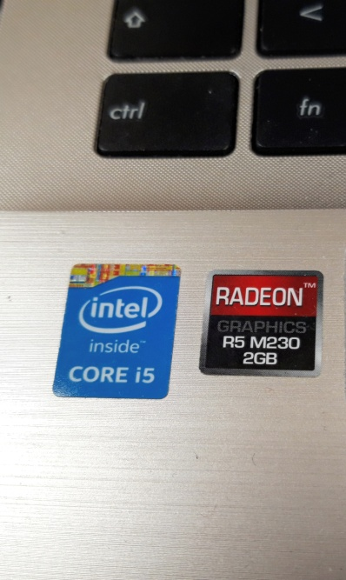
COMPONENTS, SUBSYSTEMS
AND MATERIALS
SUPPLIER
PRODUCT
INTEGRATOR
SELLER
CUSTOMER

Slide 10
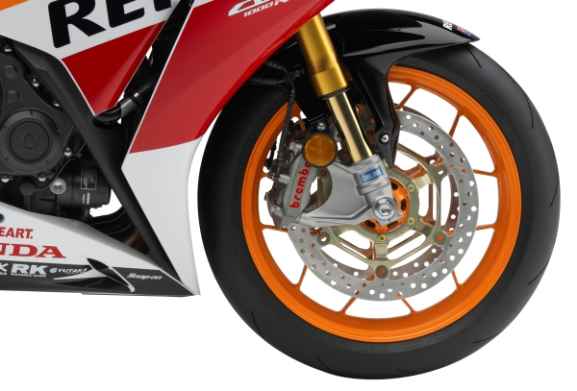
COMPONENTS, SUBSYSTEMS
AND MATERIALS
SUPPLIER
PRODUCT
INTEGRATOR
SELLER
CUSTOMER

Slide 11
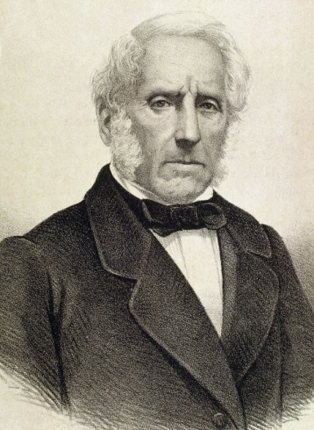
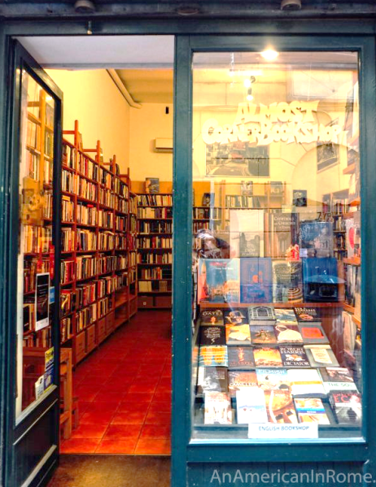
COMPONENTS, SUBSYSTEMS
AND MATERIALS
SUPPLIER
PRODUCT
INTEGRATOR
SELLER

Slide 12
What is a “supply chain”?
The sequence of relationships and exchange activities between suppliers and customers is called a "supply chain".
Every intermediate supplier in the chain has its suppliers and every intermediate customer has its customers.

Slide 13
What is a “supply chain”?
At one end of the chain are the extractors of raw materials that do not buy from anyone, at the other end are the end consumers who do not sell to anyone.
The production and exchange activities (for tangible products or services) that follow one another are interdependent and linked activities that have costs and that add value.
Therefore, a supply chain is also a value chain.

Slide 14
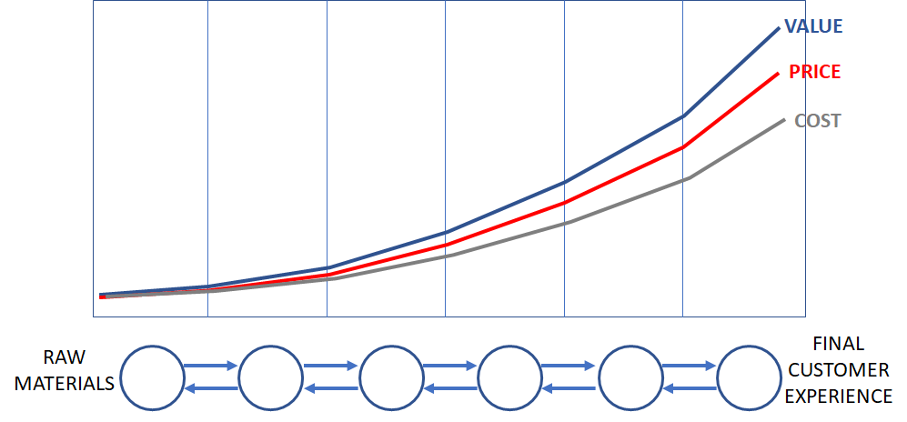
A viable business
In an economically viable supply chain, for each exchange it must occur that Value> Price> Costs

Slide 15
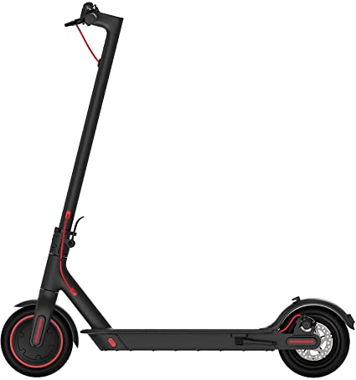
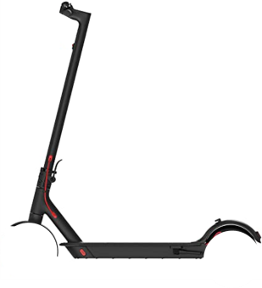
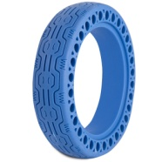
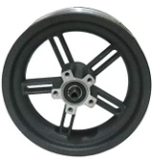
Global supply chains, global value chains
The cells of a supply/value chain are spread all over the world.
The flow of value is a “river” that collects the contributions of its tributaries.
From France
From India
Value flow
From Italy
From China
From Germany
From Brazil

Slide 16
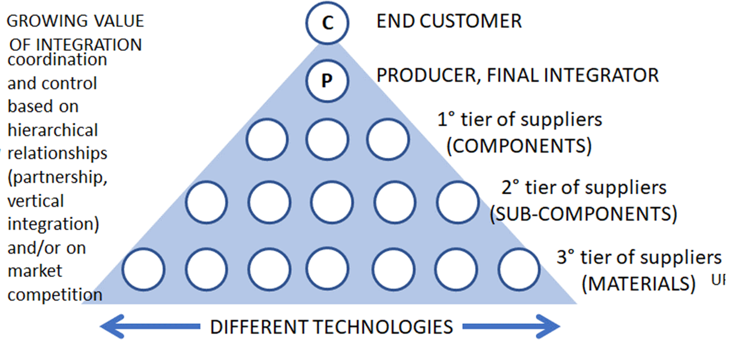
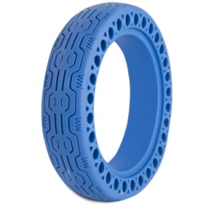
Customer Experience
Complete scooter
Complete wheels
Rubber tire
Steel rims
Steel Pipes
Rubber, Steel, Paint

Slide 17
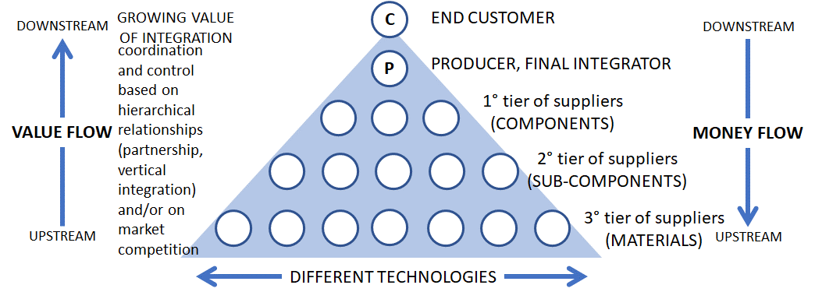
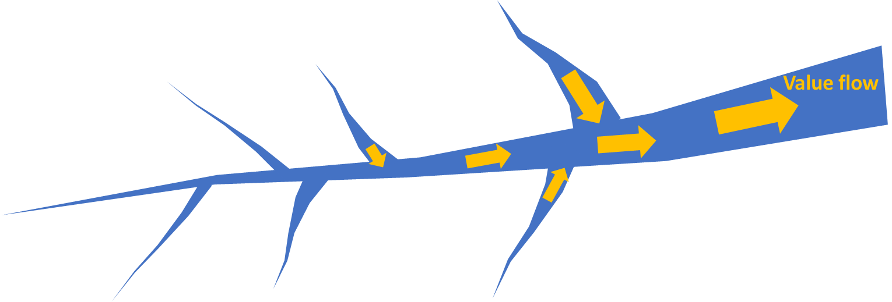
A supply chain can be represented as a hierarchy.

Slide 18
A supply chain can be represented as a hierarchy.
The processes of the individual suppliers upstream are coordinated and integrated by the level downstream of the "river", the one closest to the end customers

Slide 19
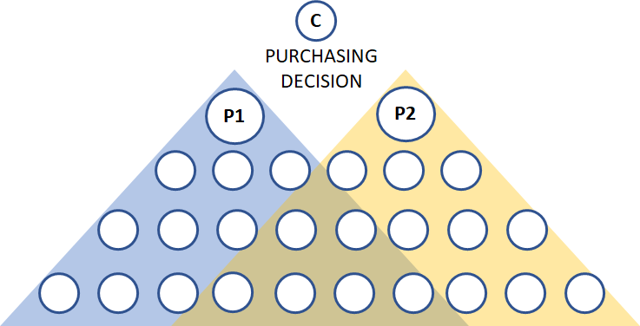
Competition between supply chains
Competition between two producers/integrators to win the purchase choice of the end customer.
Competition is, actually, a competition between supply chains.
Where some of the sub suppliers can be shared

Slide 20
Competition between supply chains
The winner is the best managed supply chain, i.e. the most effective and efficient one, capable of delivering better value to the customer at a lower price.

Slide 21
Coordination and control of a S.C.
The strategies to manage vertical relations of coordination and control between the different units (internal departments or external suppliers) that contribute to the realization of the product can adopt three “way to play”:
market relations
vertical integration
vertical partnership

Slide 22
Market relations
consist in continuously promoting competition on value and price among several alternative suppliers and choosing the best one (best “value-for-money” performance).

Slide 23
Vertical integration
consists in the acquisition of some upstream (backward) or downstream (forward) production and/or control phases
P

Slide 24
Vertical integration
consists in the acquisition of some upstream (backward) or downstream (forward) production and/or control phases
P
P
Backward
integration

Slide 25
Vertical integration
consists in the acquisition of some upstream (backward) or downstream (forward) production and/or control phases
P

Slide 26
Vertical integration
consists in the acquisition of some upstream (backward) or downstream (forward) production and/or control phases
Forward
integration
P
P

Slide 27
Vertical integration
consists in the acquisition of some upstream (backward) or downstream (forward) production and/or control phases
P
P
Backward
integration
P
P
Forward
integration

Slide 28
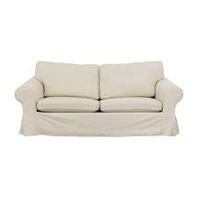
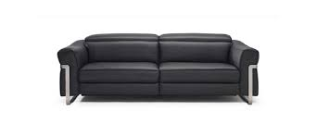
USER
28

Slide 29
COMPONENTS, SUBSYSTEMS
AND MATERIALS
SUPPLIER
P
PRODUCT
INTEGRATOR
SELLER
USER
29

Slide 30
Vertical integration story 1
1960
COMPONENTS, SUBSYSTEMS
AND MATERIALS
SUPPLIER
P
PRODUCT
INTEGRATOR
SELLER
USER

Slide 31
Vertical integration story 1
Backward
integration
Backward
integration
COMPONENTS, SUBSYSTEMS
AND MATERIALS
SUPPLIER
P
PRODUCT
INTEGRATOR
SELLER
USER

Slide 32
Vertical integration story 2
1960
COMPONENTS, SUBSYSTEMS
AND MATERIALS
SUPPLIER
P
PRODUCT
INTEGRATOR
SELLER
USER

Slide 33
Vertical integration story 2
Forward
integration
Forward
integration
COMPONENTS, SUBSYSTEMS
AND MATERIALS
SUPPLIER
P
PRODUCT
INTEGRATOR
SELLER
USER

Slide 34
COMPONENTS, SUBSYSTEMS
AND MATERIALS
SUPPLIER
PRODUCT
INTEGRATOR
SELLER
CUSTOMER

Slide 35
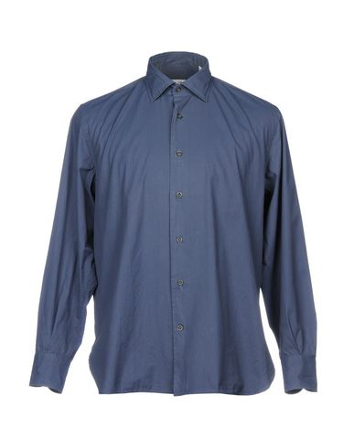
Backward
integration
Store Brand
COMPONENTS, SUBSYSTEMS
AND MATERIALS
SUPPLIER
PRODUCT
INTEGRATOR
SELLER
CUSTOMER

Slide 36
Vertical partnership (quasi integration)
consists, for a producer, in choosing a priori and collaborating backward with the best suppliers and establishing long-term partnerships with them and less frequent and more simplified transactions.
The partnership could be about the sharing of some proprietary knowledge, of some resources (technologies, information, services), of a part of risks and of a part of profits.

Slide 37
The two ways to play supply chain management
More integration means less transactions and a better alignment of strategies and a more direct coordination between the different units of the hierarchy in order to improve the performance of the supply chain (value and costs).
More market means relying on the competition between suppliers in order to improve the performance of the supply chain (value and costs).

Slide 38
What is the role of the user in business processes?
An important contribution of design culture to business culture is the attention to the user of the artificial.
The concept of User Centered Design or that of User Experience Design, attributes to the user a central role in the creation of value.
This is because it is the user who uses the outputs of the design and production processes to obtain his own desired outcome: the value of his/her own experience of use.
The product failure happens within the user's processes.

Slide 39
The «customer’s strategy»

Slide 40
Value in Use (a design thinking view)
Those who design and produce a product (or a service) do not create “absolute” value.
The value is attributed by the customer in his/her process of use (Value in Use).

Slide 41
Value in Use (and value in Interpretation)
The customer is therefore the last segment of the value chain
as part of the executive process (buying, transporting, opening a package, installing, using, storing, disposing)
because it is in the mind and body of the customer that takes place the overall experience of use. Where a fundamental part of the experience is in the meaning that the user attributes to the product and its use, in a private or a social context.

Slide 42
Meeting the two strategies
The producer's strategy and processes
must meet
the user's strategy and processes.
The better the matching between the needs and processes of the two parties, the greater the probability of success of a project.
The same principle applies to the satisfaction of all the stakeholders.

