Slide 1
MASTER MEIM 2021-2022
Crowdfunding & Innovation
How to build a successful crowdfunding campaign
A cura del prof. Francesco Schiavone
Prof. di Gestione dell’Innovazione all’Università degli Studi di Napoli Parthenope

Slide 2
Who I am
Italian Citizen, 44 years old, franz.schiavone@gmail.com
Ph.D. in «Network Economics and Knowledge Management» at University Ca’ Foscari of Venice (Italy)
Full Professor in Management at University Parthenope of Naples (Italy)
Visiting Professor at Emlyon and PSB (France)
Scientific Director of the VIMASS Research Lab

Slide 3
The Course
The seminar in “Crowdfunding and Innovation” aims to equip students with an understanding of the main issues, methods, and techniques of such emerging phenomenon. The course is structured in two parts:
Theoretical (frontal lecture)
Practical (group exercise)

Slide 4
What is Crowdfunding?
Crowdfunding (CF) is derived from the broader concept of crowdsourcing, a way to harness the creative solutions of a distributed network of individuals.
CF is defined as an “open call over the Internet for financial resources in the form of a monetary donation, sometimes in exchange for a future product, service, or reward”.

Slide 5
CF is nothing new
CF is an updated version of a traditional fundraising process.
For instance, church groups or civic groups were used to raise money to build a school or some community project.
Early CF efforts can even date back to the 18th century when writers and musicians gathered money from many investors to publish large pieces of work.
Historical Example of CF: Statue of Liberty

Slide 6
Motives behind CF
The success of a crowdfunded project largely depends on the incentives behind the participation of the main actors in CF:
Creators (or project owners): lower cost of capital, access to information about customers, product pre-ordering
Crowdfunders (or donors or backers): access to investment, opportunities and new products, community participation, support for the pitched idea, formalization of contracts
CF platforms: transaction fees (usually between 4% and 5%) from successful projects

Slide 7
Benefits of CF
Knowledge/Experience
Funders bring relevant industry knowledge and experience to the table
Strategy
Funders assist the entrepreneur in crafting winning strategies
Market Opportunity
Funders provide introductions and suggest market opportunities
Product
Funders assist in refining a product offering and meeting demand needs
Demand
Funders assist entrepreneurs in gauging demand for a product
Money
Funders provide capital for NPD or commercialisation

Slide 8
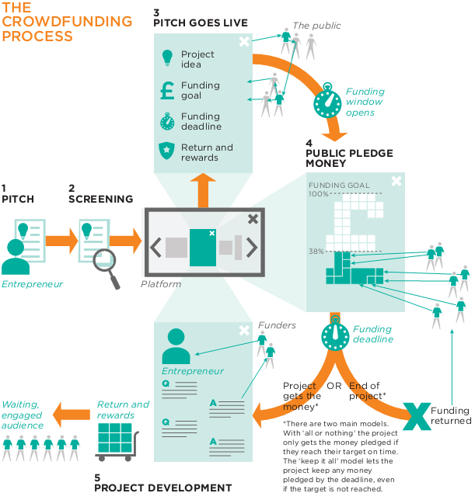
The CF Process
Pitch
Screening
Pitch Goes Live
Public Pledge Money
Project Development

Slide 9
CF Types
Equity – based: project backers have the right for a dividend generated through the income gained by an entrepreneurial incentive
Lending – based: in this form, the contributors are paid back for their financial involvement, and are entitled to an interest payment as well, in some cases
Donation – based: this form is characteristic for charity pledges, where the contributors are not compensated for their payments
Reward – based: the project backers are provided with a non-monetary reward for their contributions, for example a product, or an acknowledgment

Slide 10
Models of CF
All or Nothing – When the fund-raising period is over, money is only collected from the contributors if a pre-determined minimum amount of money has been pledged. If the goal is not met, no money is collected.
Keep it All – Whether the project goal is met or not, all of the funds collected (minus commission) are handed over to the entrepreneur. If he or she has insufficient funds to meet the objectives, then it is up to the recipient to refund them to the contributors.
Bounty – Funds are raised for the creation of a product or the solution of a particular problem (often a software bug). They are awarded when someone successfully provides the requested service.

Slide 11
«Do It Yourself» CF
The process of a crowdfunder not placing their campaign on any of the recognised CF platforms and choosing to run it themselves typically via their own online presence.
Drivers of DIY CF are:
The increasing number of successfully crowdfunded projects;
A desire to maximise returns by avoiding the costs associated with using a platform;
Increasing restrictions on many crowdfunding platforms;
The perceived decreasing advantages of discoverability on a major platform as they become more crowded;
Lower cost and higher availability of tools enabling it;
Integrates into digital business models.

Slide 12
Theories explaining Crowdfunding
The Pareto principle
Six degrees of separation
The social proof
Network externalities

Slide 13
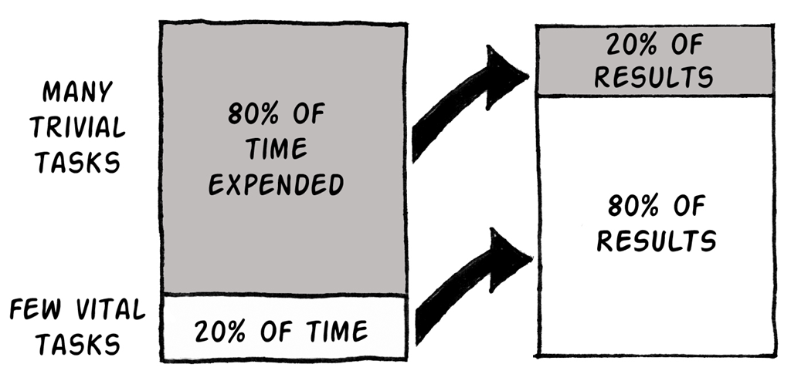
The Pareto «80-20» Rule
The Pareto principle (also known as the 80–20 rule, the law of the vital few, and the principle of factor sparsity) states that, for many events, roughly 80% of the effects come from 20% of the causes.

Slide 14
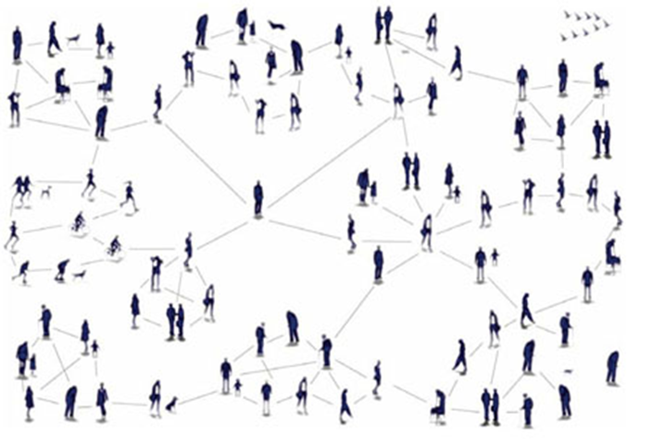
Six Degrees of Separation
Everyone and everything is six or fewer steps away, by way of introduction, from any other person in the world, so that a chain of "a friend of a friend" statements can be made to connect any two people in a maximum of six steps (J. Guare).

Slide 15
The Social Proof
The Social Exchange Theory
Social proof is the psychological principle that people are much more prone to do something when they see others doing the same thing.
Social proof is an important and proven marketing principle.
Social proof provide a signal to others that the person or project is worthy of a commitment

Slide 16
Network Externalities
The effect that one user of a good or service has on the value of that product to other people.
When network externalities are present, the value of a product or service is dependent on the number of others using it

Slide 17
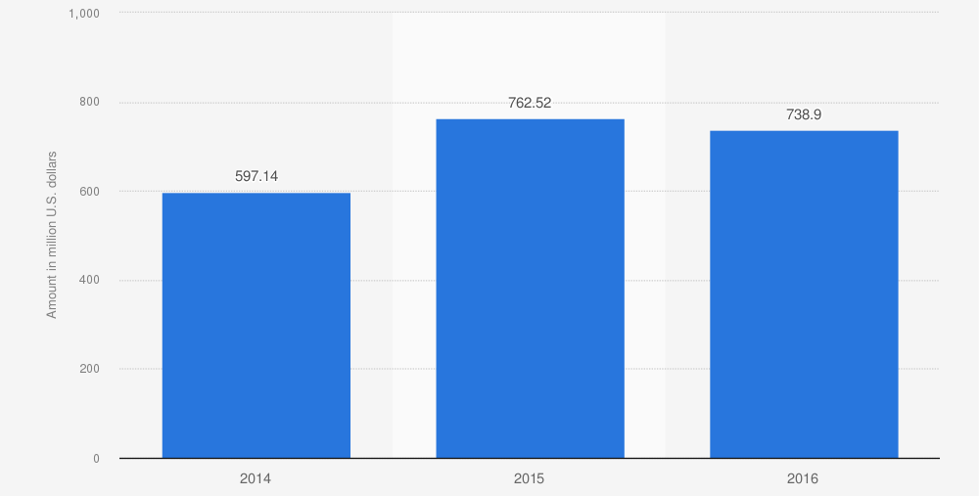
Data and statistics
Value of funds raised through crowdfunding worldwide from 2014 to 2016 in million U.S. dollars (Source: The Crowdfunding Center).

Slide 18
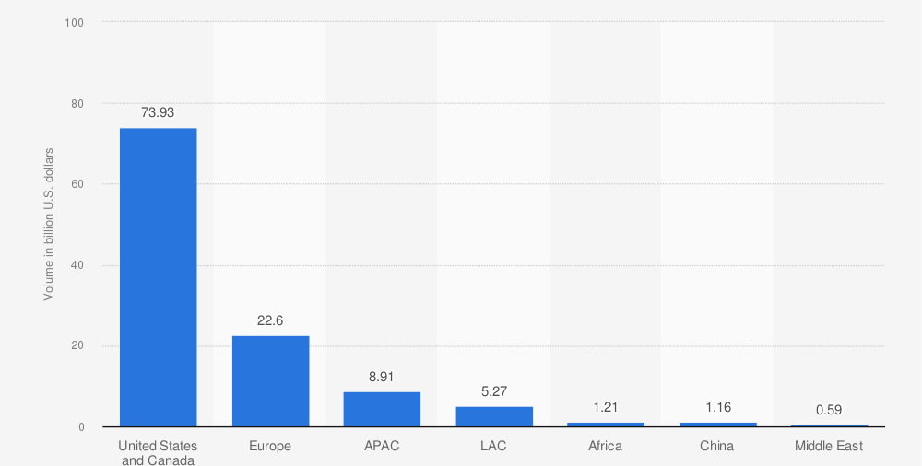
Data and statistics
Volume of funds raised through crowdfunding worldwide in 2020, by region in billion U.S. dollars (Source: Cambridge Judge Business School).

Slide 19
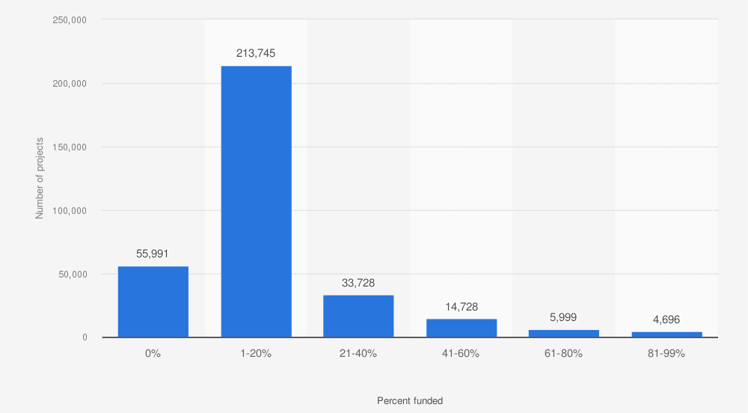
Data and statistics
Distribution of unsuccessfully funded projects on crowdfunding platform Kickstarter as of December 2021, by share of funding reached (Source: Kickstarter).

Slide 20
Steps for a successul campaign
Research: studying similar (successful and unsuccessful) campaigns and reviewing crowdfunding platforms;
Planning: particularly sorting your contacts and setting out a strategy;
Building your project: writing the copy for your project page, making a video;
Rewards: ensuring your rewards are attractive and you have considered; production/postage costs etc.;
Communications: mail-outs, social media, press, engaging your backers;
Post-campaign: production and delivery of rewards, backer communication.

Slide 21
Some facts
Once you’ve raised 40% of funds – visitors stay on page 31% longer and are 22% more likely to donate;
If a campaign reached its goal, 78% received more than goal;
Campaign with personal video raises 105% more than one without;
Projects with word count between 300 and 500 words raise the most money;
Most successful campaigns generally last between 20 and 40 days;
Campaigns with teams raise 38% more;
Campaigns with day-to-day marketing plans raise 180% more.
Source: GoGetFunding.Com (Dec. 13, 2013)

Slide 22
Types of Rewards
Donations
Sponsoring
Pre-selling (pre-order)
Lending: interest and payback of money lend
Equity: shares of the ventures

Slide 23
Setting the economic goal
The economic goal of the campaign should cover the project costs.
Typical costs of a CF project come from:
Campaign implementation (e.g., Pitch video production)
Project implementation
Rewards’ production and delivery
Marketing & Communication (if any)
Platform Fees (usually about 5%)
Don’t aim too high
Don’t be too modest

Slide 24
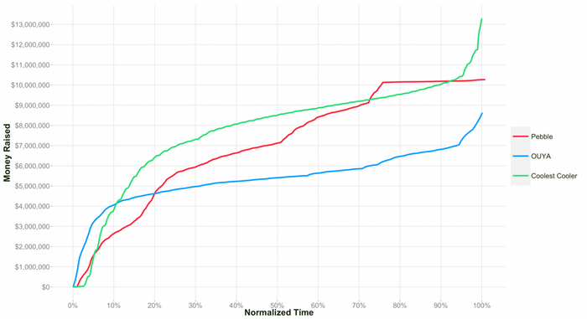
Timing of the project
Duration: 30 days better than 60 days
The first days are critical for the success of your campaign (see below).

Slide 25
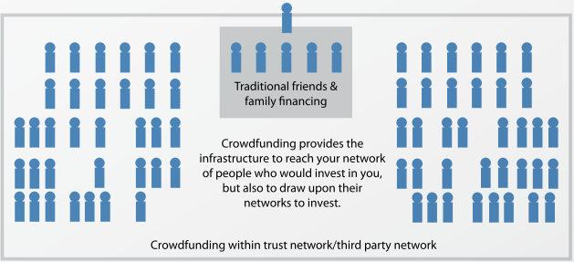
The role of trust

Slide 26
Marketing and Communication never end…
Before the Campaign
Creation of a community around the project
During the Campaign
The Project is online for 30-60 days
After the Campaign
Updates to Funders
Marketing and Communication

Slide 27
What to do
Build Media Relations For Long-Term Relationships
Setup a Press Room
Build Press Kit Full of Crowdfunding Campaign Content
Writing Effective Press Releases
Complete Analysis To Define Your target Market
Use Of Search Engine Optimization to Promote Campaign
Use Of Social Media Networks

Slide 28
Tips for a successful CF Pitch
The pitch needs to be short and pithy capturing the main points of the project idea.
The pitch also has to be aimed at the target audience of likely contributors.
Your story should be authentic, clear, and precise
Don’t assume your audience are experts in your field or even in investments
Show the investor what you already have
Choose the investment platform carefully

Slide 29
“Day-to-Day” Marketing Plan
Start before the campaign
Friends, family, local community, mailing list, linkedin group, meetups groups.
Find where you ideal customers are.
Media coverage
Enthusiast sites– Gizmodo/Techcrunch /IGD
Social Network – Kickstarter itself
Reputation of people associated with project
Select media used by your customers.

Slide 30
MASTER MEIM 2021-2022
Thanks for your attention!!
francesco.schiavone@uniparthenope.it

