Slide 1
MASTER MEIM 2021-2022
DIGITAL TECH
High Performance Computing
Lesson 1: Basic scientific computing tools
Prof. Ardelio Galletti
Prof. of Numerical Computing, Università degli Studi di Napoli Parthenope

Slide 2
Lesson 1: Basic scientific computing tools
Vectors (arrays)
Matrices
Linear systems

Slide 3
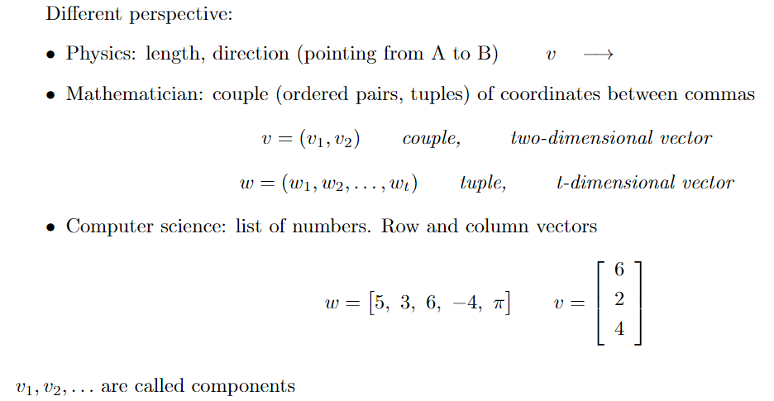
Vectors: preliminaries

Slide 4
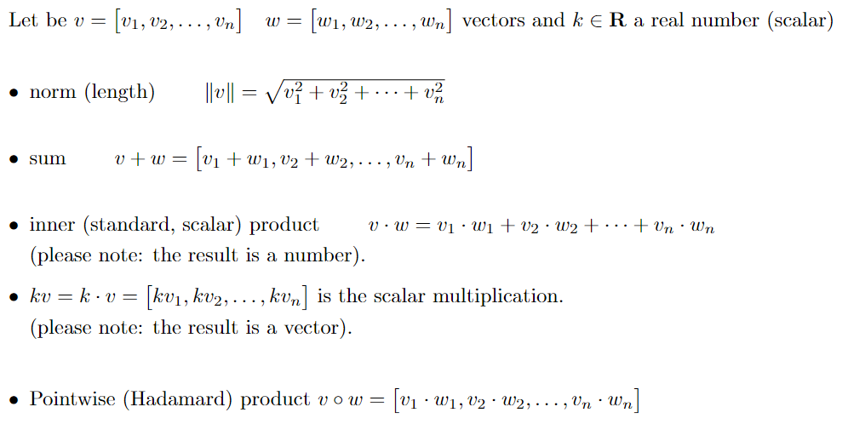
Vectors: preliminaries (2)
The resulting vector is k times as long as v (k times the original length

Slide 5
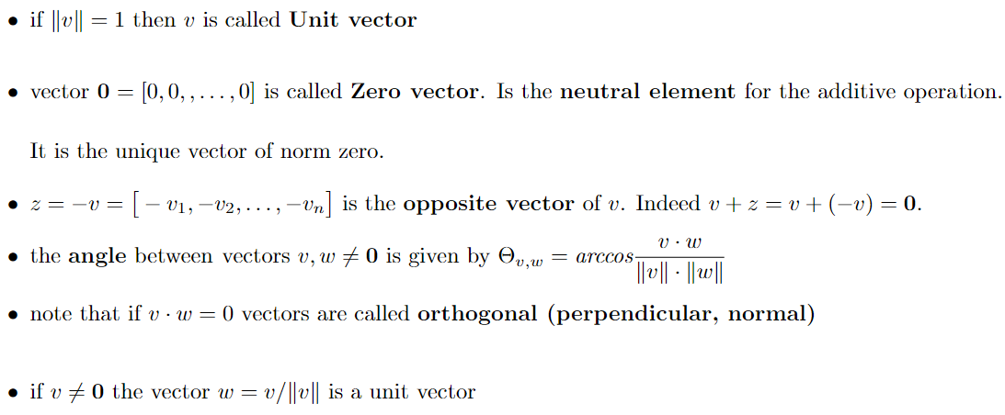
Vectors: preliminaries (3)

Slide 6
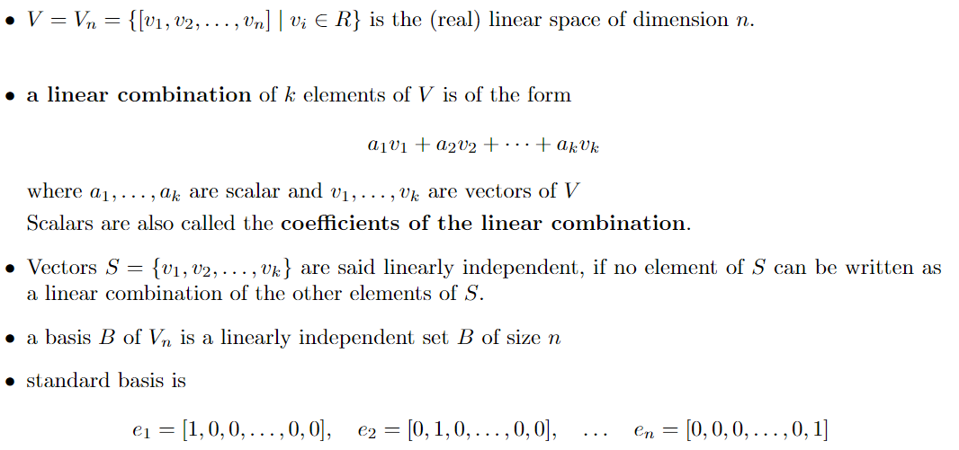
Vectors: preliminaries (4)

Slide 7
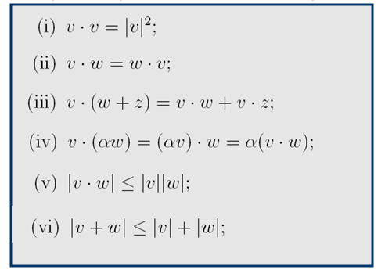
Vectors: preliminaries (5)
Cauchy-Schwartz
inequality
Triangle
inequality

Slide 8
Lesson 1: Basic scientific computing tools
Vectors (arrays)
Matrices
Linear systems

Slide 9
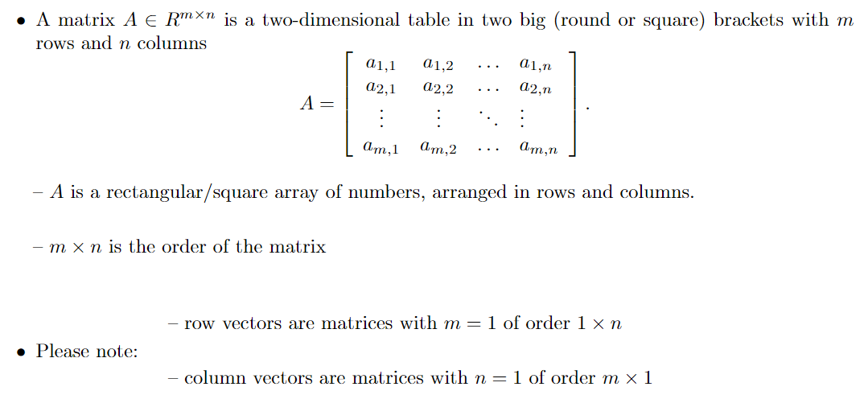
Matrices: main concepts

Slide 10
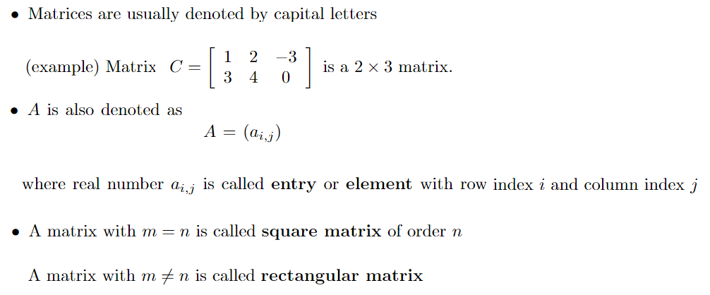
Matrices: main concepts

Slide 11
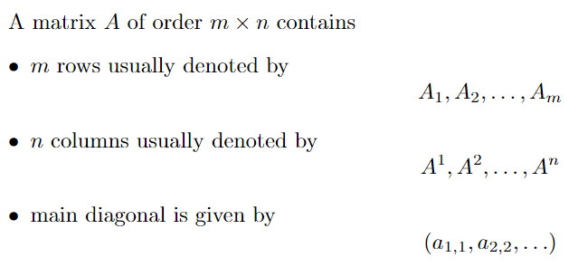
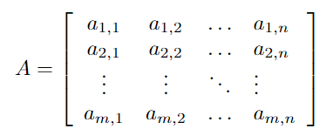
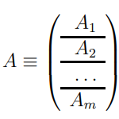
Matrices: main concepts

Slide 12
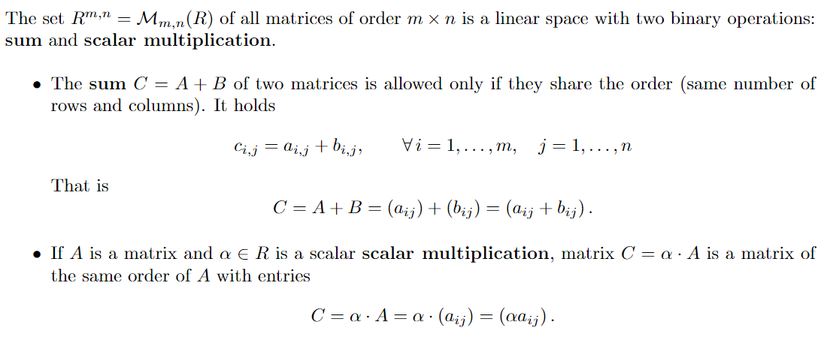
Matrices: main concepts

Slide 13
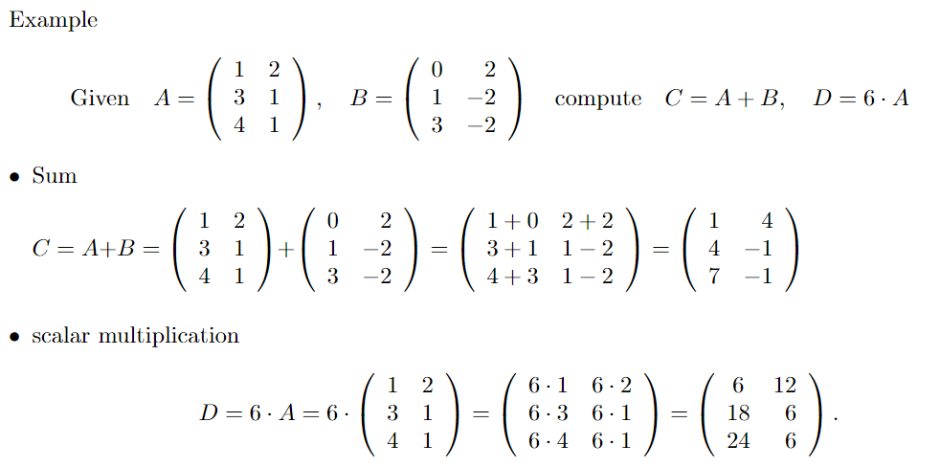
Matrices: main concepts

Slide 14
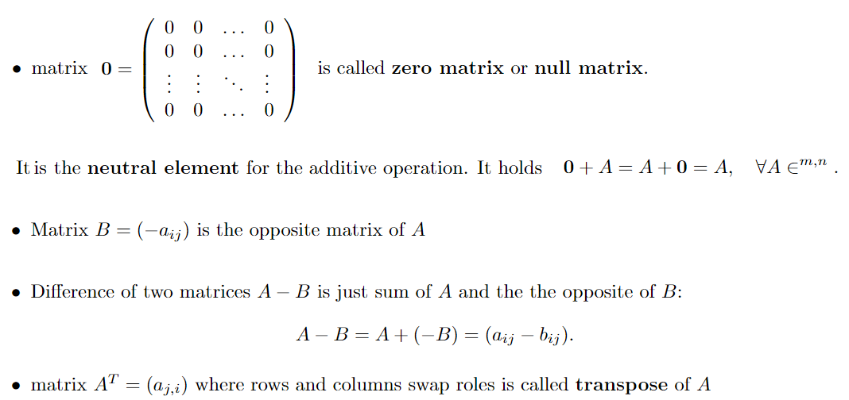
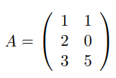
Matrices: main concepts

Slide 15
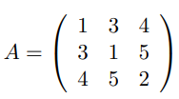
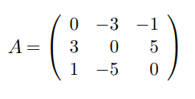
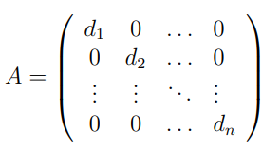
Matrices: main concepts

Slide 16
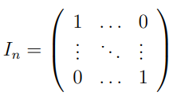
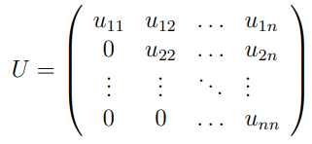
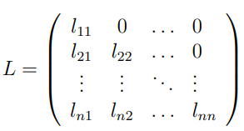
Matrices: main concepts

Slide 17
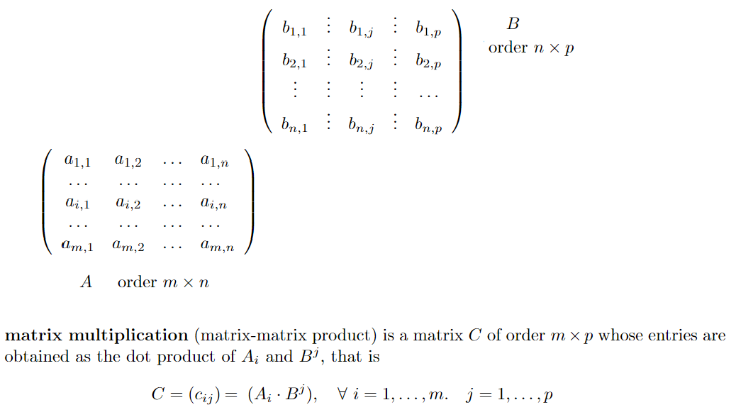
Matrices: multiplication

Slide 18
Matrices: multiplication

Slide 19
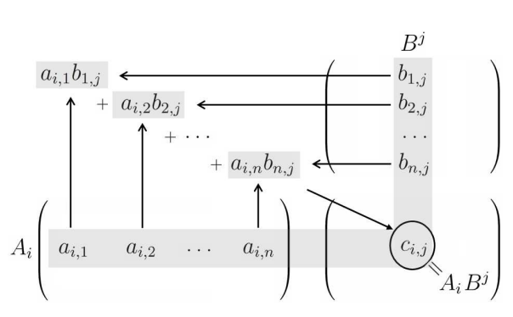
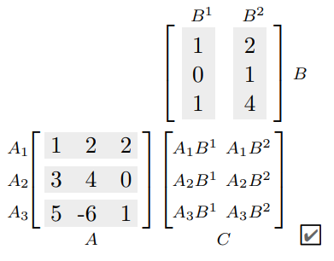
Matrices: multiplication

Slide 20
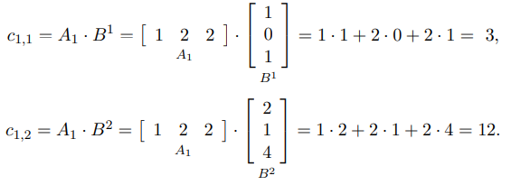
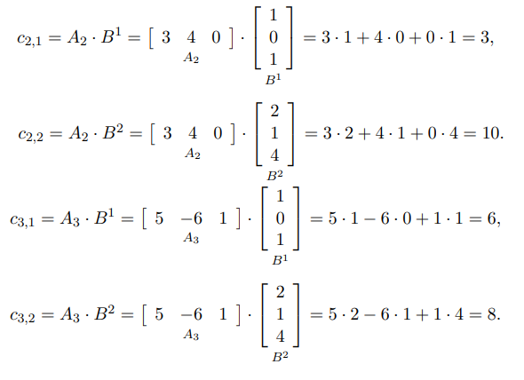
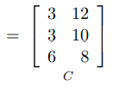
Matrices: multiplication

Slide 21
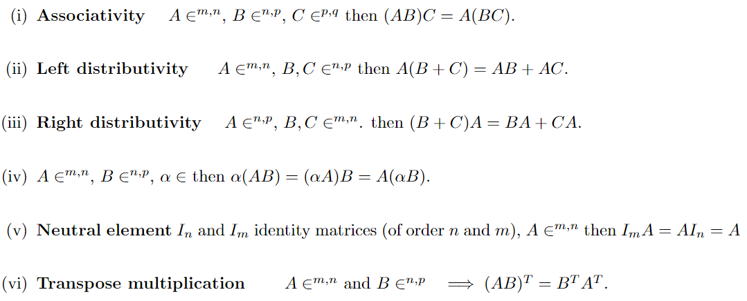
Matrices: multiplication (properties)

Slide 22
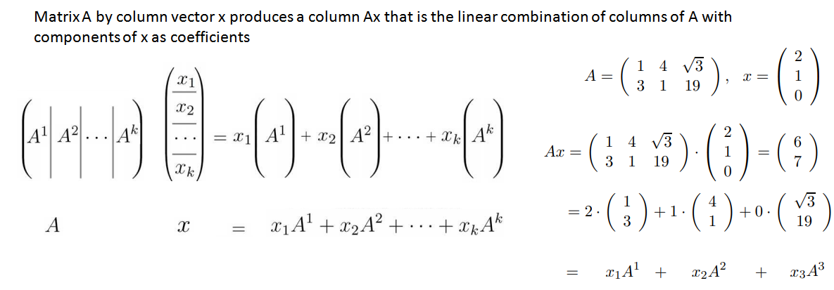
Matrices: matrix-vector multiplication as a linear combination

Slide 23
Matrices: vector – matrix multiplication as a linear combination

Slide 24
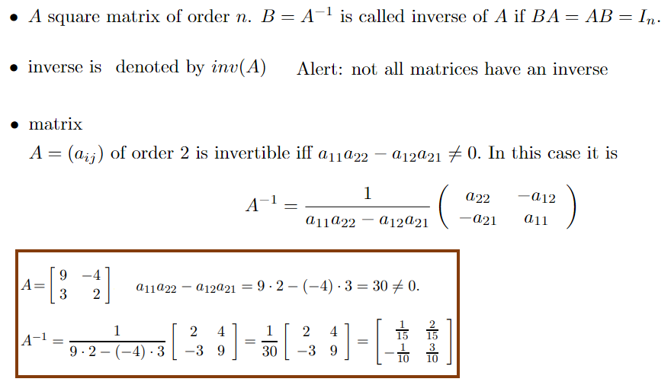
Matrices: inverse matrix

Slide 25
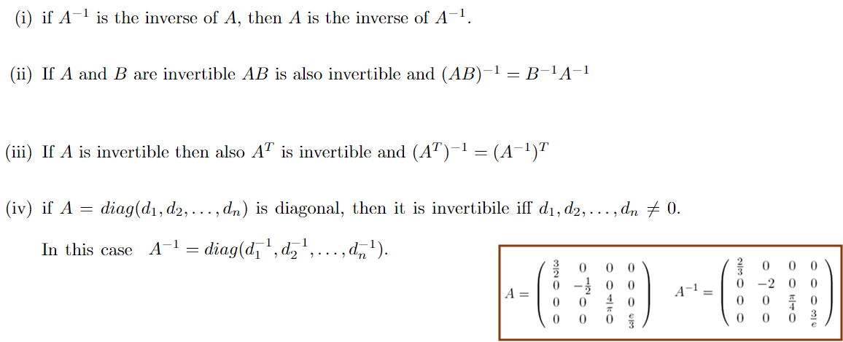
Matrices: inverse matrix (properties)

Slide 26
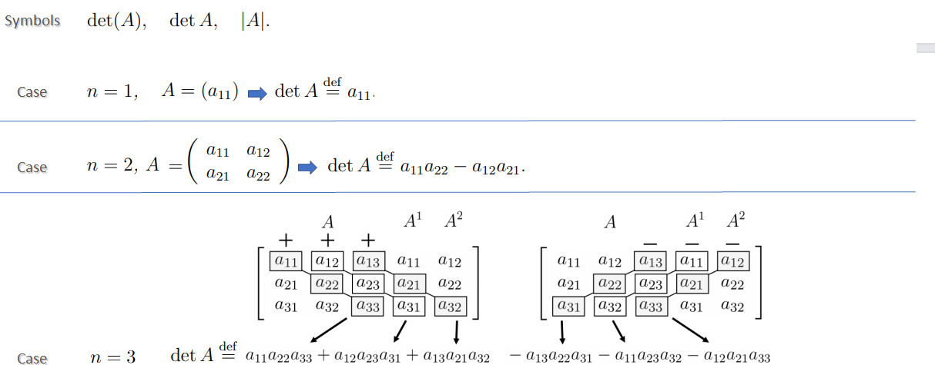
Matrices: determinant (small order n=1, n=2, n=3)

Slide 27
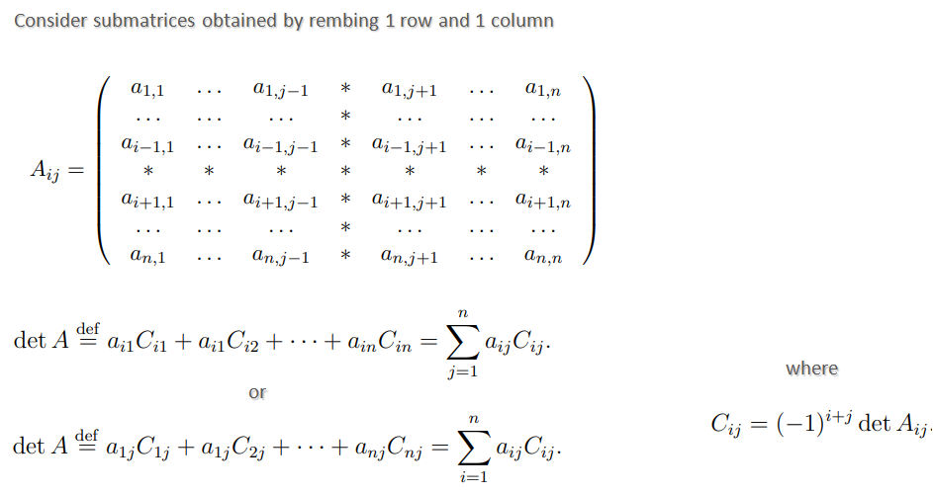
Matrices: determinant (Laplace expansion, recursive definition)

Slide 28
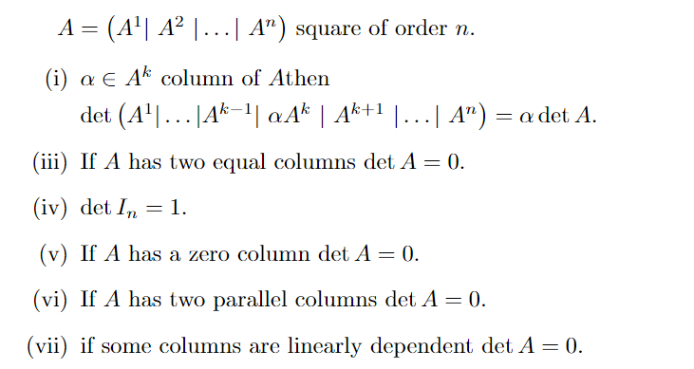
Matrices: determinant (properties)

Slide 29
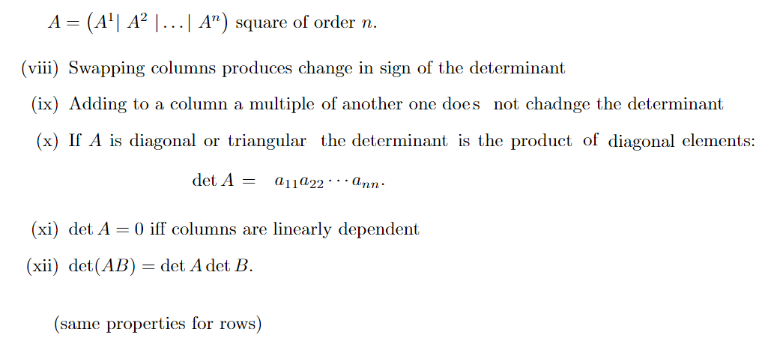
Matrices: determinant (properties)

Slide 30
Lesson 1: Basic scientific computing tools
Vectors (arrays)
Matrices
Linear systems

Slide 31
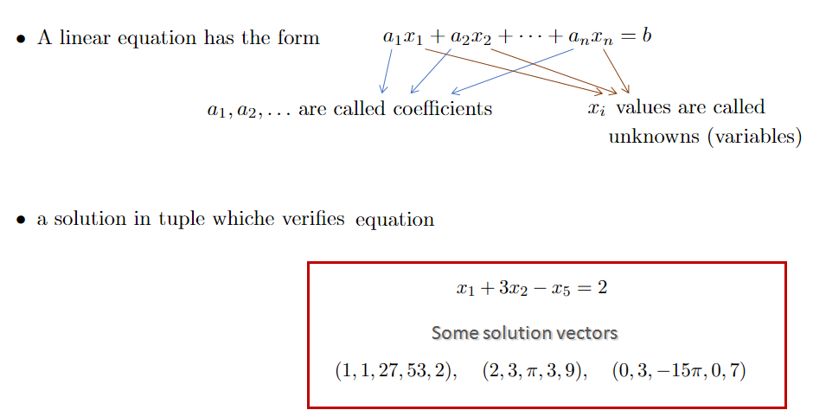
Linear systems: a linear equation …
Some solution vectors

Slide 32
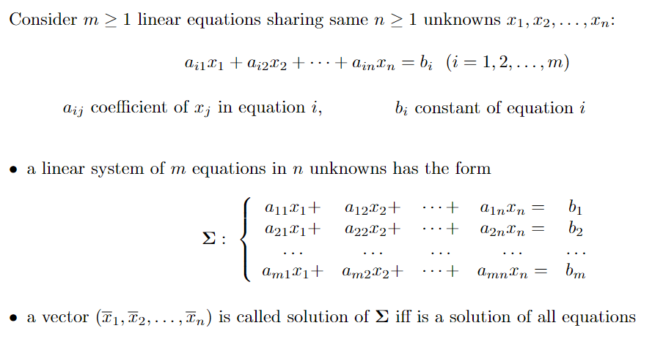
Linear systems: more linear equations, i.e linear systems

Slide 33
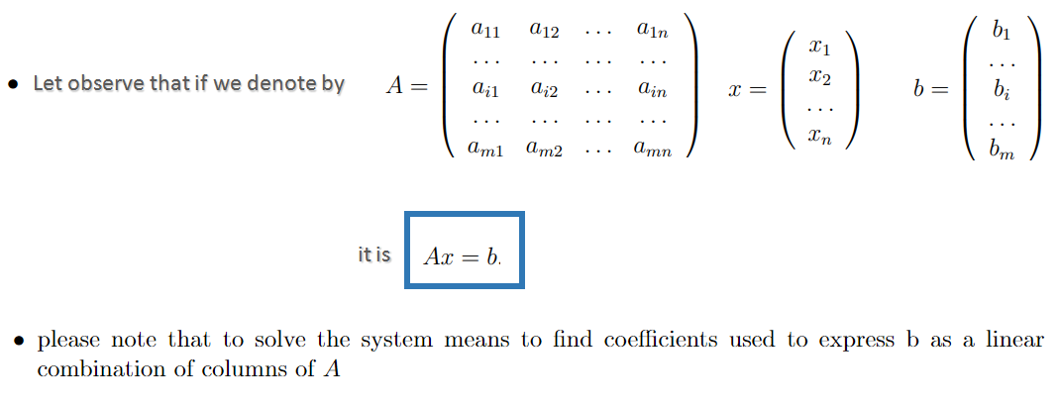
Linear systems: matrix form

Slide 34
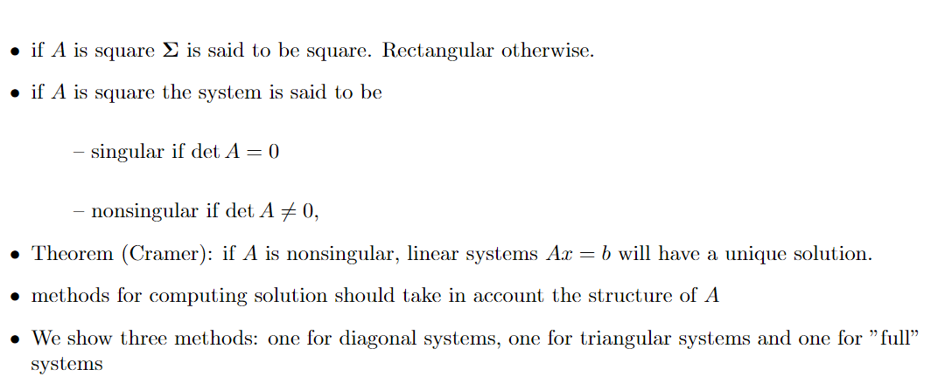
Linear systems: linear systems with a unique solution

Slide 35
Linear systems: DIAGONAL SYSTEMS
What linear systems are fast to solve?
DIAGONAL SYSTEMS
Immediate
solution

Slide 36
Linear systems: TRIANGULAR SYSTEMS
1)
TRIANGULAR SYSTEMS
2)
3)
4)

Slide 37
Linear systems: TRIANGULAR SYSTEMS
IN GENERAL → Backward Substitution Algorithm (matlab code)
x(n)=b(n)/A(n,n)
for i=n-1:-1:1
x(i)=b(i)
for j=i+1:n
x(i)=x(i)-A(i,j)*x(j)
end
x(i)=x(i)/A(i,i)
end

Slide 38
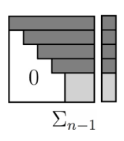
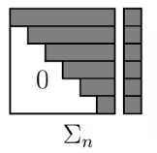
Linear systems: FULL SYSTEMS (Gaussian elimination)
Gaussian elimination method transforms a full system of n equations in a equivalent triangular one in n-1 steps
Idea
Step 1
Step 2
Step 3
…
Step n-2
Step n-1
How to do this?

Slide 39
Linear systems: Gaussian Elimination
IN GENERAL → Gaussian Elimination Algorithm (matlab code)
for k=1:n-1
for i=k+1:n
M(i)= A(i,k)/A(k,k)
for j=k+1:n
A(i,j)=A(i,j)-M(i)*A(k,j)
end
b(i)=b(i)-M(i)*b(k)
end
end

Slide 40
MASTER MEIM 2021-2022
Thanks for your attention
…… Digital Tech HPC continues

