Slide 1
Innovation & Entrepreneurship Session 4
Son Thi Kim LE
University of Littoral Côte d’Opale
France

Slide 2
Course sessions
1. Identify entrepreneurial ideas and opportunities
2. Building a business model and plan
3. Innovation and entrepreneurship
4. Innovation diffusion and Open innovation/Innovation network
5. Protecting intellectual property
6. Innovation management in resource-constrained environment

Slide 3
4. Innovation diffusion and Open innovation
Diffusion of innovation
Innovation as an interactive process
Open innovation/innovation network

Slide 4
a. Diffusion of Innovation
Innovation diffusion includes:
the process by which ideas underpinning product and business process innovations spread (innovation knowledge diffusion), and
the adoption of such products, or business processes by other firms (innovation output diffusion).
Innovation diffusion creates knowledge flows that lead to further innovations.

Slide 5
b. Innovation as an interactive process
Linear model of innovation
General or oriented knowledge
Location: public research centers and universities
Basic research
Applied research Invention
Tests, prototypes for mass production
Location: industrial laboratory
Applications of fundamental knowledge
Location: industrial laboratory
Technological development
Launching on the market
Innovation
Activities related to marketing (marketing, advertising, etc.)
Location: company

Slide 6
b. Innovation as an interactive process
R & D
(universities, public research laboratories, other companies)
Available Knowledge base/Knowledge set
Activities related to commercialization

Slide 7
c. Open Innovation / Innovation network

Slide 8
c. Open Innovation / Innovation network

Slide 9
c. Open Innovation / Innovation network

Slide 10
c. Open Innovation / Innovation network

Slide 11
c. Open Innovation / Innovation network

Slide 12
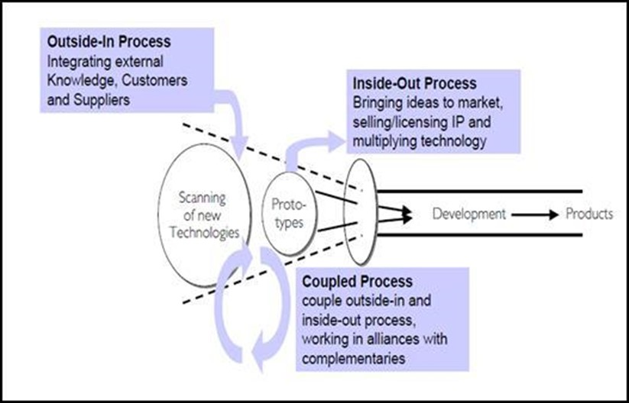
c. Open Innovation / Innovation network
Coupled open innovation
Examples of Coupled Open Innovation:-
Joint research projects between universities and industry partners.
Consortia or industry alliances focused on innovation.
Co-development agreements between companies in different sectors.

Slide 13
c. Open Innovation / Innovation network
Networked enterprises
1/ Central firm/ Holding company: focuses on core activities such as firms’ strategy, considered as a designer and an architect of a global network. 2/ Other independent entities (subcontracting, partnerships, licences, franchises): Outsources activities: the production of parts of the final products, the commercialization of final goods are managed through contracts with other more or less independent entities. These activities are mainly to deal with the implementation of the firm’s strategy.
Licensing
Internal subsidiaries
Subcontracting
Central firm/ Holding company
Subsidiaries acquired
Partnerships
Franchises
Core activities
Outsourced activities

Slide 14
Thank you for your attention
Don’t hesitate to contact me
if you have any question or you need further information
Son Thi Kim Le
ISI/Lab RII and ISCID-CO (ULCO)
Sontk.le@univ-littoral.fr

