Slide 1
MASTER MEIM 2022
Self-knowledge, identity and future
Master 2022
A cura del dott. Luca Fusco
Psicologo clinico e dell’orientamento
Assegnista di ricerca dell’Università degli studi di Napoli Parthenope

Slide 3
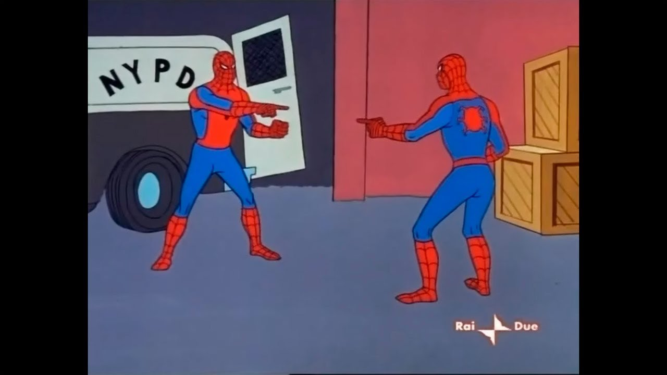

Slide 4
ACTIVITY NUMBER 2: SELF-EVALUATION

Slide 5
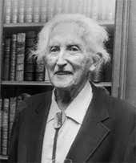
Definitions of Identity
«A fundamental organizing principle which develops constantly throughout the life span»
[Erik Erikson, 1968]

Slide 6
Definitions of Identity
«A feeling of samenees and continuity that accompanies the person in her/his life experiences»

Slide 8
Main identity processes
Exploration
Commitment
Reconsideration

Slide 9
Narrative Identity
«The Self as a story»

Slide 10
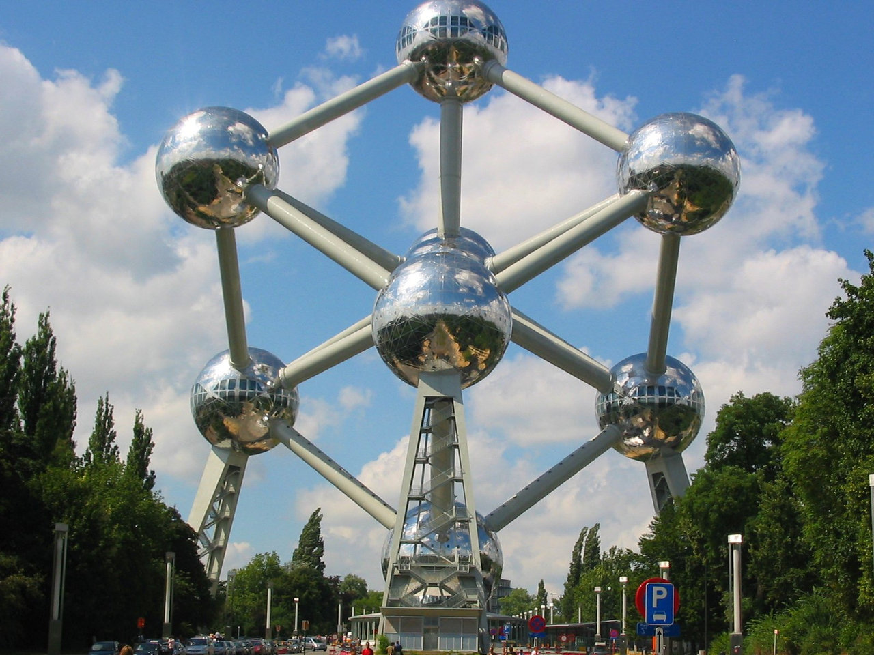
The self system
Present representations (core or peripheric)
Self-judgements
Domains of self (social identity, ethnic identity, occupational identity)
Temporal dimensions (past representations of self, possible selves)

Slide 11
Build your self structure
Choose the elements (things you are, things you do, things you will and things you want to do) that most describe yourself
Place them in your self structure (remember that central positions are occupied by core elements, essential qualities of yourself and side positions are occupied by more accessory elements)

Slide 12
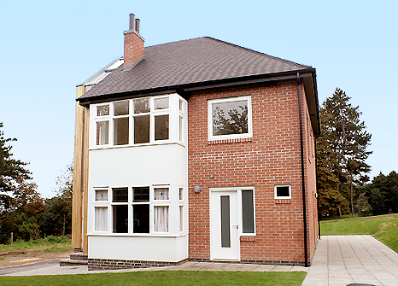
What are you taking home?

