Slide 1
MASTER MEIM 2021-2022
Different types of business strategies
MEIM
Master 2021-2022
SOTTOTITOLO DI ESEMPIO PER LA PRESENTAZIONE
A cura del prof. Francesco Calza
Prof. Di Management all’Università degli Studi di Napoli Parthenope

Slide 2
Industry Competition
Porter’s Model of Industry Competition, commonly known as “Porter’s Five Forces”
Porter’s Model provides a framework for analyzing the influence of the forces on the industry to determine the industry’s profitability and competitiveness.

Slide 3
Porter’s Five Forces model
The model is made up by identification of 5 fundamental competitive forces:
Barriers of New Entrants.
Threat of substitutes.
Bargaining power of buyers.
Bargaining power of suppliers.
Rivalry among existing firms.

Slide 4
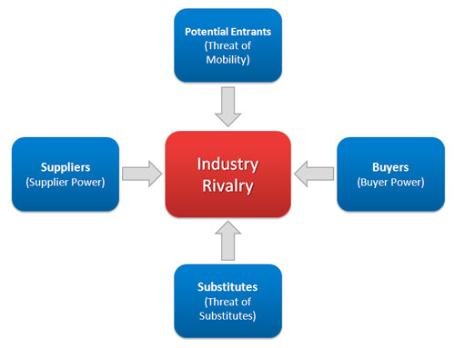
Porter’s Five-Forces Model of Competition

Slide 5
1. Threat of New Entrants
Fundamental question: how easy is it for another company to enter the industry?
Factors making easy entry to industry:
Low economies of scale.
Low product differentiation.
Low capital requirements.
No switching costs for buyer.
Easy access to distribution channels.
Little government regulation.

Slide 6
1. Threat of New Entrants
Factors making difficult entry to industry (Barriers to entry)
Need to gain economies of scale quickly.
Lack of experience.
Strong customer loyalty.
Strong brand preferences.
Large capital requirements.
Lack of access to raw materials.
Government policies and taxation.

Slide 7
2. Supplier Power
Fundamental question: how badly does a supplier need your business?
.
Factors giving power to supplier:
Supplier industry dominated by few firms.
Buyer is not important to customer.
Supplier’s product is important input to buyer’s product.
Supplier’s products have high switching costs.
Supplier can “integrate forward” and become competitor of buyer

Slide 8
3. Threat of Substitutes
Fundamental question: what other products or services could perform the same function as your
products or services?
.
Factors indicating high threat of substitutes:
Few switching costs for buyer.
Price of substitute lower or quality higher than for your products.
Firms offering substitutes have high profitability.

Slide 9
4. Buyer Power
Fundamental questions: How badly does a buyer need your products or services?
Factors contributing to high buyer power:
Few buyers compared to the number of sellers.
Buyers purchases high relative to seller’s sales.
Products are undifferentiated.
Buyer has low switching costs.
Buyer has low profits.
Buyer can “integrate backward” and supply the product to itself.

Slide 10
5. Competitive Rivalry
Fundamental question: how intense is competition in the industry?
Factors leading to high competitive rivalry:
Numerous or equally balanced competitors.
High fixed costs.
Slow industry growth.
Lack of differentiation or switching costs.
High strategic stakes.
High exit barriers.

Slide 11
Competitive advantage
When a firm earns higher economic profit than the average in its industry
Profitability depends on
-market level economics (the 5-forces)
-firm’s value creation relative to competitors
Value creation depends on
-cost position relative to competitors
-benefit position relative to competitors

Slide 12
Perceived benefit and consumer surplus
What is consumer surplus?
How could you measure it?

Slide 13
Components of value created
Consumer’s Surplus
B-P
.
Value created
Producer’s Profit
P-C
Cost
C
One Unit of product

Slide 14
Value created
Value created=Benefit to final customer- Cost of inputs=B-C
Value created=Consumer Surplus + Producer Profit= (B-P)+(P-C)

Slide 15
Value creation and value chain
To achieve a competitive advantage a firm’s product must create more value than its competitors
Value is created as goods move down the vertical chain
Therefore the vertical chain is referred to as the value chain

Slide 16
Strategic positioning for competitive advantage
The economics of cost advantage
The economics of benefit advantage
The importance of the price elasticity of demand

Slide 17
Importance of price elasticity
 | Cost advantage (low C vs competition) | Benefit advantage (high B vs competition)
High price elasticity of demand | Modest price cuts gain lots of market share Share strategy: Underprice competitors to gain share | Modest price hikes lose lots of market share Share strategy: Maintain price parity with competitors (let benefit advantage drive share)
Low price elasticity of demand | Big price cuts gain little market share Margin strategy: Maintain price parity with competitors (let lower cost drive higher margin) | Big price hikes lose little market share Margin strategy: Charge price premium relative to competitors.

Slide 18
Generic competitive strategies
Overall cost leadership
Differentiation
Focus

Slide 19
Business Strategies

Slide 20
Quality choice without competition
Should a firm produce more than, equal to, or less than the quality that suits average customer?
The product should be optimized to the lowest type of consumer
Two exceptions
-firm sells multiple products
-firm faces competition

Slide 21
Quality choice and competition
Two competitors should choose different qualities
One firm above and one below the average consumer’s position
The first entrant can stake out the more profitable position, and attempt to force the follower farther down
Thus, leader can accommodate or dissuade

Slide 22
Discussion question
Can a firm pursue cost and benefit advantage, or will it just be “Stuck in the middle”?

Slide 23
Impediments to imitation
Legal restrictions
Market size and scale economies
Superior access to inputs or consumers
Intangible barriers
Strategic fit

Slide 24
Early mover advantages
Learning curve
Network externalities
Reputation and buyer uncertainty
Buyer switching costs

Slide 25
Discussion question
Does the prospect of achieving early mover advantage stimulate or suppress competition?

Slide 26
Strategy Implementation Considerations
7-S Framework – Strategic Fit
Human Resources
Patience

Slide 27
7-S Framework
Shared Values
Strategy
Structure
Systems
Skills
Style
Staff

Slide 28
Human Resource Rule
Hire Smart
Train Hard
Manage Easy

