Slide 1
MASTER MEIM 2021-2022
Time, work and life.
Managing and un-managing your «soft» resources
A cura del dott. Luca Fusco, PhD
Psicologo clinico e dell’orientamento.

Slide 2
Program of the day:
Time management 8 am – 1 pm
2) Your time employment 2 pm – 6 pm

Slide 3
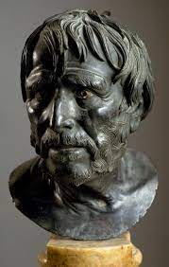
«Ci è stata data un vita abbastanza lunga e per il compimento di cose grandissime…»
Lucio Anneo Seneca,
«de brevitate vitae»

Slide 4
Which are your time issues?

Slide 5
Rate your time management…
From 1 to 10, how are you satysfied with your time management in relation to…
1) … your passions?
2) … your health and well-being (physical and mental)?
3) … your family?
4) … your friends?
5) … your career?
6) … your fun?
7) … any other domains of your life?

Slide 6
Rate your time management…
Look at your lower scores…
…which are the obstacles that led you not to be satysfied about your time management?

Slide 7
«…quando si perde tra il lusso e la trascuratezza, quando non la si spende per nessuna cosa utile, quando infine ci costringe la necessità suprema, ci accorgiamo che è già passata mentre non capivamo che stesse passando. È così: non abbiamo ricevuto una vita breve, ma la rendiamo tale, e non siamo poveri di essa ma prodighi. Come ricchezze notevoli e regali, quando sono giunte ad un cattivo padrone, in un attimo si dissipano, ma, sebbene modeste, se sono state consegnate ad un buon amministratore, crescono con l'uso, così la nostra vita dura molto di più per chi la dispone bene.»

Slide 8
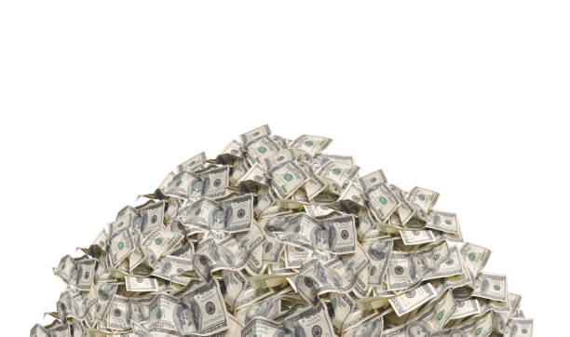
Time = money?

Slide 10
Time is not just quantity… It’s quality!
Time management is not just about how you employ your time.
It’s also about how you live your time.

Slide 11
Time perspective (Zimbardo and Boyd, 1999)
Future time perspective
Present – hedonistic perspective
Present – fatalistic perspective
Past – negative time perspective
Past- positive time perspective

Slide 12
Affluent time vs Pressured time
Time affluence (compared to time pressure) broadens individual’s cognitive perspective, reduces negative affective states, and promotes individual well-being (Levesque & Stephan, 2020)

Slide 14
What’s your cyrcadian rhytm?
How could you connect your body clock with your work?
Create your routine in hours:
Then insert the following expressions next to the blocks:
“on fire,’ ‘vibrant,’ ‘cruise control,’ ‘at 70%’, ‘distracted,’ ‘slowing down,’ ‘tired,’ ‘hungry’
What is the most active part of your day ‘on fire’?
What is the most ‘distracted’ part of the day?
During which part of the day is it better to complete the hardest/most manageable tasks?
When is it best to take a break?
Who has similar working/ relaxing rhythms in your team?

Slide 15
«Comportati così, Lucilio mio, rivendica il tuo diritto su te stesso e il tempo che fino ad oggi ti veniva portato via o carpito o andava perduto raccoglilo e fanne tesoro. Convinciti che è proprio così, come ti scrivo: certi momenti ci vengono portati via, altri sottratti e altri ancora si perdono nel vento. Ma la cosa più vergognosa è perdere tempo per negligenza. Pensaci bene: della nostra esistenza buona parte si dilegua nel fare il male, la maggior parte nel non far niente e tutto quanto nell’agire diversamente dal dovuto.
Puoi indicarmi qualcuno che dia un giusto valore al suo tempo, e alla sua giornata, che capisce di morire ogni giorno? Ecco il nostro errore: vediamo la morte di fronte a noi e invece gran parte di essa è alle nostre spalle; appartiene alla morte la vita passata. Dunque, Lucilio caro, fai quel che mi scrivi: metti a frutto ogni minuto; sarai meno schiavo del futuro, se ti impadronirai del presente.»
Lucio Anneo Seneca, «Epistulae moralae ad Lucilium»

Slide 16
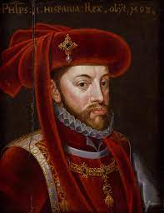
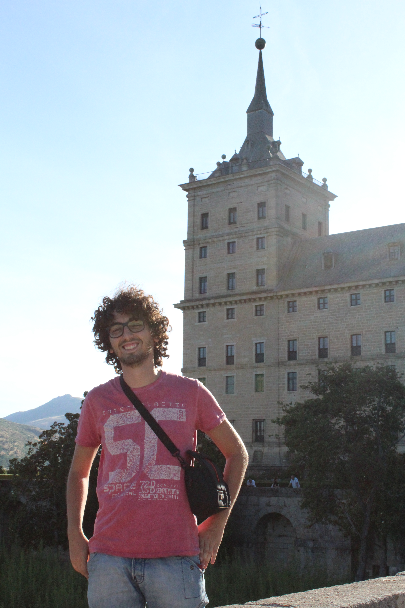
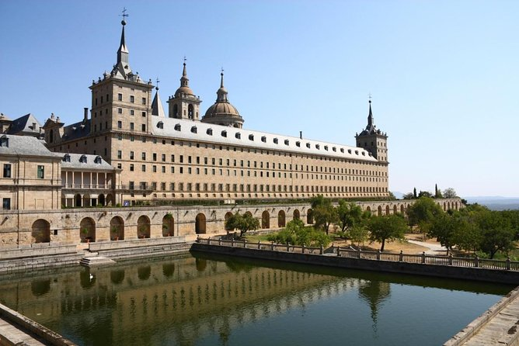
Time and work? A bit of history…
1593: Felipe II sets an 8 hour limit for the workers in the Spanish empire (4 in the morning – 4 in the afternoon) in order to prevent health problems related to sun exposure.

Slide 17
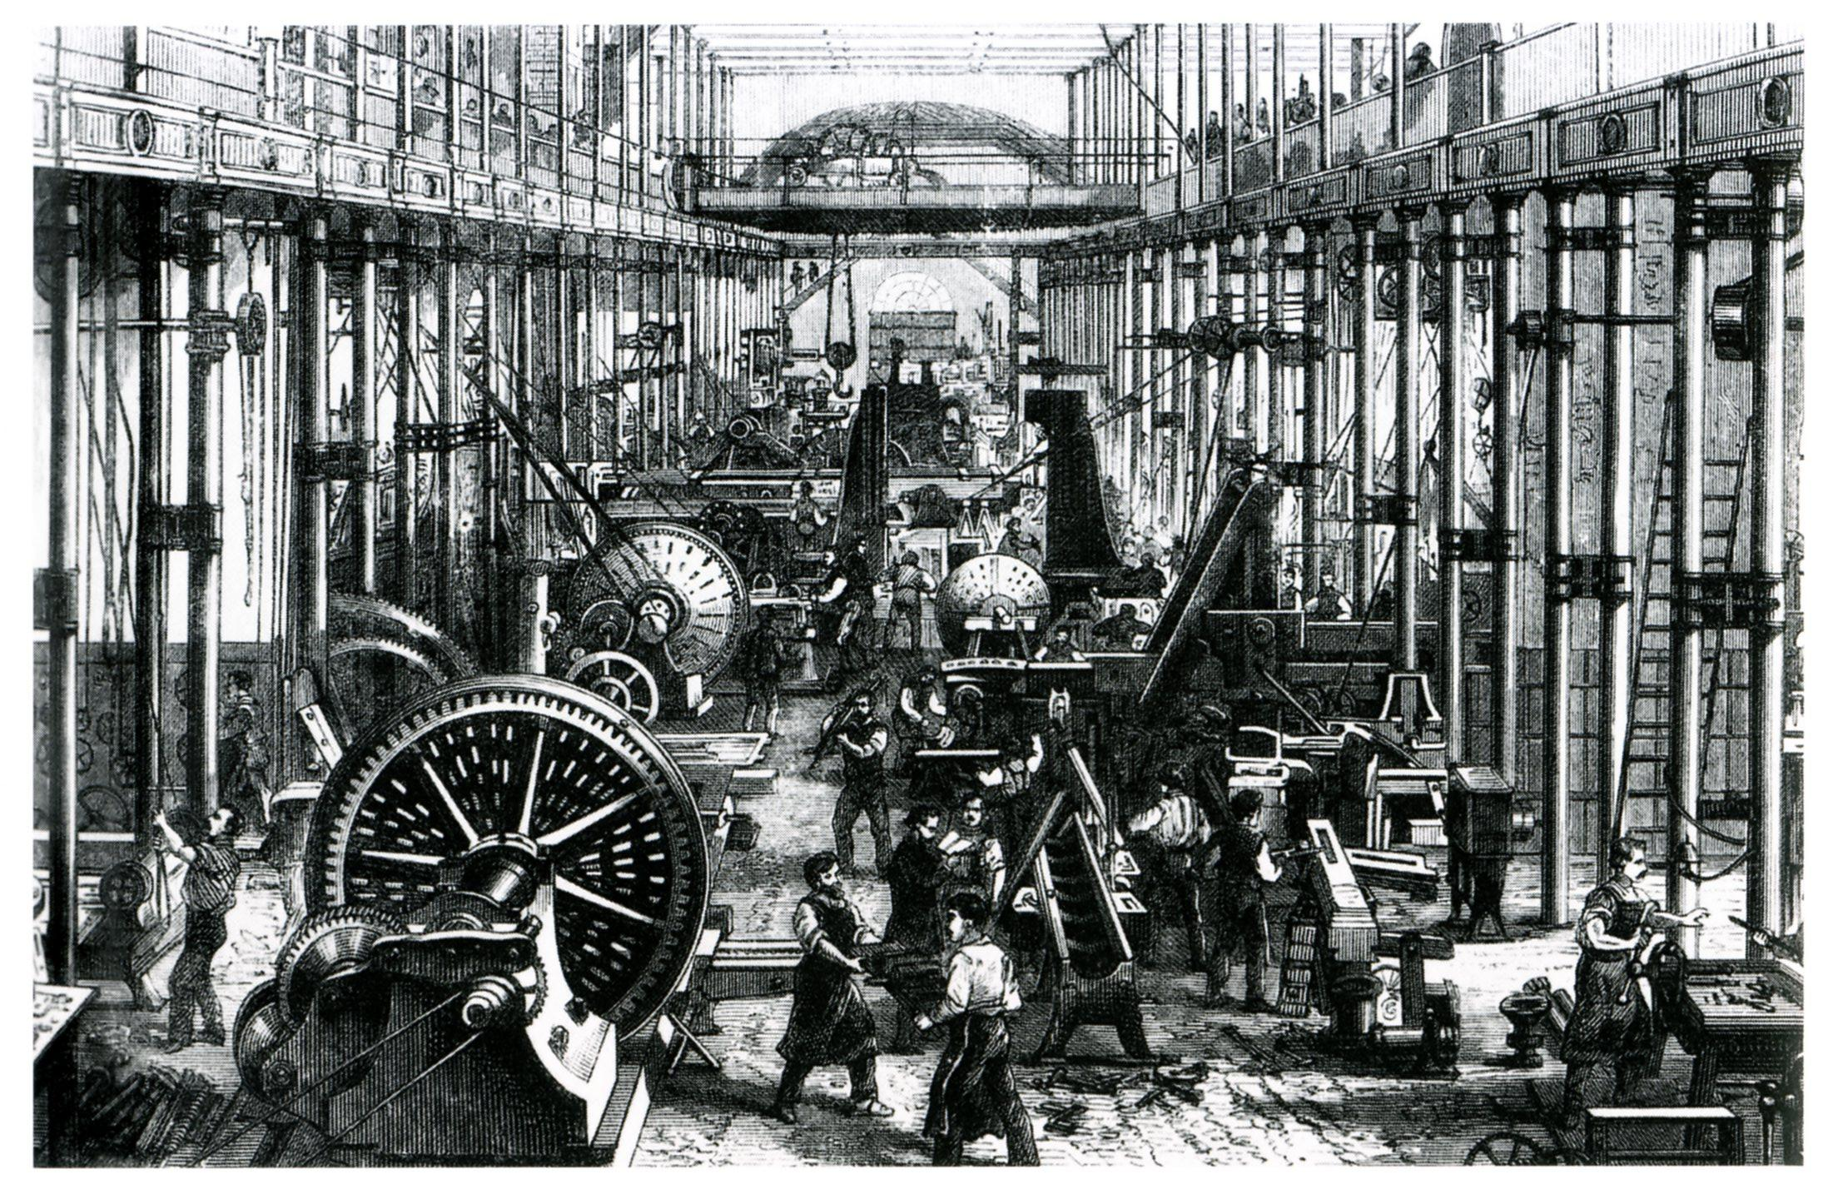
Time and work? A bit of history…
Industrial revolution:
1810 Robert Owen (entrepreneur) introduces the
10 hours limit.
1847: Great Britain sets the mandatory 10 hours limit
1848: France sets the mandatory 12 hours limit

Slide 18
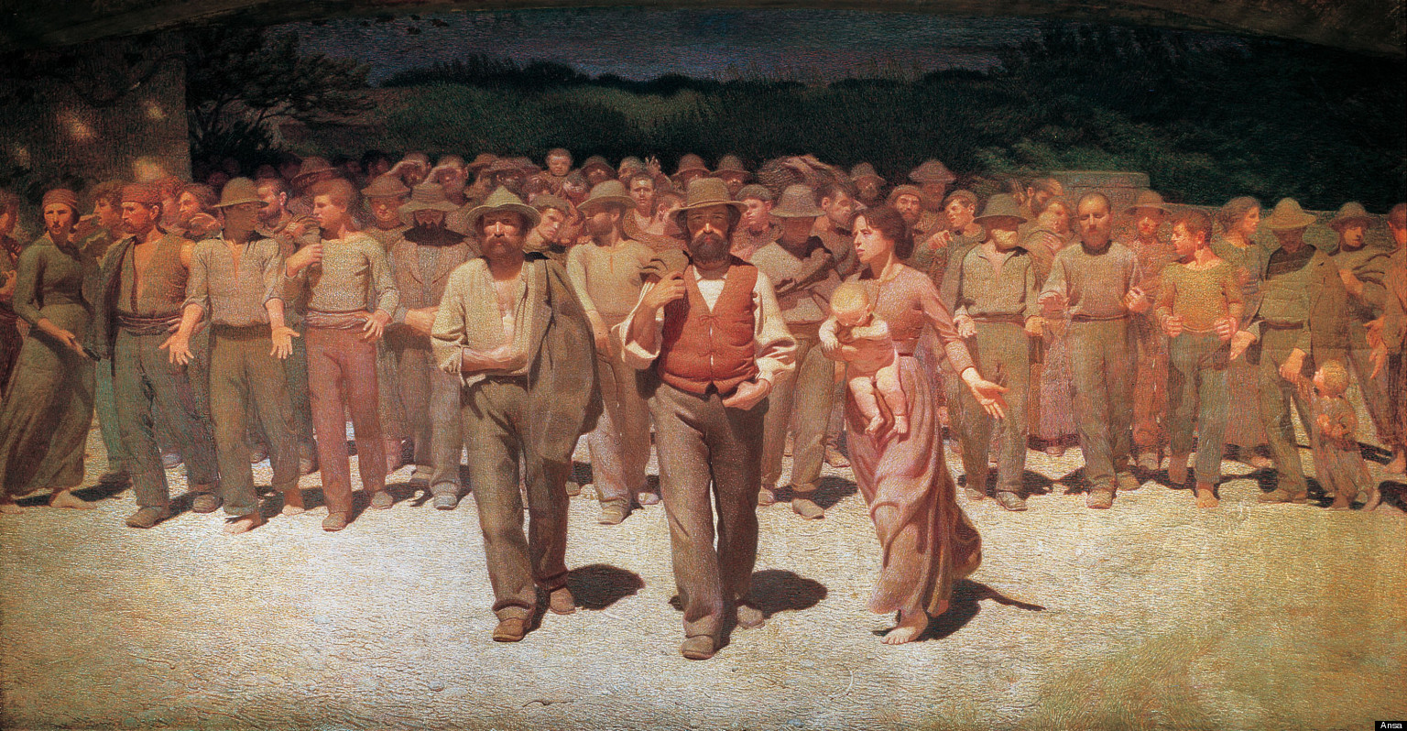
Time and work? A bit of history…
- The America Federation of Labour meeting in December 1888, set 1 May 1890 as the day that American workers should work no more than eight hours
- 1919, International Labour Organization ILO sets the 8 daily hours and 48 weekly hours limit
- Italy 1919: FIOM obtains an agreement for the 8 hours limit
Between 1969 and 1970 the weekly limit is set at 40 hours

Slide 19
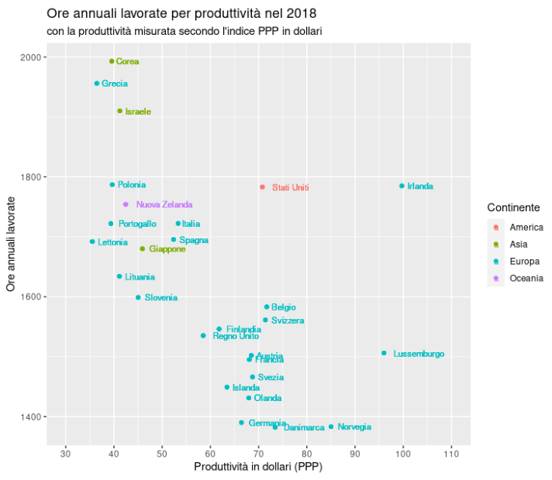
Tempo e produttività

Slide 20
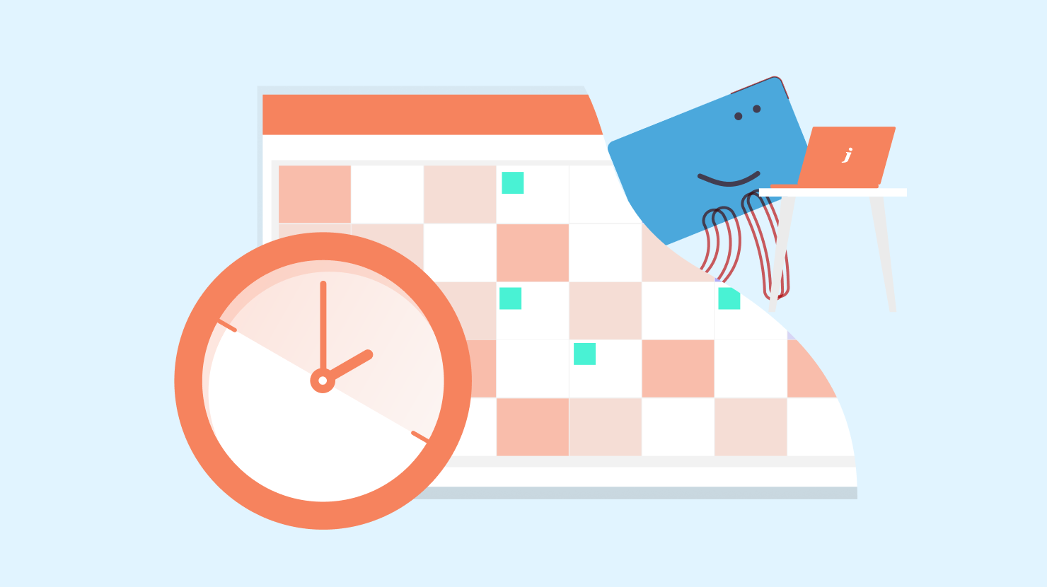
Time and work? A bit of history…
New challenges:
6 hours day
4 days week

Slide 21
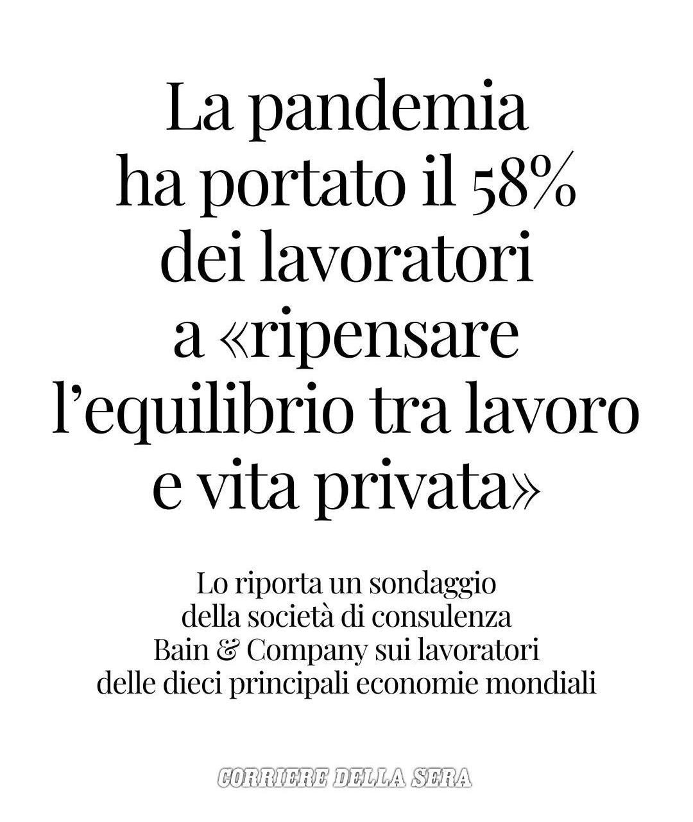

Slide 22
Smart working vs traditional working?

Slide 23
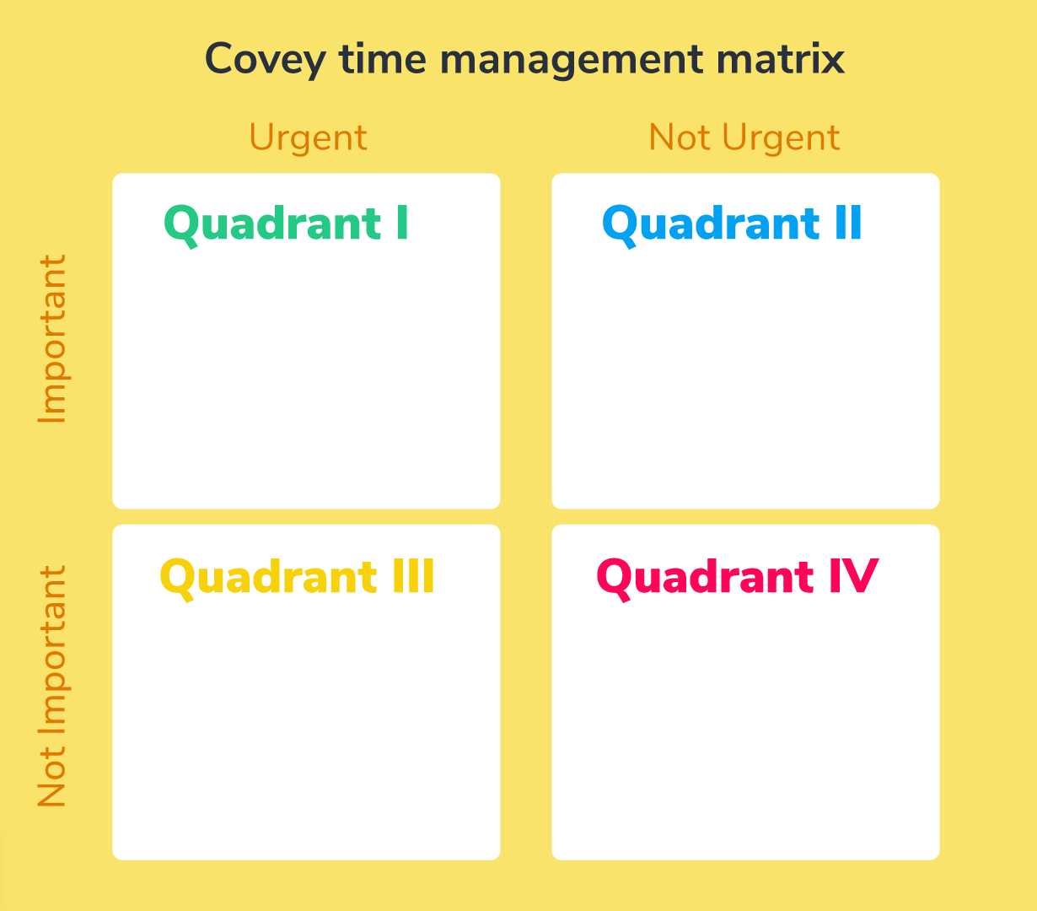
DO IT!
Schedule
Delegate
Eliminate

Slide 24
Delegation tasks!
Choose a very boring task you experienced in your work, education or private life.
Choose an employee in the group and give him instruction to delegate to him the task.

Slide 25
Did the delegator explain how important the task was?
Did the delegator expose the purpose of the task?
Did the delegator expose the employee to do the task?
Did the employer ask any questions about the task? Did he understand the task?

Slide 26
Techniques:
To do lists
Timeboxing
Hell yeah or no
Artificial deadlines
Protected time
Daily highligth
Daily numbers
Ideas notebook
Let it go
Lists and more lists!

Slide 27
Protected time
Create a «box» dedicated to yourself and your most beloved personal and professional activities.

Slide 28
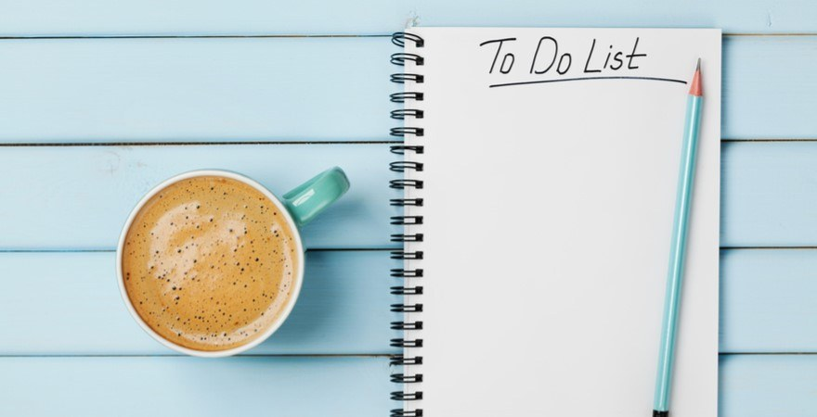
Useful if you’re worried about forgetting tasks to do.
If you’re afraid to organize
Risky if you’re not in control of the achievement of the tasks

Slide 29
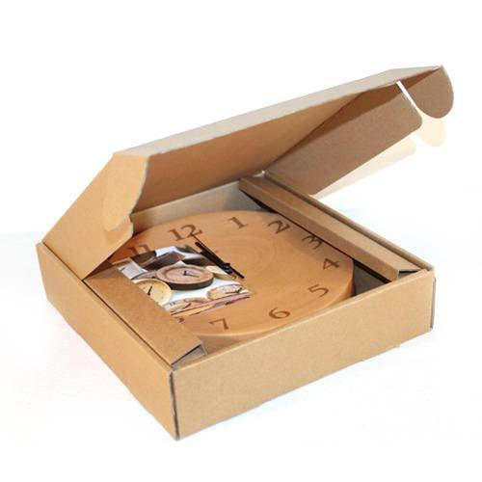
Timeboxing
Create boxes of your days and precisely plan each activity you’re going to work on, and your breaks.
Best moment to plan your day is the night before!

Slide 31
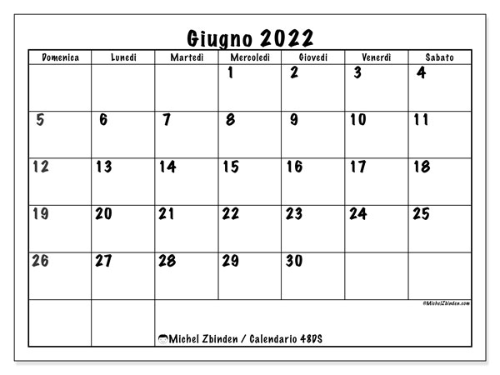
DAILY HIGHLIGHT
Giving yourself a daily highlight is a useful tool if you’re afraid dislocating your attention too much.
It gives you the opportunity to focus your attention on achieving one goal per-day.

Slide 32
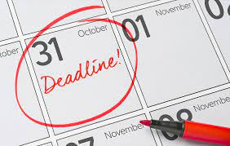
Setting personal deadlines for self-directed tasks is a useful methods if you’re afraid procrastinating too much when working at a personal project.
You should set multiple day limits working at different advancements of the same day project.
You should be flexible enough to give you the opportunity of setting a delay, but also disciplined enough to make this deadline a real stimulus to work in the present.

Slide 33
DAILY HIGHLIGHT
Giving yourself a daily highlight is a useful tool if you’re afraid dislocating your attention too much.
It gives you the opportunity to focus your attention on achieving one goal per-day.

Slide 34
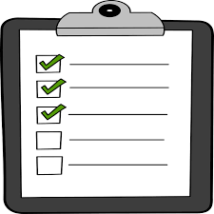
Daily numbers
Consider your workday over when you have achieved a self-set number of tasks (like from 3 to 5).
This technique will allow you to set your days based on achievements and not on time
Very useful if you want to focus on productiveness.

Slide 35
«Hell yeah!» or no
Choose if accepting a task basing on your personal enthusiasm.
Useful for busy people and people who get stuck in working at things they’re not interested in.

Slide 36
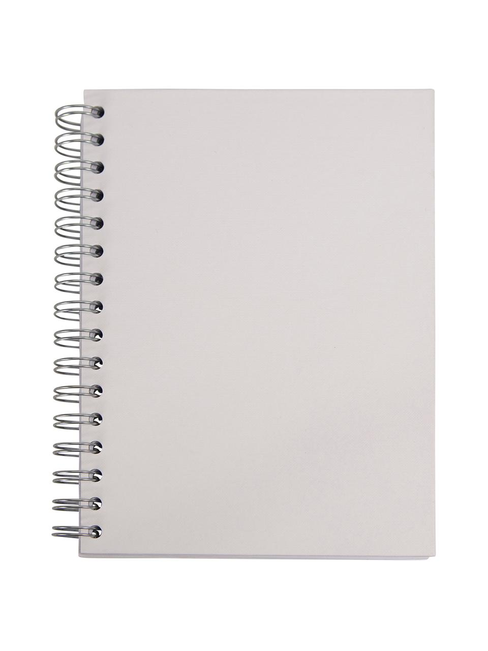
Ideas notebook
This is a great technique if you both want to keep your attention on your work and at the same time give importance to your creativity.
Keep your ideas notebook next to you while you work.
If you get an idea, take note of it and go back to your work.
Then set a specific time of your day (like one hour) in which you develop your new ideas.

Slide 37
«Nessuno ti renderà gli anni, nessuno ti restituirà a te stesso; andrà il tempo della vita per la via intrapresa e non tornerà indietro né arresterà il suo corso; non farà rumore, non darà segno della sua velocità: scorrerà in silenzio, non si allungherà per editto di Re o favore di popolo; correrà come è partito dal primo giorno, non farà mai fermate, mai soste. Che avverrà? tu sei affaccendato, la vita si affretta: e intanto sarà lì la morte, per la quale, tu voglia o no, devi aver tempo.»

Slide 38
Techniques:
To do lists
Timeboxing
Hell yeah or no
Artificial deadlines
Protected time
Daily highligth
Daily numbers
Ideas notebook
Let it go
Lists and more lists!

Slide 39
Task # 1: What if… individual ideas
«How would you employ your time and energies if you were 100% sure you had infinite financial resources for your life, no social pressure or expectations about your jobs or occupations?»

Slide 40
Task # 2: What if… group project
In groups from two to five, choose a project you would dedicate your energies together if you had the conditions previosly mentioned (infinite financial resources for your life, no social pressure or expectations about your jobs or occupations).
First, you should decide your teams, according to how your personal motivations best fit with your other team members.
The project can’t provide you with any form of financial profit and can be of any kind: a start-up, a no-profit , a cultural club, a football team, etc.
Provide us with most details on your project: what the role each of you would have, what the goal of the project would be, which are the personal motivation of each of you for joining the group.
Prepare a power point and present it in 10/20 minutes.

