Slide 1
MASTER MEIM 2021-2022
Case study: HPC for environmental forecasting
Using HPC to deliver a science-inspired startup service for muggles
Prof. Raffaele Montella - raffaele.montella@uniparthenope.it http://raffaelemontella.it
Associate Professor of Computer Science

Slide 2
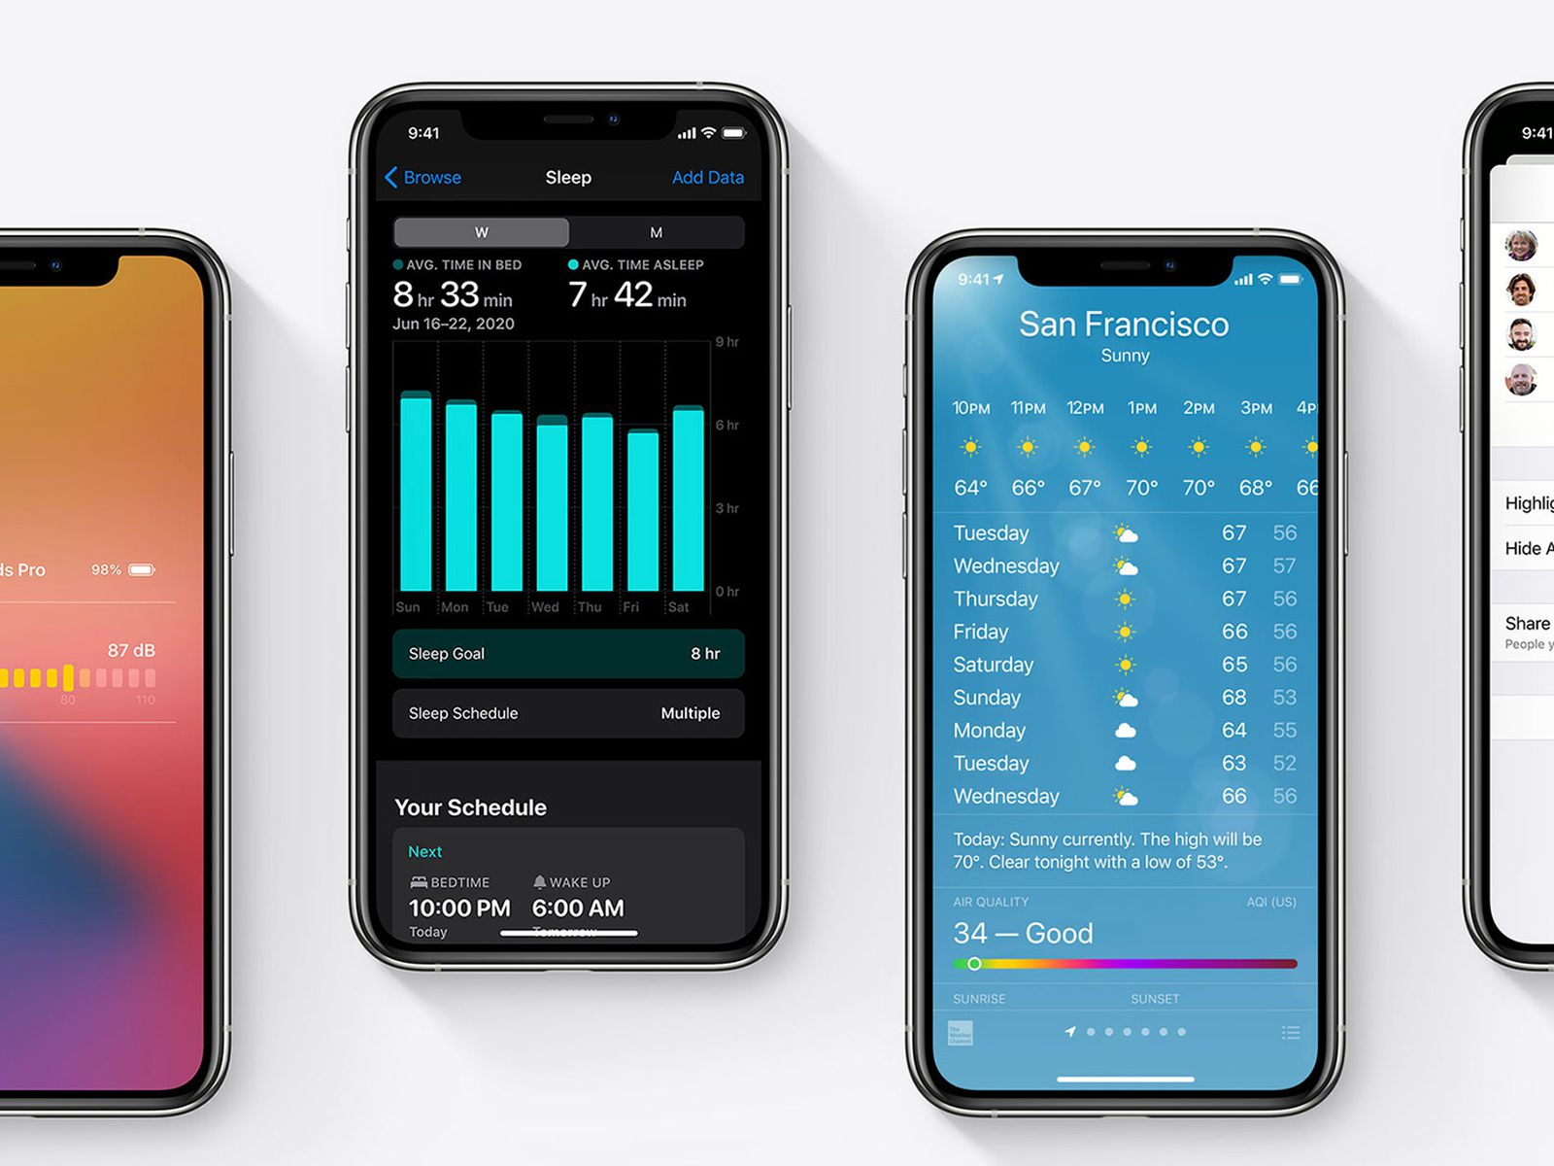
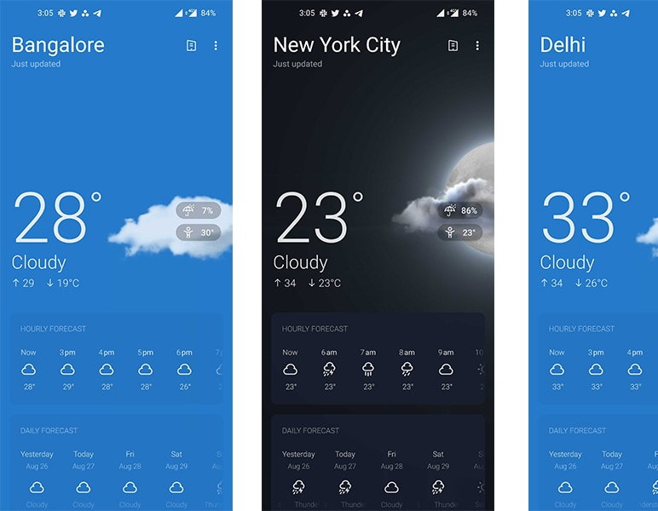
“...check the weather app…”
Performing a weather forecast is easy as 1, 2, 3: an app does that in a matter of secs...

Slide 3
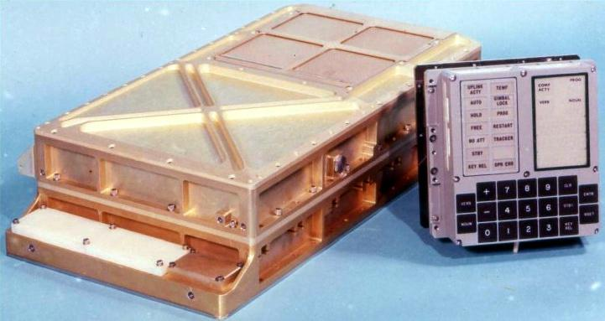
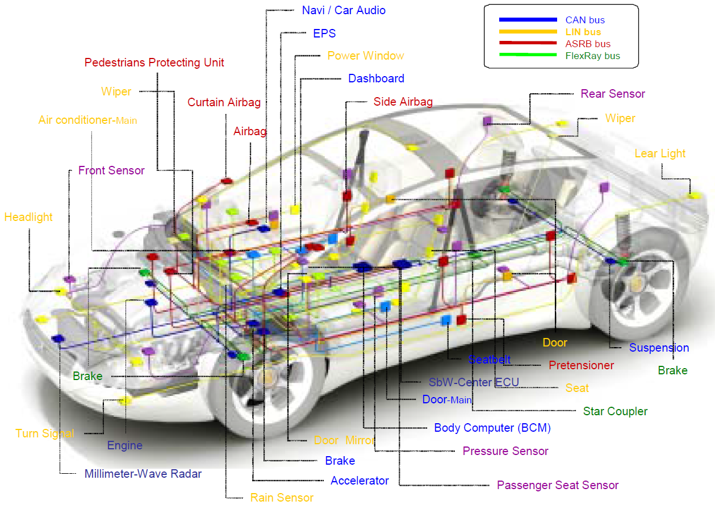
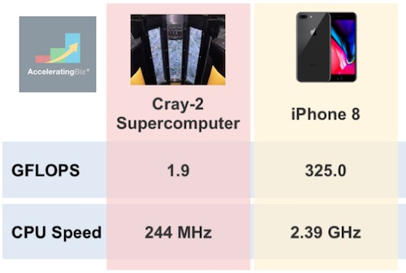
“…and
Since 1999 each car is provided with more computing power than what has been used to send man to the Moon and back in 1969.
An iPhone 8 (2017) has more computing power than a 1985 Cray-2 supercomputing.
Nevertheless…

Slide 4
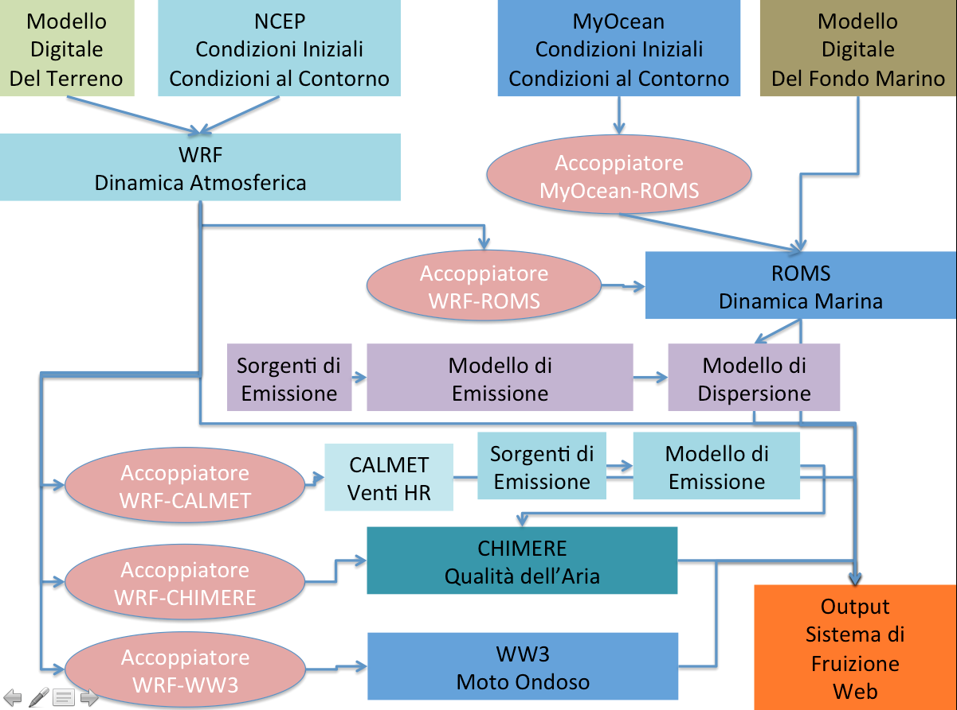
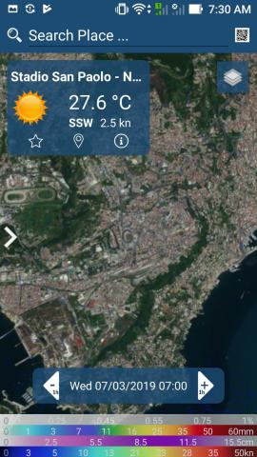
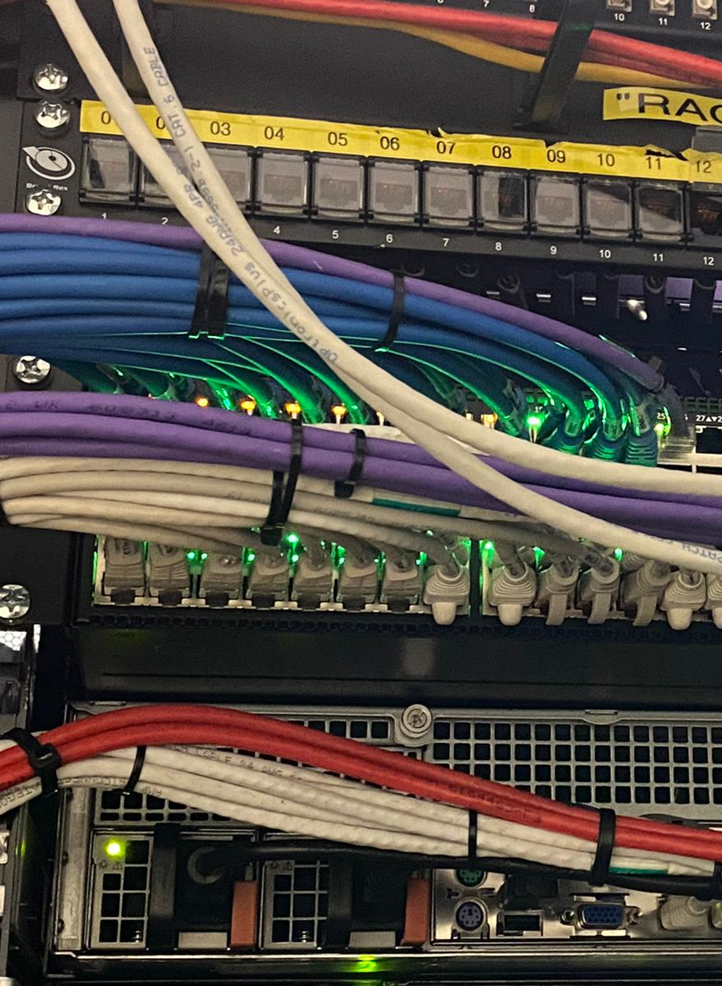
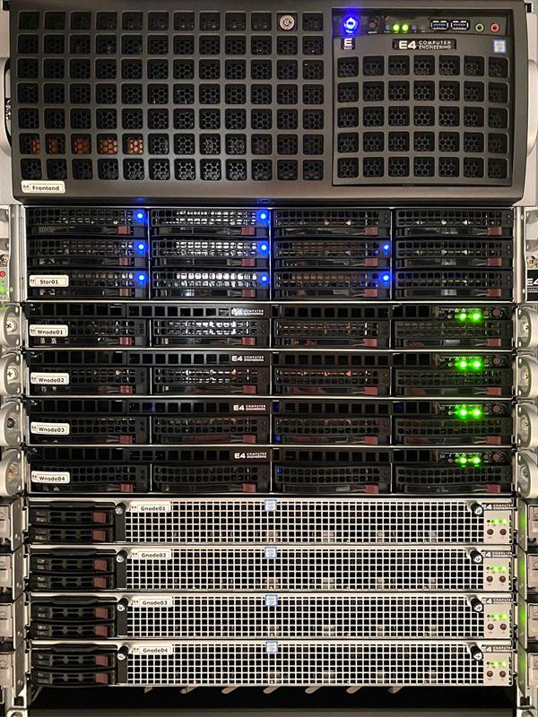
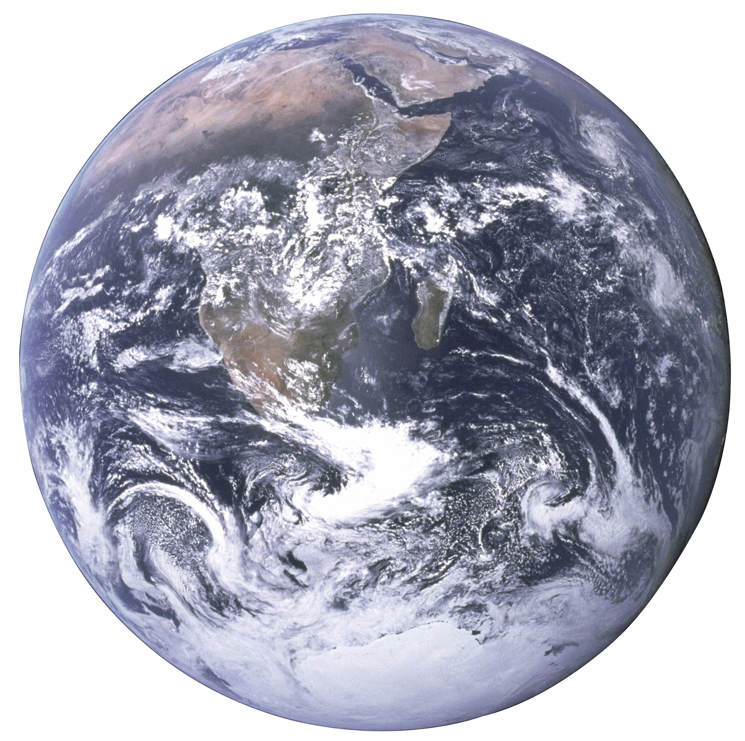
…it is not so easy!
The app is the very last step, the iceberg peak of a complex workflow relying on science, technology, supercomputing and artificial intelligence.

Slide 5
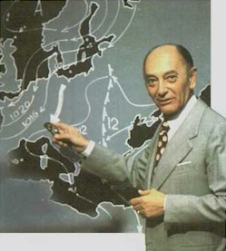
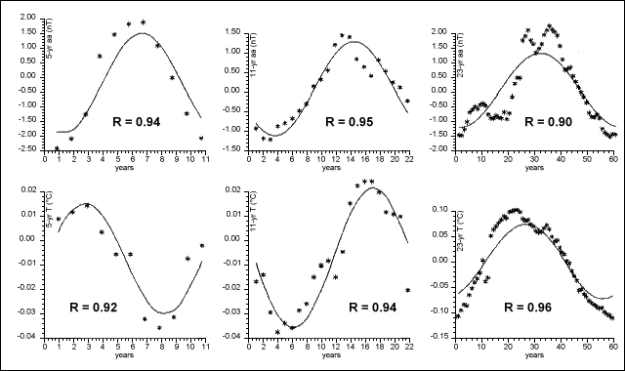
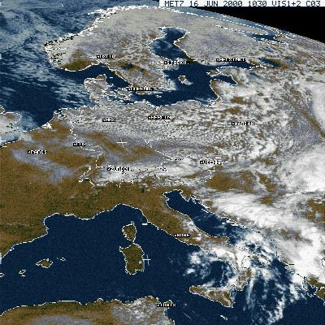
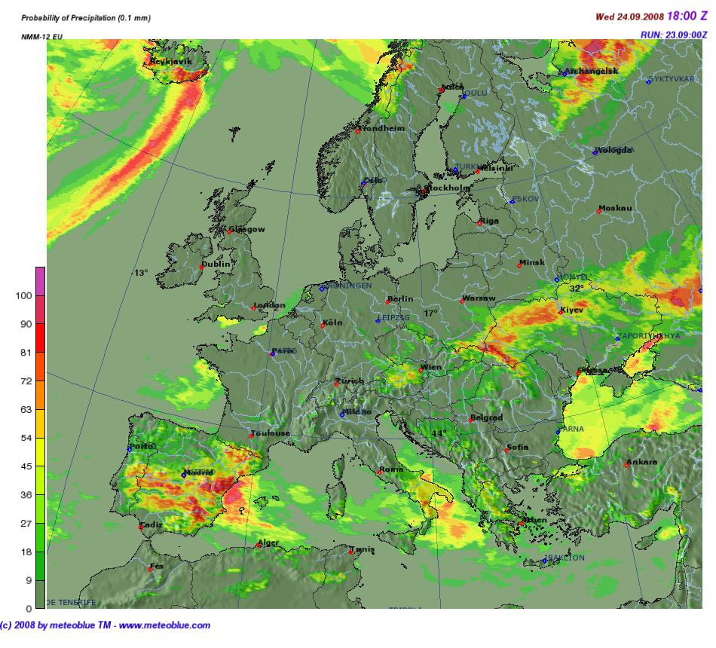
...focusing back on weather forecasts...
How the weather forecast are produced today?
Observations (weather stations, …)
Remote sensing (satellites, …)
Statistics
Time series analysis
Numerical models
…and her majestic “buzzword” Artificial Intelligence…

Slide 6
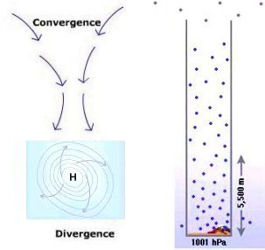
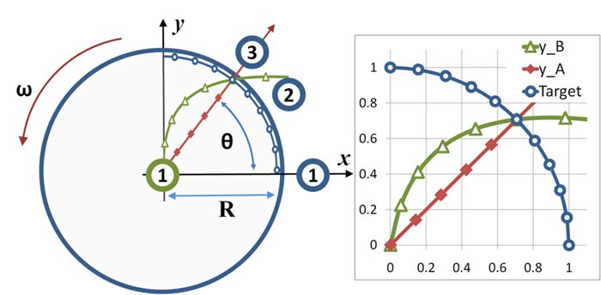
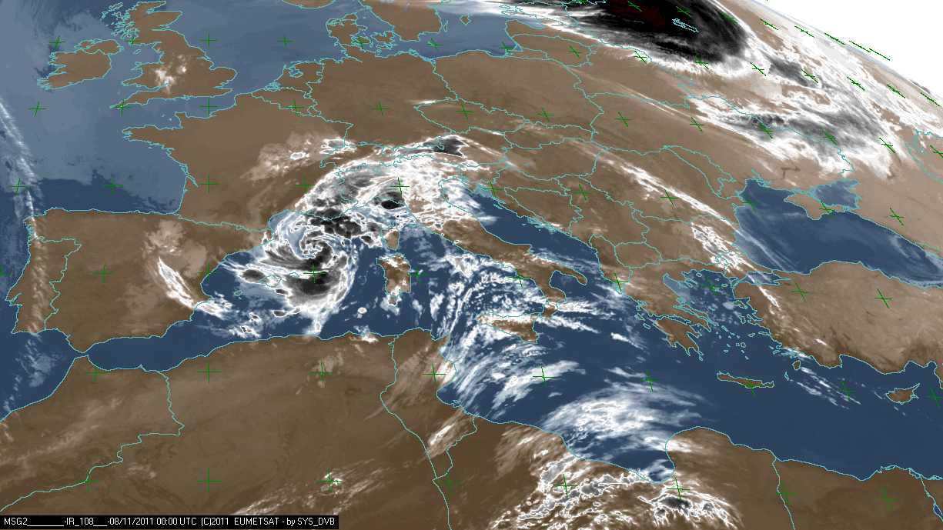
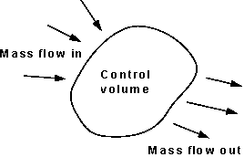
…making it simple at the max...
m=1, one air mass
Δp, how the air pressure is varying (pressure gradient)
lat, the Coriolis force is related to the latitude
g, the gravity acceleration
a, frictions
F=m*a
a=F
v/t=F
v/t=F(Δp,lat,g,a)
Believe me, the Navier-Stokes equations are one of the most complicated-to-solve math toys of the universe!

Slide 7
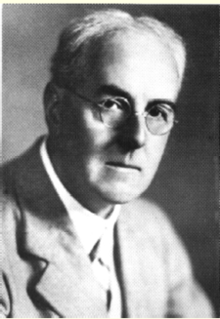
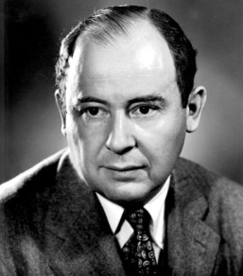
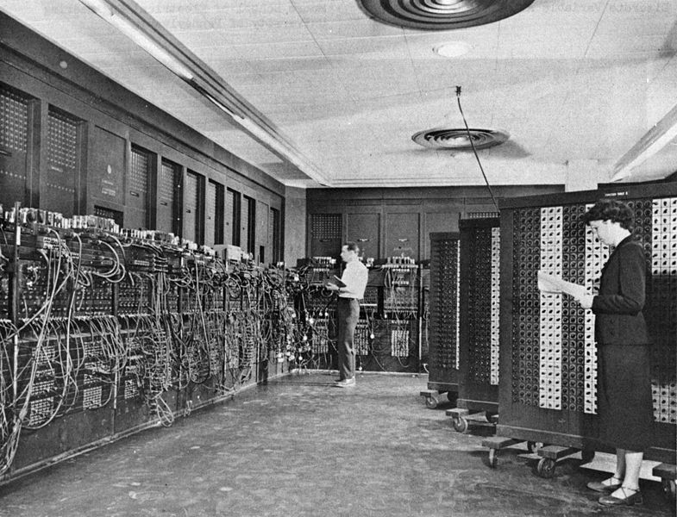
Let start from the beginning
The british mathematician Lewis Fry Richardson proposed a numerical approach to weather predictions in 1922.
Richardson unfortunately failed because the lack of computing power.
First numerical weather prediction: 1950 (USA).
Weather team: Jule Charney, Philip Thompson, Larry Gates, Ragnar Fjörtoft.
Numerical mathematician: John von Neumann.
Digital computer: ENIAC.
Need for speed, need for computing power…

Slide 8
The computing power is never enough
A supercomputer is a computer with a high level of performance as compared to a general-purpose computer.
Computing power is measured in floating-point operations per second (FLOPS).
A desktop computer has performance in the range of hundreds of gigaFLOPS to tens of teraFLOPS.
Today supercomputers can perform over 1017 FLOPS (a hundred quadrillion FLOPS, 100 PFLOPS)
Initial Costs of Investment, Total Costs of Ownership, …at the max!

Slide 9
High-Performance Computing
Compute Node 1
Processor 0
Supercomputers performs supercomputing or High Performance Computing (HPC)
Today HPC systems are build by tens to hundreds of off the shelf computing nodes.
Each computing node has more processors (CPUs).
Each processor has many computing cores.
Computing nodes are connected each other by high performance networks (from 1Gbit to hundreds Gbits)
C0
C1
...
Cc
Processor 1
C0
C1
More elastic definition: High-End Computing
...
Cc
...
Processor p
C0
C1
...
Cc
Compute Node ...
Compute Node n

Slide 10
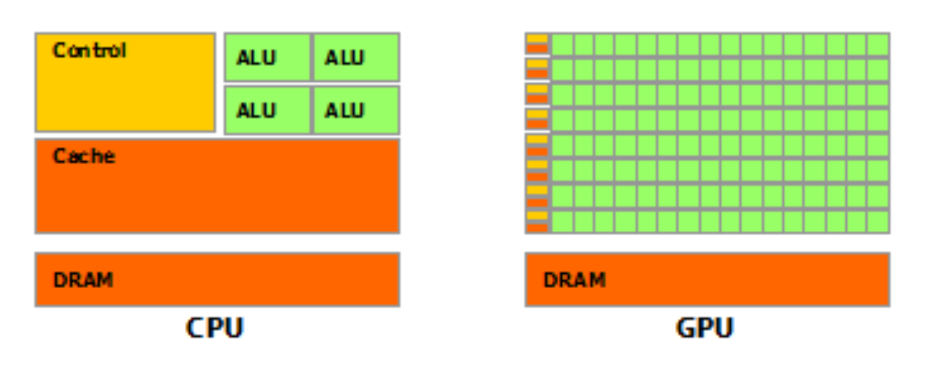
High-Performance Computing
Computing nodes leverage on storage resources.
Today computing nodes can be powered by accelerators.
General Purpose Graphic Processing Units: high performance processors designed to speed up graphic operations, but then for HPCs.
NVIDIA, Compute Unified Device Architecture (CUDA)
Cores, lot of cores!
https://developer.nvidia.com/blog/cuda-refresher-reviewing-the-origins-of-gpu-computing/

Slide 11
High-Performance Computing
Supercomputers challenge to score better and better on http://top500.org
The most part of supercomputers use Linux as operating system
Applications:
quantum mechanics
weather forecasting & climate research
oil and gas exploration
molecular modeling
vaccines and drugs
cancer research
physical simulations
cryptanalysis
More pervasive than the muggles expect

Slide 12
High-Performance Computing
High-end supercomputers cost hundred thousands dollars to billions.
Alternatives:
High Performance Cloud Computing: using on demand public cloud resources to create a virtual HPC system to be used just for the needed computation.
DIY “Beowulf”: supercomputers made using off the shelf hardware components (desktops, servers, single board computers)
HPCC & HPCNC good for business, Beowulf better for R&D

Slide 13
Focusing back on weather forecasts
The needed parts checklist (tentative):
A supercomputer.
An operating system.
A software implementing the weather numerical model.
A weather numerical model software implements a solver algorithm for the atmosphere state equations.
Weather Research and Forecasting model is one of more used model for both research and operational services.
Still happy about your science-inspired business idea?

Slide 14
Weather Research and Forecasting
The Weather Research and Forecasting (WRF) Model is a next-generation mesoscale numerical weather prediction system designed for both atmospheric research and operational forecasting applications.
Web portal: https://www.mmm.ucar.edu/weather-research-and-forecasting-model
Available as open source on github: https://github.com/wrf-model

Slide 15
Focusing back on weather forecasts
The needed parts checklist (tentative):
A supercomputer.
An operating system (Linux).
Weather forecasting model (WRF).
The weather forecasting model needs atmosphere initial conditions produced by a global forecasting system:
European Centre for Medium-Range Weather Forecasts (ECMWF)
Global Forecasting System (NOAA, NCEP)

Slide 16
Computing Domains
Numerical weather models solve the atmosphere state equations on a 3D grid.
A domain is a geographical matrix covering the earth area on which the weather forecast is focused on.
Domains are characterized by:
A geographic center
A horizontal extension in terms of kilometers
A horizontal resolution (the size of each matrix cell in the real world)
A vertical resolution

Slide 17
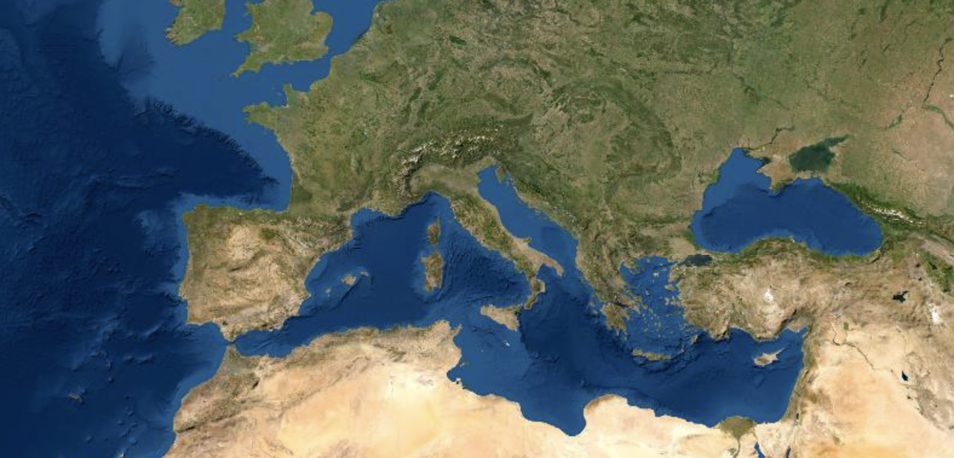
Computing Domains
The Mediterranean Area
300 x 200 cells, resolution 25 Km

Slide 18
Computing Domains
High resolution initial conditions
High resolution land digital models
High resolution domains
More computing power needed
Nesting domains into domains creases locally the weather forecast resolution mitigating the need for more computing power.

Slide 19
Computing Domains
The Mediterranean Area
300 x 200 cells, resolutions 25 Km, 5 Km, 1 Km.

Slide 20
If you need weather forecast, who you gonna call?
Center for Marine/atmosphere Monitoring, Modelling, and Applications
Mission: “deliver operational forecasts, predictions, and simulations for science, engineering, and management in the field of weather, ocean-dynamics, air-quality, and pollutant transport and diffusion at the sea.”
http://meteo.uniparthenope.it

Slide 21
From initial conditions to the forecast
Initial Conditions (weather)
Weather Model
Weather Forecast
Weather Research and Forecasting
NCEP
GFS
Ocean Model (wind driven waves)
Initial Conditions (ocean)
Sea Waves Forecast
WaveWatch III
Ocean Model (ocean dynamics)
Sea Current Forecast
Regional Ocean Model System
Pollutant emission sources (passive tracers)
Passive Tracers Forecast
Transport and Diffusion Model (passive tracers)
Local administration
WaComM++

Slide 22
From the forecast to the app (at last!)
AI: Weather Pattern Recognition and intense event trajectory predictions (Medicane)
AI: Intense local weather events predictions
Weather Forecast
OPEnDAP Server
Web Portal
Sea Waves Forecast
API Server
Mobile Applications (iOS/Android)
Sea Current Forecast
Passive Tracers Forecast
AI: Biologic contamination predictions

Slide 23
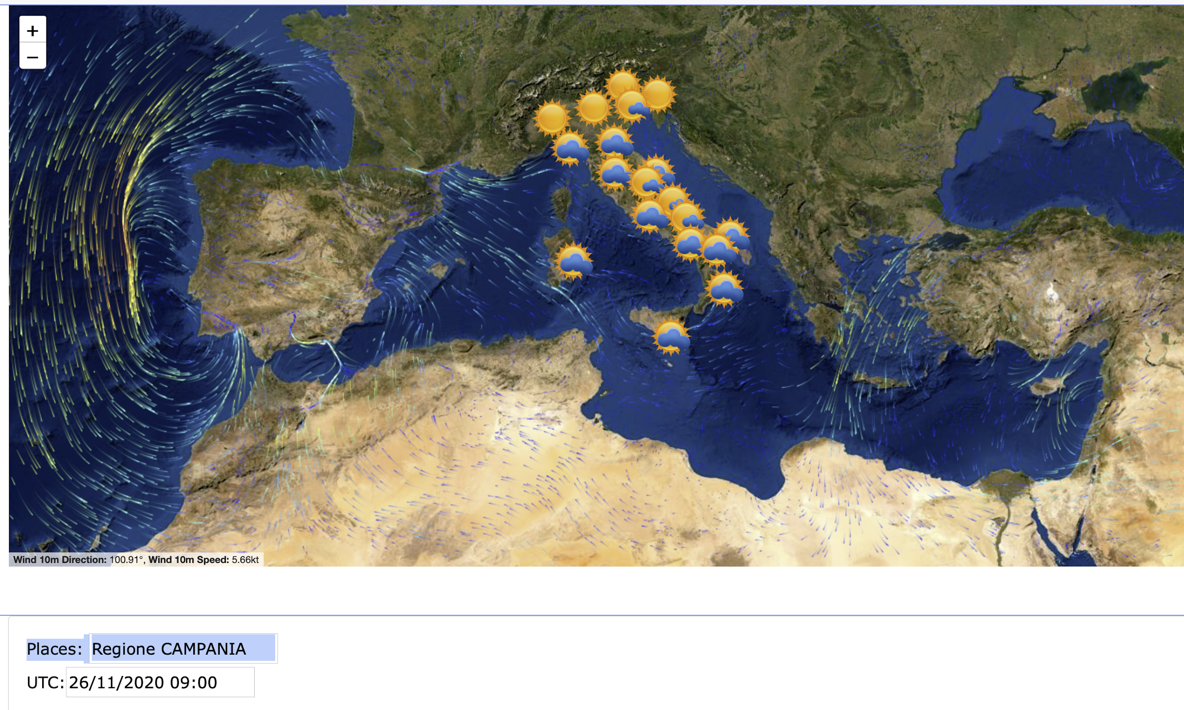
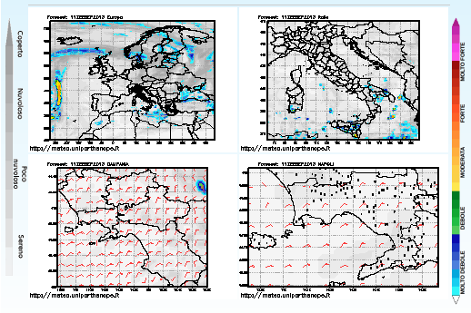
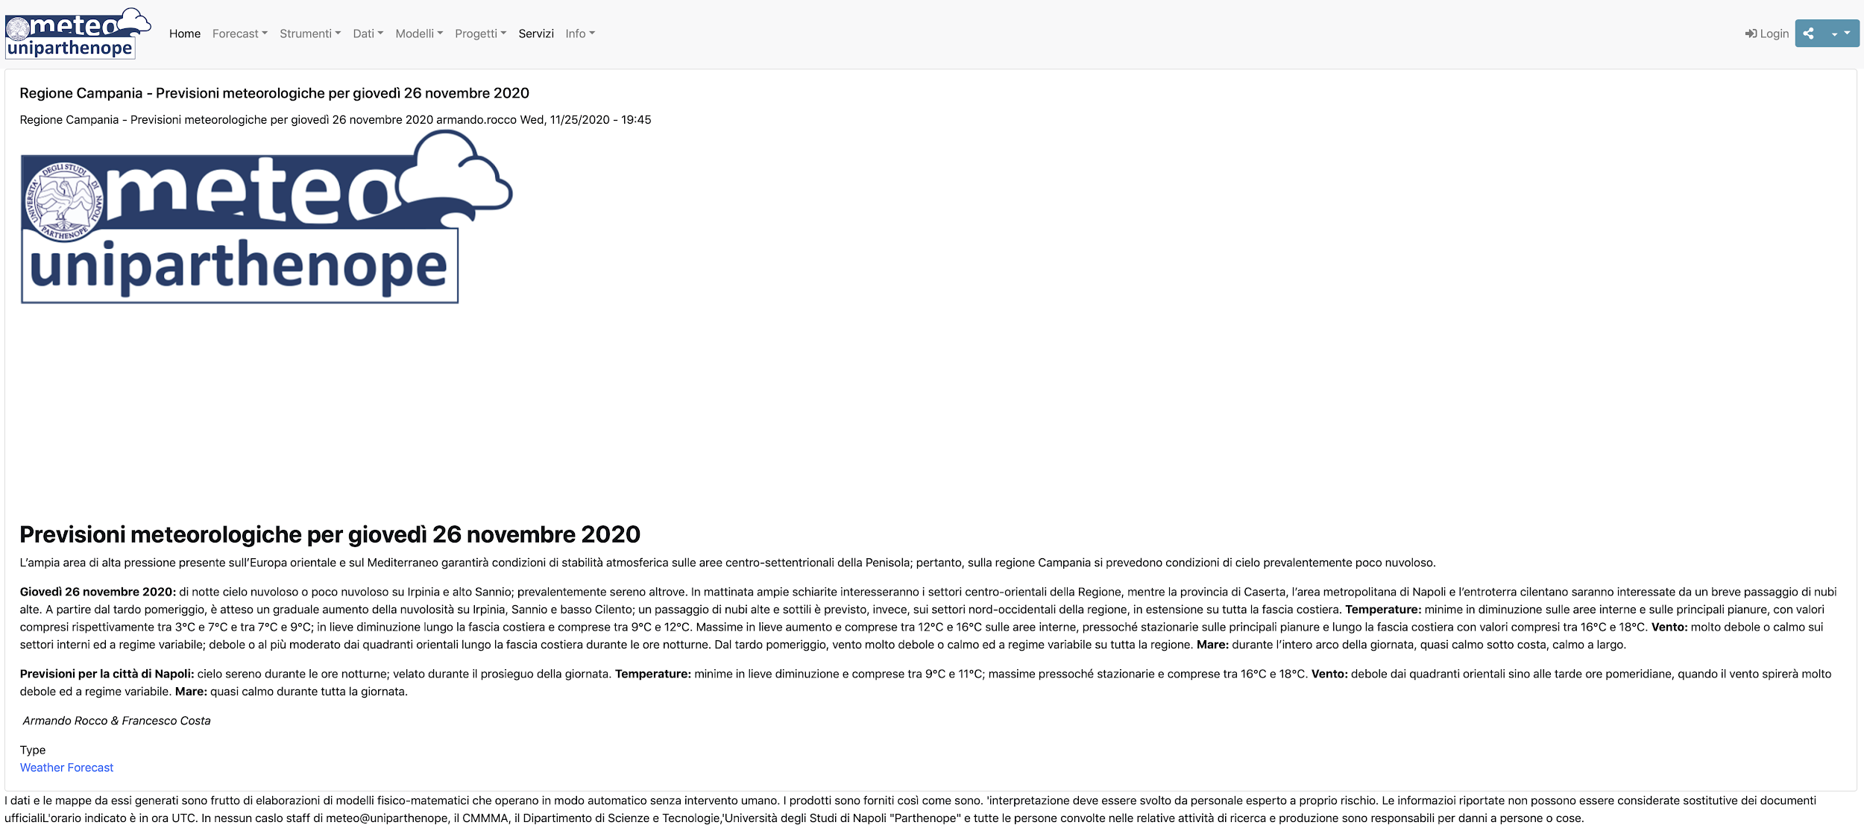
Weather forecast products

Slide 24
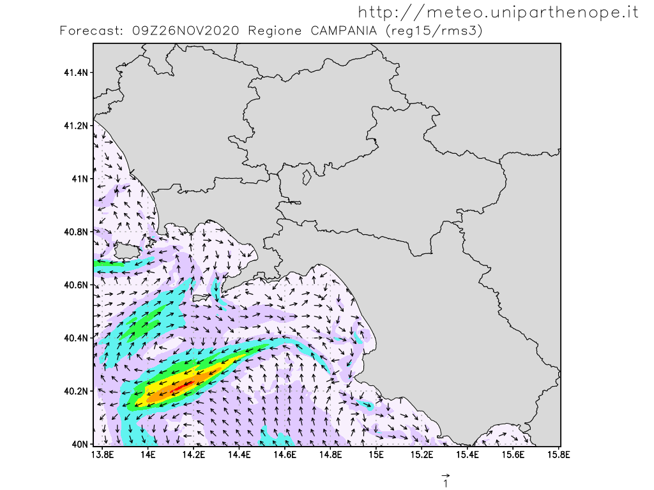
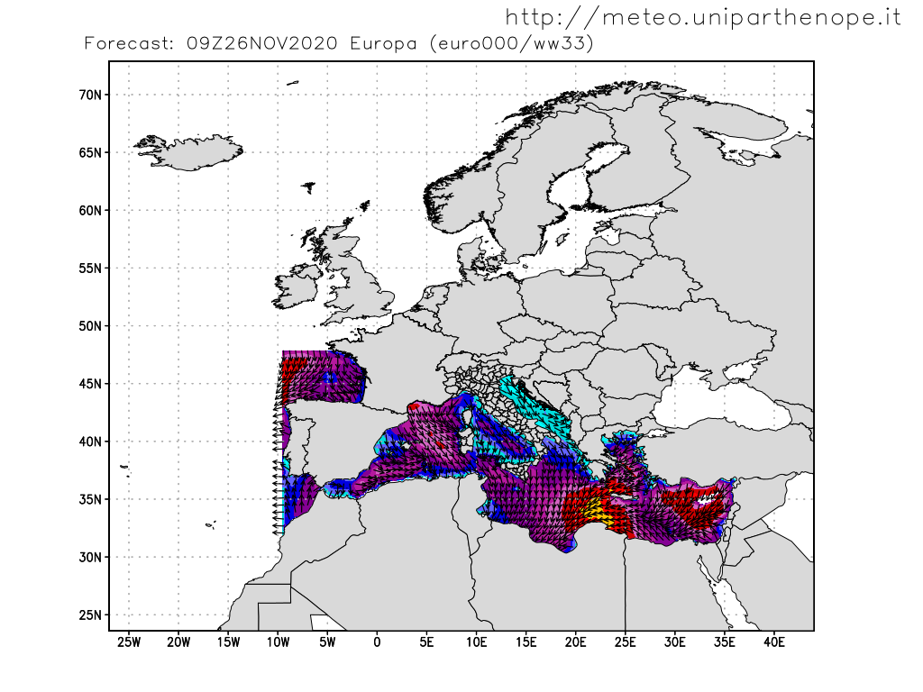
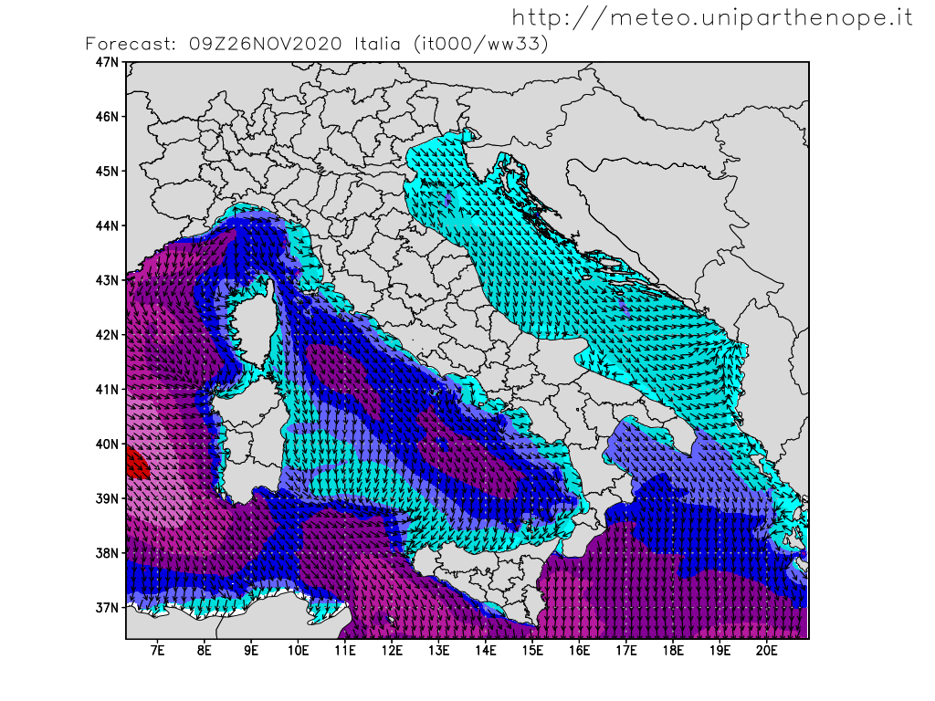
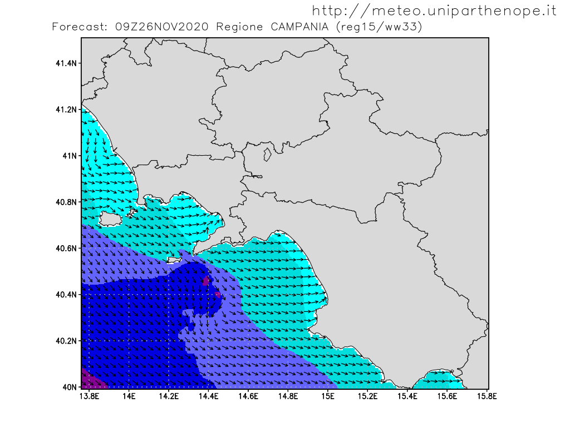
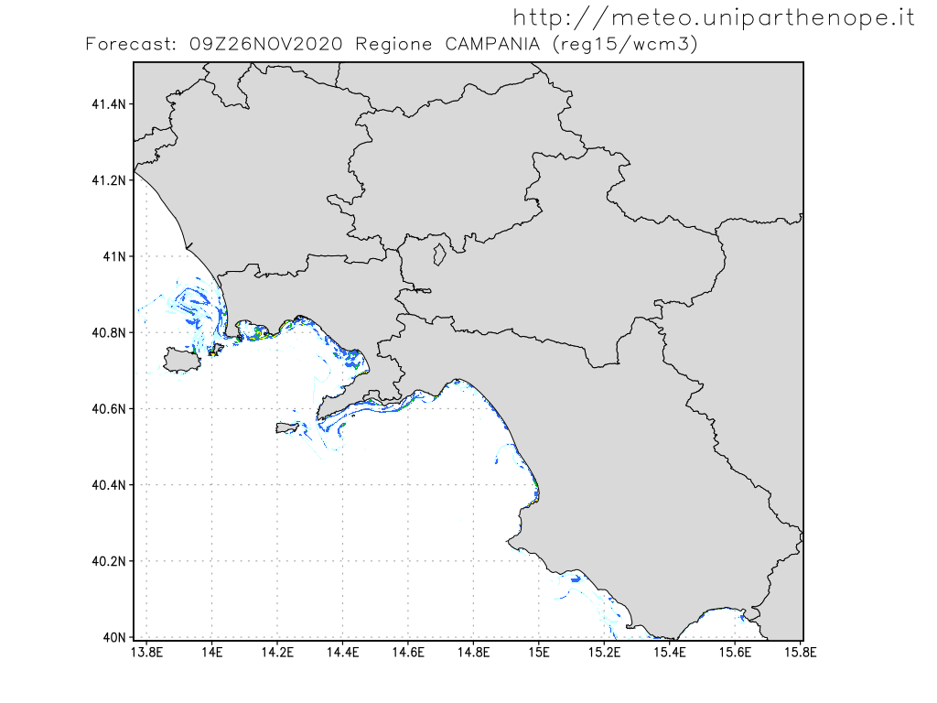
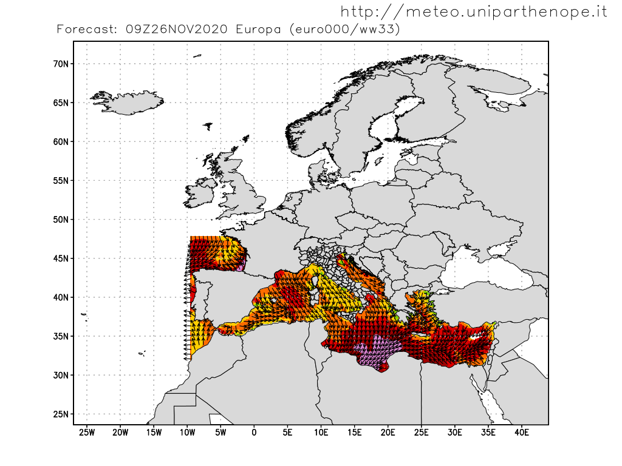
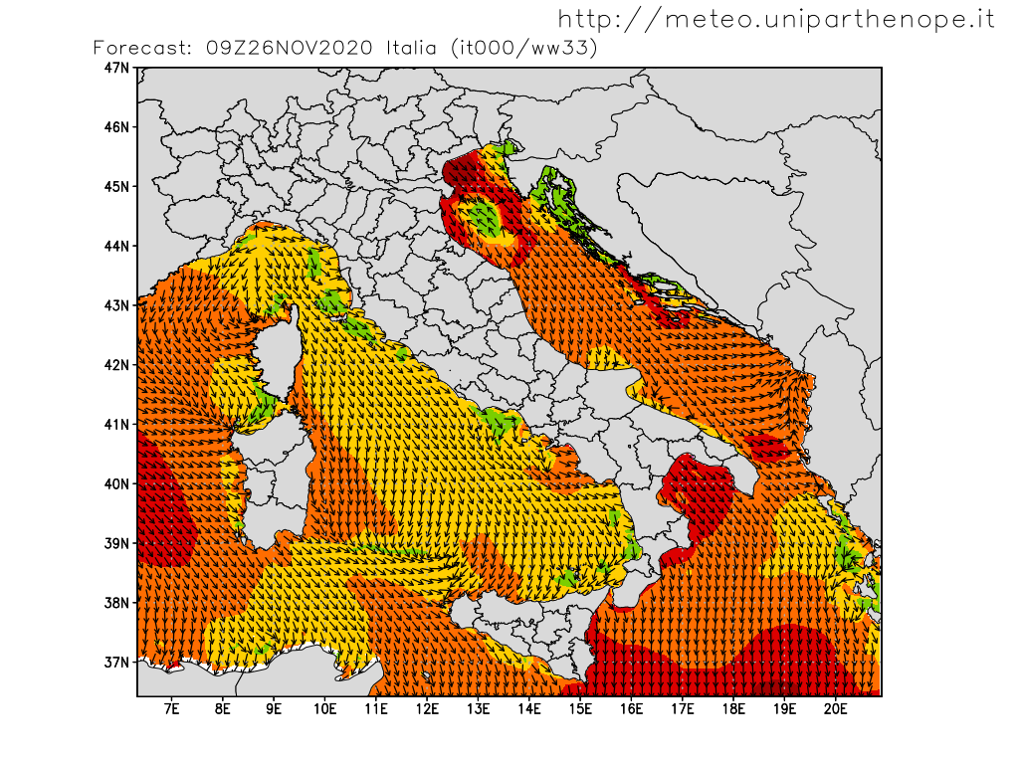
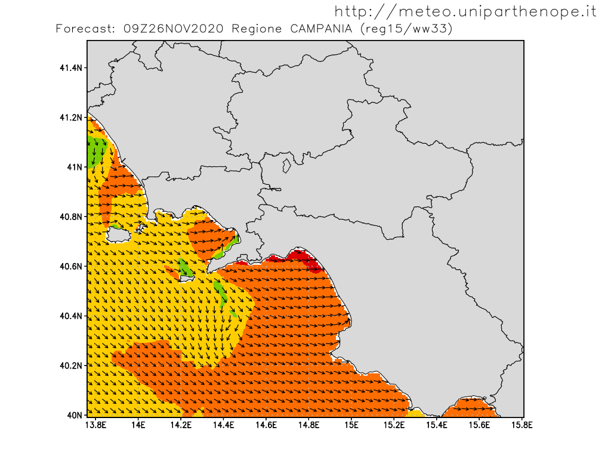
Ocean forecast products
Sea Current
Sea Waves
Passive Tracers

Slide 25
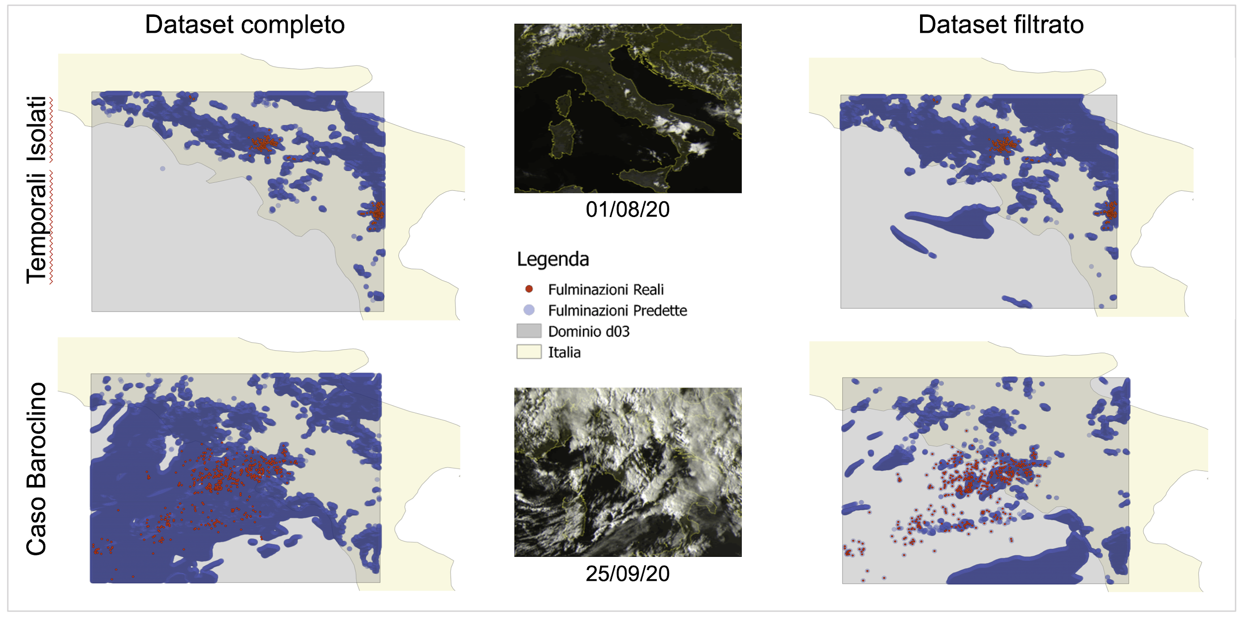
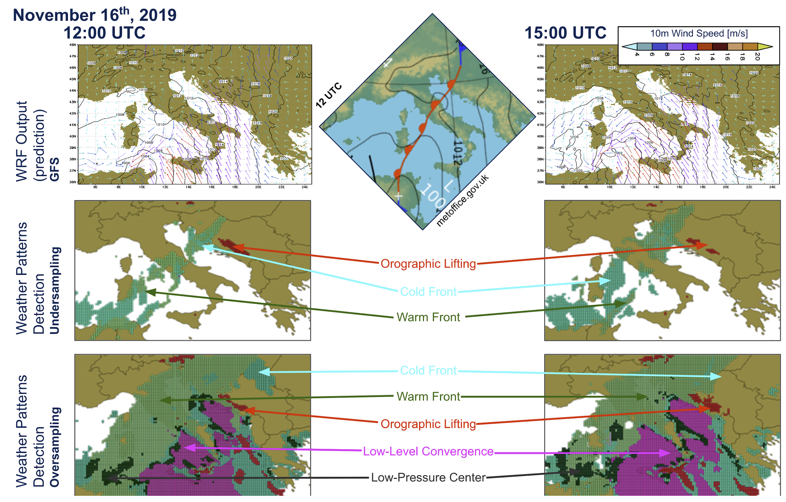
Artificial Intelligence based products
Lightning predictions at sub-grid resolution.
Weather Pattern recognition.

Slide 26
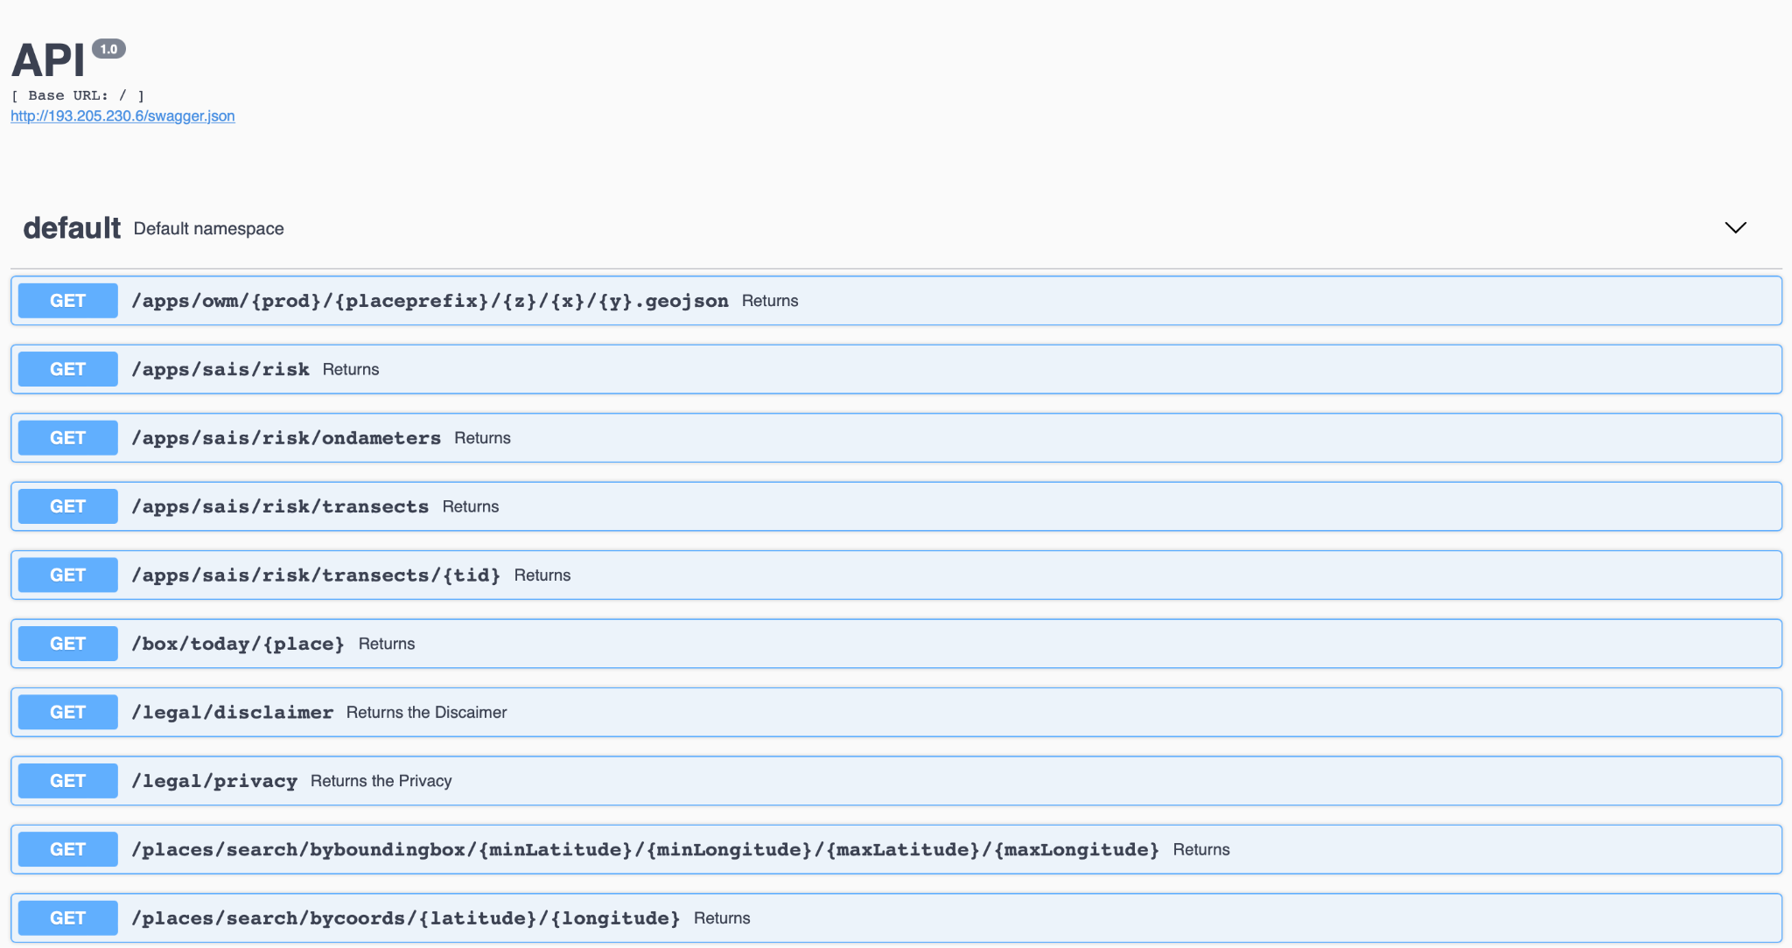
Weather application program interface
http://api.meteo.uniparthenope.it

Slide 27
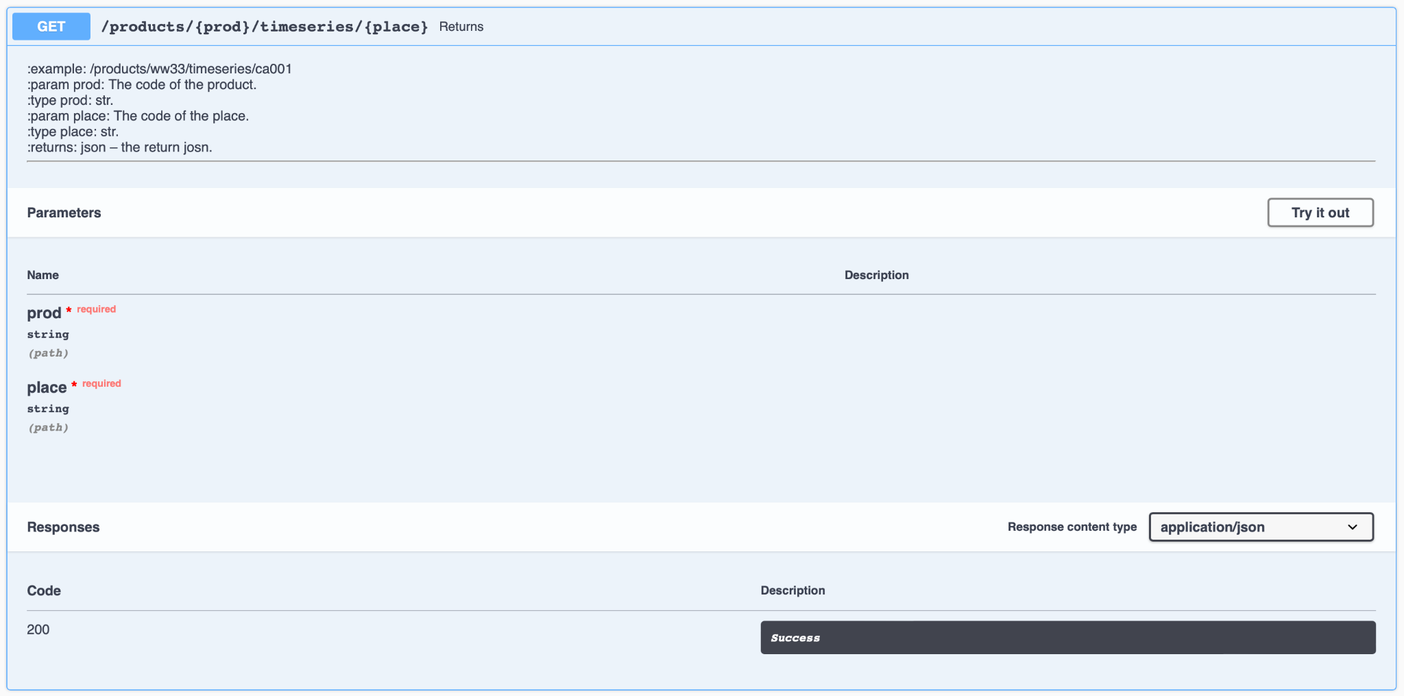
Weather application program interface
http://api.meteo.uniparthenope.it

Slide 28
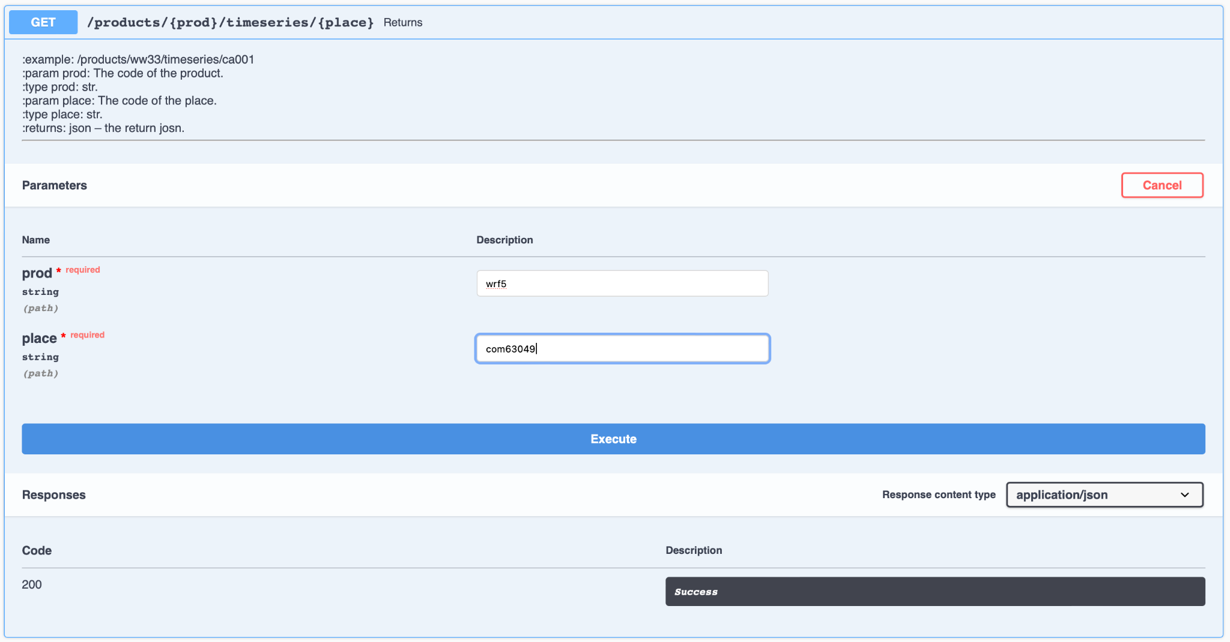
Weather application program interface
http://api.meteo.uniparthenope.it

Slide 29
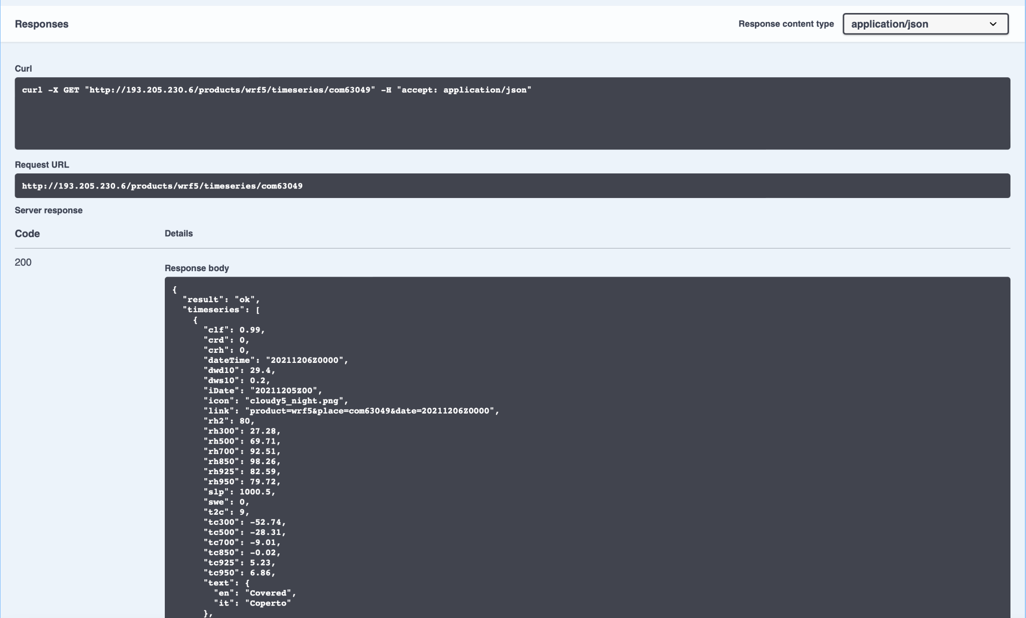
Weather application program interface
http://api.meteo.uniparthenope.it

Slide 30
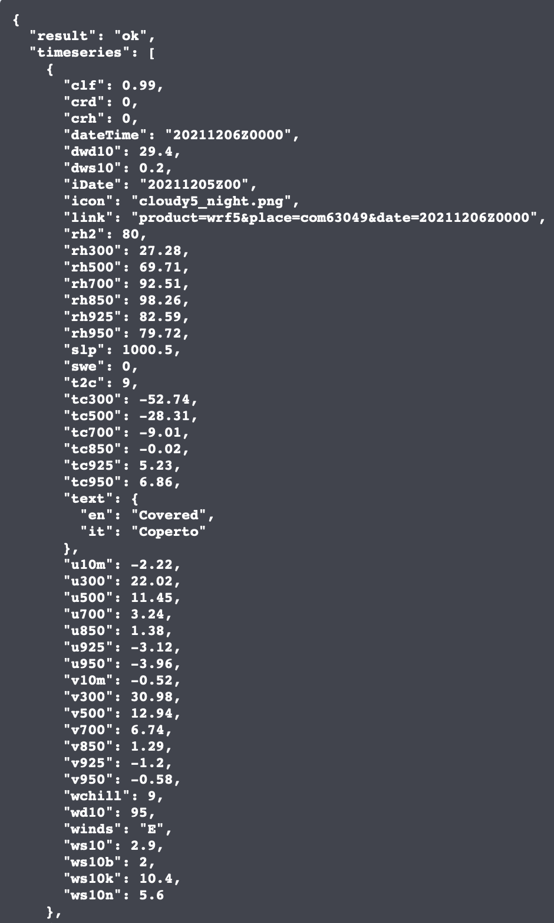
Weather application program interface

Slide 31
Weather application program interface

Slide 32
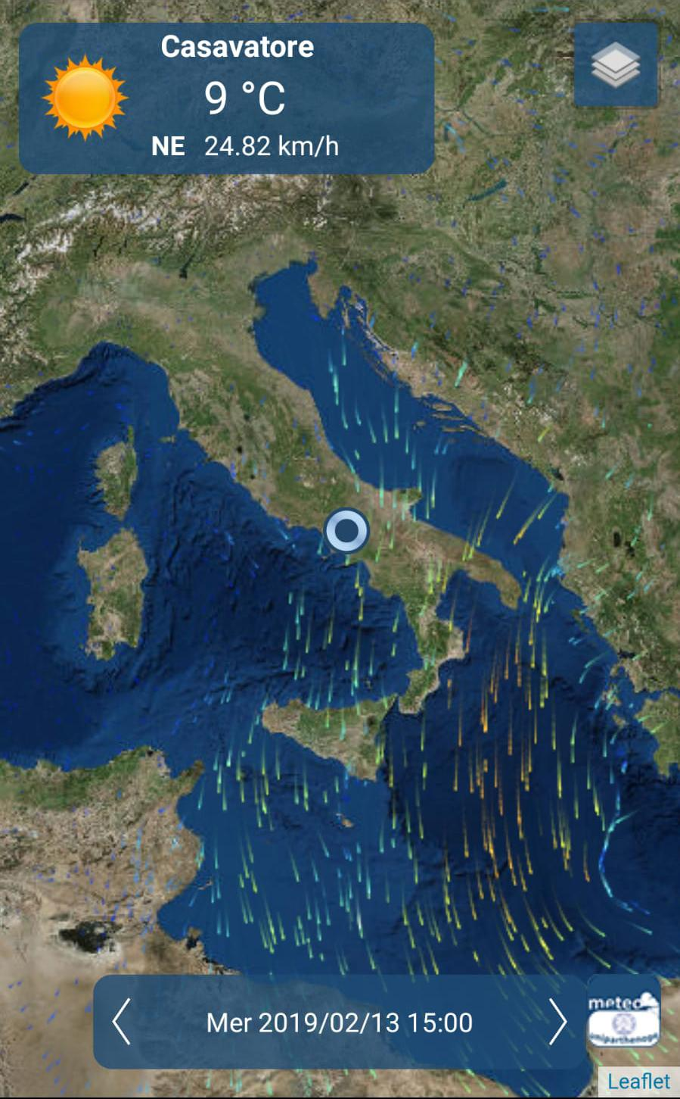
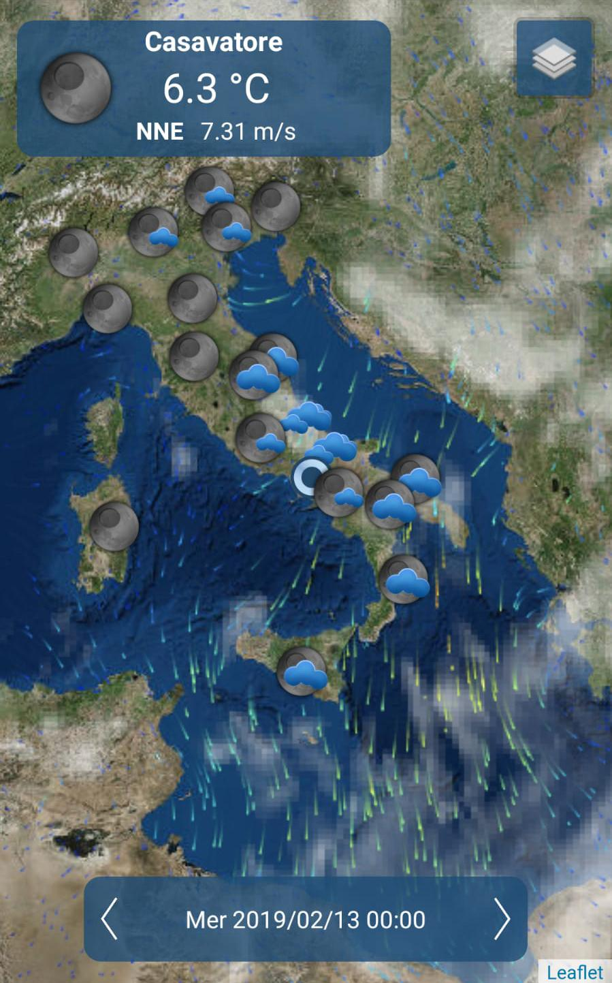
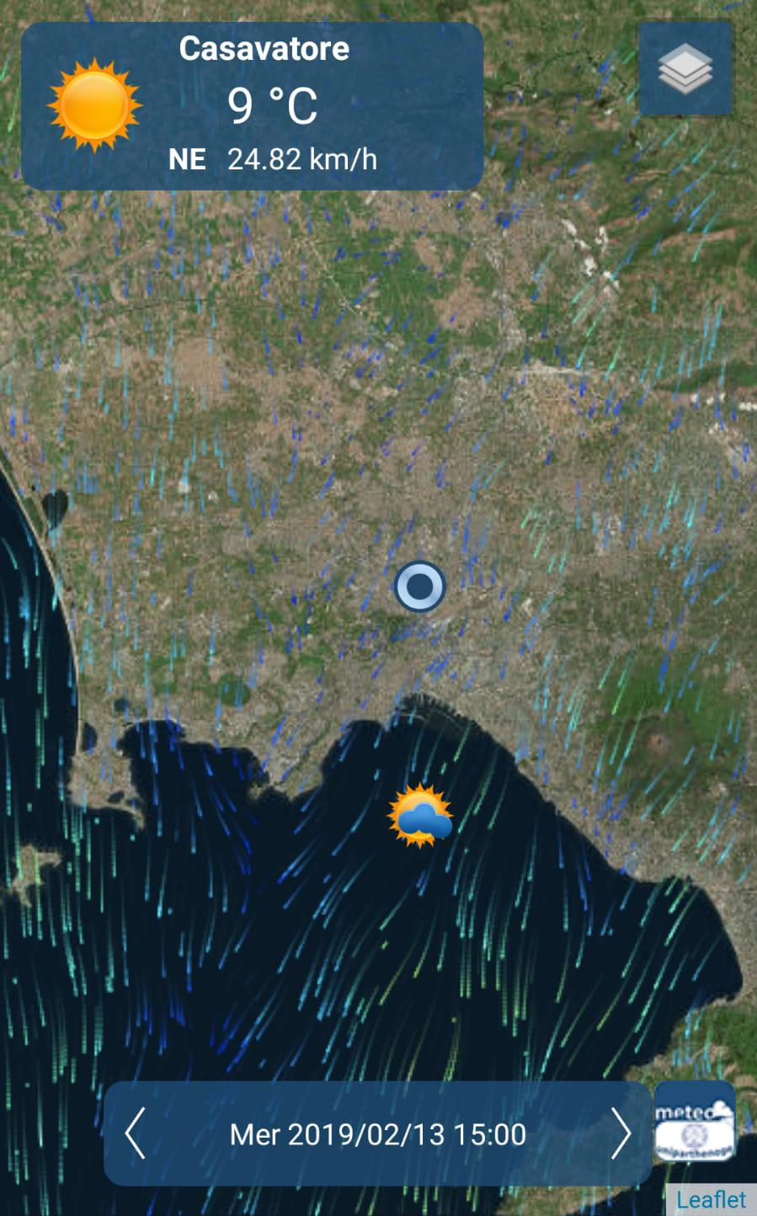
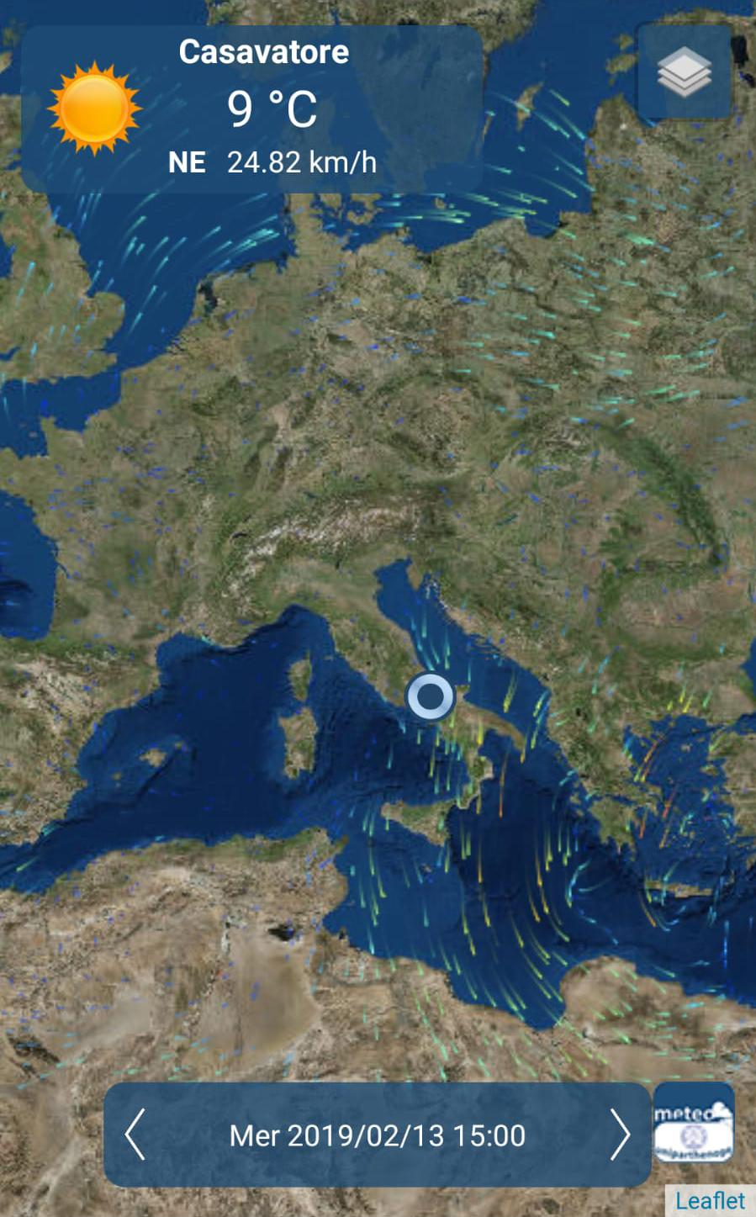
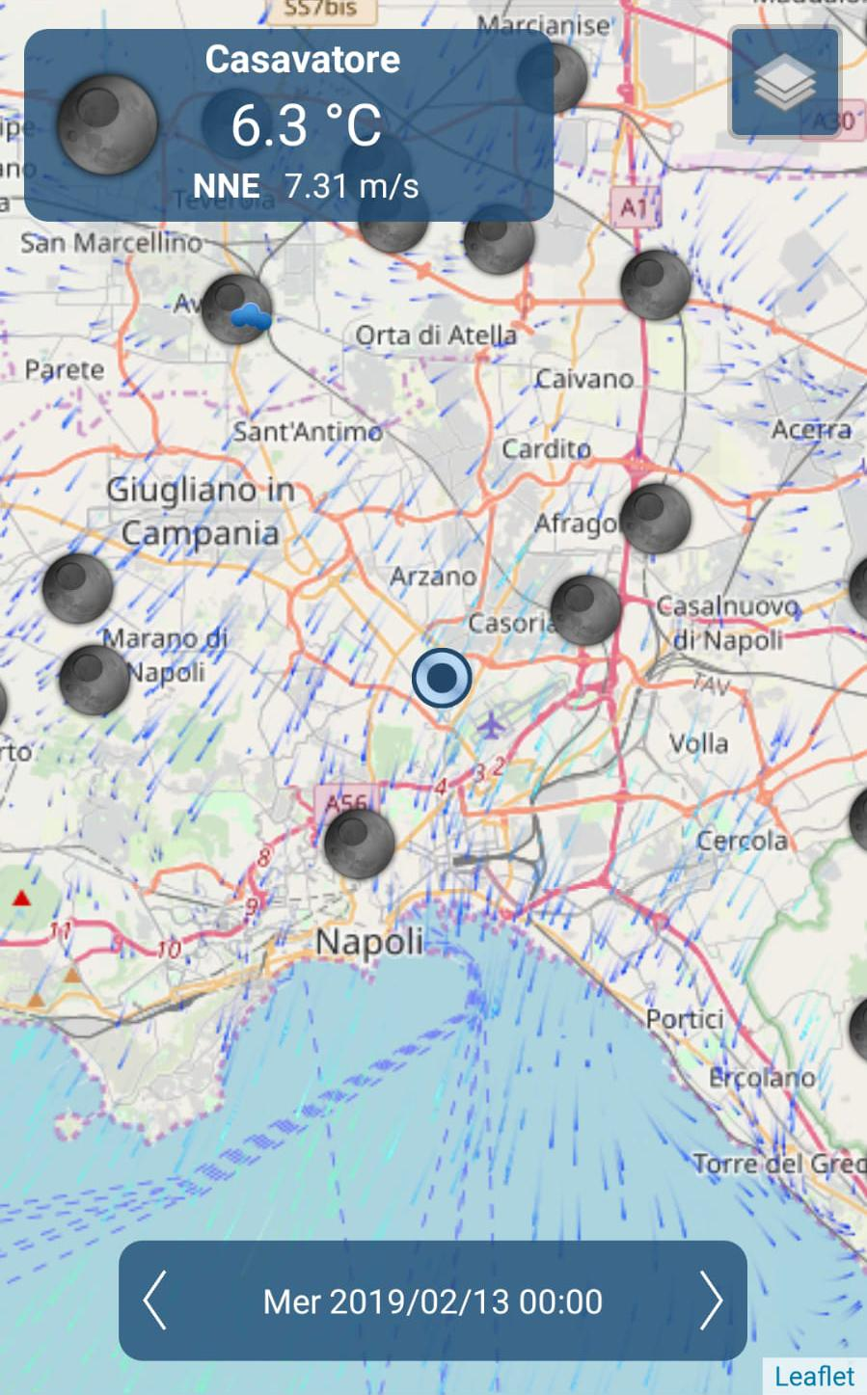
Eventually, the Weather App!

Slide 33
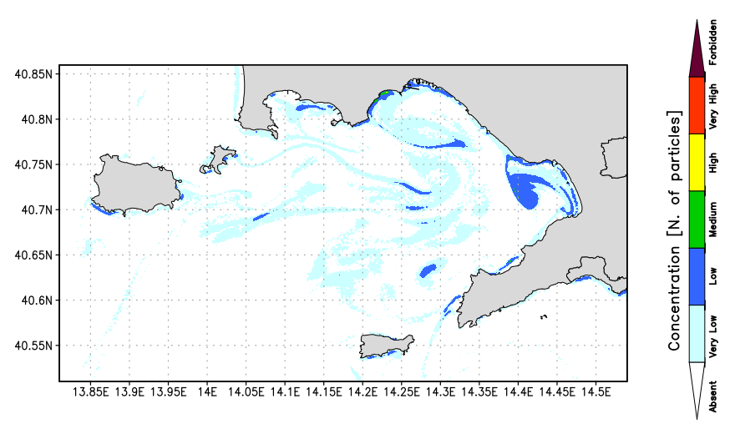
The Water quality Community Model is back!
Lagrangian model for the transport and diffusion of passive tracers.
Hierarchical and Heterogenic parallelization.
Restart particles and Sources.
Different and numerous applications. (pollutant concentration, search and rescue, ...)
C++ 17 Language
Transport and diffusion Lagrangian model

Slide 34
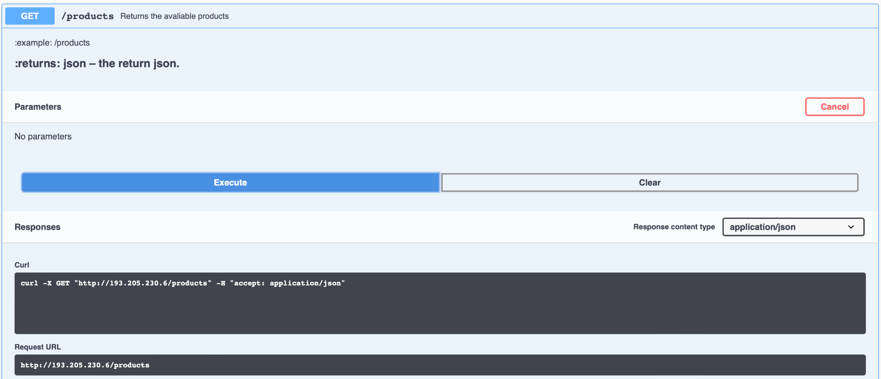
Practical task: get the products list

Slide 35
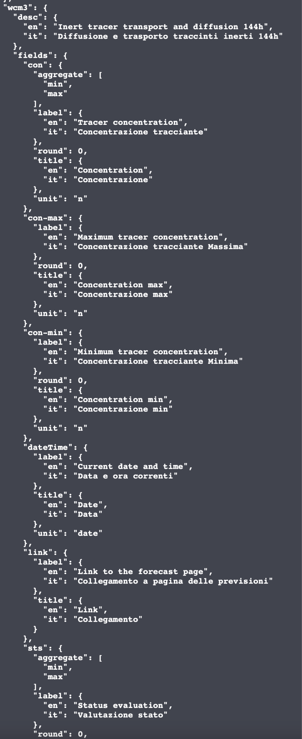
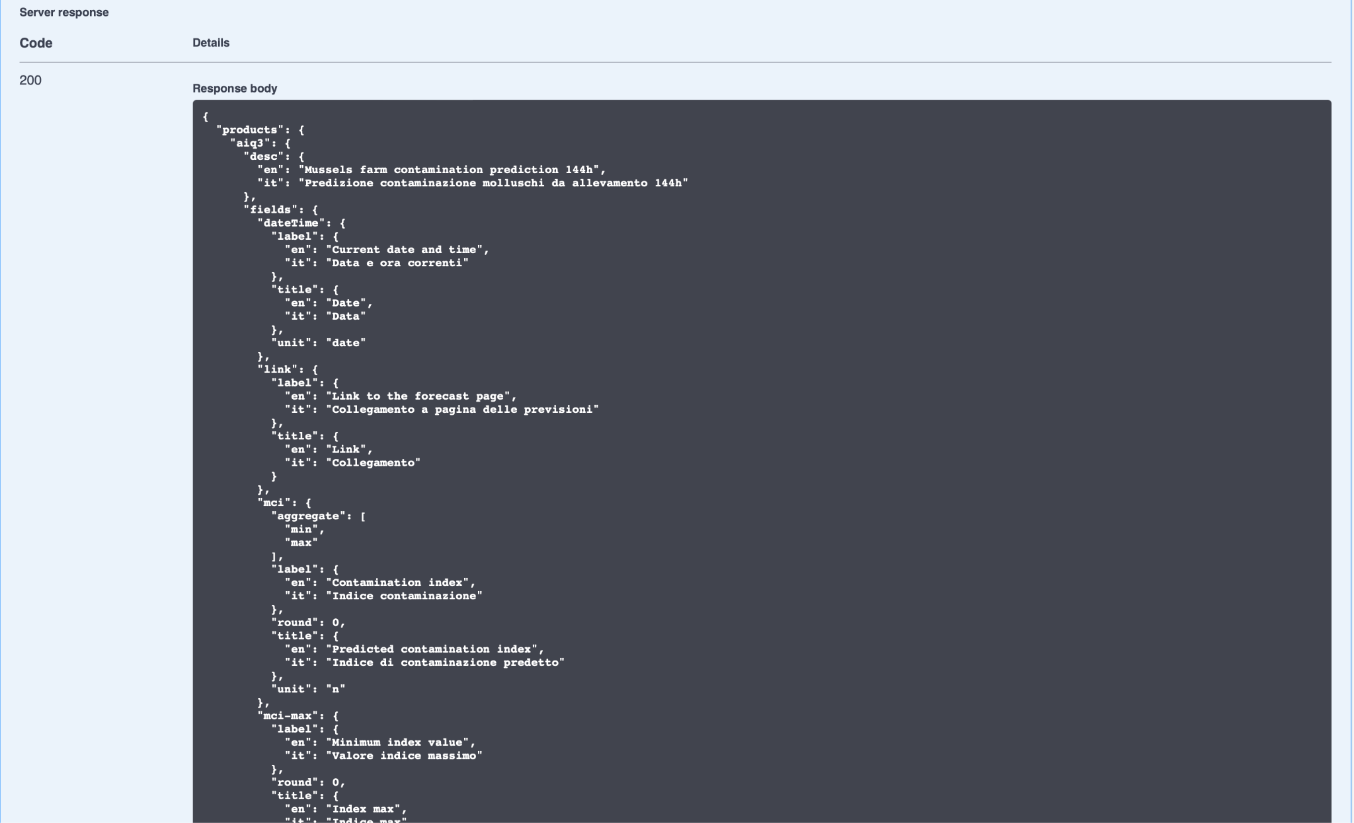
Practical task: get the products list
wcm3

Slide 36
Practical task: get the code of a place

Slide 37
Practical task: get the id of a place
porti116

Slide 38
Practical task: get WaComM++ forecast data
http://api.meteo.uniparthenope.it

Slide 39
Practical task: get WaComM++ …

Slide 40
MASTER MEIM 2021-2022
Looking forward the next step: develop a progressive web app for choosing the best place where to swim by the sea…
https://app.meteo.uniparthenope.it/index.html?page=products&place=porti116&prod=wcm3

