Slide 1
MASTER MEIM 2021-2022
Entrepreneurship and start-up
Master 2021-2022
STRATEGY
A cura del prof. Adele Parmentola
Prof. Di Economia e Management all’Università degli Studi di Napoli Parthenope
Adele.parmentola@uniparthenope.it

Slide 2
Where does a company come from?

Slide 3
False myths
You need a totally new idea
You need many infrastructures and technologies
You need a lot of money

Slide 5
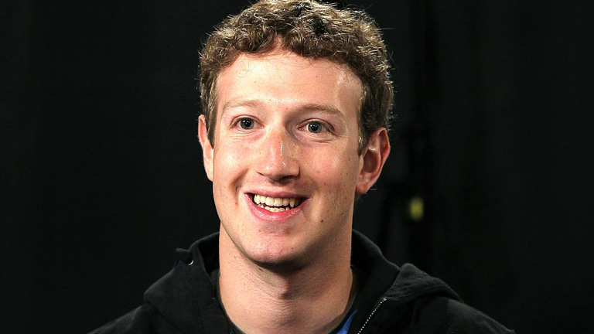
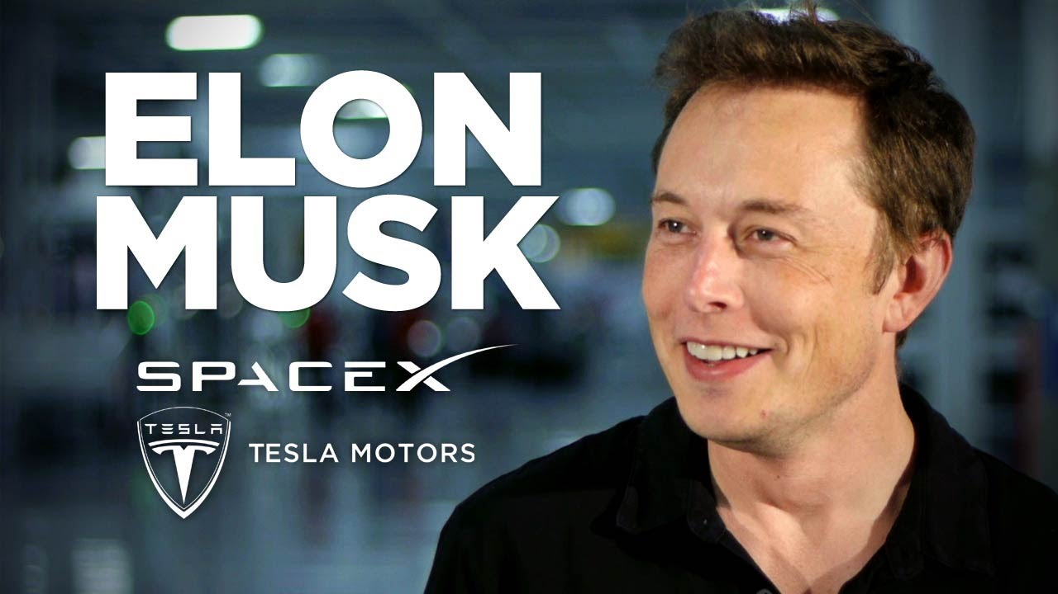
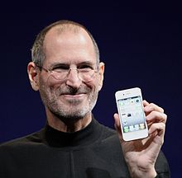
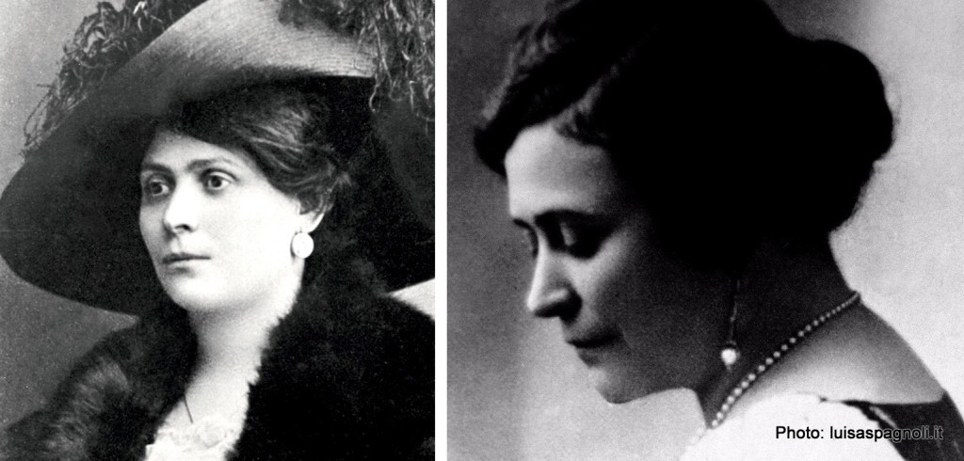
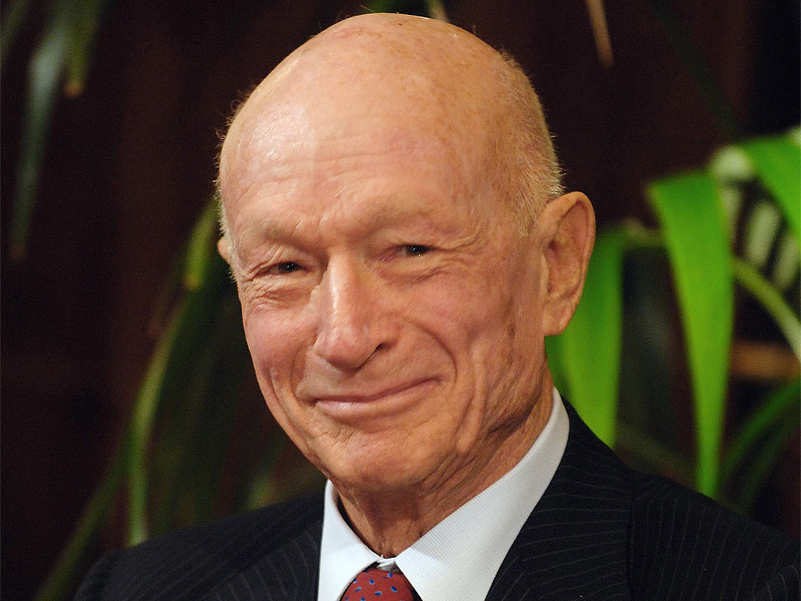
Successfull entrepreneurs

Slide 6
Characteristics of successful entrepreneurs
Ambition, brave , self confidence, perseverance, creativity, bold, vision, leadership quality

Slide 7
Characteristics of successful entrepreneurs
Creativity
Rationality
Risk propensity
Empathy
Previsional capability
Being in the right place at the right moment
Rewrite the rules being inside the rules
Luck

Slide 8
https://m.youtube.com/watch?v=QUfjIODGHh4
https://m.youtube.com/watch?v=QXbbvxuiv7c

Slide 9
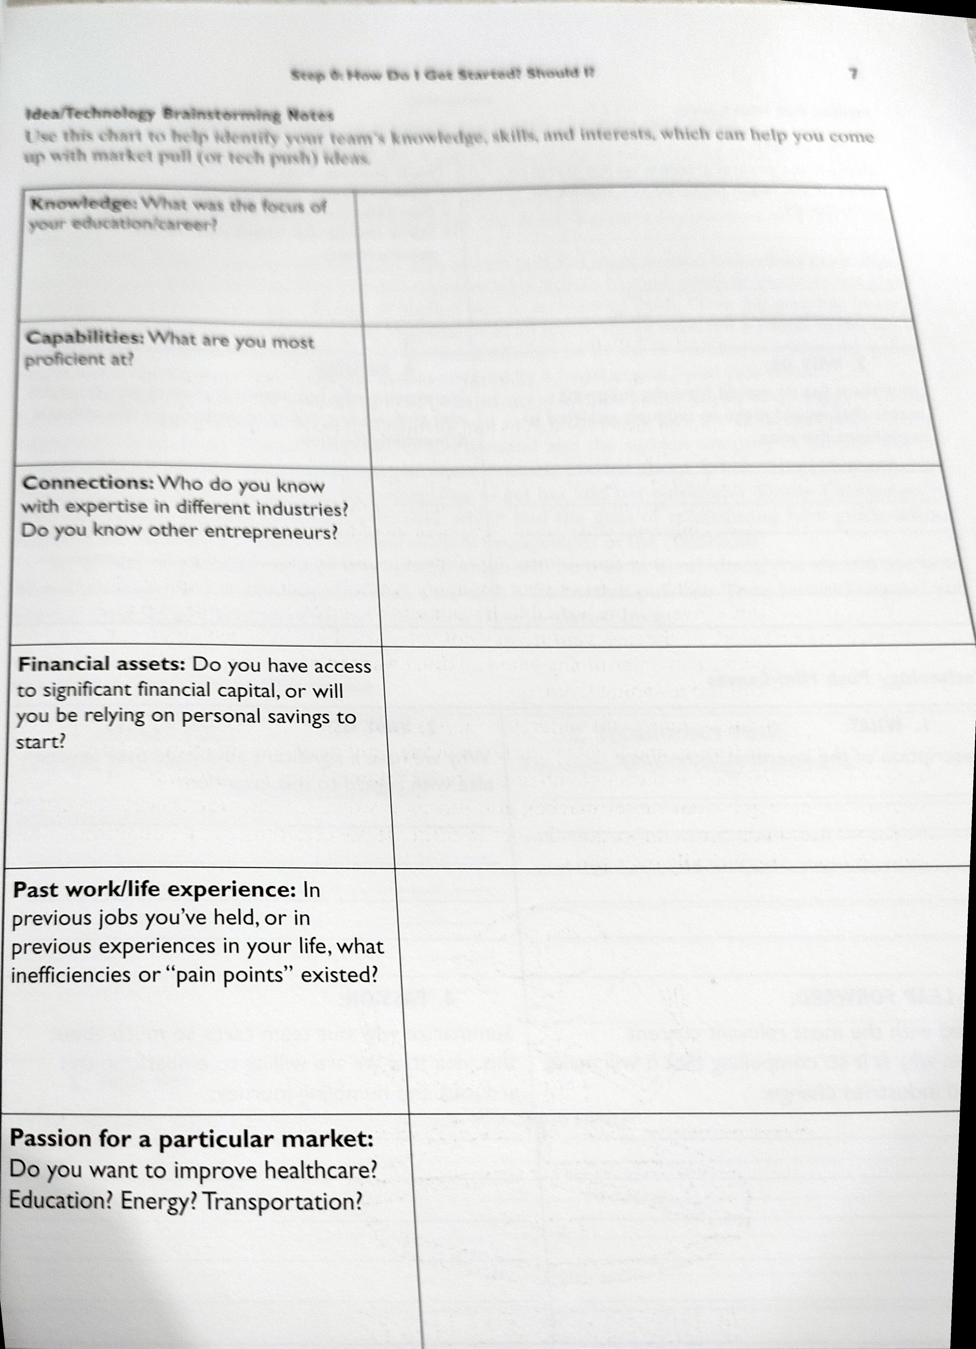
Are you able to be
an entrepreneur?

Slide 10
What is a start-up ?

Slide 11
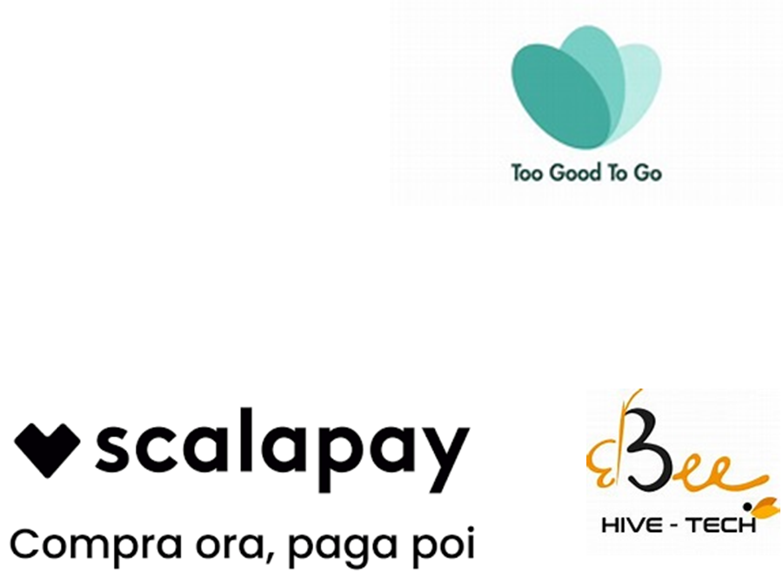
Main start-ups

Slide 12
Project work
Check the website of the above mentioned start-up
Describe: core business, entrepreneurial team, company’s history

Slide 13
What a start-up is
«a temporary organization having the goal to validate a new business model» (Steve Blanck).
« a human institution aimed at creating a new product or service working in a really uncertaint environment»» (Ries).
Common features:
A business model that needs to be validate;
Uncertainty;
Innovation propensity;
A scalable business model.

Slide 14
A good idea is not enough

Slide 15
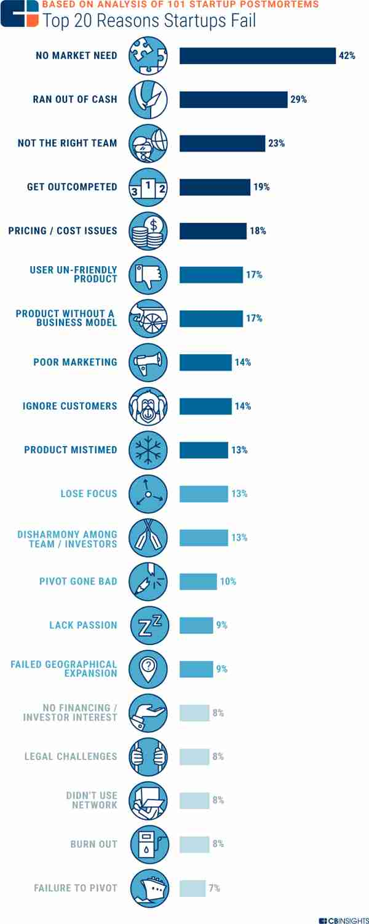
Top 20 reasons start-up fail

Slide 16
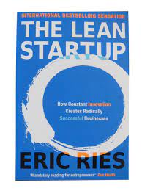
Start-up creation process: Lean Approach
Start-up creation process: Lean Approach
1) Business idea validation
2) Business model definition
3) Market and competitors
4) Find the right team
5) Fundraising
6) Supporting institutions
7) Minimum Viable Product
8) Business Plan
9) Legal form
10) Marketing plan

Slide 17
Business Idea Validation

Slide 18
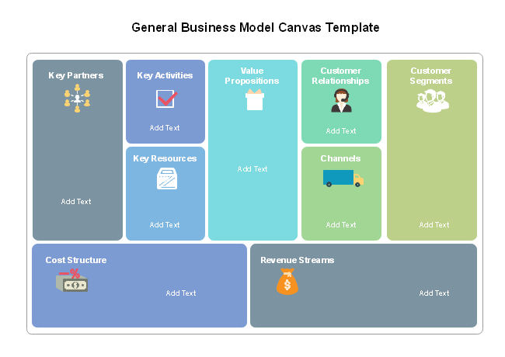
Business Model definition

Slide 19
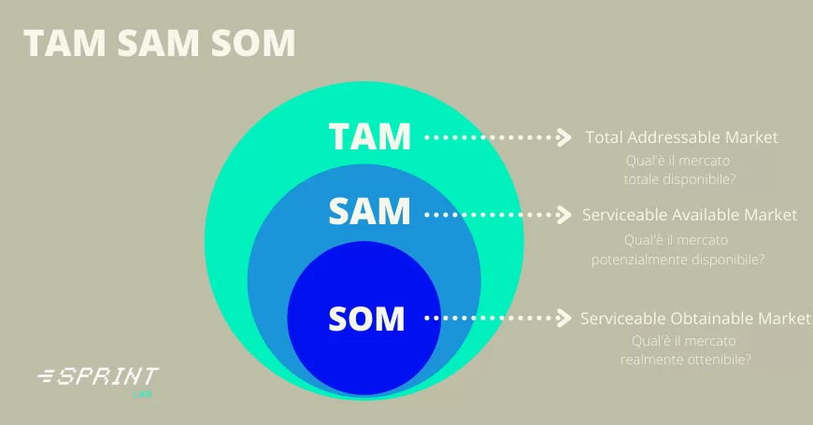
Market and Competitor

Slide 20
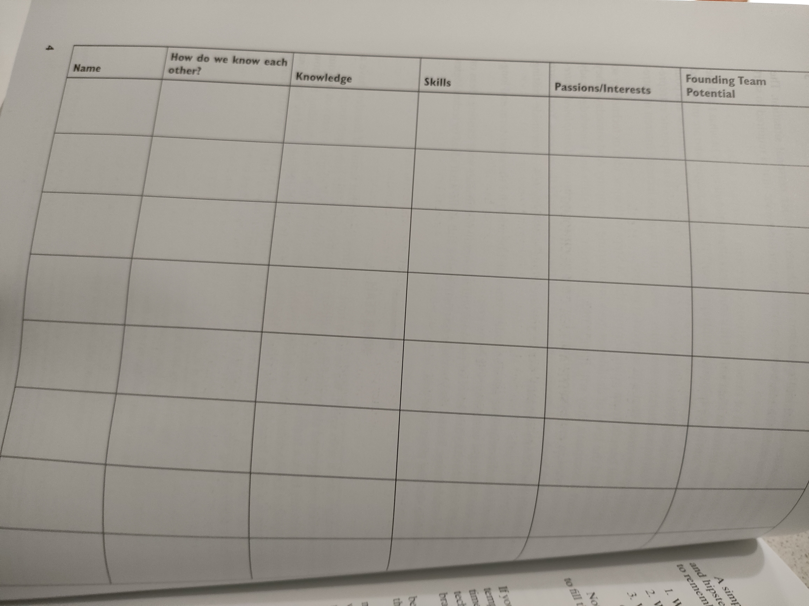
Create the right team
Create the right team
It’s a group of people brought together
to compete with the goal
of winning a competition

Slide 21
Fundraising
Bootstrapping
Business Angel
Crowdfunding
Venture Capital
Public funds

Slide 22
Supporting organizations
Business incubator
is an organization that helps startup companies and individual entrepreneurs to develop their businesses by providing a fullscale range of services starting with management training and office space and ending with venture capital financing.^{[1]} The National Business Incubation Association (NBIA) defines business incubators as a catalyst tool for either regional or national economic development. NBIA categorizes its members' incubators by the following five incubator types: academic institutions; non-profit development corporations; for-profit property development ventures; venture capital firms, and a combination of the above
Startup accelerators
are fixed-term, cohort-based programs, that include mentorship and educational components and culminate in a public pitch event or demo day.^{[1]} While traditional business incubators are often government-funded, generally take no equity, and rarely provide funding, accelerators can be either privately or publicly funded and cover a wide range of industries. Unlike business incubators, the application process for seed accelerators is open to anyone but highly competitive.^{[2]} There are specific types of seed accelerators, such as corporate accelerators, which are often subsidiaries or programs of larger corporations that act like seed accelerators

Slide 23
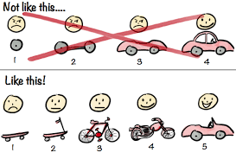
Minimum Viable Product
A minimum viable product, or MVP, is a product with enough features to attract early-adopter customers and validate a product idea early in the product development cycle

Slide 24
Minimum Viable Product
Dropbox. Starting out as a demo video MVP, Dropbox explained the benefits of storing data in one place. ...
Amazon. Most people know that Amazon began as an online bookstore. ..
Core Feature
Video Demo
Concierge
Mago di Oz
Piecemeal
Landing Page
Crowdfunding
Pitch Deck

Slide 25
Minimum Viable Product: Smoke test
Minimum Viable Product: Smoke Test
A smoke test is a method for determining if there is sufficient customer demand for a given value proposition of a product or service to justify building the actual product or service.
This is commonly a one-page website which describes the product and asks the visitor to sign up to the product or service before the product or service is actually available. The customer is unaware that the product or service does not yet exist but must give some form of payment in order to get access.
Payment may be done via cash, cash equivalent, time/attention, or simply data as in the case of requesting an email address to sign up.
KPI: Key Performance Indicator
Target segment
Data Analysis

Slide 26
Last phases
8) Business Plan
9) Legal form
10) Marketing plan

