Slide 1
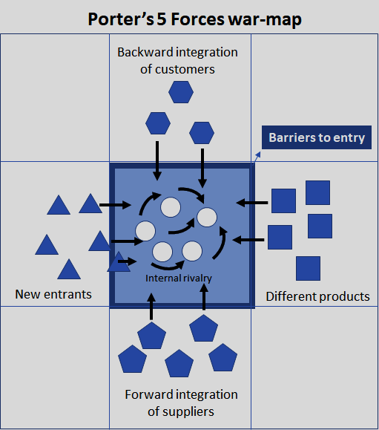
Michael Porter’s 5 Forces Framework

Slide 2
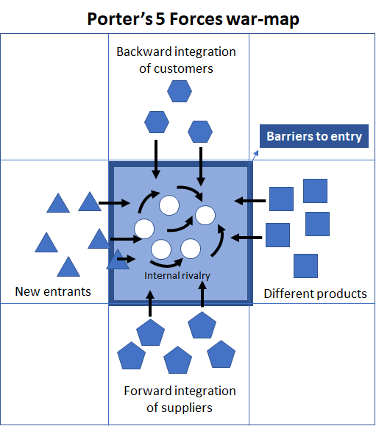

Slide 3
1) The degree of business competition in an industry provides information for the formulation of a corporate strategy (enter, remain, exit).
2) There is also the threat of future competition from possible new competitors who can enter the market.
An industry that has low barriers to entry (that is, easily penetrated with modest efforts and investments) can be invaded by many new competitors.

Slide 4
3) Competition, with its negative effect on profits, can also come from products from other industries that meet more or less the same needs as those satisfied by the companies in the sector you are considering and that can be chosen alternatively
(tea can be replaced by coffee, and airlines by railroads for example).

Slide 5
4) The competition can come from customers in the sector who can decide to integrate vertically backward, going to produce in the upstream sector those products or components that they previously purchased by a supplier.
5) The competition can also come from suppliers in an upstream sector in the supply chain who decide to integrate vertically forward, going to produce what their customers previously produced.

Slide 6
Intensity of direct competition

Slide 7
Intensity of direct competition
A fenced lawn could be defined as crowded if there are too many sheep in relation to the amount of grass
An industry could be defined as crowded if there are too many competitors in relation to the amount of money allocated by customers to satisfy a certain demand for value.

Slide 8
Intensity of direct competition

Slide 9
Market value and market share
VALUE OF THE MARKET
OF CHAIRS FOR OFFICES
10 MILLION EURO

Slide 10
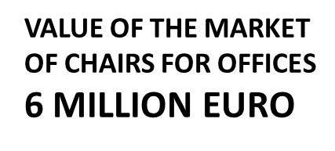
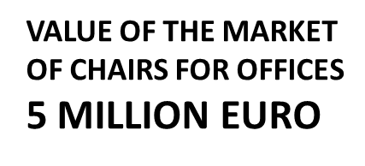
VALUE OF THE MARKET
OF CHAIRS FOR OFFICES
10 MILLION EURO

Slide 11
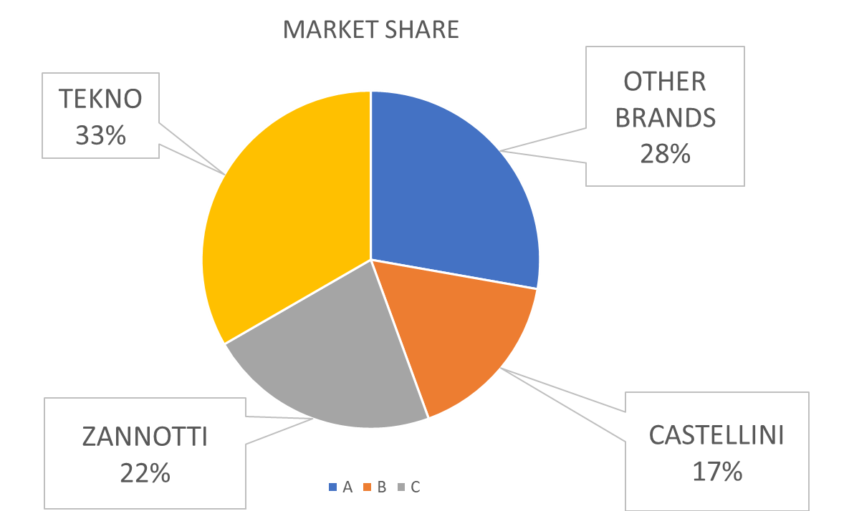
VALUE OF THE MARKET
OF CHAIRS FOR OFFICES
10 MILLION EURO

Slide 12
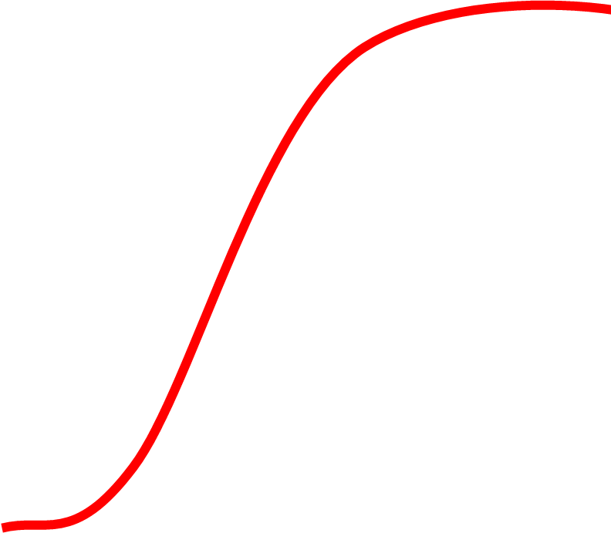
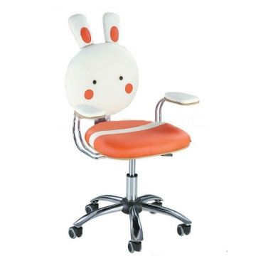

Slide 13
Threat of prospective competition from new entrants facilitated by low entry barriers

Slide 14
Threat of prospective competition from new entrants facilitated by low entry barriers;

Slide 15
Threat of indirect competition from substitute products;

Slide 16
High Entry barriers

Slide 17
In short
the prospective profitability of a sector depends on the presence or threat of 5 types of competition, also called "forces":
The intensity of direct competition;
the threat of prospective competition from new entrants facilitated by low entry barriers;
the threat of indirect competition from substitute products;
the threat of suppliers becoming competitors (forward integration);
the threat of customers becoming competitors (backward integration).

Slide 18
The inflexible law of competition
High competition requires all companies competing with each other to produce more value at lower prices.
A market with many competitors is not very profitable.
An unprofitable market does not remunerate the investments made to enter it.
An unprofitable market discourages the entry of new competitors. They fear they will not make adequate profits
Low competition rate does not stimulate companies that compete with each other to produce more value at lower prices.
A market with few competitors is very profitable (monopoly, oligopoly)
A highly profitable market rewards the investments made to enter it.
A highly profitable market attracts new competitors that want to make a profit

Slide 19
Threat of prospective competition from new entrants facilitated by low entry barriers

Slide 20
Threat of prospective competition from new entrants facilitated by low entry barriers;

Slide 21
Threat of indirect competition from substitute products;

Slide 22
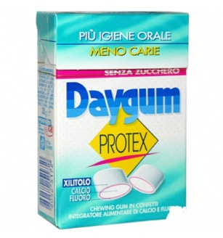
Threat of indirect competition from substitute products;

Slide 23
An industry is in a supply chain
THE INDUSTRY
OF OUR SUPPLIERS
OUR INDUSTRY
THE INDUSTRY
OF OUR CUSTOMERS
VALUE

Slide 24
An industry is in a supply chain
THE INDUSTRY
OF STEEL
THE INDUSTRY
OF FURNITURE
SELLERS
THE INDUSTRY
OF WHEELS
THE INDUSTRY OF
CHAIRS
THE INDUSTRY
OF LEATHER
VALUE

Slide 25
About the bargaining power
In an exchange there is a Value, a Price and a Cost
Two balanced bargaining powers
If both parties to the exchange have the same need to exchange, the price is at a level that satisfies the two parties.
Two unbalanced bargaining powers
If one contractor needs more than the other to make the deal, he will be willing to accept a more disadvantageous price and the other to benefit from a more advantageous price. Whoever has more bargaining power has greater advantages.

Slide 26
BARGAINING, CONFLICT OR PARTNERSHIP
IN A SUPPLY CHAIN
SUPPLIER
CUSTOMER
GROWING
MARKET
EXCHANGE
THE CUSTOMER WINS
BARGANING
WIN-LOSE
PARTNERSHIP
WIN-WIN
THE CUSTOMER LOSES
DECLINING
MARKET
CONFLICT
LOSE-LOSE
BARGANING
WIN-LOSE
THE SUPPLIER LOSES
THE SUPPLIER WINS

Slide 27
The bargaining power of suppliers and customers
THE INDUSTRY
OF OUR SUPPLIERS
OUR INDUSTRY
THE INDUSTRY
OF OUR CUSTOMERS
VALUE

Slide 28
The bargaining power of suppliers and customers
THE INDUSTRY
OF OUR SUPPLIERS
OUR INDUSTRY
THE INDUSTRY
OF OUR CUSTOMERS
BALANCED POWRS/ADVANTAGES ALONG THE SUPPLY CHAIN

Slide 29
e bargaining power of suppliers and customers
THE INDUSTRY
OF OUR SUPPLIERS
OUR INDUSTRY
THE INDUSTRY
OF OUR CUSTOMERS
ADVANTAGE FOR THE CUSTOMER’S INDUSTRY

Slide 30
e bargaining power of suppliers and customers
MANY SUPPLIERS
NO COMPETITORS
MANY SELLERS/INTEGRATORS
THE INDUSTRY
OF OUR SUPPLIERS
OUR INDUSTRY
THE INDUSTRY
OF OUR CUSTOMERS
BEST SITUATION

Slide 31
The bargaining power of suppliers and customers
ONE SUPPLIER
MANY COMPETITORS
ONE SELLER/INTEGRATOR
THE INDUSTRY
OF OUR SUPPLIERS
OUR INDUSTRY
THE INDUSTRY
OF OUR CUSTOMERS
WORST SITUATION

Slide 32
Low entry barriers

Slide 33
High Entry barriers
CAPABITIES

Slide 34
High Entry barriers:
The height of the barrier depends on the investments and efforts to be made to acquire the critical capabilities to be able to compete within the fence.
Investment in
Technical capabilities (tangible / intangible)
Process and product technology
Capacity, flexibility, elasticity
Relational capabilities (tangible / intangible)
Brand (awareness, reputation)
Business relations

Slide 35
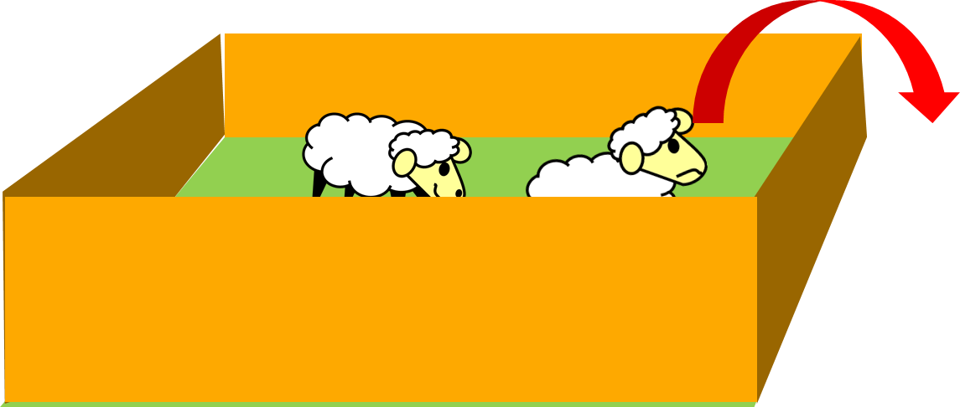
High Exit barriers:
High barriers imprison competitors in the fence.
Leaving the fence, those inside would give up the tangible and intangible assets in which they had invested.
Many competitors imprisoned in a fence fight each other
Therefore the prices go down.

Slide 36
In short
the prospective profitability of a sector depends on the presence or threat of 5 types of competition, also called "forces":
The intensity of direct competition;
the threat of potential competition from new entrants facilitated by low barriers to entry;
the threat of indirect competition from substitute products;
the threat of suppliers becoming competitors (forward integration) AND THEIR CONTRACTUAL POWER;
the threat of customers becoming competitors (backward integration) AND THEIR CONTRACTUAL POWER.

