Slide 1
Innovation & Entrepreneurship Session 2
Son Thi Kim LE
University of Littoral Côte d’Opale
France

Slide 2
Course sessions
1. Identify entrepreneurial ideas and opportunities
2. Building a business model and plan
3. Innovation and entrepreneurship
4. Innovation diffusion and Open innovation/Innovation network
5. Protecting intellectual property
6. Innovation management in resource-constrained environment

Slide 3
2. Building a business model and plan
Business model – Definition and Typology
Design the business model
Conducting a feasibility analysis
Business plan

Slide 4
a. Business model – Definition and Typology
Business model
Offering
Customers
Infrastructure
Financial viability

Slide 5
a. Business model – Defintion and Typology
Direct businesses: one- sided actors - users is customers
Multisided models: users and customers—multi-actors—are usually different people.
Marketplace models: a more complex variant of multisided models made up of two different customer segments of buyers and sellers.

Slide 6
b. Design the business model
A business model needs to address revenue streams (e.g., a revenue model), a value proposition, and customer segments.
Value Proposition: the value of their products
Benefits (value) customers can expect from a particular product/service
Financial measures of value: economic performance, job creation, wealth, growth measures.
Canvas: use to map out and plan different components of the business models.
Business model canvas: a better fit for mature business
Lean canvas: a better fit for startups

Slide 7
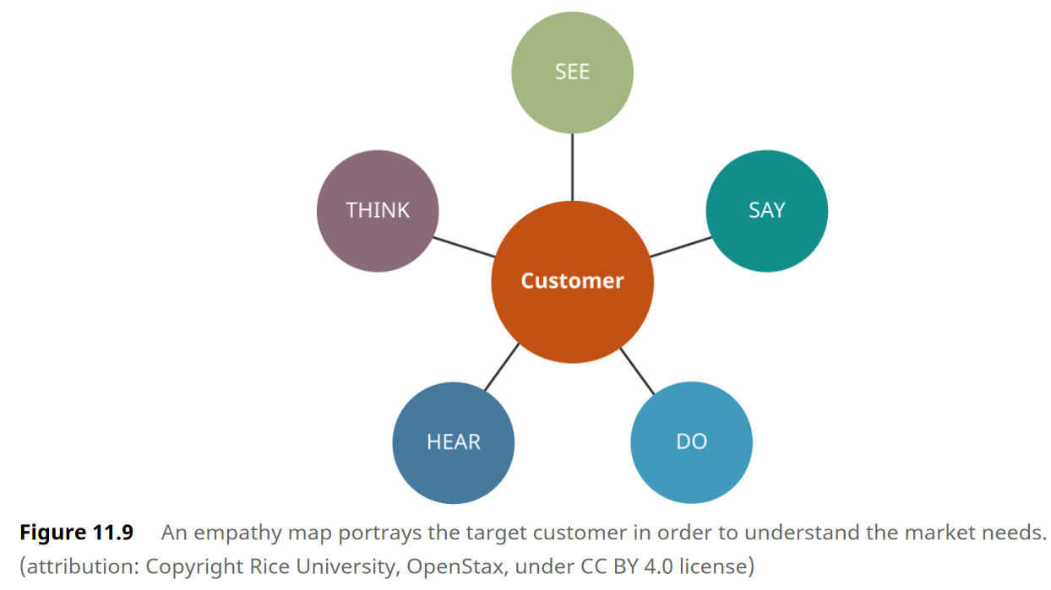
b. Design the business model
Business model and Lean canvas: customer-focused design.
Customer empathy map:
- A portrayal of target customer
- To address customer pains (fears, frustrations, and anxieties) and gains (wants, needs, hopes, and dreams)

Slide 8
b. Design the business model

Slide 9
b. Design the business model

Slide 10
b. Design the business model
• Desirability: How desirable is the product? Who will use it and why?
• Feasibility: How feasible is this idea? What are the costs of making it? How practical is the concept?
• Viability: Will this idea remain viable? How will it make money? How will it be sustained over time?

Slide 11
c. Conducting a feasibility analysis

Slide 12
c. Conducting a feasibility analysis
Organizational Feasibility Analysis: Assess the prowess of management and sufficiency of resources to bring a product or idea to market
A financial analysis: Forecasts of project revenue and expenses; project a financial narrative; and estimate project costs, valuations, and cash flow projections.
Market Feasibility Analysis: Define competitors and quantify target customers in the market within the chosen industry

Slide 13
d. Business plan
Business plan: long-range planning of a company’s operation and includes background information, financial information, and a summary of the business (business and industry, market strategies, sales potential, and competitive analysis, the company’s long-term goals and objectives and projects financial data)
Executive summary
Business Description
Industry Analysis and Market Strategies
Competitive Analysis
Operations and Management Plan
Marketing Plan
Financial Plan

Slide 14
Thank you for your attention
Don’t hesitate to contact me
if you have any question or you need further information
Son Thi Kim Le
ISI/Lab RII and ISCID-CO (ULCO)
Sontk.le@univ-littoral.fr

