Slide 1
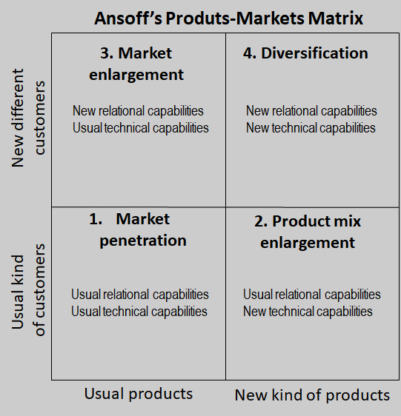
Igor Ansoff’s Growth Framework
Analyze your growth opportunities based on your own capabilities:
market diversification
product diversification
market and product diversification

Slide 2
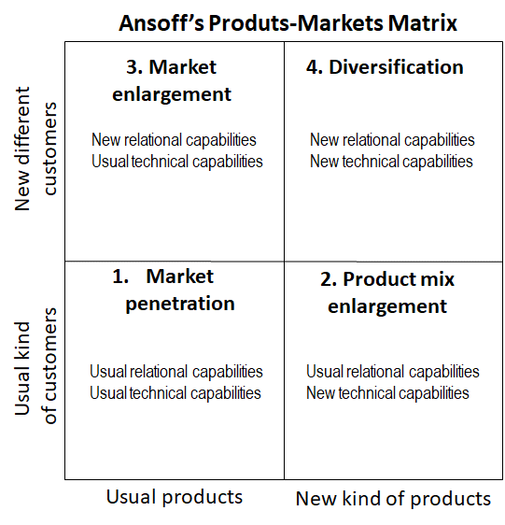

Slide 3
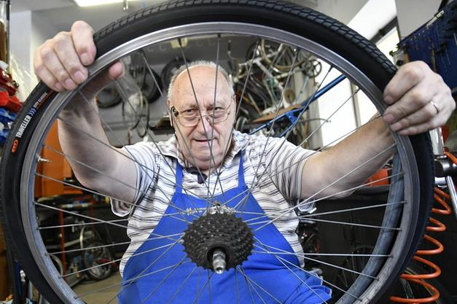
1954, THE FOUNDER
THE STORY BEGAN 67 YEARS AGO
GIROLAMO GATTO
BICYCLE REPAIRER

Slide 4
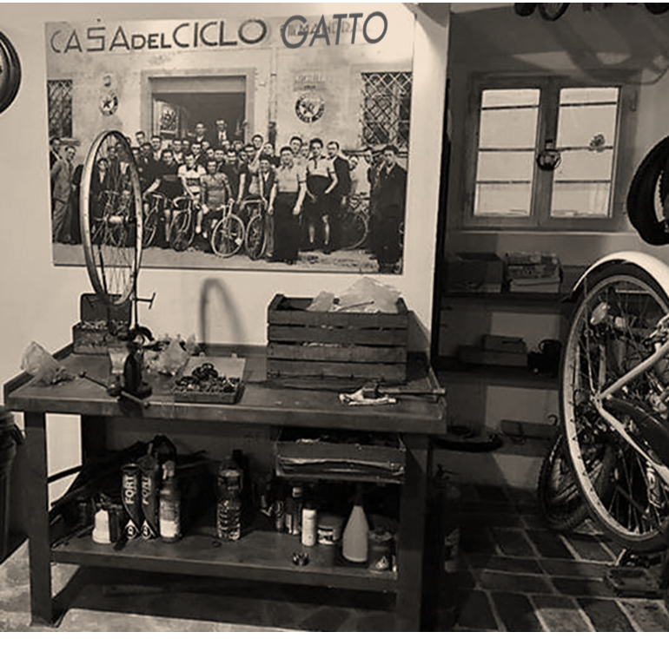
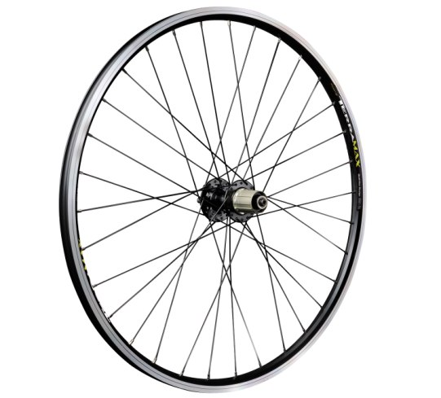
GIROLAMO GATTO RIPARAZIONE DI BICICLETTE
FELICE GATTO PRODUZIONE DI CERCHIONI PER BICICLETTE
PINO GATTO PRODUZIONE DI RUOTE PER CARELLI INDUSTRIALI
1970
1979

Slide 5
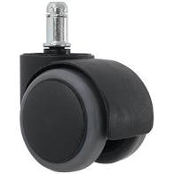
PINO GATTO PRODUZIONE DI RUOTE PER ARREDAMENTO

Slide 6
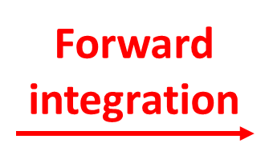
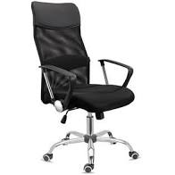
COMPONENTS, SUBSYSTEMS
AND MATERIALS
SUPPLIER
PRODUCT
INTEGRATOR
SELLER
CUSTOMER

Slide 7
THE ANSOFF’S GAMBLING OF MR. GATTO
TEKNO BRAND OWNER

Slide 8
THE ANSOFF’S GAMBLING OF DOCTOR GATTO
TEKNO BRAND OWNER

Slide 14
WHAT IS
MY BUSINESS ?

Slide 15
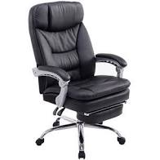
THIS IS
MY BUSINESS !
CHAIRS FOR BUSINESS COMFORT
BASIC
PRO
EXECUTIVE

Slide 16
LET ME TELL
A STORY ...

Slide 17
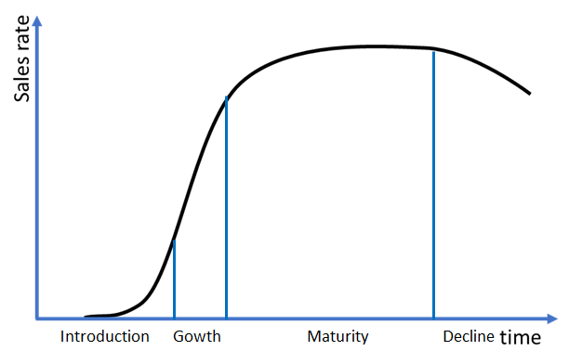
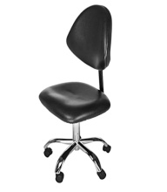
ACTIONS:
Keep improving
the value of our products for our customers
communication and relationships
Keep increasing efficiency = higher margins - lower prices
WOW! WE
ARE GROWING !

Slide 18
CHAIRS FOR BUSINESS COMFORT

Slide 19
LET ME TELL
A DIFFERENT STORY ...

Slide 20
WE STOPPED
GROWING !

Slide 21
WHERE SHOULD
WE INVEST ?

Slide 22
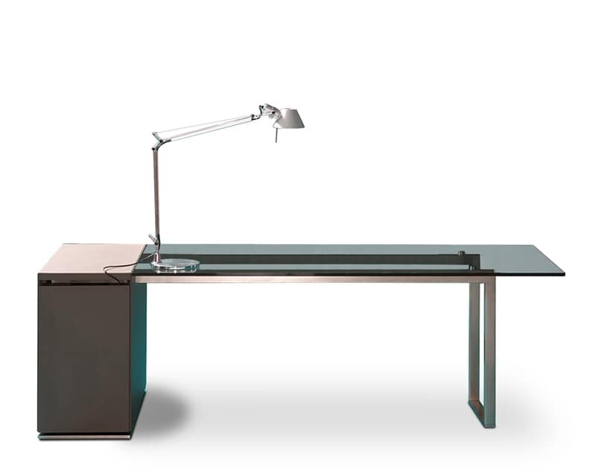
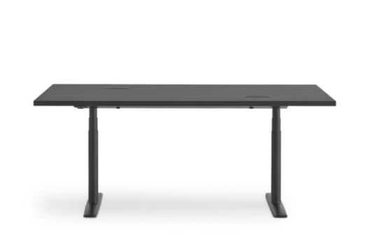
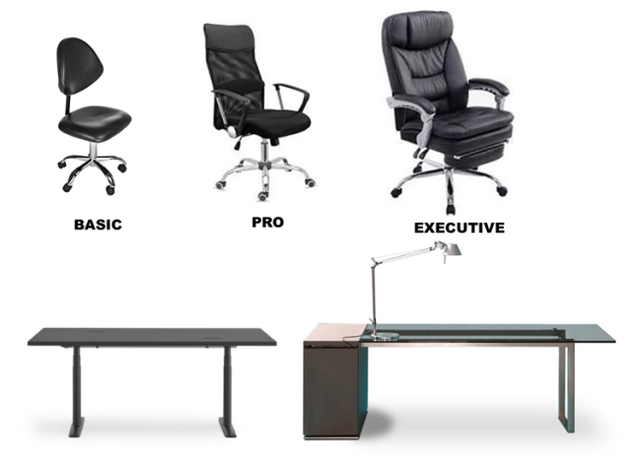
SMART OFFICE FURNITURE
LEVERAGE ON
RELATIONAL
CAPABILITIES

Slide 23
LET ME TELL
A THIRD STORY ...

Slide 24
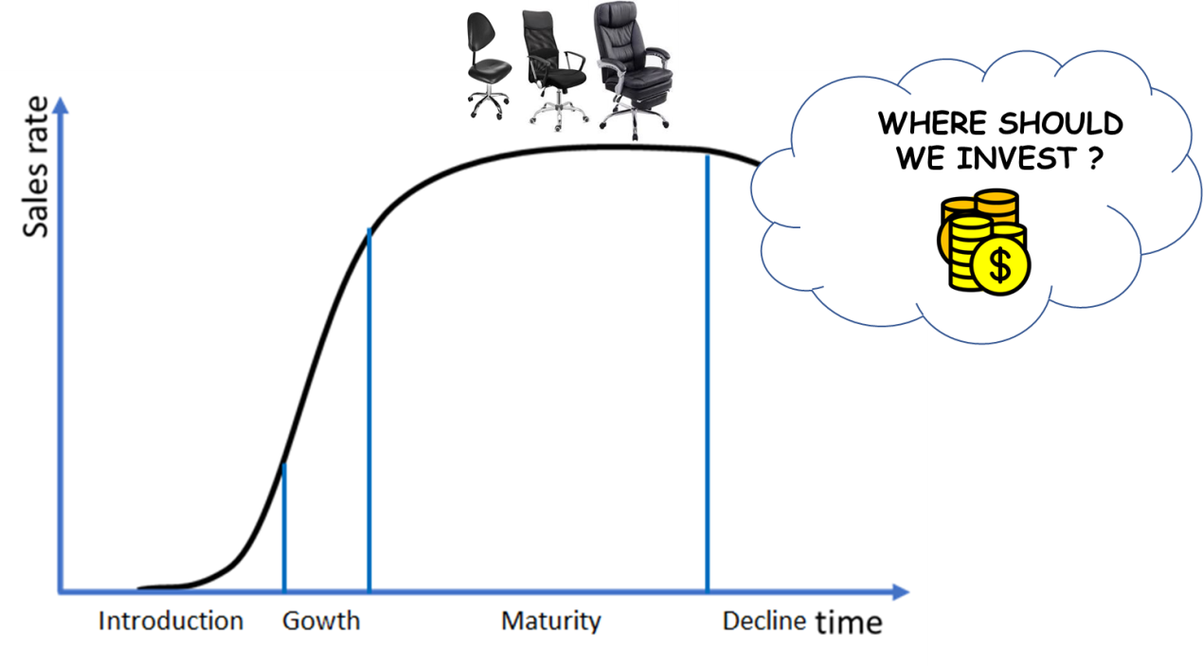
WARNING!
UNHEALTY
CHAIR !

Slide 25
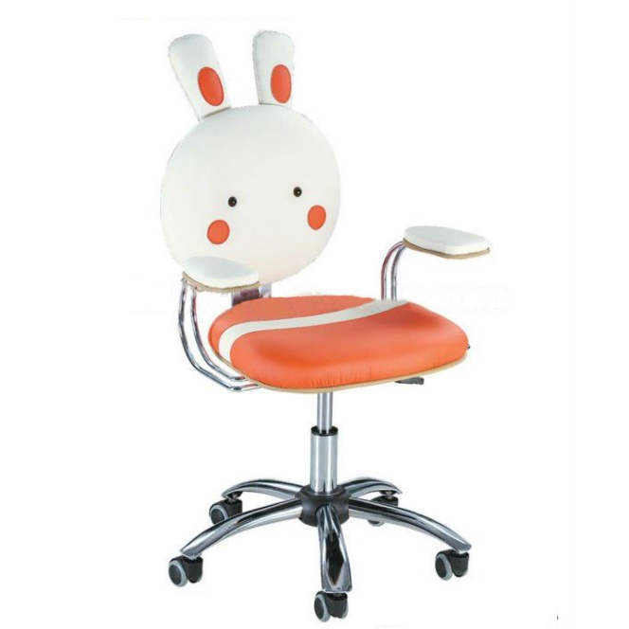
WARNING!
UNHEALTY
CHAIR !

Slide 26
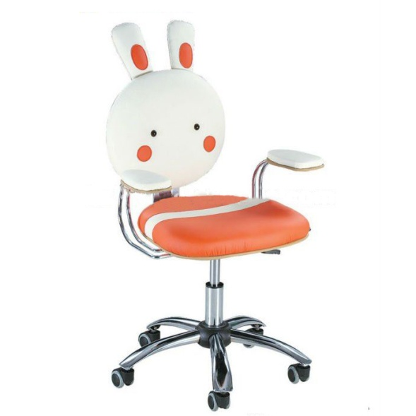
PLAY & STUDY CHAIRS
LEVERAGE ON
TECHNICAL
CAPABILITIES
CHAIRS FOR BUSINESS COMFORT

Slide 27
WHAT IS THE FOLLOW-UP
OF THE SECOND STORY?...

Slide 28
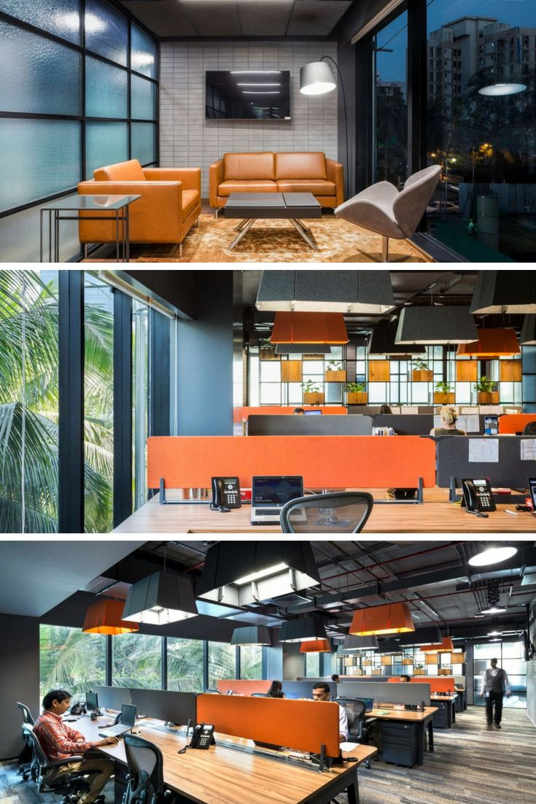
WORKSPACE DESIGN

Slide 29
COULD THERE BE ANOTHER EVOLUTION OF THE SECOND STORY?

Slide 30
VERTICAL
FORWARD
INTEGRATION

Slide 31
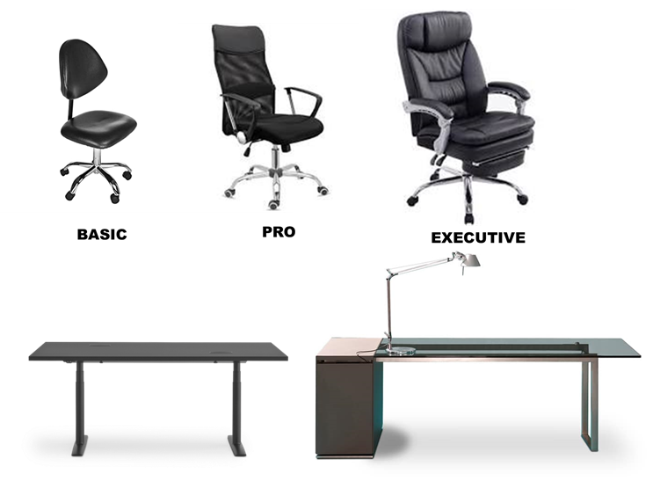
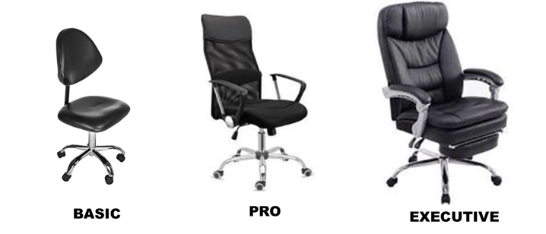
EVOLUTION THROUGH PRODUCT DIVERSIFICATION
MARKET PENETRATION
PRODUCT DIVERSIFICATION
RELATED DIVERSIFICATION
B2B
BUSINESS TO BUSINESS
STRATEGY

Slide 32
EVOLUTION THROUGH PRODUCT DIVERSIFICATION
MARKET PENETRATION
PRODUCT DIVERSIFICATION
RELATED DIVERSIFICATION
B2B
BUSINESS TO BUSINESS
STRATEGY
B2C
BUSINESS TO CONSUMER
STRATEGY

Slide 33
CHANGING MISSION STATEMENT

Slide 34
CHANGING MISSION STATEMENT

Slide 35
WHAT IS THE FOLLOW-UP
OF THE THIRD STORY?...
PLAY & STUDY CHAIRS

Slide 36
PLAY & STUDY

Slide 37
EVOLUTION THROUGH MARKET DIVERSIFICATION
MARKET PENETRATION
MARKET DIVERSIFICATION
RELATED DIVERSIFICATION
PLAY & STUDY
B2B
BUSINESS TO BUSINESS
STRATEGY
B2C
BUSINESS TO CONSUMER
STRATEGY

Slide 38
ADDING A MISSION STATEMENT
PLAY & STUDY
B2B
BUSINESS TO BUSINESS
STRATEGY
B2C
BUSINESS TO CONSUMER
STRATEGY

Slide 39
IS THERE A POSSIBLE
FOURTH STORY?...

Slide 40
NATURALE SALUTARE
LEVERAGE ON
FINANCIAL &
MANAGMENT
CAPABILTIES
CHAIRS FOR BUSINESS COMFORT

Slide 41
EVOLUTION THROUGH CONGLOMERATE DIVERSIFICATION
MARKET PENETRATION
CONGLOMERATE DIVERSIFICATION

Slide 42
ADDING A BRAND NEW MISSION STATEMENT

Slide 43
COMPONENTS, SUBSYSTEMS
AND MATERIALS
SUPPLIER
PRODUCT
INTEGRATOR
SELLER
CUSTOMER

Slide 44
COMPONENTS, SUBSYSTEMS
AND MATERIALS
SUPPLIER
PRODUCT
INTEGRATOR
SELLER
CUSTOMER

Slide 46
TOTAL ANNUAL REVENUE =
15 ml
15 ml
WE STOPPED
GROWING !
YESTERDAY …

Slide 47
TOTAL ANNUAL REVENUE =
75 ml
25 ml
PLAY & STUDY
ANNUAL
REVENUE
15 ml
+ 5 ml
+ 25 ml
+ 20 ml
+ 10 ml
TOTAL ANNUAL REVENUE =
75 ml
TODAY !

Slide 48
TOTAL ANNUAL REVENUE =
75 ml
THANK YOU
PROF. ANSOFF !

