Slide 1
MASTER MEIM 2021-2022
Introducing Cloud Computing
Digital Tech
Prof. Raffaele Montella
Associate Professor in Computer Science - Università degli Studi di Napoli Parthenope

Slide 2
Definitions
“Cloud computing is the on-demand availability of computer system resources, especially data storage and computing power, without direct active management by the user.”
Large clouds are distributed over multiple locations.
Edge computing: part of the user computation is offloaded on proximal servers.

Slide 3
What is Cloud Computing
User
Computing and Storage infrastructure
User
User
User
User
Services provided by customized resources.
On demand virtual machine instances,
Geographically independent services
“pay as you go”

Slide 4
The pyramid
Software as a Service
(SaaS)
*as a Service
A service is provided by an access point
Browser web.
Programmatically (API)
Users
Platform as a Service
(PaaS)
Developers
Infrastructure as a Service
(IaaS)
Value
System People

Slide 5
Pros
Elasticity
Scaling
On demand computing power
On demand storage
Effort
Easy to configure and start
Final users are decoupled from the infrastructure
No need to buy, install and configure the infrastructure (*)
No maintenance expenses

Slide 6
TCO, TTM
Total Cost of Ownership
On-cloud
€
€
Business size
On-premises
Infrastructure costs
Tempo
JAN FEB MAR APR MAY JUN JUL AUG SET OCT NOV DEC
Total Cost of Ownership minimization
Fix costs to variable costs transformation
Time To Market minimization (easy prototyping, scaling)

Slide 7
Pros
Costs
No initial investments in infrastructure
No “over provisioning” costs
Pay per use
Availability
Redundancy
Trust
Data Backup
Security
What happens in case of provider failure?
Are data really private?

Slide 8
Virtualization
“the act of creating a virtual (rather than actual) version of something, including virtual computer hardware platforms, storage devices, and computer network resources.”
Virtual machine: the virtual hardware components supporting an operating system and applications.

Slide 9
Hypervisor
“Software component enabling virtualization (virtual machine monitor)”
Xen - https://www.xenproject.org (Linux, open source, root)
VMBox - https://www.virtualbox.org (Linux, Win, OsX, open source, user)
KVM - https://www.linux-kvm.org (Linux, open source, user)
VMWare - https://www.vmware.com (Linux, Win, commerciale, user)

Slide 10
Virtualization
Immagine
Hardware Virtuale
Image: persistent configuration of a virtual machine (as a just installed OS on a boot device).
Instance: an active virtual machine booted from an image.
Snapshot: a virtual machine persistent state.
Appliance: a ready to use application installed on a virtual machine.
start
Snapshot
Instanza
APP
Appliance
stop
terminate

Slide 11
OS-level virtualization
“OS-level virtualization refers to an operating system paradigm in which the kernel allows the existence of multiple isolated user space instances.”
Container: fuller virtual machine environments operating in varying degrees of concert with the host OS (split-driver)

Slide 12
Storage
File Storage:
Data stored as a POSIX file system
Block Storage:
Virtual hard drive
Connected to a virtual
machine instance.
Object Storage:
Non structured data.
URL identified.
Database/Data warehouse:
SQL
NoSQL
File Storage
File System
Block Storage
Instance
APP
Appliance
Object Storage

Slide 13
Autoscaling
“Computing and storage resources vary as the actual application needs.”
Load balancing
Metrics
Cost management

Slide 14
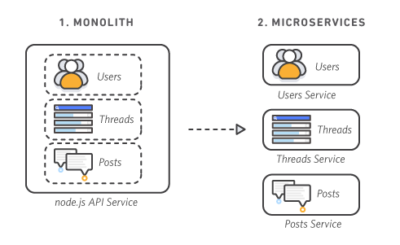
Microservices & lambda functions
Applications made joining multiple services
Easy to develop, easy to scare
Time to Market minimization
Easy maintenance, update, upgrade
Lambda functions: the developer take care about the code, not the computing resource needed to execute the service.

Slide 15
Conclusions
Cloud computing is more that just a “paradigm”.
Now the correct question is not: “What is/could be on the cloud” But: “What isn’t…”
The amount of computational resources needed to solve a problem is not an issue.
Evaluate the cloud affordability is the real issue.
It is “profitable” mastering cloud computing tools and resources in any Computer Science application scenario.

Slide 16
MASTER MEIM 2021-2022
That’s all folks

