Slide 1
MASTER MEIM 2022
Soft skills introduction
Master 2022
A cura del dott. Luca Fusco
Psicologo clinico e dell’orientamento
Assegnista di ricerca dell’Università degli studi di Napoli Parthenope

Slide 3
Program
DAY 1
DAY 2
Introduction to soft skills
2) Team working
Self-knowledge
2) Career construction

Slide 4
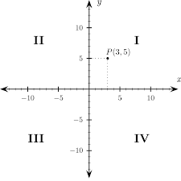
ACTIVITY NUMBER ONE:
CATEGORIES

Slide 5
A) SUSHI
B) PIZZA
C) BURGER
D) PASTA

Slide 6
A) RUNNING
B) TENNIS
C) SWIMMING
D) BASKETBALL

Slide 7
A) MOUNTAIN
B) SEA
C) ARCHEOLOGICAL SITE
D) MODERN TOWN

Slide 8
A) THRILLER
B) DRAMA
C) LOVE STORY
D) COMEDY

Slide 9
A) NETFLIX
B) SKY TV
C) PRIME VIDEO
D) NORMAL TV

Slide 10
A) MILAN
B) PALERMO
C) ROME
D) FLORENCE

Slide 11
A) BATMAN
B) IRON MAN
C) SUPERMAN
D) SPIDERMAN

Slide 12
A) MUSIC
B) DANCE
C) CINEMA
D) THEATER

Slide 13
A) HISTORY
B) MATH
C) SCIENCE
D) LITERATURE

Slide 14
A) TEAM WORKING
B) LEADERSHIP
D) TIME MANAGEMENT
C) COMMUNICATION

Slide 15
A) CREATIVITY
B) ACCURACY
D) GOAL ORIENTATION
C) AUTHONOMY

Slide 16
A) EMOTIONAL STABILITY
B) COSCIENTIOUSNESS
D) OPENESS TO EXPERIENCE
C) AGREEABLENESS

Slide 17
DEFINING SOFT SKILLS

Slide 18
DEFINING SOFT SKILLS
“non-technical skills that impact interpersonal interactions, how people respond to their environment, and their overall performance at work.”

Slide 19
Beyond soft skills?

Slide 20
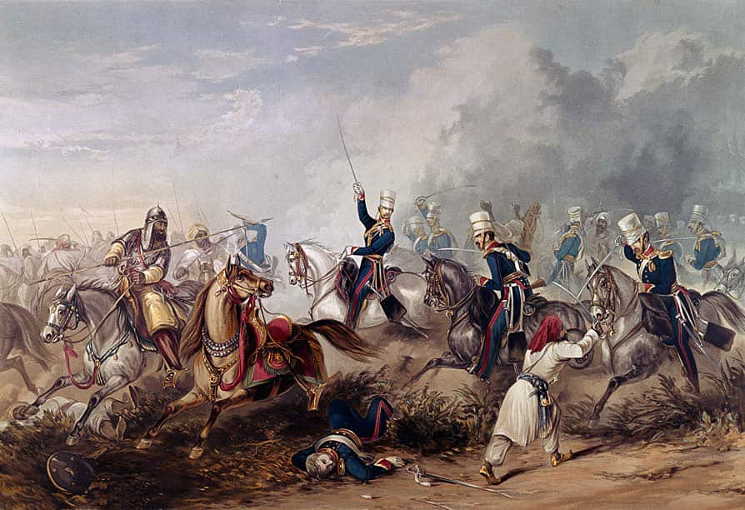
ACTIVITY NUMBER TWO:
Soft skills battle!
How many can you count?

Slide 21
A list… (Adecco)
AUTHONOMY
SELF-ESTEEM
ADAPTING SKILLS
STRESS-RESISTENCE
PLANNING SKILLS
ORGANIZING SKILLS
ACCURACY/DETAILS ATTENTION
UPDATING SKILLS
GOAL SETTING
INFORMATION MANAGEMENT
LEADERSHIP
NEGOTIATING
INTERPERSONAL SKILLS
CREATIVITY
LISTENING
RESILIENCE
TIME MANAGEMENT
COMMUNICATING
PROBLEM SOLVING
TEAM WORKING

Slide 22
ACTIVITY NUMBER THREE:
A STEP FORWARD!

Slide 23
ACTIVITY NUMBER FOUR:
Describe my feelings…

Slide 25
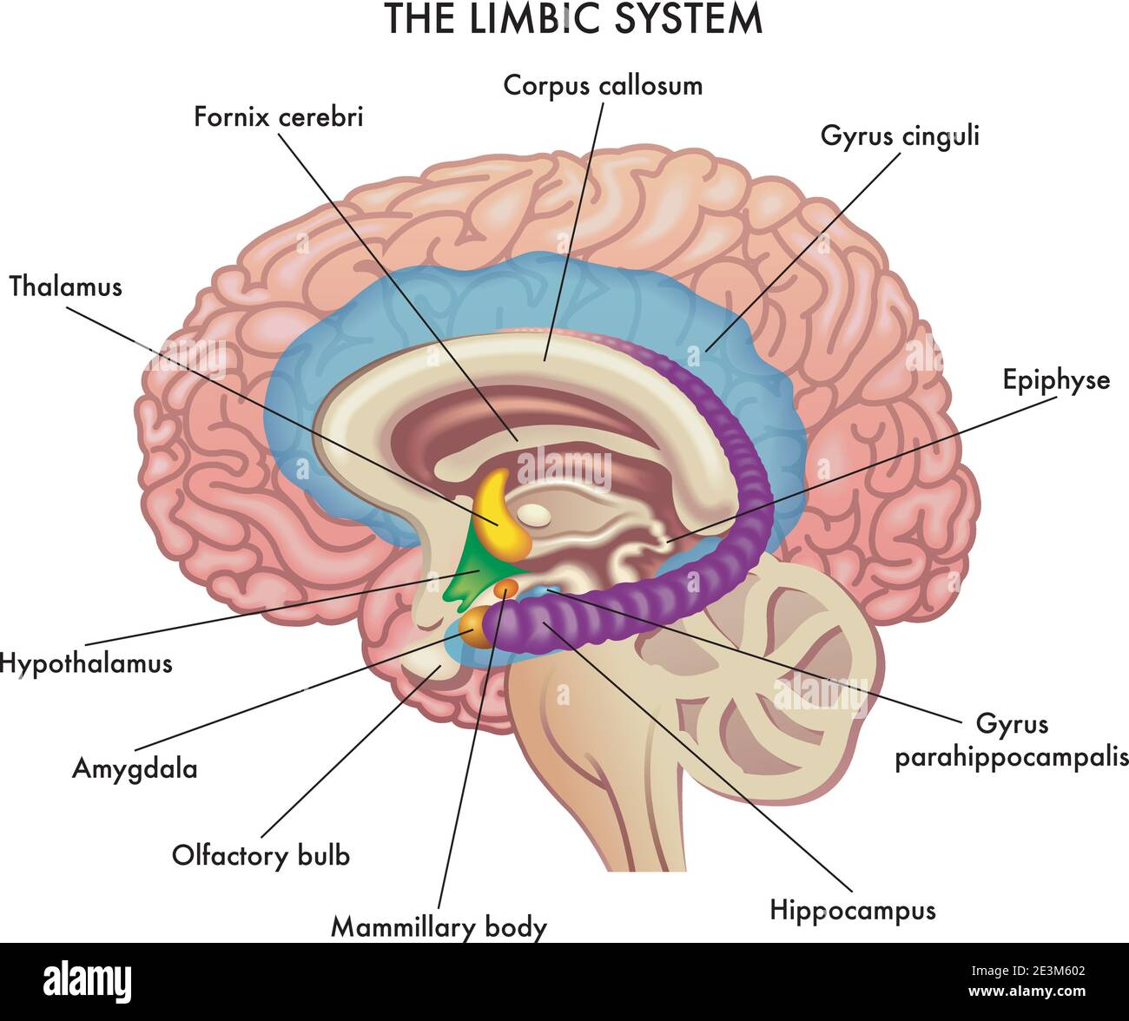

Slide 26
EMPATHY
«The ability to identify with another person until being able to get her/his thoughts and affective states.»
«An affective sharing, the ability of accepting the other’s point of view, even when this is not shared by the subject»

Slide 27
Empathy development (Hoffman)
STAGE 0: Emotional contagious
STAGE 1: Egocentric empathy
STAGE 2: Almost egocentirc empathy
STAGE 3: True empathy
STAGE 4: Existential empathy

Slide 28
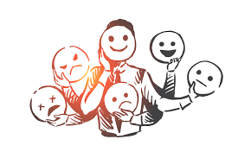
Emotions at work?

Slide 29
Coping styles:
«problem-focused vs emotion-focused»

Slide 30
Emotional Intelligence/competence
Understanding one’s own emotional state
Understanding other people’s emotions
Ability to identify with others’ emotional states
Awerness that there’s no necessary correspondance between emotional state and manifest expression
Ability to cope with painful or unpleasent emotions
Emotional self-efficacy

