Slide 1
MASTER MEIM 2021-2022
Self-knowledge, identity and future pt.2
Soft skills final session
Dr. Luca Fusco, PhD in «Mind, Gender and Language»
Career and clinical psychologist
Assegnista di ricerca, Università degli studi di Napoli Parthenope

Slide 2
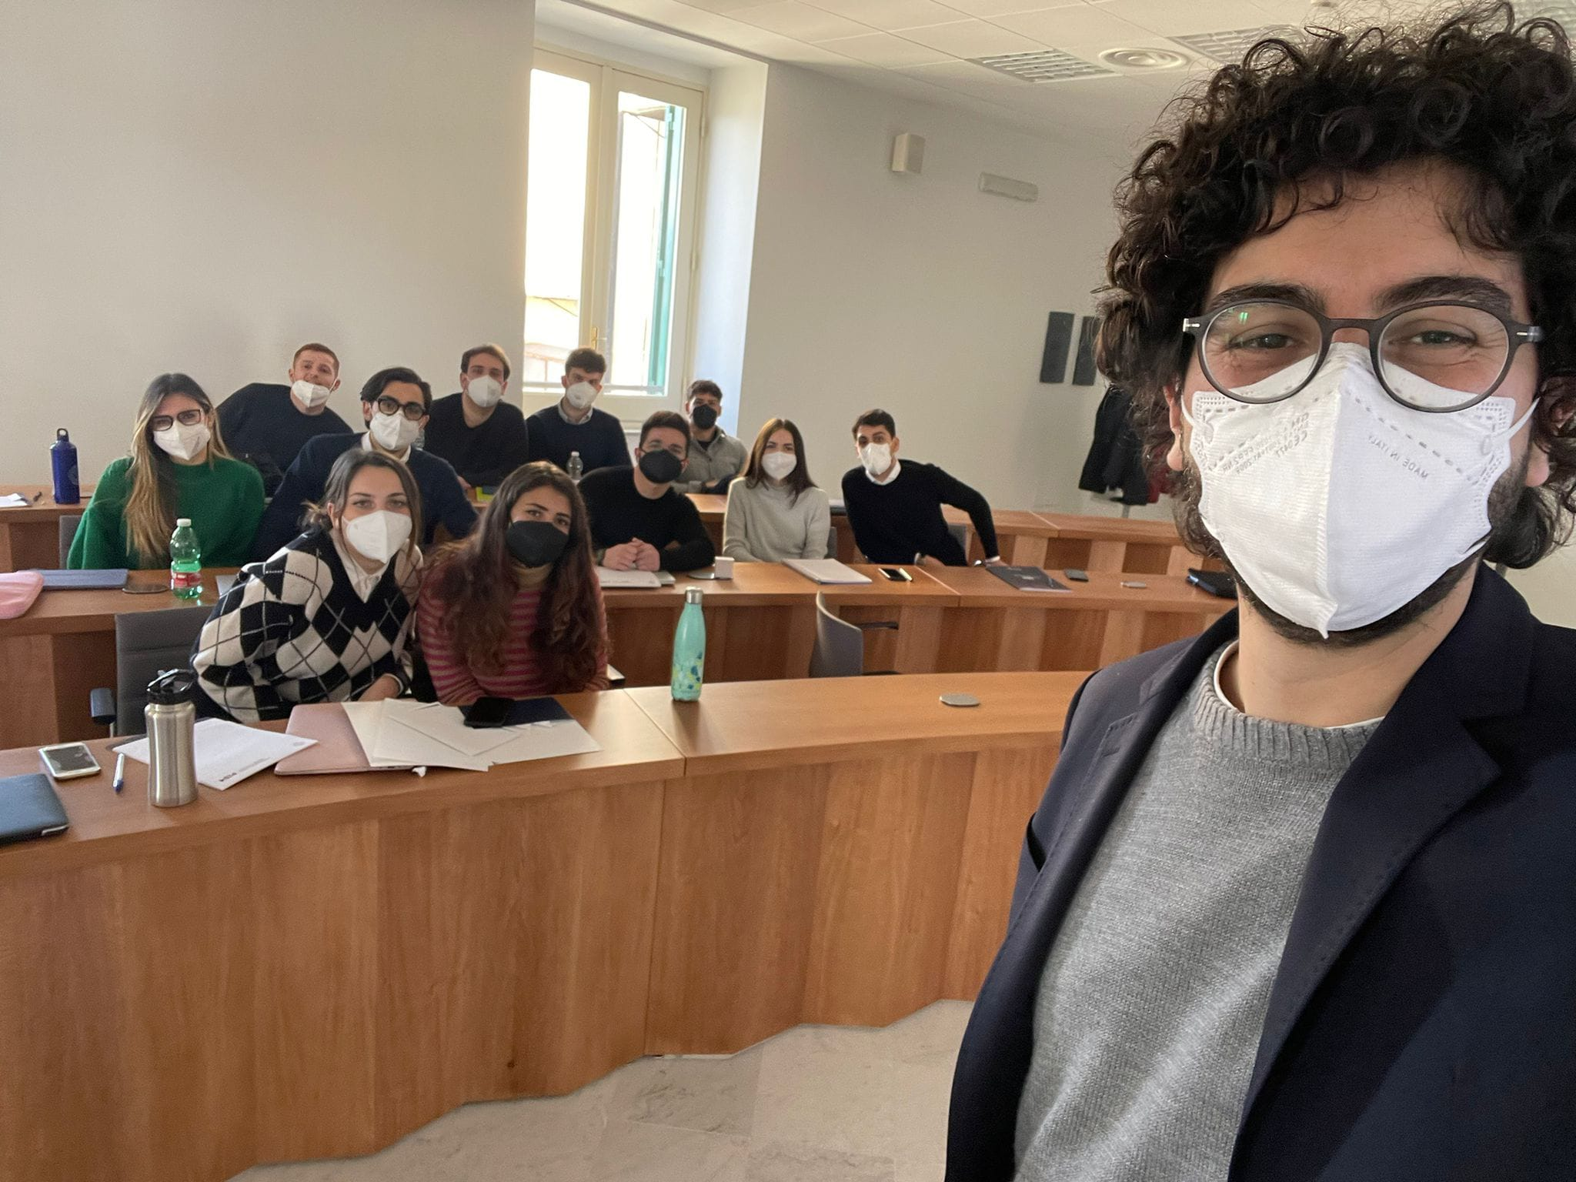
Team working and interpersonal cognition

Slide 3
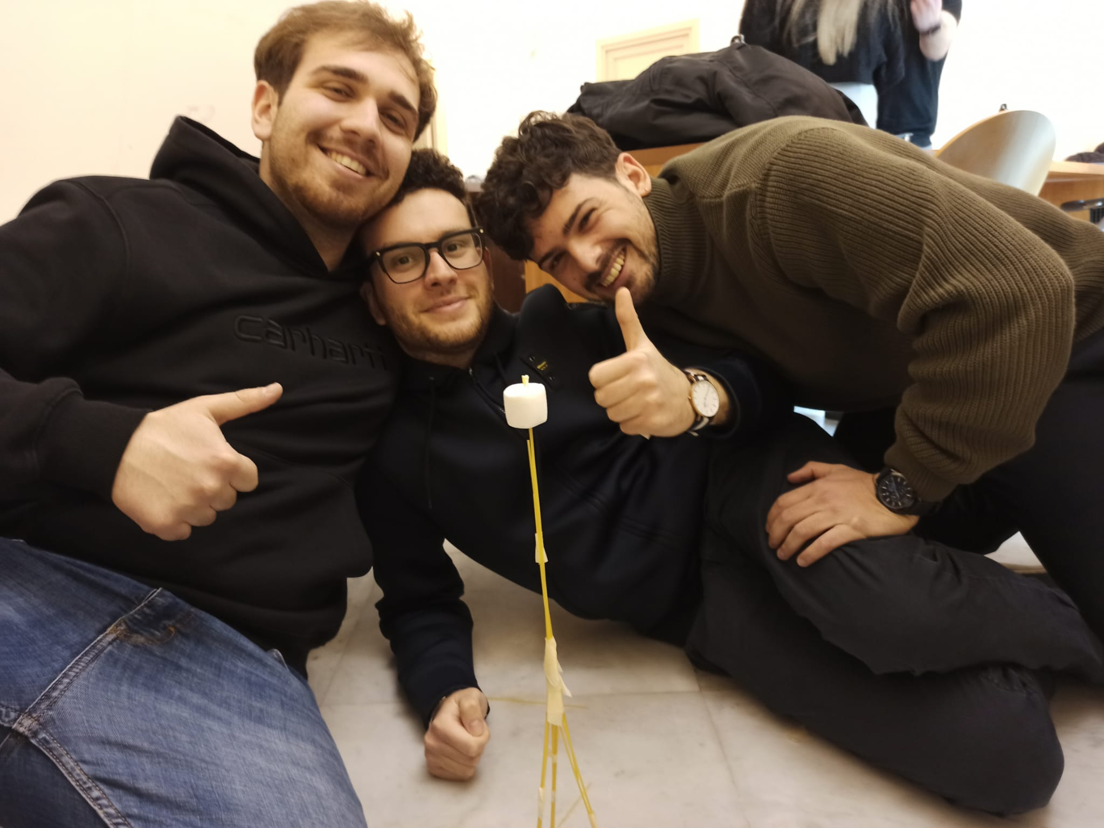
Problem solving

Slide 4
Emotions, mindfulness

Slide 5
Communication and lie detection
«You cannot not communicate!»

Slide 6
Time management/time employment/ desire and meaning exploration

Slide 7
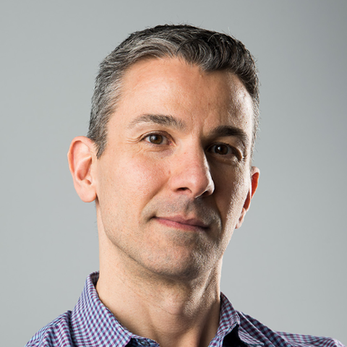
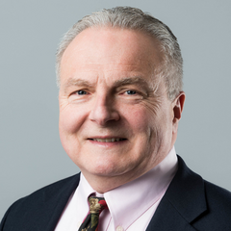
Relationship and human resources management

Slide 8
FORMAL LEARNING VS INFORMAL LEARNING
Formal learning | Informal learning | Non-formal learning
Structured context for education | Un-structured contexts for education | Un-structured contexts for education
Intentional | Unintentional | Intentional
Officially certificated | Product of everyday experience | Product of planned activities

Slide 9
Make three colums: 1) Which soft skill did you improve during the MEIM master? 2) What do you still need to improve?
3) How do you plan to improve it?

Slide 10
A list… (Adecco)
AUTHONOMY
SELF-ESTEEM
ADAPTING SKILLS
STRESS-RESISTENCE
PLANNING SKILLS
ORGANIZING SKILLS
ACCURACY/DETAILS ATTENTION
UPDATING SKILLS
GOAL SETTING
INFORMATION MANAGEMENT
LEADERSHIP
NEGOTIATING
INTERPERSONAL SKILLS
CREATIVITY
LISTENING
RESILIENCE
TIME MANAGEMENT
COMMUNICATING
PROBLEM SOLVING
TEAM WORKING

Slide 11
A look at yourself…
Check your e-mail…

Slide 12
Identity is dynamic in:
Contents
Qualities

Slide 13
Identity content:
The identity capital:
Identity capital is the accumulation of our personal assets, a culmination of things that make us who we are.
They can be:
- Tangible (titles, jobs, clothes, money, etc.)
- Untangible (personality traits, values, opinions, competencences, etc.)
Coté says people build identity accumulating identity capital in a passive (consumer identity) or an active (agent identity) way.
Meg Jay (2012) proposes that young people use the identity capital criteria when in doubt about a choice.

Slide 14
Identity qualities:
Clear vs confused
Rigid vs flexible
Positive vs negative
Self-centered vs other-centered
Rich vs Poor
Past vs present vs future oriented

Slide 15
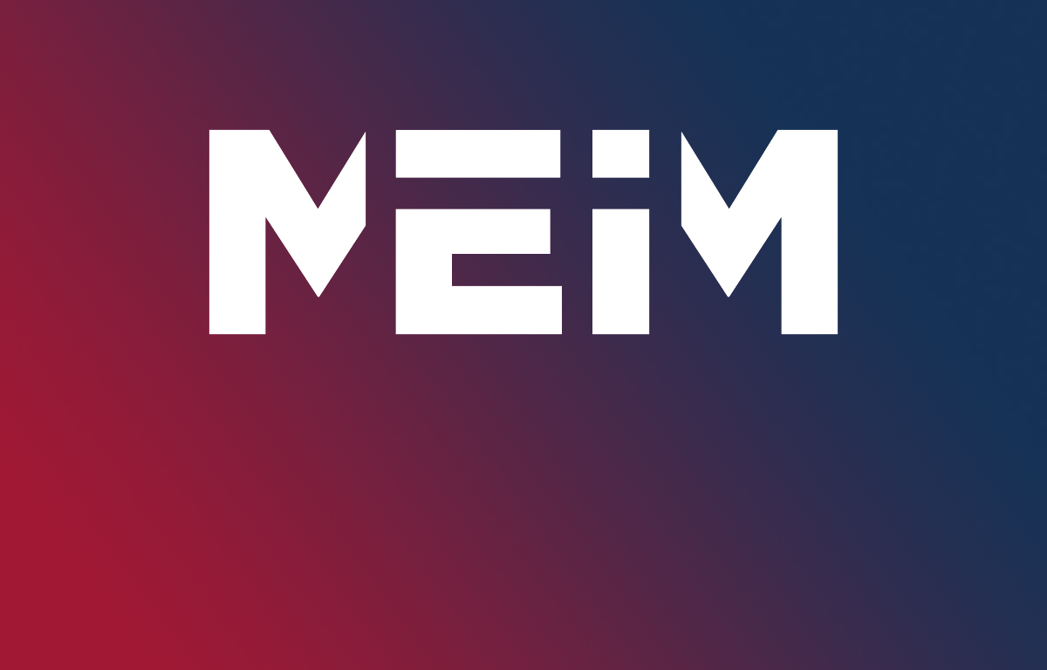
MEIM identity
The Master in Entrepreneurship and Innovation Management has a complex and multi-dimensional training program.
How does this complexity gets translated into your identity and your life story?

Slide 16
«Why would you hire a MEIM student?»
Prepare a creative team presentation in which you answer the main question including the following points:
1) Which are the essential professional and personal characteristics of MEIM students?
2) Which soft and hard skills do they have?
3) What’s their optimal function in an organization?
4) Bring examples, use the individual students of the other team showing what their qualities are and why should a company hire them.

