Slide 1
Michael Porter’s Generic Strategies Framework

Slide 2
How to combine strategic product diversification decisions with strategic differentiation decisions?
Differentiating your offer of products means aiming at a narrow target of customers who are willing to spend more to have a product with certain valuable features
Diversifying your offer of products means expanding your range of products with more different product lines

Slide 3
Mass Market vs Differentiated Market
In planning the offer of our products, we must consider our resources and capabilities and decide to develop profits by providing
high volumes of goods sold at low unit prices
low volumes of goods sold at high unit prices
one alternative excludes the other.

Slide 4
Mass Market vs Differentiated Market
MASS PRODUCTION
If market A requires many product units, it is better to produce the largest possible quantity in order to have a lower unit cost.
The high "capacity" is a reward in market A which demands many units of standardized product.
DIFFERENTIATION -SPECIALIZATION
Market B request small quantities of a product with very particular characteristics to which customers attribute value and for which, therefore, they are willing to pay more.
In market B, I cannot count much on economies of scale, but I must be able to provide those special characteristics (aesthetic, qualitative, technical or functional) that are required.
The unit cost will therefore be higher, but, on the other hand, the customer is willing to accept a higher price.

Slide 5
Generic Strategies
Michael Porter says there are two "generic strategies" to choose from:
a "cost strategy" aimed at a type A market
a "differentiation strategy" targeting a type B market

Slide 6
Cost Strategy: searching competitive advantage for efficiency
Market A: profit derives from a greater quantity of products at a lower cost and a lower price.
The key technical and relational capabilities for this generic strategy are related to efficiency, i.e. the ability to produce, distribute and sell a large quantity of products at low prices.
Competition among undifferentiated product will be made by many practically similar competing products.
These products are called “commodities” and competition between manufacturers is based on efficiency, availability and on the lowest price.

Slide 7
Differentiation Strategy: searching competitive advantage for efficiency
Market B: profit derives from a smaller quantity of higher priced products.
The key technical and relational capabilities for this generic strategy are linked to efficacy, that is, the ability to create products with highly attractive characteristics for a market willing to recognize their value.
The attraction exerted by the products can derive from technical, aesthetic and sometimes symbolic characteristics.
For example, we can consider differentiated a product that is a status symbol or is able to provide relevant meanings for the user.

Slide 8
The product manager is aligned with the strategy
The product manager should launch new projects in accordance with the “generic strategy” that the company has chosen
by providing designers with clear indications on the cost and differentiation objectives for the development of new products or for the restyling or streamlining of existing products.

Slide 13
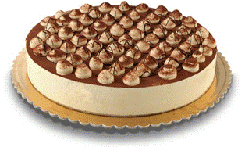
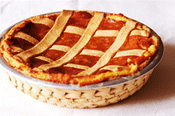
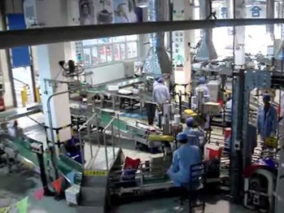
Alignment of operations and strategy
Different kind of processes
Discontinuous processes
of single, unique, tailored, outputs
Variety of possible outputs
Flexibility of process
Small quantity of outputs
NO
PROCESSS
HERE!
Process flows
Uniformity of outputs
Rigidiy of processe
Large quantity of outputs
Continuous rigid flow of production of many identical outputs
NO
PROCESSS
HERE!
Discontinuity of flow
Continuity of flow

Slide 14
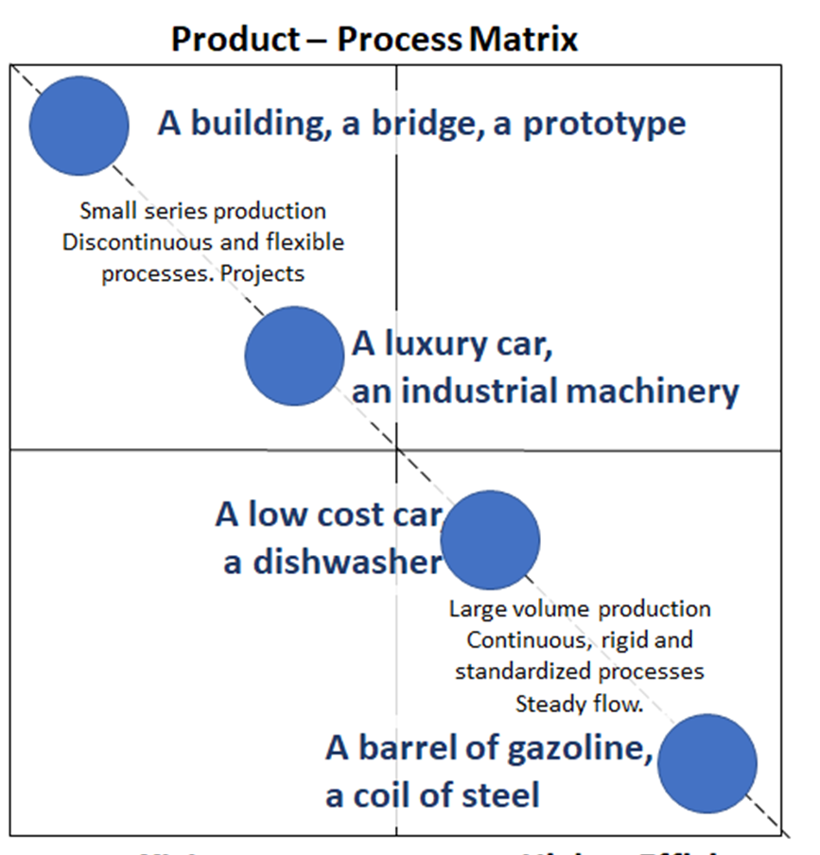
Operations Strategy decisions about volume and flexibility of processes
The "products-processes" matrix shows the different types of production according to the needs of the market and the differentiation strategies of the companies.

Slide 15
